Slide 1
Toxic Release Inventory
Chris Rascher
Region 1 TRI Compliance and Program Coordinator
U.S. EPA, Region 1,
rascher.chris@epa.gov
(617) 918-1834

Slide 2
What is TRI ?
TRI is the only national, publicly available, easily useable database showing a facility’s toxic chemical releases, discharges, and transfers.

Slide 3
Toxic Release Inventory (TRI)?
Provides important environmental information on the release and transfer of toxic chemicals in the United States.
Individual facilities report TRI data annually
The public can search the data by geographic area, facility, industry, parent company, and offsite waste transfer data,
Quantity of toxic chemicals released to the environment.
Better than TURI

Slide 4
Common manufacturing sectors in NE reporting under TRI (2015)
Manufacturing Sector | # Reporting
Fabricated Metal Products | 182
Chemical Manufacturing | 132
Primary Metal Manufacturing | 60
Plastics And Rubber Products | 54
Nonmetallic Mineral Products | 53
Paper Manufacturing | 43
Computer Manufacturing | 74
Transportation Manufacturing | 55
Notes:
This is several years old and sectors have probably changed by now. The economy is dynamic.

Slide 5
Three TRI tools
Envirofacts Multisystem search – Facility specific reports and summaries
TRI Toxic Tracker - Graphical representations of nationwide TRI data from the past 10 years and easily explore by geography, facility, industry, chemical, or specific data elements. Incorporates demographic information onto maps
TRI Explorer - State fact sheet, sector, state, and chemical information

Slide 6
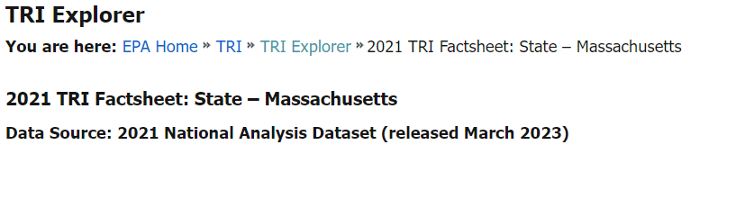
https://enviro.epa.gov/triexplorer/tri_release.chemical

Slide 7
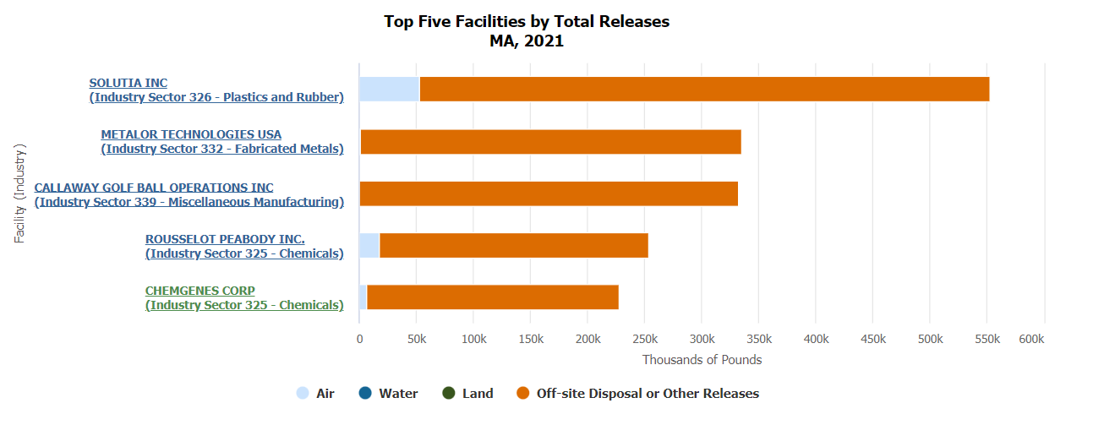
Top Releasers in Massachusetts from TRI Explorer

Slide 8
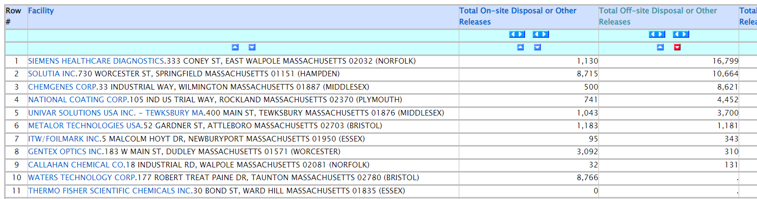
Using TRI Explorer to get list of methanol releasers in MA

Slide 9
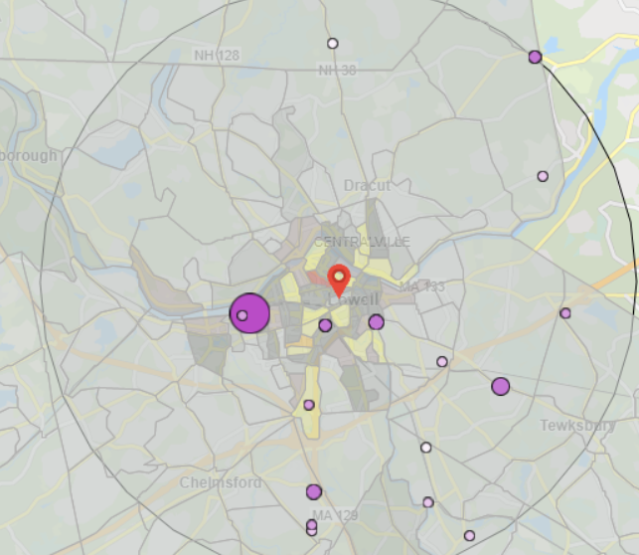
EPA Toxics Tracker, Lowell MA https://edap.epa.gov/public/extensions/TRIToxicsTracker/TRIToxicsTracker.htmlRI Toxics Tracker

Slide 10
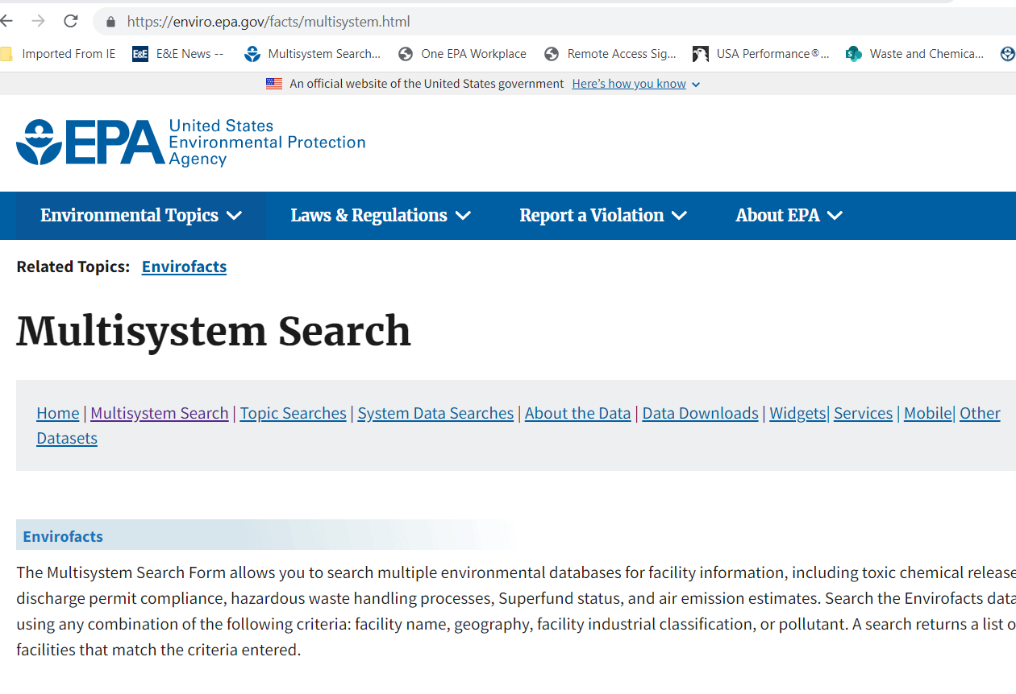
Envirofacts, Multisystem Seach

Slide 11
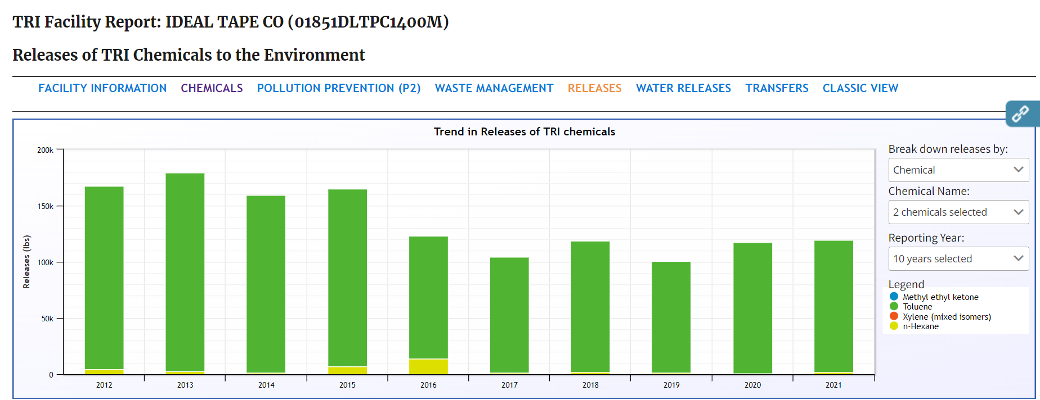
Toluene and n-Hexane air releases

Slide 12
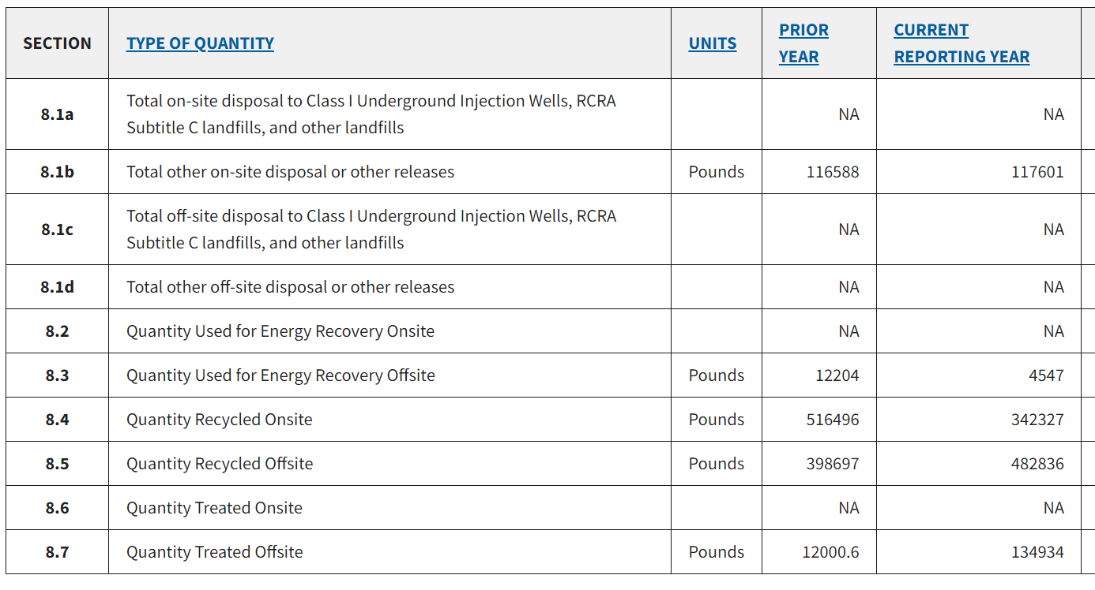
Site specific data for Ideal Tape in Lowell, MA

