Slide 1
Chloroprene Air Emissions from
DuPont and Denka Facilities
Detoxifying Commerce
Boston University
April 19, 2023
By: Wilma Subra
Subra Company
New Iberia, Louisiana

Slide 2
Chloroprene has been released into the air from the DuPont Pontchartrain Works Neoprene manufacturing facility since 1969 in St. John the Baptist Parish, Louisiana.
Denka Performance Elastomer purchased the DuPont facility in November 2015. Denka releases Chloroprene into the air from the Chloroprene Unit, Neoprene Unit, HCL Recovery Unit and Utilities.

Slide 3
In December 2015, a month after Denka purchased the DuPont facility, the National Air Toxics Assessment (NATA) released a screening-level assessment of 0.2 ug/m3 and classified Chloroprene as a likely human carcinogen
NATA estimated higher than expected levels of Chloroprene in the air in the community of LaPlace/Reserve, St. John the Baptist Parish, Louisiana.

Slide 4
In March 2016, the Environmental Protection Agency (EPA) and the Louisiana Department of Environmental Quality (LA DEQ) began performing air sampling for Chloroprene in the areas surrounding the Denka facility. The Chloroprene concentrations were in excess of 0.2 ug/m3.
I began providing workshops with handouts to the Concerned Citizens of St. John ever two weeks.
On May 25, 2016, EPA began collecting 24-hour ambient air sampling events at six locations around the Denka facility. The samples were collected every three days for 24 hours using Summa Canisters.

Slide 5
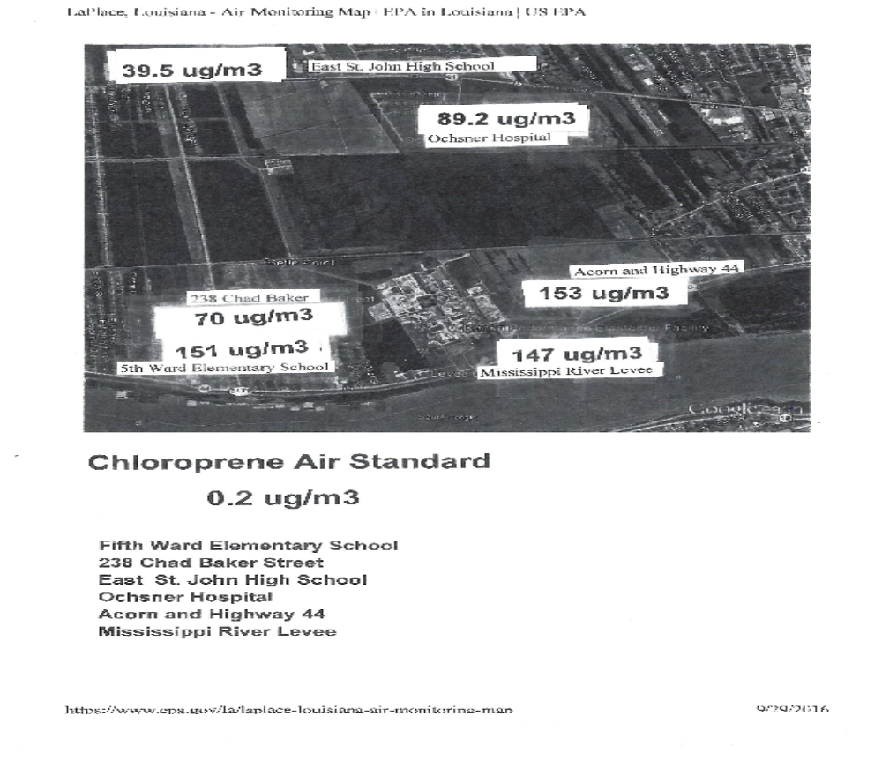

Slide 6
The highest levels of Chloroprene in the air samples were 120 to 373 times 0.2 ug/m3.
The Fifth Ward Elementary School had Chloroprene concentrations up to 221 times the 0.2 ug/m3 in 2016.
On March 29, 2016, LA DEQ requested that Denka perform fence line air monitoring for Chloroprene in the ambient air in the neighborhoods surrounding the Denka facility.

Slide 7
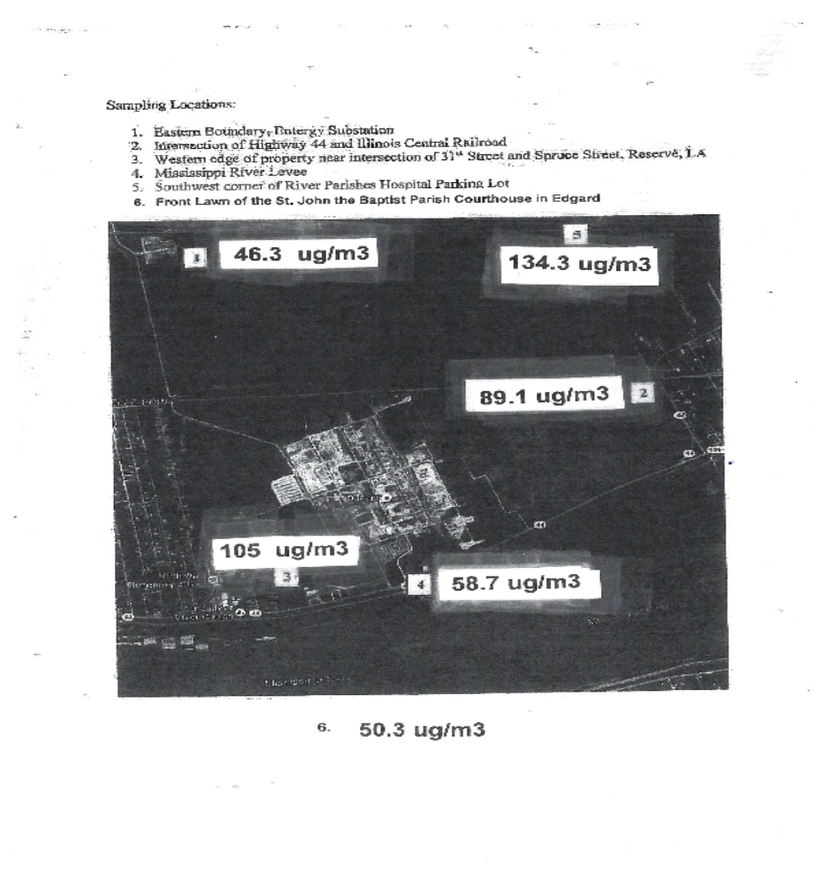

Slide 8
Denka began air sampling on August 8, 2016 and the frequency was once every 6 days over a 24-hour sampling period.
The Denka Chloroprene air sampling results fell in the range of the EPA air monitoring results. The Denka air sampling at the six locations continues to be collected and reported once per month through the present time.

Slide 9
Health Impacts Associated with Chloroprene
Short Term Exposure to high concentrations affects the nervous system, causes headaches, irritability, lightheadedness, dizziness rapid heartbeat, gastrointestinal disorders, dermatitis temporary hair loss, corneas damage, damages to the liver, kidneys, and lungs, affects the immune system.
Chronic long-term exposure and occupational worker exposure to Chloroprene causes respiratory impacts, irritation and burning of the eyes and skin chest pains, neurological symptoms, fatigue, changes in blood cells reduced blood pressure, increased risk of developing cancer, carcinogen or the liver and lungs of animals, mutagens, damages developing fetus, causes spontaneous abortions and interferes with sperm production.

Slide 10
Toluene
Toluene is the second largest quantity of chemicals released by the Denka facility into the air. Toluene is a human teratogen. It may damage the fetus, affect the nervous system, causes trouble concentrating, causes headaches, dizziness, lightheadedness, coughing, wheezing and irritates the skin, eyes, nose and throat.
Denka performed modeling and identified the Chloroprene air concentrations would exceed 0.2 ug/m3 throughout the entire parish. The maximum Chloroprene concentrations was 12.07 ug/m3 (60.4 times 0.2 ug/m3).

Slide 11
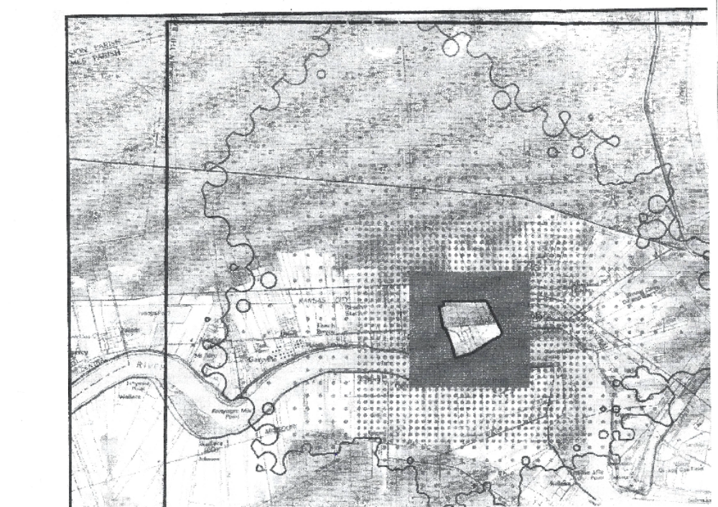

Slide 12
Incidence Rate of All Cancers Combined in St. John the Baptist Parish
The Denka facility is located in two census tracts in St. John the Baptist Parish. Census Tracts 708 and 709.
The incidence rate of all cancers in Census Tract 708 was the highest in St. John the Baptist Parish, 446.2 per 100,000 population.

Slide 13
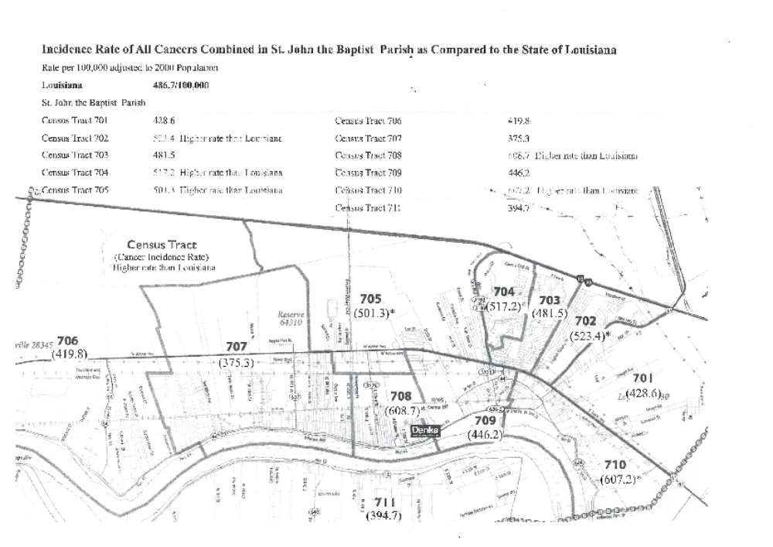

Slide 14
On January 6, 2017, LA DEQ issued to Denka an Administrative Order on Consent to complete four major construction projects to control Chloroprene air emissions. The results were a very small decrease in Chloroprene air concentrations.
Air Sampling continues until today. EPA utilizes a continual air monitoring process known as SPODS (Stationary Solar Powered Photoionization Detectors) at their six monitoring locations. One of those locations is the Fifth Ward Elementary School.
Denka continues monitoring at its six monitoring locations using Summa Canisters.

Slide 15
In 2021, EPA Required Denka to set up Passive Air Monitors at 18 locations around the fence line of the Deka facility. Passive Air monitors collect samples for Chloroprene and 1,3-Butadiene over 14 day periods. The Passive Air Monitoring program began collecting air on January 6, 2022 and continues today.
On July 6, 2022, EPA Air Enforcement Division of the Office of Civil Enforcement issued to Denka requirements to add three additional passive Air Monitoring locations. One at the Fifth Ward Elementary School, one on Chad Baker and one at the Western Edge of the Denka Property.

Slide 16
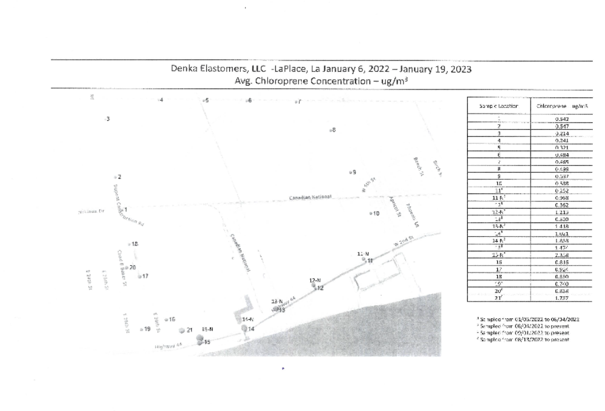

Slide 17
Based on all of the air monitoring data collected by EPA and Denka, on October 12, 2022, the EPA Office of Environmental Justice and External Civil Rights issued a letter of Concern to Secretaries of LDEQ and LA Department of Health concerning the Denka facility and issues accepted by EPA for investigation.
The basis of the complaints focused on LA DEQ’s duty to inform and make recommendations to the public about prevention and reduction of health threats and air toxics exposure. EPA issued the letter to present significant evidence suggesting that the Departments’ actions or inactions have results and continue to result in disparate adverse impacts on Black residents of St. John the Baptist Parish.

Slide 18
EPA’s initial factual investigation strongly suggest that Louisiana residents who identify as Black and are living and/or attending school near the Denka facility have been subjected to adverse and disparate health impacts as a result of LA DEQ’s decisions. For decades it appears that LA DEQ‘s implementation of its air permitting program continuously exposed the residents who live near the Denka facility and the children who attend the St. John the Baptist Parish’s Fifth Ward Elementary School to average annual concentrations of Chloroprene in ambient air at levels associated with increased life time cancer risk. One hundred in one million generally represents the upper bound of acceptability for estimates excess cancer risk over a 70-year lifetime. Specifically, residents of neighborhoods surrounding the Denka facility were routinely exposed to Chloroprene concentrations that placed them at greater than an estimated 100-in-1 million risk developing chloroprene-linked cancers over a 70-year lifetime.

Slide 19
EPA’s initial factual investigation suggests that La Dept. of Health may have failed to provide the predominantly Black residents living near the Denka facility and school children attending the Fifth Ward Elementary school with critical information about cancer risks associated with Chloroprene levels in these areas. EPA has concerns that LA Dept of Health neither implemented the commitments it made in connection with reviews and studies of Chloroprene exposure risk, not made meaningful recommendations to educate and protect community members from elevated cancer risks as indicated by its own research and required by its implementing regulations.

Slide 20
EPA Recommended that LA DEQ immediately conduct additional monitoring within St. John the Baptist Parish to determine where Chloroprene concentrations are below 0.2 ug/m3 and are otherwise appropriate locations to temporarily host the Fifth Ward Elementary School.
Evaluate all potential protective measures including the relocation of the school children to alternate locations inside and outside the Parish. Provide recommendations on measures necessary to eliminate or reduce the children’s negative health impact.
Since November 2022, little to no progress has been made to relocate the students of the Fifth Ward Elementary School.

Slide 21
Thank You
Wilma Subra
Subra Company
Subracom@aol.com

