Slide 1
Alternatives Analysis incorporating innovation and
Toxicant-Induced Loss of Tolerance
Nicholas Ashford, PhD., JD
Technology and Law Program
MIT

Slide 2
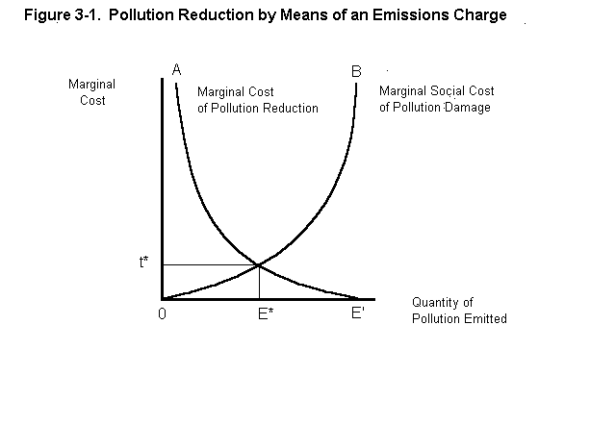
Figure 3.1: The Socially Optimal (i.e., ‘efficient’) Level of Pollution Derived from the Marginal Costs and Benefits of Pollution Control

Slide 3
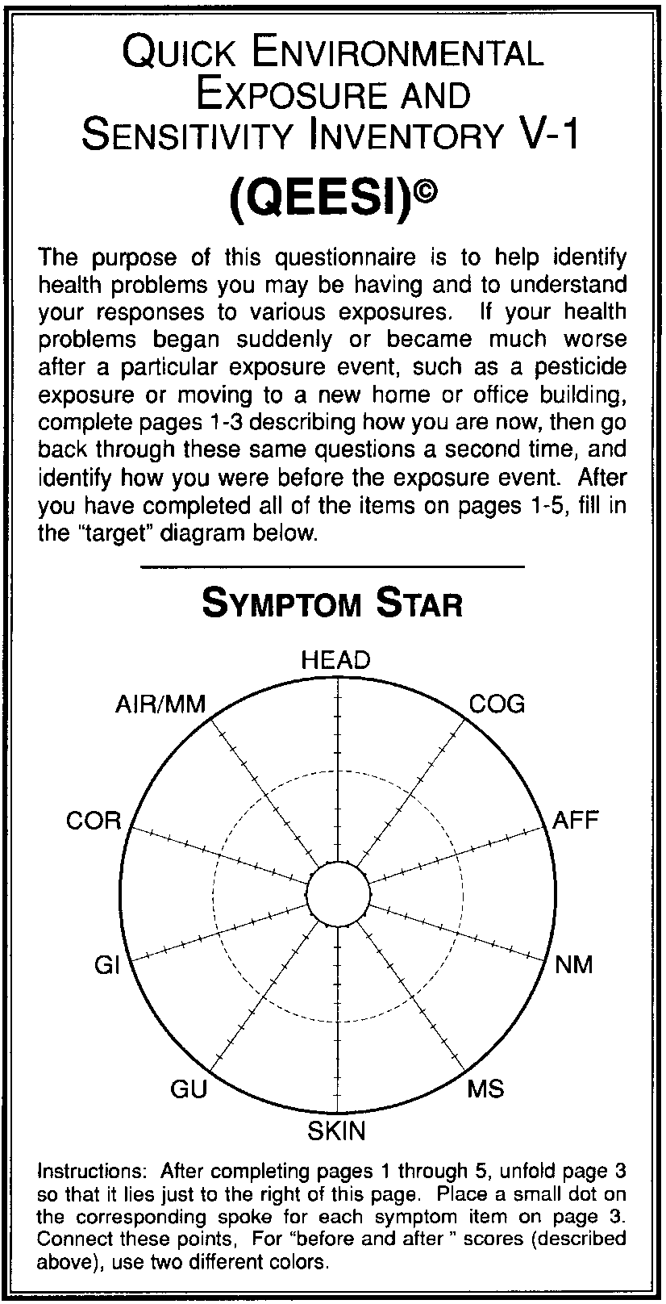

Slide 4
Cost
Maximum Allowable Risk Under Regulation
Demand for Risk Reduction
C0
Existing Technology
C0’
New Technology
Risk
Ro
Pre-regulatory Level of Risk
An Innovative Response to Regulation

Slide 5
Cost
Maximum Allowable Risk Under Regulation
Demand for Risk Reduction
C0
C1
Existing Technology
C0’
New Technology
Risk
R1
Ro
Pre-regulatory Level of Risk
An Innovative Response to Regulation

Slide 6
Toxicant-Induced Loss of Tolerance
A non-classical mechanism of widespread disease
A two step disease process involving initiation/sensitization followed by triggers at low level exposures
Examples: Autism, ADHD, chronic fatigue, gulf war syndrome, combustion/fire incidents, chemical and food intolerances, mold

Slide 7
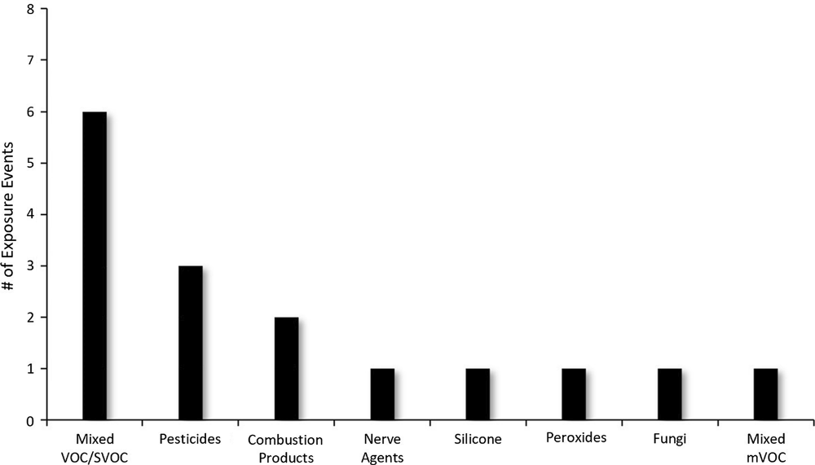

Slide 8
Toxicant-Induced Loss of Tolerance
Symptoms more or less identical from people who have been labeled as exhibiting different diseases
Examples: Autism, ADHD, chronic fatigue, gulf war syndrome, combustion/fire incidents, chemical and food intolerances, mold

