Slide 1


CAS EE 538
Accelerating The Transition To Lead-Free Skies
Becky Petrou O'Rourke
Fall 2022

Slide 2
For centuries, we have known lead is dangerous
Riva, M. A., Lafranconi, A., D’orso, M. I., & Cesana, G. (2012). Lead poisoning: Historical aspects of a paradigmatic “occupational and environmental disease.” Safety and Health at Work, 3(1), 11–16. https://doi.org/10.5491/shaw.2012.3.1.11

Slide 3

Health Effects...
  cognitive limitations (IQ loss),
  pre-term births,
  cardiovascular mortality
  & more...
As per the World Health Organization, any exposure to lead is unsafe.
Lanphear, B. P., Rauch, S., Auinger, P., Allen, R. W., & Hornung, R. W. (2018). Low-level lead exposure and mortality in US adults: A population-based Cohort Study. The Lancet Public Health, 3(4). https://doi.org/10.1016/s2468-2667(18)30025-2
Testimony of Bruce P. Lanphear, MD, MPH Simon Fraser University. Oversight Committee. (2022, July 28). RetrievedDecember 11, 2022, from https://oversight.house.gov/sites/democrats.oversight.house.gov/files/Lanphear%20Testimony.pdf
World Health Organization. (2022, August 31). Lead poisoning. World Health Organization. Retrieved December 11, 2022, from https://www.who.int/news-room/fact-sheets/detail/lead-poisoning-and-health

Slide 4
Brief US Regulatory History
"an extensive body of information exists which indicates that the addition of alkyl lead to gasoline...results in lead particles that pose a threat to public health."
-William D. Ruckelshaus, 1971
(EPA 1st Administrator)
Environmental Protection Agency. (2016, September 16). Lead poisoning: A historical perspective. EPA. Retrieved December 11, 2022, from https://archive.epa.gov/epa/aboutepa/lead-poisoning-historical-perspective.html

Slide 5



1973 EPA issued regulations under the Clean Air Act
1996 EPA full ban of leaded-gas*
*exception: aircraft [small], racing cars, farm equipment, & marine engines.
Leaded
U.S. Energy Information Administration (EIA). (2020, November 19). U.S. Energy Information Administration - EIA - independent statistics and analysis. Gasoline and the environment - leaded gasoline. Retrieved December 11, 2022, from https://www.eia.gov/energyexplained/gasoline/gasoline-and-the-environment-leaded-gasoline.php#
Environmental Protection Agency. (2016, September 16). Lead poisoning: A historical perspective. EPA. Retrieved December 11, 2022, from https://archive.epa.gov/epa/aboutepa/lead-poisoning-historical-perspective.html

Slide 6

470 tons
lead per year
EPA. (2022, October 7). Proposed Finding That Lead Emissions From Aircraft Engines That Operate on Leaded Fuel Cause or Contribute to Air Pollution That May Reasonably Be Anticipated To Endanger Public Health and Welfare. Federal Register. Retrieved December 11, 2022, from https://www.federalregister.gov/documents/2022/10/17/2022-22223/proposed-finding-that-lead-emissions-from-aircraft-engines-that-operate-on-leaded-fuel-cause-or

Slide 7

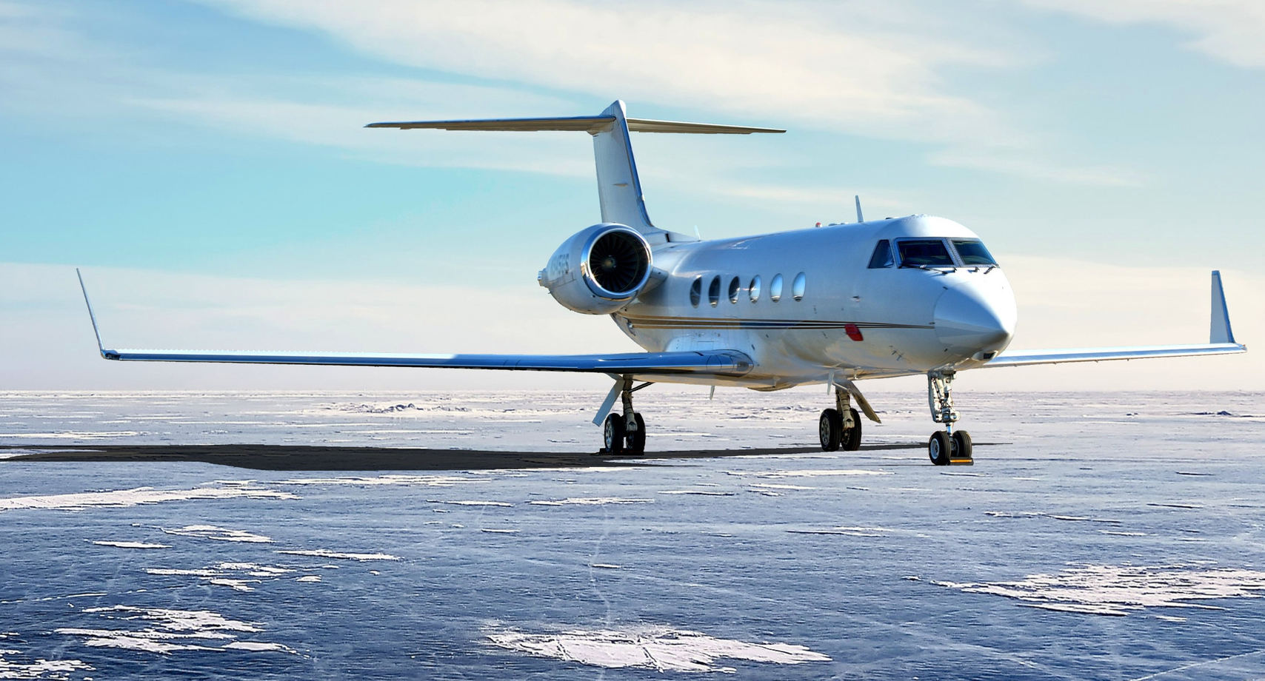

Small aircraft
(General Aviation Industry)

Slide 8
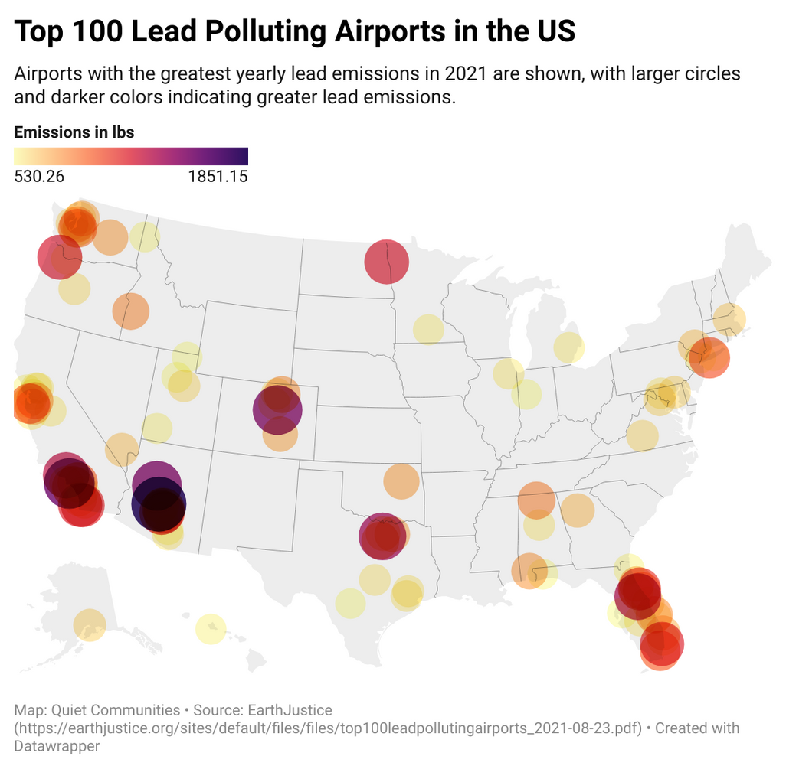
Scope of the Issue:
20,000
general aviation airports
> 16 million Americans
within 1 km
Envt. Justice Issue:
many in minority and low -income communities
Testimony of Santa Clara County Supervisor Cindy Chavez, District Two. Oversight Committee. (2022, July 28). Retrieved December 11, 2022, from https://oversight.house.gov/sites/democrats.oversight.house.gov/files/Chavez%20Testimony.pdf
Opening Statement of Chairman Ro Khanna. Hearing on “Toxic Air: How Leaded Aviation Fuel Is Poisoning America’s Children.” (2022, July 28). Retrieved December 11, 2022, from https://oversight.house.gov/sites/democrats.oversight.house.gov/files/2022-7-28%20Khanna%20Opening%20Statement%20LETTERHEAD_FINAL_VERSION.pdf

Slide 9


Santa Clara County - study lead by Dr. Zahran, 2021
  found increases in BLL comparable that of Flint, MI
Canfield et al. (2003)
just 0.0000001 g lead/dL blood
4.6 IQ
points in lifetime avg
Miranda et al. (2011)
geospatial analysis; found significant association between potential avgas exposure (proximity to general aviation airport) and BLL
Santa Clara County &amp; California Department of Public Health (CDPH) Childhood Lead Poisoning Prevention Branch (CLPPB) & Mountain Data Group. (2021, August 3). Leaded aviation gasoline exposure risk at Reid-Hillview Airport in Santa Clara County, California. Retrieved December 11, 2022, from https://news.sccgov.org/sites/g/files/exjcpb956/files/documents/RHV-Airborne-Lead-Study-Report.pdf
Canfield, R. L., Henderson, C. R., Cory-Slechta, D. A., Cox, C., Jusko, T. A., & Lanphear, B. P. (2003). Intellectual impairment in children with blood lead concentrations below 10 μg per deciliter. New England Journal of Medicine, 348(16), 1517–1526. https://doi.org/10.1056/nejmoa022848
Miranda, M. L., Anthopolos, R., & Hastings, D. (2011). A geospatial analysis of the effects of aviation gasoline on childhood blood lead levels. Environmental Health Perspectives, 119(10), 1513–1516. https://doi.org/10.1289/ehp.1003231

Slide 10

Why the exception?

Slide 11
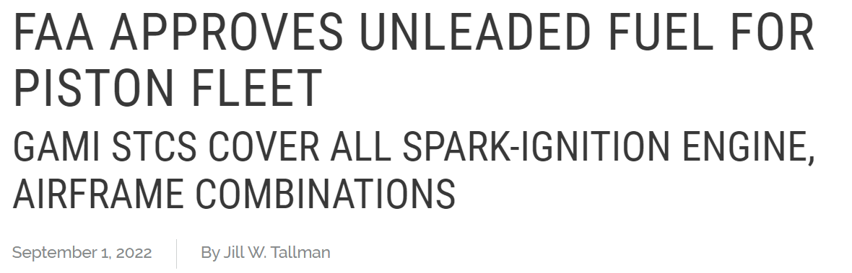


Lead
Free
Tallman, J. W. (2022, September 1). FAA Approves Unleaded Fuel for Piston Fleet. GA moves closer to unleaded future. Retrieved December 11, 2022, from https://www.aopa.org/news-and-media/all-news/2022/september/01/closer-to-an-unleaded-future

Slide 12


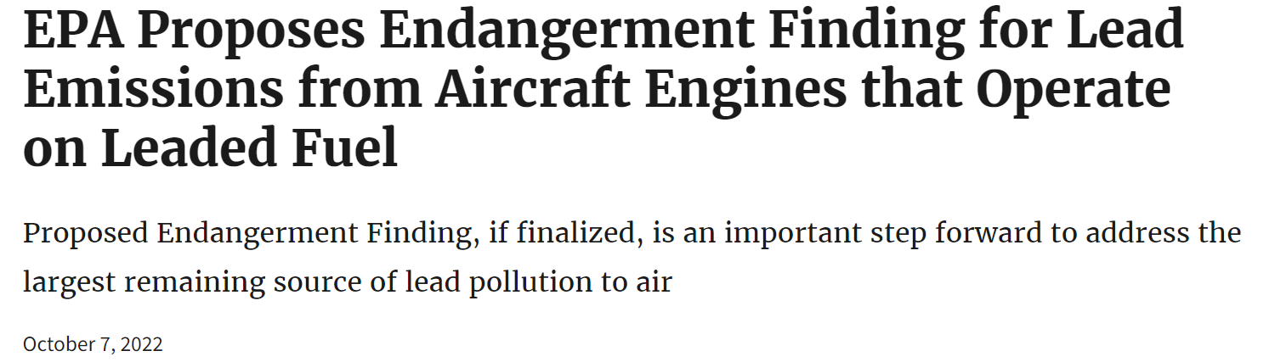
Consider submitting a comment
EPA - Environmental Protection Agency. (2022, October 7). EPA Proposes Endangerment Finding for Lead Emissions from Aircraft Engines that Operate on Leaded Fuel. News Releases: Headquarters: Air and Radiation (OAR). Retrieved December 11, 2022, from https://www.epa.gov/newsreleases/epa-proposes-endangerment-finding-lead-emissions-aircraft-engines-operate-leaded-fuel#:~:text=Under%20the%20Clean%20Air%20Act,this%20source%20of%20lead%20pollution.
EPA - Environmental Protection Agency. (2022, October 19). Petitions and EPA Response Memorandums related to Lead Emissions from Aircraft that Operate on Leaded Fuel. Regulations for Emissions from Vehicles and Engines. Retrieved December 11, 2022, from https://www.epa.gov/regulations-emissions-vehicles-and-engines/petitions-and-epa-response-memorandums-related-lead

Slide 13
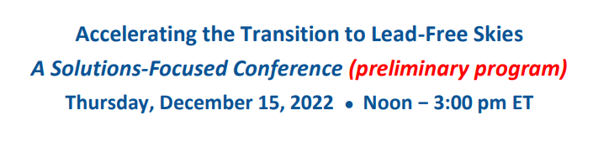

Conference

Slide 14
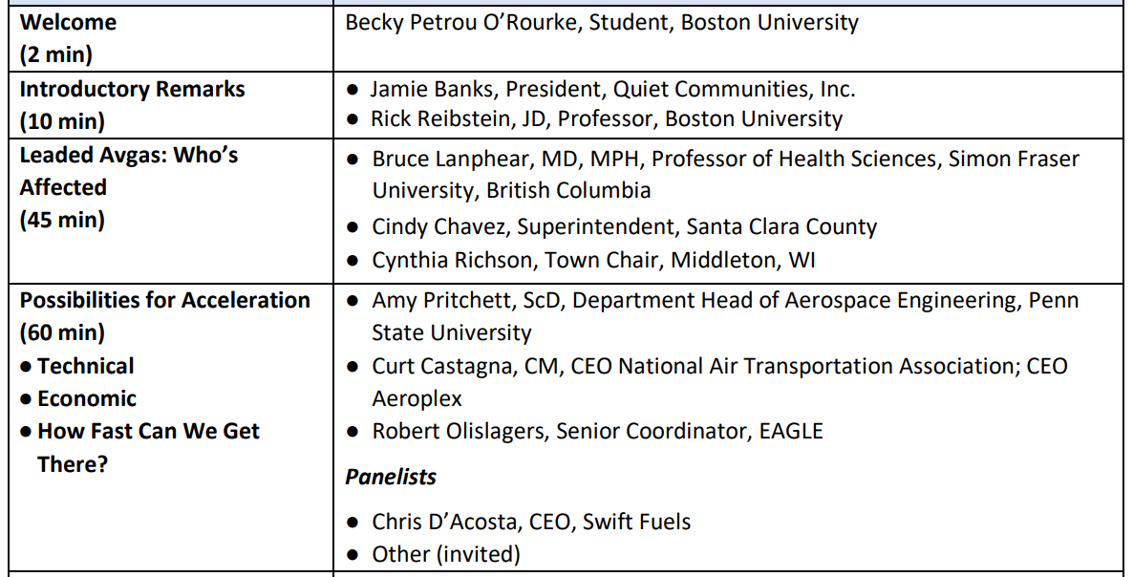

Conference Agenda
George, Braly, CEO GAMI
Quiet Communities. (2022, December). Preliminary Program. Accelerating the Transition to Lead-Free Skies: A Solutions-Focused Conference (preliminary program). Retrieved December 11, 2022, from https://quietcommunities.org/wp-content/uploads/2022/11/Program_Transition-to-Lead-Free-Skies-2022.12.15_Preliminary.pdf?mc_cid=6411c968cf&amp;mc_eid=1893a34e5d

Slide 15

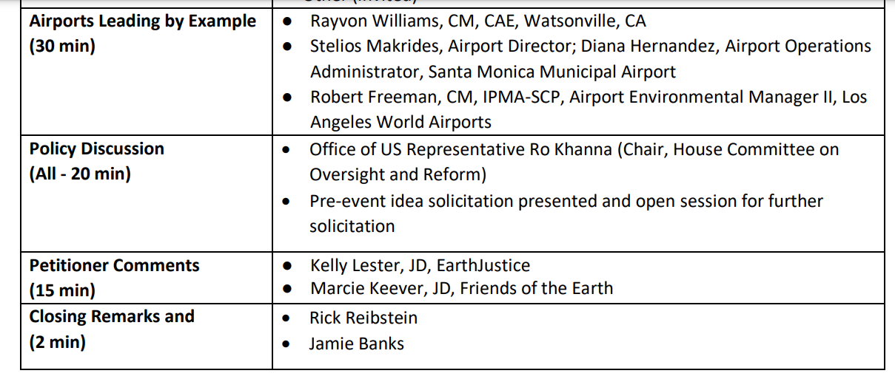


Conference Agenda
Quiet Communities. (2022, December). Preliminary Program. Accelerating the Transition to Lead-Free Skies: A Solutions-Focused Conference (preliminary program). Retrieved December 11, 2022, from https://quietcommunities.org/wp-content/uploads/2022/11/Program_Transition-to-Lead-Free-Skies-2022.12.15_Preliminary.pdf?mc_cid=6411c968cf&amp;mc_eid=1893a34e5d

Slide 16
Thank you!

