Slide 1
Road to Banning PFAS
Mila Maglov and Sarah Rosenthal

Slide 2
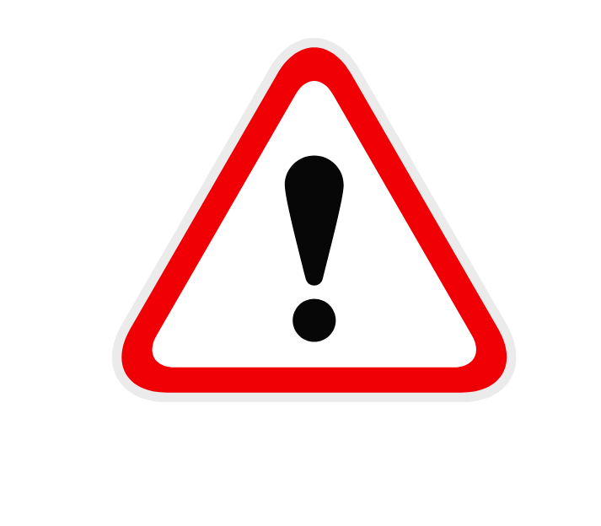
Background: What is PFAS?
P per- and poly-
F fluoro
A alkaline
S substances
NON DEGRADABLE
DANGEROUS FOR HEALTH
  banned from use in food contact applications
98%
3000
different chemicals that bioaccumulate and persist in environment and water waste
of population has detectable PFAS blood levels
Notes:
PFAS
More than 3,000 synthetic chemicals
Hard to break down → bioaccumulation
1930s
Documentation of its toxicity dates back to its inception
2004 → EPA fined DuPont the largest fine in administrative history at the time $8million, but that didn’t stop them
Regulatory tools insufficient
Instead of getting out of the business of PFAS, 3M and Chemours dove further into it and made different versions of PFAS as replacements. These new replacements can have many of the same problematic characteristics as earlier PFAS.
Detected in blood
PFOA and PFOS are being phased out → currently banned from use in food-contact applications
Persists in the environment and waterways

Slide 3


How are we exposed?
possible exposures
PFAS
product manufacturing
food
drinking water
livestock meat
anti-stick, water repellent, and firefighting products
Waste discharge
sludge
soil
Notes:
Common products
Non-stick cookware and food packaging
Cosmetics
Fire and water resistant clothes
Pollution commonly sourced from military bases due to its use in firefighting
Aqueous film-forming foam → easily dispersed in waterways
Health problems linked to high PFAS exposure
Links to kidney cancer and testicular cancer
Endocrine disruption
High cholesterol
Biggest concern with contamination → drinking water (esp that of personal wells)
Many drinking water sources are testing for high levels of PFAS
Issue with contaminated sludge → accumulates in fat
Leads to contaminated soil → contaminated produce
Not sure of ALL of the contamination as testing and reporting aren’t mandated
Some states voluntarily report, others only are tested by feds at military sites
Solid waste → shipped out from manufacturers

Slide 4
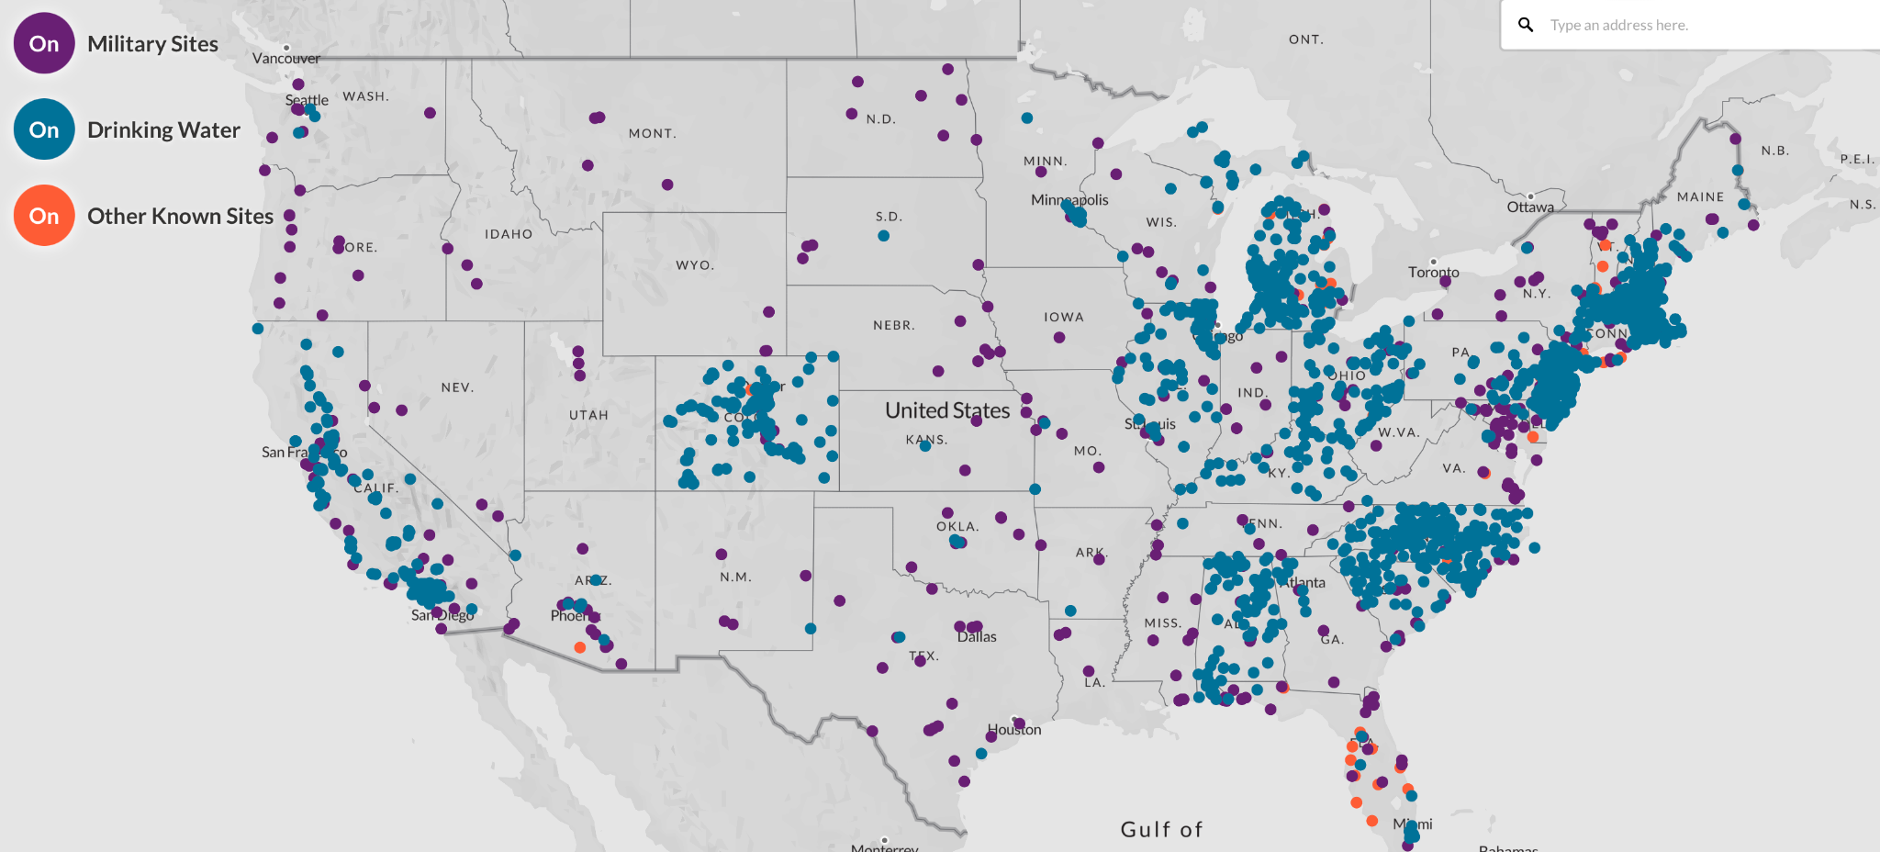
Tracking Contamination
source: Environmental Working Group

Slide 5
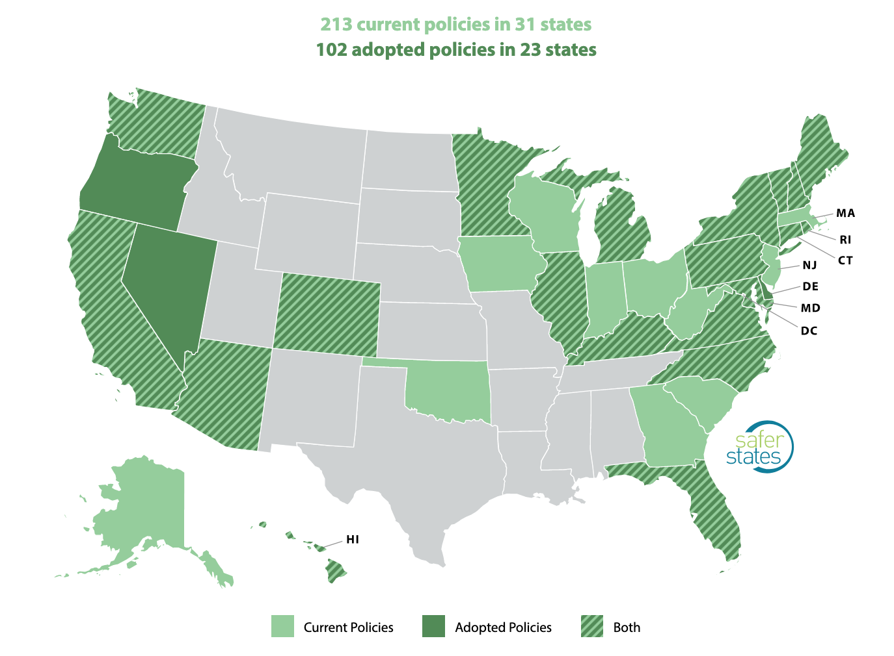
Tracking Policy
source: Safer States

Slide 6
Why not?
“When EPA establishes water quality criteria, ADEM can then adopt water quality standards that can be used to set permit limits on discharges to a waterbody and to determine if a waterbody requires cleanup to protect human health and aquatic life.” – Alabama
“While Alaska has the authority to establish MCLs for drinking water, DEC does not have the resources and scientific expertise necessary to develop its own MCLs. Like most states, Alaska adopts federal MCLs. Just a small number of states, such as New Jersey and California, have the large budgets and programs necessary to develop their own MCLs.” – Alaska
Notes:
Note that California does not have an OFFICIAL MCL, only suggested contaminants levels → this may indicative of a overall lack of communication and collaboration across states

Slide 7
Federal Opportunities to Reduce PFAS Contamination
Military Sites domestically and abroad
Manufacturing and Discharge
Class Limits on PFAS
TSCA
Clean Water Act
  NPDES
Cleanup and Remediation
RCRA
CERCLA
Notes:
currently the only federal action are proposed inclusion of pfas in cercla and health advisories
Establishing limits to the class rather than doing so on a chemical-by-chemical basis would result in lower exposure values that better protect vulnerable populations such as pregnant women, children, and workers
prioritize superfund money towards cleaning up military sites domestically and abroad
first address release and manufacturing
TSCA (toxic substance control act)
EPA proposes to require persons that manufacture (including import) or have manufactured these chemical substances in any year since January 1, 2011, to electronically report information regarding PFAS uses, production volumes, disposal, exposures, and hazards
TSCA is still weak in its ability to ensure that new and potentially dangerous PFAS do not enter the marketplace
stricter requirements for all new and existing PFAS to undergo bio toxicity testing and monitoring
There are also a number of cases in which companies can evade TSCA, notably through low volume exemptions, low release and exposure exemptions, and cases where the compound is a byproduct rather than a primary product of manufacture
Clean Water Act/NPDES (national pollution discharge elimination system)
establish an MCL
requires companies to seek a permit for discharge of specific pollutants. While EPA maintains a Toxic Pollutants List to evaluate what pollutants are controlled by NPDES, PFAS are not included on the list, neither as a group nor as individual chemicals
then address cleanup
RCRA (resource conservation and recovery act)
Use RCRA for cradle-to-grave monitoring
set appropriate limit for discharge
CERCLA (Superfund Act)
As a part of the administrations PFAS Roadmap, the EPA has proposed to designate (September 2022) PFOA and PFOS as hazardous substances under CERCLA also known as the Superfund Act
CERCLA also provides an enforcement mechanism for the government and private entities to hold parties responsible for the cleanup costs —> polluters pay

Slide 8

Corporate Responsibility & Education
Heavy Burden: $2,775,876,968 on PFAS contamination
Polluters Pay Principle
Safer Alternatives
Remove exemptions
Notes:
- corporate responsibility and public education
- the burden of contamination is often unfairly placed on the taxpayers and not the polluters —> polluters pay principle
- The total costs to taxpayers has been spent/planned to be spent on PFAS contamination is $2,775,876,968 to date
- place emphasis and support on policy that will hold polluters accountable for contamination and discharge —> possibly under CERCLA/RCRA
- there are a number of cases in which companies can evade TSCA, notably through low volume exemptions, low release and exposure exemptions, and cases where the compound is a byproduct rather than a primary product of manufacture (Lerner 2018). Companies can also use the screen of confidential business information to obscure key information from the public about compounds submitted to EPA, including the chemical’s identity, place(s) of manufacture, quantities produced, and environmental releases
- further educate the public (job of non-profits) so they are aware of producers and can use their purchasing power and voting privileges to address this issue
- Incentivize the use of safer alternatives —> phase out chemicals
- R&D funding and technical assistance
- notification of PFAS in products → will garner public attention

Slide 9
What are some model policies?
Required reporting/disclosure from manufacturers (CA)
Restrict/ban the sale of consumer products (CO)
Technical assistance programs (MA)
Create a PFAS vulnerability map (CO)
Required consumer notification (MI)
Remediation and Cleanup Funds (ME)
Notes:
although significant federal action is what we need to ensure full protection against pfas across the board, federal action is often slow (as we can see with the PFAS Roadmap)
and because of the toxic nature of pfas and its ability to spread through water sources and solid waste, it is important to take more immediate action —> this can be done through state legislation and corporate responsibility
State Action
the biggest key to fighting this issue is for states to step up where the federal government is lacking or insufficient to protects its constituents
many states have already taken action to address PFAS contamination and some have gone as far as to place broad bans on PFAS

Slide 10

Some Hope
Bipartisanship
Notes:
some hope
Earlier this year, Maine adopted a policy with bipartisan support that bans the agricultural spreading of sludge
Shows that this issue is so serious that it has received bipartisan support
Although some states still do not have PFAS policies/plans (and those are republican) it shows hope for a future PFAS legislation to pass through Congress.
Keep Food Containers Safe From PFAS Act, the PFAS Action Act of 2021, and the Preventing PFAS Runoff at Airports Act have all garnered bipartisan support.

