Slide 1
Native Land Stewardship: Journey to Climate Equity
A proposal by Stephanie Leon-Rodriguez

Slide 2
Primary Goal: Land Back

Slide 3
Federal Support in Land Back

Slide 4
Land Buy-Back Program for Tribal Nations¹
Bureau of Trust Funds Administration (BTFA)
  Works closely with the Bureau of Land Management (BLM) and Bureau of Indian Affairs (BIA)
Comes to a close Nov. 2022 (11 Months!)
Land tract or interest(s) that are eligible may be purchased at fair market value
  What makes the land/interest eligible?
  What happens after?
Notes:
To be eligible for the Buy-Back Program, a tract must:
Have two or more owners;
Be under the jurisdiction of a federally-recognized Tribe;
Be mappable, i.e., the legal description of a tract does not require further research;
Be a Surface (S), Mineral (M) or Both (B) resource code tract;
Be Stage 1 if it is a Mineral (M) or Both (B) tract;
Have an appraisal determining fair market value;
Have a Tribal resolution regarding offers and lease opportunities if a tract has a structural improvement and no recorded lease; and,
Be cost-effective, i.e., not significantly more expensive than other tracts at the location based on both the cost per acre and the average cost per interest.
When landowners choose to sell their interests through the Program, those interests will remain in trust, but ownership will be transferred to the Tribe with jurisdiction over the land.
This effort strengthens Tribal sovereignty by unifying lands for Tribal benefit and use, such as economic development, housing, and cultural preservation.

Slide 5
Conservation Easement²
Deduction a donor can take for donating a conservation easement - 50% of their annual income
Qualifying ranchers and farmers may deduct up to 100% of their income
Notes:
Voluntary & legal binding agreement between landowner and land trust/govt. agency

Slide 6
State Support

Slide 7
Mass. Conservation Land Tax Credit Program⁴
Landowner does NOT need to be a Mass. income tax payer or resident
Tax credit is applied to donor’s state tax liability during the year of the donation
Credit is given in proportion to each owner’s interest in the land
Limits?
Further info: Tom Anderson (thomas.anderson@state.ma.us)
Notes:
Limits for Taxpayers: Credit is lesser of 50% of appraised fair market value of land (or CR), or $75,000 If married, must file joint return with spouse Non-transferable (that is, the tax credit is specific to the donors/taxpayers)
Limit for state: 2 mil a year

Slide 8
Natives Know the Land Better Than We Do

Slide 9
Benefits to All
Ecological
More mature forests, better ecological diversity and fewer invasive species
“Lessons from tribal forestlands could help improve the sustainable management of nontribal public forestlands.”⁵
Economical⁶
Indiscriminate Benefits

Slide 10
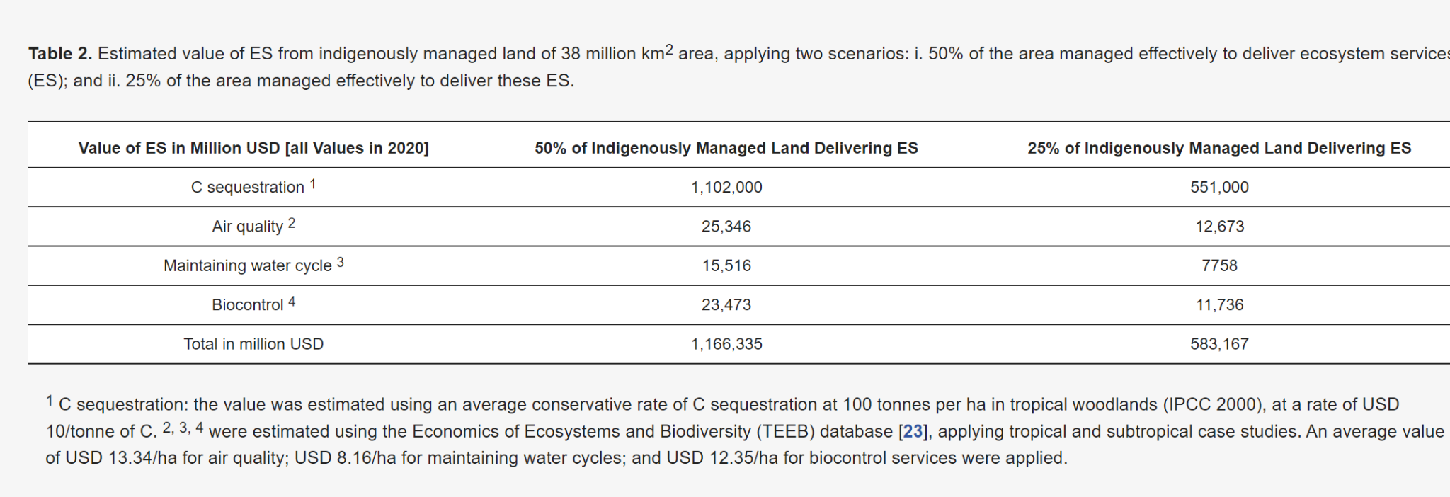
These four ecosystem services were chosen for their indiscriminate benefits

Slide 11
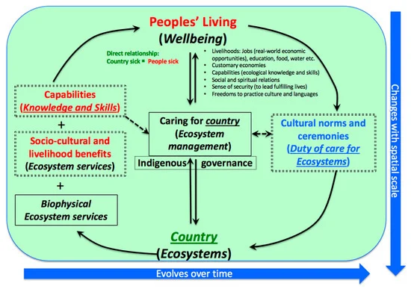
Notes:
Figure 1. An Indigenous framework for demonstrating connections with country. The green box denotes country of which people and their living are an integral part (thus, red and green text are not enclosed in a box). People derive socio-cultural, livelihoods, and other benefits including their capabilities from being connected with country, not in isolation. In each text box, the normal font indicates Indigenous, and the italicized equivalent indicates Western perspectives (except for country). The arrows denote the influence (benefits/knowledge) between the two systems. The blue arrows at the base and on the side reflect changes in peoples-country associations over temporal and spatial scales. (Source: Sangha and Russell-Smith

Slide 12
Native Land Conservancy - Mashpee, MA³
Native-run conservation organization in Mass.
  Through the Mass. Conservation Land Tax Credit Program
Received first land donation in 2015
Ramona Peters, Chairwoman & Acting Treasurer
  info@nativelandconservancy.org
Notes:
Some form of land conservation tax credits exist in 13 other states.

Slide 13
Citations
¹United States Department of Interior (www.doi.gov/buybackprogram/FAQ)
²Land Trust Alliance (www.landtrustalliance.org)
³Native Land Conservancy (www.nativelandconservancy.org)
⁴Commonwealth of Mass. (https://www.mass.gov/service-details/commonwealth-conservation-land-tax-credit-cltc)
⁵Reo, N.J., Waller D.M. “First stewards: ecological outcomes of forest and wildlife stewardship by indigenous peoples of Wisonsin, USA.” Ecology and Society, vol. 23 (1) , pg. 45.
⁶Sangha K.K. “Global Importance of Indigenous and Local Communities’ Managed Land: Building a Case for Stewardship Schemes.” Sustainability, vol. 12 (7839).

