Slide 1
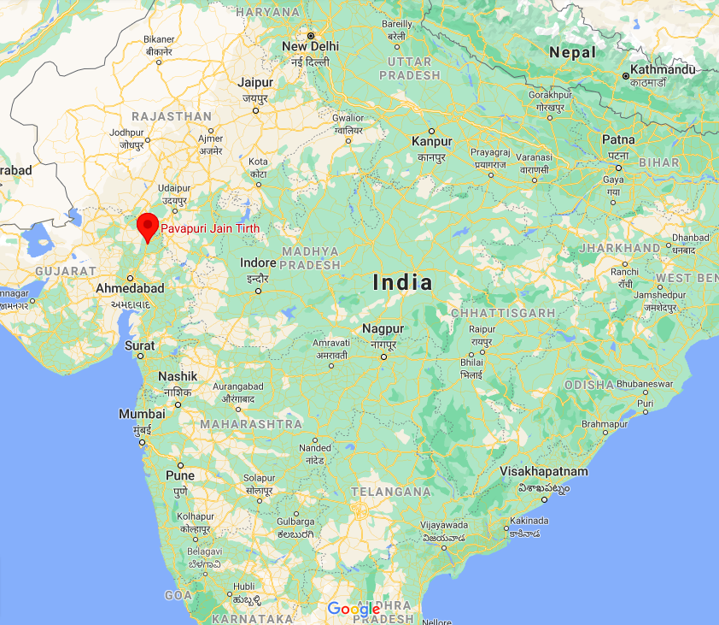
Solar Station in Pavapuri
By: Shanay Sanghvi

Slide 2
The Realization of a Problem
Pavapuri is a small village in the state of Rajasthan
Population of 200 – 300 people
Frequent electricity issues
Covid really highlighted the problem on my visit this winter
I sat down with the senator to discuss the problem
I suggested a solution of implementing a solar station

Slide 3
Potential Obstacles
Budget problems
  Village has low funds
  Need to look for alternatives
Technical Training
  Villagers are not educated on solar energy
  Need seminars and workshops for villagers

Slide 4
Finances and Funding
Senator connected me to a religious charitable group called K.P.Sanghvi
K.P.Sanghvi has helped several villages with
  Water issues
  Electricity
  Schools and Collages
They connected me to Mr. Parikh, a mechanical engineer who has worked in the energy industry for 25 years
We drew out a rough plan with estimated for energy capacity, plant size, panel requirements
K.P.Sanghvi agreed to sponsor the entire project

Slide 5
Identifying and Evaluating Solar Panel Supplier
We listed 3 primary suppliers based on Mr. Parikh’s experience:
  Adani : Industry leaders
  PV Powertech : Growing company
  Evvo : British company, great industry position
Khanak systems, a broker provided us with a bundle which included:
  Solar panels from each of these companies
  Construction equipment
  Labor
  Insurance

Slide 6
Choosing the Best Supplier
Evvo’s delivery period was very high which did not align with our schedule
We chose to go with Adani for a few reasons:
  Industry Leaders
  Great post purchase customer service
  Affordable price
  High quality panels
  Yearly maintenance

Slide 7
Conclusion
Once we placed the order, the expected delivery time was 2-3 weeks
We started with the construction process of the base of the station
  Used aluminum for lower costs yet great stability
Once we receive the panels, we will begin installing them
The journey has been humbling for me as I have realized the importance of basic things in life that most people live without
This station will help them for many years to come by:
  Lowering electricity costs
  Constant source of reliable electricity
  Reduced pollution

