Slide 1

Power-to-gas for the united states
Alexander Fukuchi

Slide 2

Project Background
Earth & Environment
Internship & Coursework

Slide 3
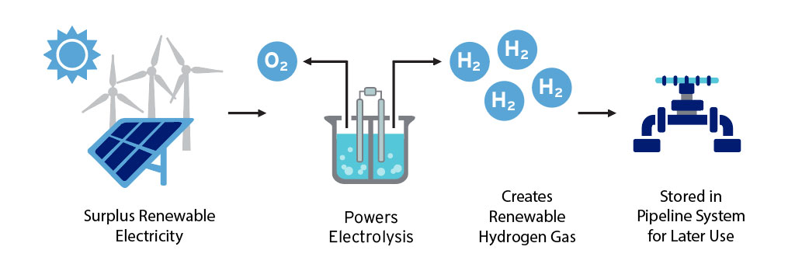
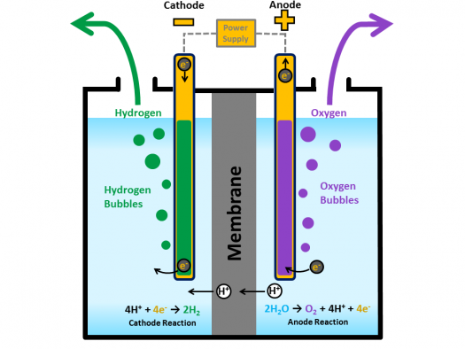
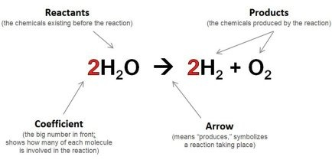
P2G Technology
Involves the conversion of excess renewables energy into a form of gas.
Excess electric energy powers electrolysis to generate clean hydrogen gas & methane blends.
Clean hydrogen & other blends stored in existing pipeline network.

Slide 4
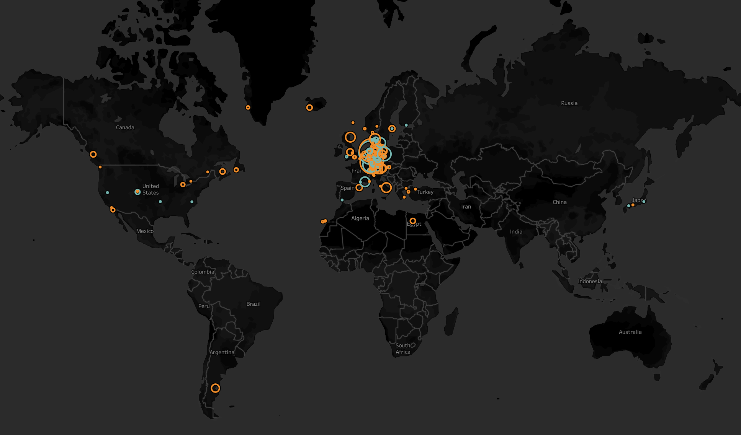
P2G on the World Stage
Europe leads the way

Slide 5

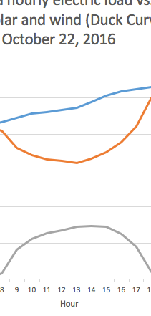
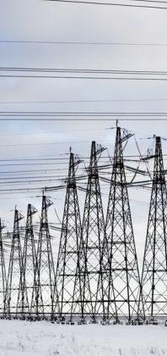

Maximizing Benefits Through an Innovative Application
Pairing storage with renewables generation
Safety
Intermittency
Resilience
Zero-Carbon

Slide 6

Technology Readiness
Commercially Proven
Two popular regimes of electrolysis: PEM & alkaline.
Injection into existing pipeline is possible, but only at low concentrations.
Solar + Storage funding opportunities.

Slide 7

Financial Readiness
High Up-Front Costs
Electrolysis is energy intense, and storing synthetic fuels is expensive.
Major economic benefit of capturing lost excess-generation from renewables.
Government subsidies needed to accelerate development.

Slide 8

Policy Readiness
Regulatory Involvement
Precedence of involvement in MA: Gov. Patrick, DPU, & grid modernization.
CA Gov. Jerry Brown: 2018 bill mandating 100% renewables-sourced electricity by 2045.
Subsidies for fostering competition with fossil fuels.

Slide 9



P2G Projects
At Home & Abroad
Etogas P2G Plant
Werlte, Germany
HyDeploy P2G
Keele University, UK
P2G Concept
Stony Brook University, NY

Slide 10
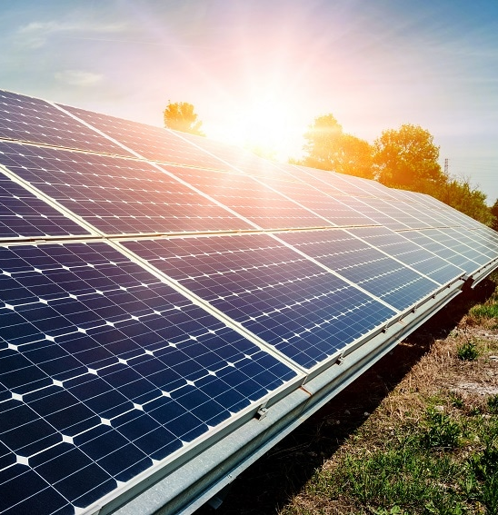
P2G @
The Source
Sensible, Safe, Impactful

Slide 11
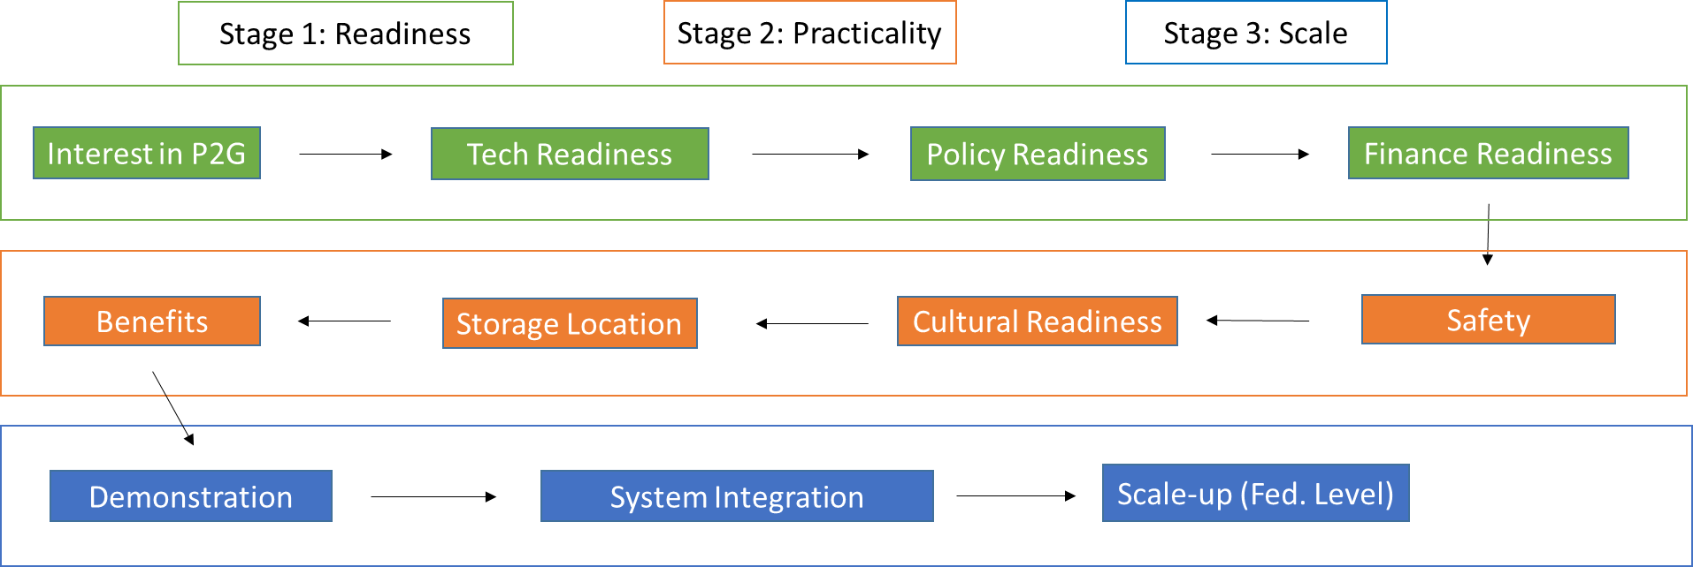
The Path Forward

Slide 12

THANK YOU
FIRST UP
CONSULTANTS
Alexander Fukuchi
alexsf@bu.edu

