Slide 1
Renewable Energy Substitution Choice
--- Potential of Geothermal Heat Pump (GHP)
Lanzheng Liu

Slide 2
Content
Introduction
Cost
Efficiency
Saving
Improvements

Slide 3
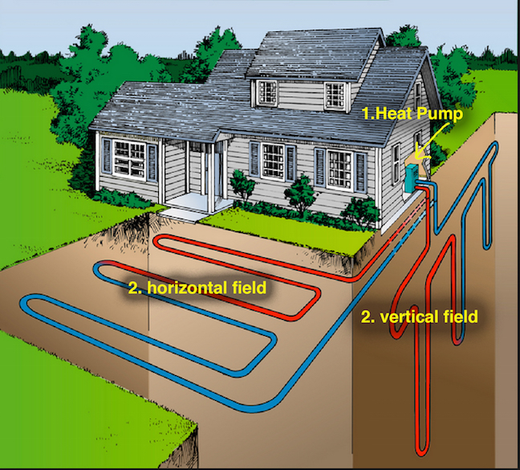
How Geothermal Heat Pump (GHP) Functions
<302 Fahrenheit
Source for geothermal heat pump (GHP)
Source: https://www.renewableenergyworld.com/2016/02/24/the-hidden-genius-of-geothermal-hvac-systems/#gref

Slide 4
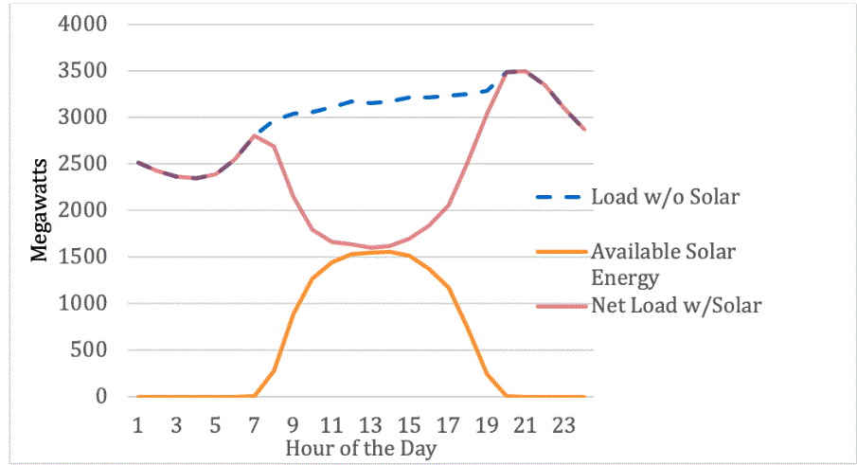
Duck Curve
“Actual duck curve shown in brown, representing data from March 27, 2017 in Los Angeles Department of Water and Power territory. The net load (brown) represents the load without solar energy (dotted blue) minus the available solar energy (orange) represents the load with solar energy .” Behdad, K., Joan, O., & Lauren, C. (2020)

Slide 5
A) Keep making profit?
B) Not increasing utility price?
C) States cover extra maintaining fee?

Slide 6
Cost of Energy
 | # of Housing Units (Million) | Per housing unit Energy Consumption ($)
New England | 5.6 | $2,186
Middle Atlatic | 15.4 | $2,055
Single-family | 10.8 | $2,974
Apartments in buildings with 2-4 units | 3.2 | $1,105
Apartments in buildings with 5 or more units | 4.7 | $834
Natural Gas | 10.6 | $2,073
Electricity | 6.8 | $1,963
Fuel Oil | 2.5 | $2,385
Source EIA: 2015 statistics survey of “Main Space Heating Fuel”

Slide 7
Natural Gas Transformation & Electricity Transmission
Losses In Gas Transformation(Million)
Direct Losses | $513
CO2 Emission | $1.07
Total | $514.07
Sample Massachusetts Bill | %
Distribution | 35.18
Stranded Costs | 6.54
Transmission | 9.54
Renewable Energy | 0.33
Energy Cons | 1.67
Supply/Energy | 46.74
Losses In Electric Transmission (Billion)
Direct Losses | $5.53
CO2 Emission | $0.63
Total | $6.16

Slide 8
Electrical Space Heating Combined With GHP
(New England and Middle Atlantic)
$1,963
$981.5
$6Billion
Saving/Year

Slide 9
EXTRA Saving
energystar.gov: Tax Credits for Renewable Energy

Slide 10
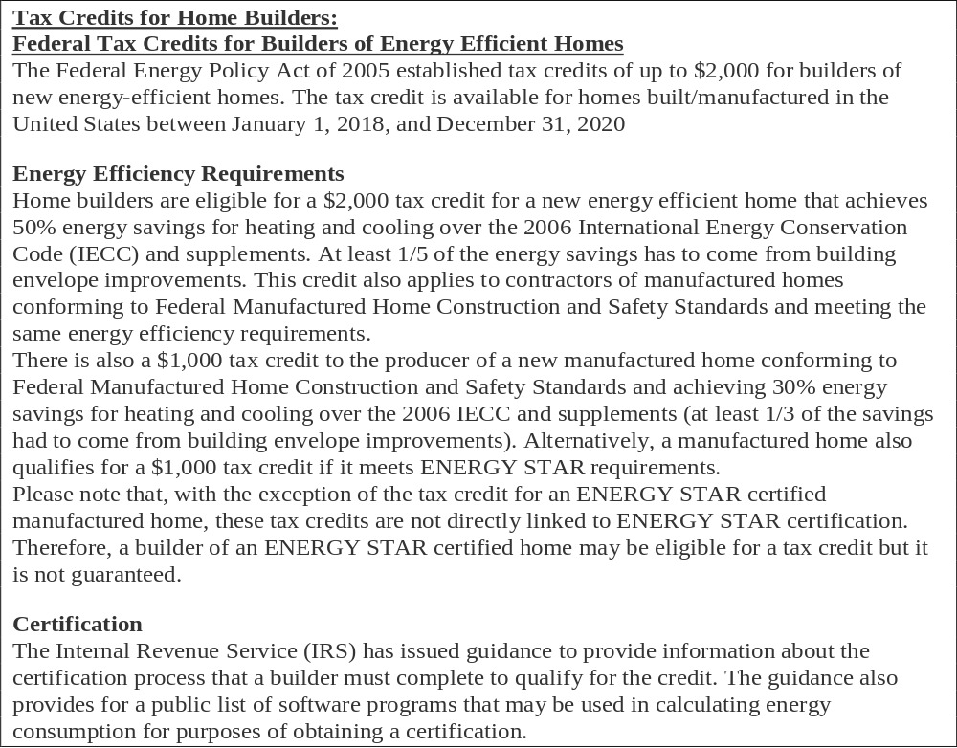
energystar.gov: Tax Credits for Residential Renewable Energy

Slide 11
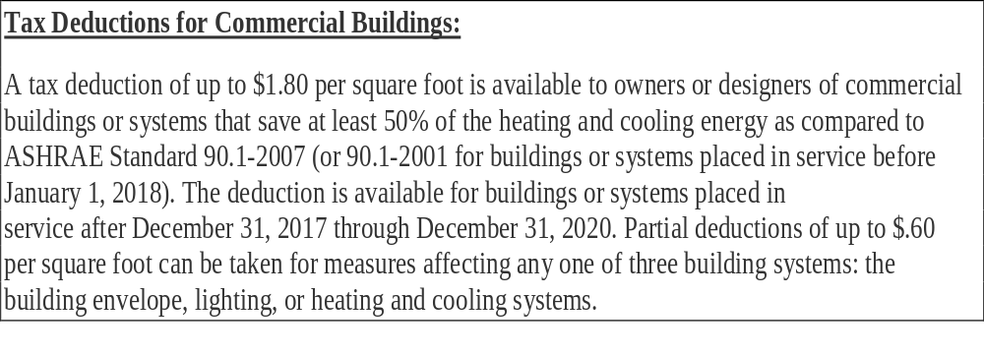
energystar.gov: Tax Credits for Commercial Building

Slide 12
Cost of GHP
(With full credits)
$10,000
$7,800
$5,800
Pay back reduced from 10 to 6 years with tax credits
25 – 30 years life cycle
Potential $144 Billion saving in total

Slide 13
Improvement
Tax Credits for Residential Energy Efficiency: “10% of cost up to $500 or a specific amount from $50-$300.”
Include GHP!
GHP has 30-50% higher initial capital cost
“(a) Consume less energy to operate; (b) they tap the earth or groundwater, a more stable energy source than air; (c)they do not require supplemental heat during extreme low outside temperature; (d) they use less refrigerant; (e) they have a simpler design and consequently less maintenance and; (f) they do not require the unit to be located where it is exposed to weathering.” Hepbasli, A., & Akdemir, O. (2004)
GHP has 10 to 15 years longer life time than air source heat pump

Slide 14
Suggestion
Explore different business models instead of individual installation
Overcoming barrier of high upfront cost
Analogous to solar
Power purchase agreement
Lease
New subsidies

Slide 15
Reference
Apply for EERE Funding Opportunities. (n.d.).Retrieved from https://www.energy.gov/eere/funding/apply-eere-funding-opportunities
Behdad, K., Joan, O., & Lauren, C. (2020). Utilizing Highway Rest Areas for Electric Vehicle Charging: Economics and Impacts of Renewable Energy Penetration in California. UC Davis. doi: 10.7922
Brenn, J., Soltic, P., & Bach, C. (2010). Comparison of natural gas driven heat pumps and electrically driven heat pumps with conventional systems for building heating purposes. Energy and Buildings, 42(6), 904–908. doi: 10.1016/j.enbuild.2009.12.012
Esen, H., Inalli, M., & Esen, M. (2006). Technoeconomic appraisal of a ground source heat pump system for a heating season in eastern Turkey. Energy Conversion and Management, 47(9-10), 1281–1297. doi: 10.1016/j.enconman.2005.06.024
Federal Income Tax Credits and Other Incentives for Energy Efficiency. (n.d.). Retrieved from https://www.energystar.gov/about/federal_tax_credits
Geothermal Heating and Cooling Technologies. (2016, December 19). Retrieved from https://www.epa.gov/rhc/geothermal-heating-and-cooling-technologies
Heidrich, M. (2016). Bounded energy exchange as an alternative to the third law of thermodynamics. Annals of Physics, 373, 665–681. doi: 10.1016/j.aop.2016.07.031
Hepbasli, A., & Akdemir, O. (2004). Energy and exergy analysis of a ground source (geothermal) heat pump system. Energy Conversion and Management, 45(5), 737–753. doi: 10.1016/s0196-8904(03)00185-7
N. Galanis, E. Cayer, P. Roy, E.S. Denis and M. Désilets. (2009 february 12). Electricity Generation from Low Temperature Sources. Journal of Applied Fluid Mechanics, 2(2), 55-67, 2009, 55-67. doi:1735-3645
Sanner, B. (1993). Ground Coupled Heat Pumps with Seasonal Cold Storage. Heat Pumps for Energy Efficiency and Environmental Progress, 301–308. doi: 10.1016/b978-0-444-81534-7.50041-3

