Slide 1
An Act Enhancing Justice for Families Harmed by Lead
Sen. Patricia D. Jehlen (S.955) & Rep. David H.A. LeBeouf (H.1491)
Contacts:
Makenzie Palladino (mlp0428@bu.edu)
Clark Edwards (clark704@bu.edu)
Richard Reibstein (rreibste@bu.edu)

Slide 2
Summary of The Bill
This bill allows for manufacturers to be held liable for creating foreseeable harm by placing lead into commerce and failing to take action to prevent its incorporation into their products.
It targets manufacturers who failed to observe a standard of care required towards others in a just society.
Defendants currently avoid liability by claiming that plaintiffs must establish the specific chain of causation from those who placed lead into commerce to the specific person injured by it.
What is it?
Notes:
It should not matter if the plaintiff cannot establish the specific chain of causation when the defendant placed lead into commerce knowing it could harm individuals who used the product
Many of these manufactures knew of the dangers of lead, but still used it in their products
It is time for a change to be made and while we can not reverse the damage done by lead we can help lessen the burden with this bill

Slide 3
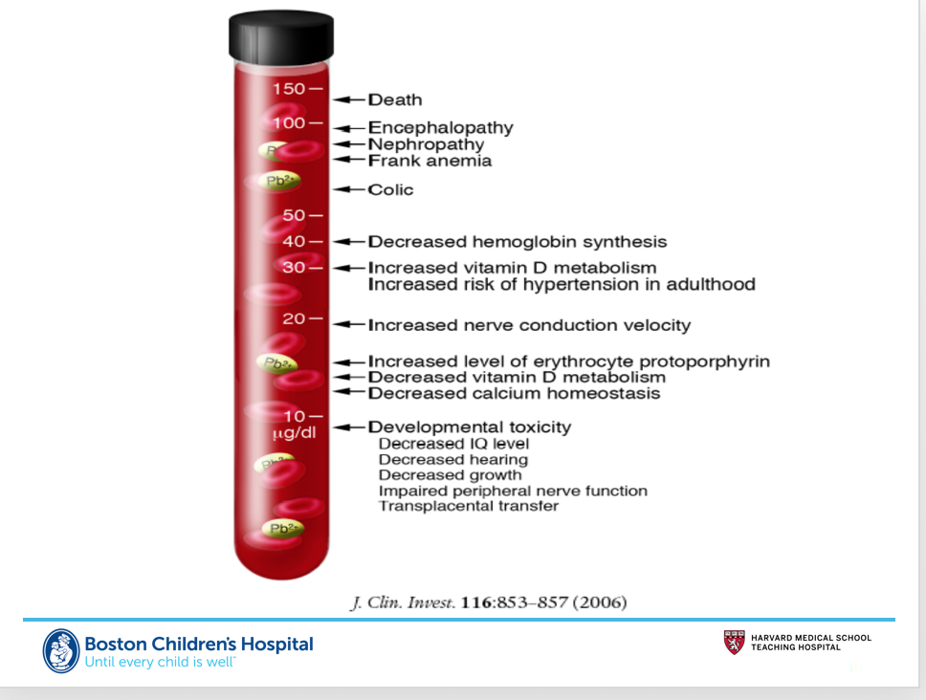
Lead Quick Facts
Lead is naturally occurring and never breaks down.
No treatment or cure has been found for lead poisoning
Lead can affect everyone
From the Environmental Protection Agency (EPA), and American Academy of Pediatrics (APA).
Notes:
The most susceptible to lead and its effects are pregnant females and children
This is due to the susceptibility of developing brains as lead can easily attach to nerves in the brain and prevent proper development
Lead has been found to cause irreversible damage in numerous ways
Some examples of this are
behavioral issues,
lower IQs,
hyperactivity, slower growth
Premature and/or undersized births
Damage to the baby’s brain, kidneys and nervous system,
increase behavioral issues
Lead can affect everyone of all ages, there is a risk to everyone exposed and the damages of lead over time in adults is still unknown
In the end lead in the body has no place

Slide 4
Lead: In Our Homes?
71% of homes in Massachusetts were built before 1978 when lead was banned.
Only 17% of homes in MA built before 1978 have been inspected for lead.
DPH records indicate that only 335,521 homes in the whole state have been tested.
  This is roughly just the amount of homes in the city of Boston, not the greater area.
Yes: Lead is a very real issue in the Commonwealth of Massachusetts.
From the Department of Health, American Academy of Pediatrics, Massachusetts Department of Health, Mass.gov, and the Boston Globe.
Notes:
Massachusetts did not routinely test for lead poisoning until 1990, causing for many people to have been affected.
They also only tested homes where lead was suspected
Many homes built before 1978 have lead paint on the inside and outside of the building.
When old paint peels and cracks, it creates lead paint chips and lead dust. This lead dust can be easily moved for instance through the opening of windows
Many people who have grown up in homes with lead paint may have experienced subtle damage to the brain and nervous system. There are no symptoms of moderate lead poisoning, so no one would know they were in danger.

Slide 5

Lead: In our Schools?
980 school water taps were tested in Massachusetts and 59% have come back positive for lead contamination.
20 early education centers out of 293 tested were found to have very high lead levels according to state regulators.
Yes: Lead is a major issue in our school systems in the Commonwealth of Massachusetts.
From the Department of Health, American Academy of Pediatrics, Massachusetts Department of Health and the Boston Globe.
Notes:
As it can be seen lead is not just an issue which is in the walls, it is also in our pipes.
This bill has the scope to go after these lead pipe manufacturers
Just like homes, schools are meant to be safe places so how can we be allowing for these places to test positive for lead
It is time some one is finally held accountable

Slide 6
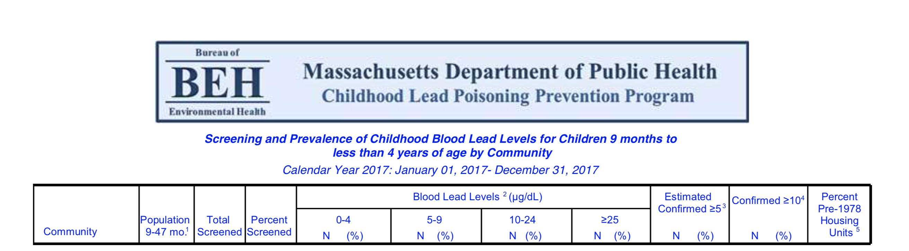
Notes:
There were a total of 73 cases of lead levels being greater than or equal to 25 microliters per deciliters in these communities. These were only the most severely affected communities. Many more communities experienced lead poisoning as the total number of lead poisoning cases in Massachusetts was 556. Overall there were 2,754 total cases of lead levels ≥5 microlgrams per deciliters throughout Massachusetts communities which are considered of concern.
The 15 locations on the next slide were the locations which shared all of the 73 cases of lead levels greater than 25 microfgrams per deciliter or higher
This is far to many, these numbers should really be 0, as no level of lead is safe

Slide 7
Lead: In our Communities?
Locations where children have high levels of lead:
  Boston
  Brockton
  Cambridge
  Chelsea
  Fall River
  Framingham
  Haverhill
  Lawrence
  Lowell
  Lynn
  Malden
  Methuen
  New Bedford
  Springfield
  Worcester
Yes: There are many towns within MA that have children who are lead poisoned
Notes:
Lead poisoning is considered anything ≥10 (μg/dL).
We have compiled this list based off of 2017 data from the Massachusetts Department of Public Health.
These places listed are of the highest of concern due to there being substantial lead poisoning with Blood Lead Levels ≥25 microliters per deciliters (μg/dL) in their children ages 9-47 months.

Slide 8

Notes:
This Map here was made in order to show the severity of this lead epidemic
This was data collected between 2010 and 2015
It shows the percent of children under 6 whom have greater than or equal to 5 micrograms per deciliter of lead present in their blood

Slide 9
Why This Bill?
Those who have been poisoned and experienced the side effects of lead poisoning should be compensated
The lives of many children have been severely hindered and they will never be able to reach their full potential
The families of these children should be able to receive compensation in order to overcome medical expenses and cover the disadvantages their children will experience
Who Benefits?
Notes:
There should be compensation to these families as the companies who benefited from poisoning and damaging the lives of others should not be able to prosperous without paying for their injustices.
It is time for those who have been affected to receive help and this is the bill is the start of that
Just remediating places which have lead present is not enough as it has already done damage to countless families which can never be fixed
These families’ children will need countless hours of educational support and who is to foot that bill
Hopefully with this bill the companies which poisoned these children will
This economic burden will not just be on these families and their kids, but will be on these kids’ families as lead can be passed onto their babies

Slide 10
Who will and won't be affected
A party will be Liable if
The placement of the lead or lead-containing products into commerce was a substantial contributing factor in bringing about the plaintiffs' injury
The party placing lead in commerce knew or should have known that such harm was a likely consequence of their actions
The party placing lead in commerce took no or insufficient action to prevent such harm to society
No Party will not be Liable if:
  They took adequate action to prevent exposure to users of the product
  They sold a product that used as intended would not cause unreasonable exposure
  That the product could not have harmed the plaintiff
  That there was no expectation that their product may be used in residences, schools, hospitals, or at child-occupied facilities as defined by the federal Residential Lead-Based Paint Hazard Reduction Act.
Only those who committed wrongdoing should be concerned.
Notes:
Those who will not be affected will be Retailers, installers, landlords, closed loop battery manufacturers, and products which contain lead below allowable lead limits as set by the government are some examples of groups who would not be liable
The liability is in the manufacturer of the lead containing products such as lead pipes and paint manufactures.
These are just some examples of whom could be held liable, but others such as toys and any other product which lead was put in could also be held accountable

Slide 11
How MA Can be a Champion for Children's Health
Now is the perfect time to make this bill law, following the ConAgra case in California.
        We have the ability to help those affected directly, rather than just cover lead abatement costs.
        Lead poisoning can occur to anyone. It doesn't matter if you are rich or poor, lead has harmful effects on everyone.
        Now is the time to step up and hold those accountable who have done damage to our country’s future generations, the children who we hold most dear.
Why Now?
Notes:
These two cases in California are making these two companies contribute 409 million dollars into a fund in order to inspect and help remove lead from homes built prior to 1951
These companies were found to create a pubic nuisance for their continuous use of lead in their products after they knew the harms
Our bill differs in the fundamental way that we need to help get those affected by lead the compensation they need, removing their lead in their homes will not solve the

Slide 12
Questions?

