Slide 1

Graduate Affairs
December 2025
Explore.
Expand.
Connect.
https://www.bu.edu/grad/

Slide 2

Graduate Affairs, Office of the Provost
Associate Provost of Graduate Affairs
Sean Mullen
Graduate Enrollment
Graduate & Postdoctoral Success
Graduate Policy
Associate VP, Graduate Enrolment
David Cotter
Assistant Provost of Graduate Affairs
Elizabeth Bristol
Assistant Provost of Graduate & Postdoc Development
Lauren Easterling
Director of Academic Affairs
Ivonne Dufresne
Graduate Enrollment
11 FTE
Director of PhD Resources
Abi Nishimura
Director of Grad Student Support
Jessica McCarthy
Manager of Graduate Affairs
Olivia Malmstrom
Graduate Program for Neuroscience
3 FTE
Special Projects & Operations
Interdisciplinary Graduate Education
Boston University: Office of the Provost

Slide 3
Graduate Education by the Numbers
Approximately 2,400 PhD Students
65 PhD Programs
(programs with enrolled students)
Approximately 16,000 Professional Doctorate & Master’s Students
Over 200 Professional Doctorate &
Master’s Programs

Slide 4
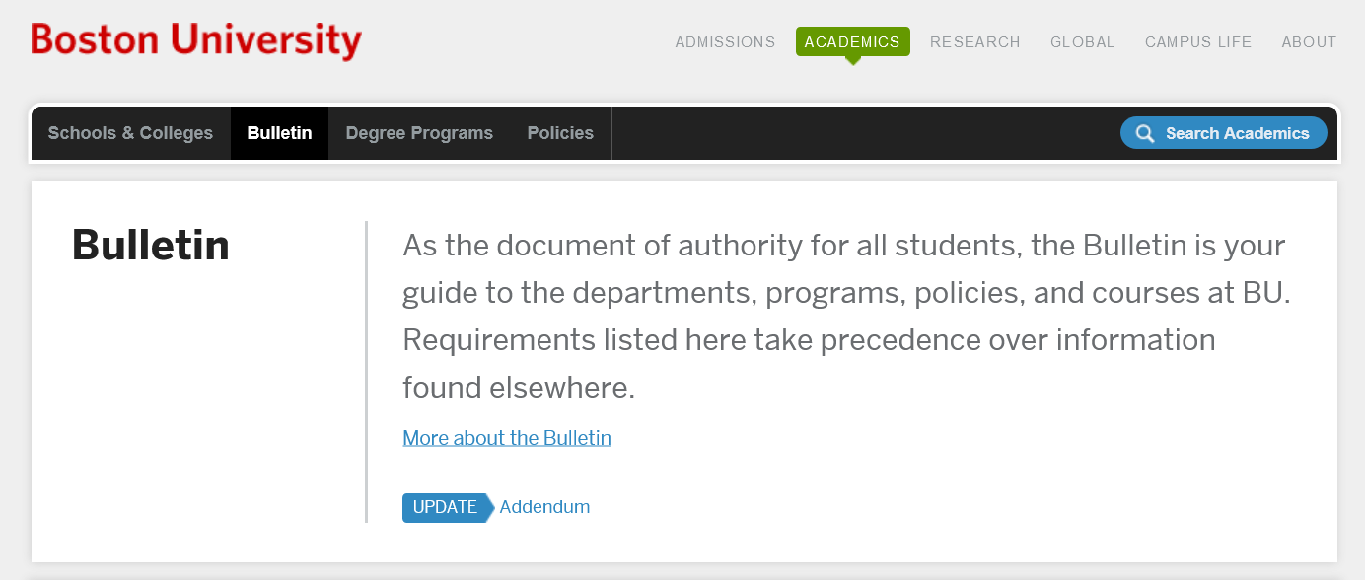
Program and Policy Review
Proposals to change or add academic programs or policies are peer reviewed at BU and move through the faculty governance process.
Proposals are submitted through the Electronical Curriculum Approval Process (eCAP) for review by the Office of the Provost and the appropriate committees. New programs are voted on by University Council.
Policies follow a similar workflow though Grad policies typically develop via UGC and GAPP.
The Bulletin is the “handbook” that lists all official program requirements and policies.
https://www.bu.edu/academics/bulletin/
Notes:
Committees: Undergraduate Council (UGC) and Undergraduate Academic Programs & Policies (UAPP) play key roles in the approval process.

Slide 5
Graduate & Postdoctoral Success
A resource for all graduate students
Purpose: To support all BU graduate and professional students through programming and resources, centering on academic, professional, and personal development of students.
Activities:
Events and programming
Individual and small group services for PhD/adjacent students and postdocs
University-wide connections that bridge programs, centers, and school/colleges
Advocacy for structures and systems to improve the professional development experience and training outcomes for graduate and professional students, and postdoc scholars
GPS Team:
Lauren Easterling
Asst Provost, Graduate & Postdoctoral Development
Jessica McCarthy
Director, Graduate Student Support
(master’s & professional programs)
Abi Nishimura
Director, PhD Student Resources
(PhD and similar terminal degree programs)
Notes:
Committees: Undergraduate Council (UGC) and Undergraduate Academic Programs & Policies (UAPP) play key roles in the approval process.

Slide 6
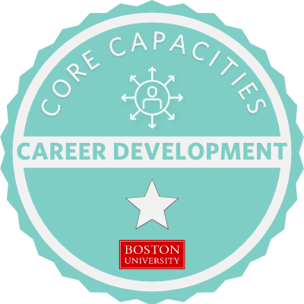
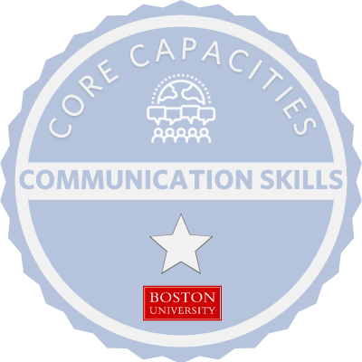
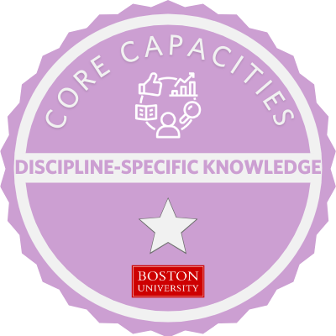
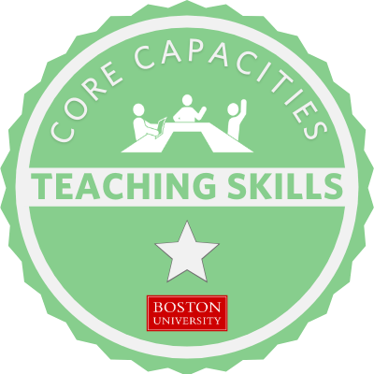
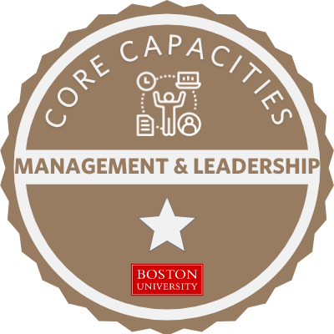
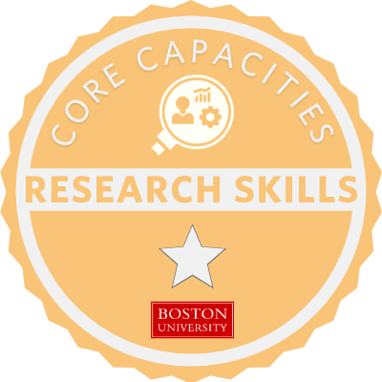
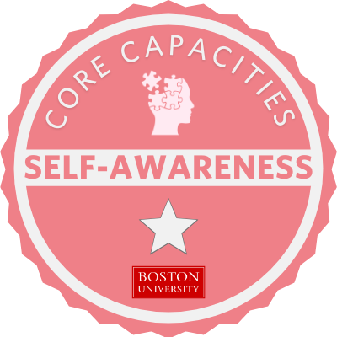
What is PhD Progression?
A self-guided approach to professional development that aligns with core capacities. PhD students have access to…
Professional development content, track professional development progress and skill development
Frameworks to describe outcomes and skills developed during the degree and the language to communicate these skills to future employers
Understand how professional development learning influences career aspirations, career outcomes, time to degree, and productivity

Slide 7
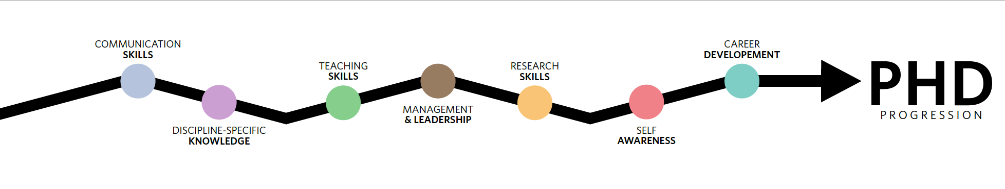
Benefits of PhD Progression
A structured curriculum of self-paced modules with guided exploration of professional development resources and skill building activities
Digital Badges (micro-credentials)
  Issued to students as they successfully complete learning activities, and contain the activities completed to earn that badge
  Provide students with concrete evidence of their work beyond the degree requirements
  Share progress reports and links to badges with faculty or publicly

Slide 8

Graduate Data Collection
Collecting data that will advance our training opportunities and increase our support for students
PhD Profiles
These PhD Program Profiles are currently under construction as we work toward a new, more informative format. Our goal is to create statistical portraits across key metrics that help prospective students understand their likelihood of admission, expected time to degree, career outcomes, and other essential considerations.
We will be partnering closely with programs to refine the structure and data elements for this new version. If you have questions in the meantime, please feel free to reach out. We anticipate sharing updated guidance and re-engaging with programs in spring 2026.

Slide 9
Getting in Touch
Contact
Sean Mullen, Associate Provost Graduate Affairs smullen@bu.edu

