Slide 1
Closing the loop
Integrating assessment findings
Into curricular design

Slide 2
Bu history department: where are we?
End of a five year “cycle”
Formulated outcomes, may 2014
Created yearly plan to assess individual goals at different levels of curriculum
Gathered data, both direct (student work at all levels) and indirect (primarily surveys to students at chosen points in the curriculum)
Finally, beginning to employ our findings as foundation for next “cycle”

Slide 3
Our outcomes, per 2014
1: Demonstrate knowledge of past societies and familiarity with patterns of social, political, economic, and cultural change; and appreciate how historical perspective can enrich understanding of contemporary developments and problems (directly assessed across levels and years, with emphasis on intro courses and direct assessment of final exams in 2017)
2: Recognize how varied sources can be used as historical evidence and analyze the role of evidence in the construction of historical arguments (targeted in 2015, indirect measurement in required methods course)
3: Understand the challenge of weighing multiple perspectives and evaluate the merits of competing interpretations (ditto to #2, along with direct evaluation of final projects from hi 200 sections deliberately including good, average, and poor examples)
4: Conduct research using both primary and secondary sources and assess their relative use (targeted 2016, via direct assessment of work in 400- and 500-level seminars that were randomly selected)
5: Construct persuasive and evidence-based arguments about historical change and present them in written formats (ditto to #4, with an additional round of data gathered in 2017)

Slide 4
Assessing our assessment: challenges and achievements
The big positives: students achieved competence in all five outcomes, even when examples were chosen to exemplify weak student performance; received buy-in from a core group of faculty
Added benefit: Open-ended survey questions revealed that students’ abilities to perform certain tasks like professional historians (esp. re: outcomes #2 and #3) improved over time, which has stimulated a s.o.t.l. project in the department
Challenges: awareness and investment of faculty as a whole; finding time for rigorous analysis of data; communicating findings to faculty in a meaningful way, “noise” from other administrative imperatives
Our Big question: We know that we’re doing what we want/need to do. Can we identify the moments and spaces that are crucial in fostering this learning, and then export them to other places in the curriculum?
  We have ideas and anecdotal data (HI 190, some sections of hi 200, honors program)
  We Don’t have enough data to say for sure…

Slide 5
April 2018: faculty half-day seminar on pedagogy and assessment
Supported by mini-grant, which offered compensation for participation and support for good event space and catering
Huge numbers in terms of faculty participation
Enthusiasm for future events that foster departmental dialogue outside of regular meetings; hopefully habit forming (advising forum, fall 2019?)
Self-assessment of curriculum: areas of need, questions about redeploying human resources, identification of best practices
Deliverable: senior exit survey to gain feedback on high impact practices and experiences, as well as forum for identifying areas for growth

Slide 6
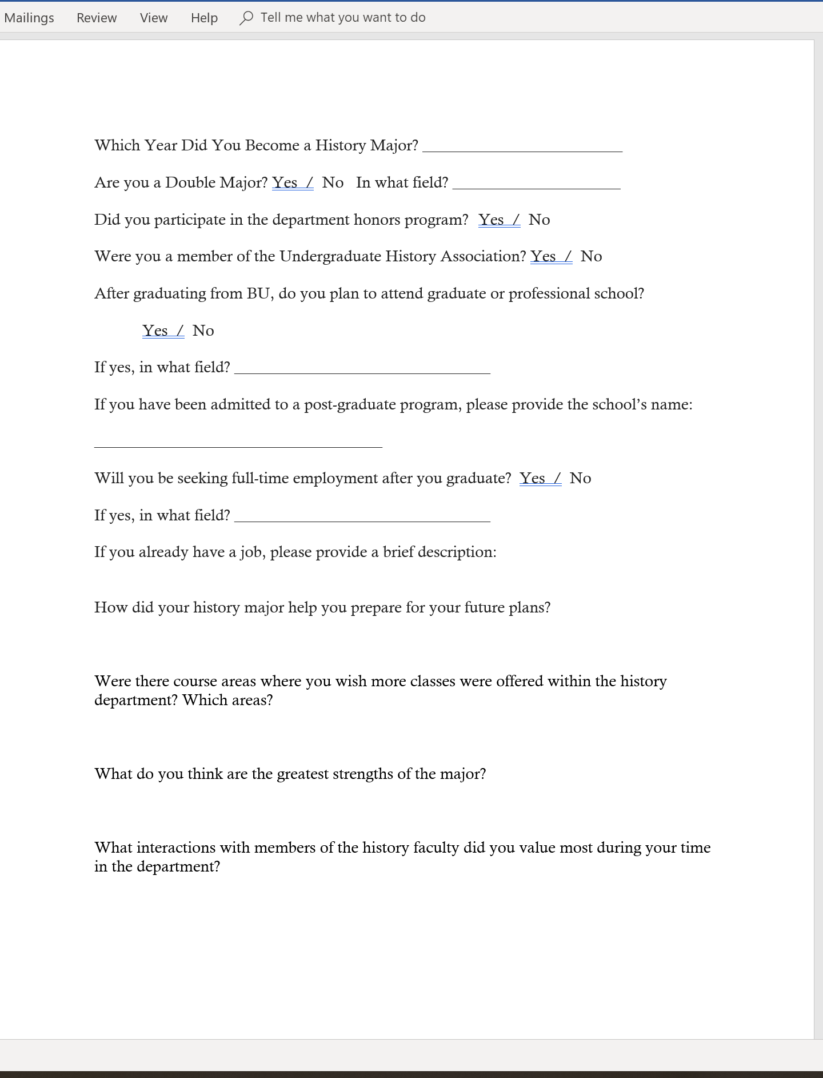
What are we looking for?
Confirmation or alteration of our curricular priorities: what do students want or need that we don’t offer?
Affirmation of strengths as reinforcement for what we do well.
Motivation for making changes or offering more in terms of faculty/student interactions (especially re: advising).
Incorporation of our classroom programs into extracurricular activities and students’ future plans.
But…Do we need more specific prompts, or some Likert scale questions about student satisfaction? This made some faculty uncomfortable, but may be an option down the road.

