Slide 1
Using an OSCE to Assess Medical Students’ Mastery of Geriatrics Competencies in a Hospitalized Older Adult
Leah Taffel MD, Laura Fernandez MD, Serena Chao MD MSc,
Andrea Schwartz MD MPH

Slide 2
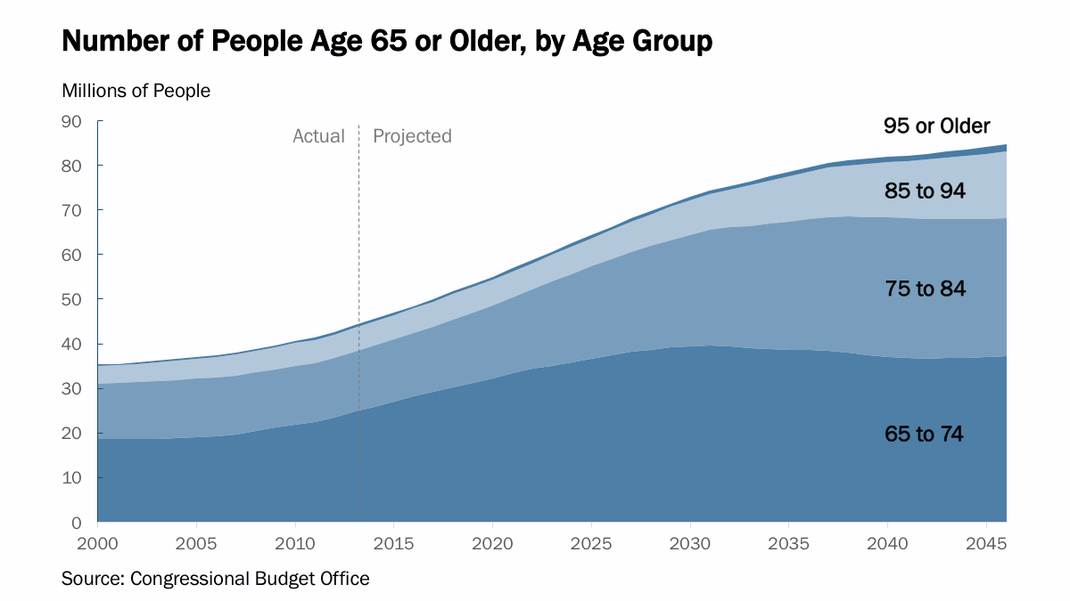
Background
  Number of older adults in the US is growing
  Increase in incidence of geriatric syndromes:
      Dementia
      Falls
      Functional impairment
      Frequent hospitalizations
Notes:
In 2017, total payments for health care, long-term care, and hospice for dementia is $259 billion

Slide 3
Background
  The “don’t kill Granny” competencies are a set of minimum standards that new interns are expected to master in order to care for older adults
  They were developed in 2009 at a national consensus conference
  To ensure that students are meeting these competencies, medical schools require evaluation tools that assess students’ knowledge and skills in these areas
Notes:
They were developed in 2009 at a national consensus conference hosted by the Association of American Medical Colleges and the John A. Hartford Foundation.

Slide 4


Background
  Harvard Medical School geriatricians and palliative care physicians are working to create a new geriatrics curriculum that is integrated into the four years of medical school.
  We created an objective structured clinical exam (OSCE) to evaluate whether students have achieved mastery of geriatrics competencies by graduation.

Slide 5
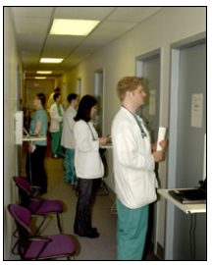
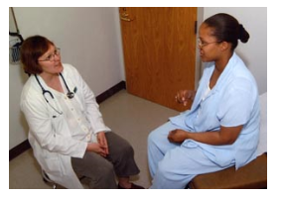
OSCE
  Form of performance-based testing used to measure clinical competence
  Standardized Patients (SP) are trained to present with a specific medical problem
  Medical students are observed and evaluated by SPs and sometimes faculty members
  Evaluated on communication skills, information gathering, clinical diagnosis skills
https://www.oscehome.com/What_is_Objective-Structured-Clinical-Examination_OSCE.html
Daniels VJ, Pugh D. Med Teach.

Slide 6
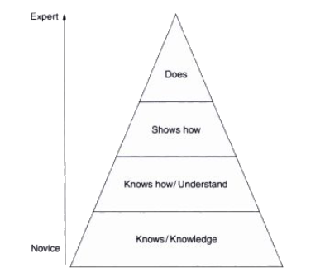
OSCE
  Miller’s pyramid
  To demonstrate clinical competence, should assess students at level 3 and 4
http://www.gp-training.net/training/educational_theory/adult_learning/miller.htm

Slide 7
Aims
  To pilot the OSCE to evaluate baseline proficiency in certain geriatric competencies among medical students, prior to implementation of a new longitudinal geriatrics curriculum

Slide 8
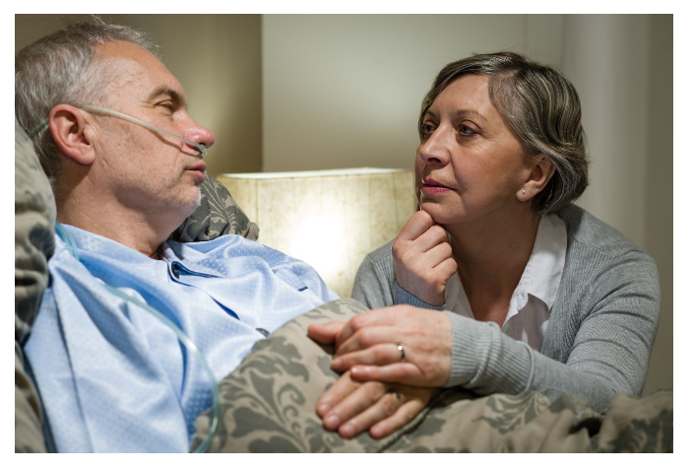
Case
  The newly developed case asked learners to interact both with a patient and a nurse in order to develop an assessment and plan for a patient who presents with new confusion and inattention, consistent with delirium.
https://www.health.harvard.edu/staying-healthy/when-patients-suddenly-become-confused
Notes:
Talk here about how we developed the case – myself and laura. And then show the competencies and why we chose this case
Describe delirium- disturbance in attention, awareness. Develops over a short period of time (hours to days), represents a change from baseline, and fluctuates during the day. Can have disturbance in cognition.

Slide 9
Competencies evaluated
In an older patient with delirium, urgently initiate a diagnostic workup to determine the root cause (etiology). Explain the risks, indications, alternatives, and contraindications for physical and pharmacological restraint use. Identify potential hazards of hospitalization for all older adult patients (including immobility, delirium, medication side effects, malnutrition, pressure ulcers, procedures, peri- and postoperative periods, and hospital acquired infections) and identify potential prevention strategies.
Leipzig et al, Acad Med, 2009

Slide 10
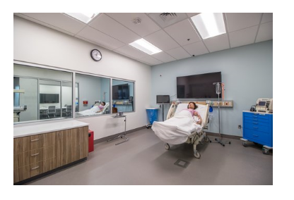
Methods
  Participants: six 4th year HMS student volunteers
  Location: Beth Israel Deaconess Medical Center (BIDMC) simulation center
  Standardized Patients:
      A nurse interested in medical education
      The patient (a simulated mannequin)
  Evaluators: Geriatricians at BIDMC
https://www.idahocom.org/facilities-rental

Slide 11
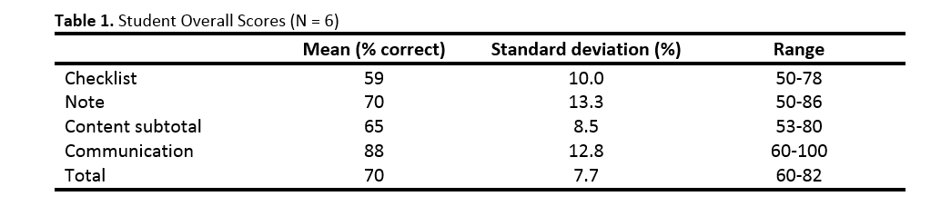
Results
  Students were evaluated on their communication skills, checklist items (history gathering and physical exam), note writing
Notes:
Whereas students received high scores in communication skills, they did not perform as strongly on geriatrics content items tested in the OSCE.
Of note, students were rated very highly on communication and interpersonal skills. Communication skills were graded as not done, done, and done well. The mean communication score for all students was 88% of checklist items done well (range 60-100%). The mean content subtotal was 65% (range 53-80). T Is this true?? Is that what the 88 % means?

Slide 12
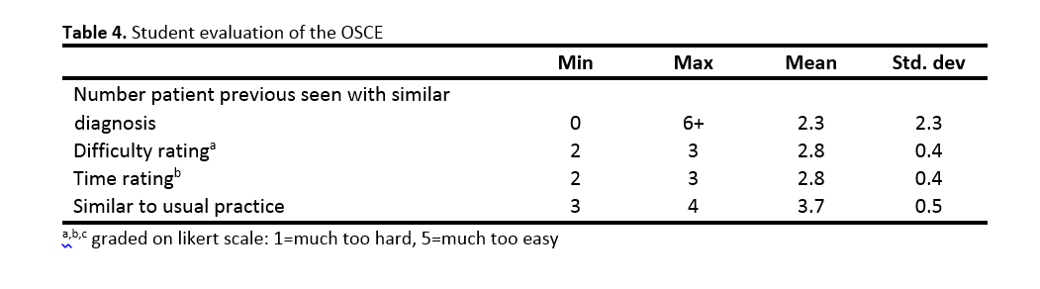
Results
  Students received timely feedback on communication skills
  Surveyed students to get their feedback on appropriateness of case

Slide 13
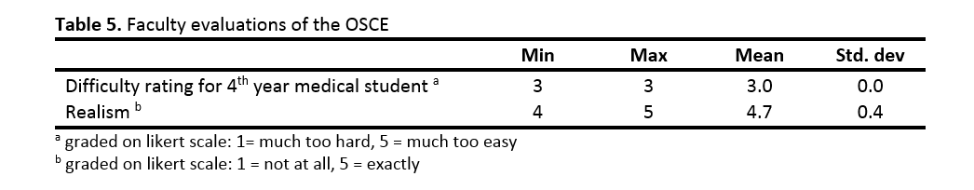
Results
  Surveyed faculty members on their feedback of the case developed

Slide 14
Conclusions
  The results from this pilot OSCE demonstrate opportunities to better integrate geriatrics content through a longitudinal curriculum.
  The OSCE provided enough variability among student performance to discriminate between better and poorer performing students.
  Faculty members felt that the delirium case was realistic and appropriate.
  Students felt the case was at the correct level of difficulty.
  In open-ended feedback, students universally indicated that this was a helpful learning opportunity.

Slide 15
Challenges
  Recruitment of students and faculty members
  Time required to create training videos (6 hours), train SPs (8 hours, divided into 3 groups), and train faculty evaluators (6 hours)

Slide 16
Next Steps
  Information obtained from this pilot OSCE is being used to implement a new longitudinal geriatrics OSCE with an aging patient at HMS
  Continue to improve the geriatrics curriculum to meet content needs of students
  Using skills obtained through this process, to think about new assessment opportunities for the BUSM geriatrics clerkship

Slide 17
Acknowledgements
  VA New England GRECC
  BIDMC Simulation Center Staff
  Sarah Berry
  Mary Beth Harrington
  Barbara Hayes
  Liz Bowers

Slide 18
References
Leipzig RM, Granville L, Simpson D, Anderson MB, Sauvigne K, Soriano RP. Keeping granny safe on July 1: a consensus on minimum geriatrics competencies for graduating medical students. Acad Med. 2009;84(5):604-610
https://www.oscehome.com/What_is_Objective-Structured-Clinical-Examination_OSCE.html
Daniels VJ, Pugh D. Twelve tips for developing an OSCE that measures what you want. Med Teach. 2017; Oct 25:1-6.
http://www.gp-training.net/training/educational_theory/adult_learning/miller.htm

