Slide 1
Program Assessment Retreat—Building a Community of Educators and Learners to Improve Learning Outcomes
Fadie T. Coleman, Ph.D. , Alexandra Bertran, and Izabela Panova, M.Sc.
Biomedical Laboratory & Clinical Sciences Program
Boston University School of Medicine and Metropolitan College
5th Annual Assessment Symposium
Boston University
March 29th, 2019

Slide 2
The Problem Defined
Effective program assessment was a challenge:
  Fragmented curriculum (course offerings lacked structure)
  Random course selection (simply to fulfill credit requirements)
  Lack of programmatic transparency (little understanding for the impact courses could have on future career success)
  Lack of programmatic identity and a unified mission (amongst educators)

Slide 3
Objective
Establish an academic program assessment plan that will:
  facilitate continuous program level improvement.
  reflect the specific goals of the BLCS program
  allow for more a organized tracking, evaluation, & review of intervention efforts

Slide 4
Approach
Two full-day retreats (one in June and another in August)
  Discuss the program in its entirety (including: mission, goals, curriculum, and learning outcome assessments)
  Provide an opportunity for core course educators to review, discuss, and revise course material to establish synergy with the overall program mission
  Focus on specific curricula to facilitate a unified understanding and mindset around the curriculum
  Assist educators in navigating the Exam Soft program as a community

Slide 5
Approach (continued)
model
This project is the first stage of a larger project that will work towards establishing an academic program assessment plan that will facilitate continuous program level improvement.

Slide 6
A multi-pronged intervention
model
Assessment
Programmatic
Course
Student
Mentoring
Academic Advising
Career Advising
Professional Development
Curriculum
Evidence-based reform
Inquiry pedagogy
Hands-on training
“The more you teach without finding out who understands the concepts and who doesn’t, the greater the likelihood that only already-proficient students will succeed.”
-Grant Wiggins, 2006
“…the aspect of classroom teaching that seems to be consistently underappreciated is the nature of “whom” we are teaching.”
–Kimberly D. Tanner
“When we treat a student as they are we make them worse than they are. But, when we treat them as if they are already what they potentially could be, we make them what they should be.”
-Johann Wolfgang von Goethe

Slide 7
Program Retreat
Introduction—A Discussion on the Program mission
Course Presentation Exercise
Changes to BLCS Degree—Presentation of Approved New Courses
Backward Design—An exercise in curriculum alignment
Active Learning—A Discussion on Inclusive Teaching Practices
Notes:
Yet, this line of reasoning does not fully address the discrepancy that exists between STEM field pursuers and their representation in the workforce. Alternately, one can argue that the dearth of diversity in the STEM workforce is due to a lack of rigorous preparation. Not all STEM studies are made equal and not all programs focus on the combination of academic preparation and the acquisition of a diverse skill-set, which implies that many graduates with STEM degrees do not possess the hands-on, real-world experience and soft skills needed to compete in the workforce. Biomedical hubs, such as the greater Boston area, are attractive to many underrepresented STEM graduates and therefore present a challenge to 4-year institutions to make it a priority to develop underrepresented students’ interests and talents in STEM. The National Academies of Sciences, Engineering, and Medicine encourage us to recognize that there is an opportunity to expand and diversify the nation’s STEM workforce and STEM-skilled workers by providing more opportunities to engage in high-quality STEM learning and experiences⁶.

Slide 8
Foundational Courses
Brought instructors together to discuss new and existing courses, and revise course content
Chose courses for the first round of evaluations based on their focus on cell/molecular concepts
Sought to identify and elucidate the unifying conceptual thread amongst the courses and connect to programmatic mission
Notes:
Undergraduate students often appear to be treated as interchangeable entities without acknowledgment of the central role of the individual students, their learning histories, and their personal characteristics in the student-centered nature of “how” we aspire to teach.
(Kimberly Tanner)— justifying my approach [when I started the restructuring process for BLCS, I had to understand where are students were coming from in order to really know how the program can best address their needs.]
Hard skills: science, research, trouble shooting, critical thinking, data analysis
Soft skills: writing, oral presentations, self-advocacy

Slide 9
Program Retreat (Part II)—
A digital assessment tool that will facilitate collaborative assessment creation, ease in assessment administration, and analysis of assessment data
retreat will provide an opportunity for core course educators allowed for the review, discussion, and revision of course material to establish synergy with the overall program mission.

Slide 10

Evaluating the intervention
Data driven intervention
Mapping of exams to programmatic goals
Transparent system of assessment analysis
Notes:
Self efficacy-–trying to address the issue of students not knowing how to present themselves (market their skills, etc)
Sustainability of intervention efforts and self-efficacy among students
Writing workshops; CV/resume workshops; networking (approaching Pis)
Inform students about the following:
Understanding the value of gaining effective study skills.
Understanding how to leverage the skills gained throughout the program
Learning how to take advantage of the opportunities available to them on the med campus
Learning how to articulate their thoughts about the science they are learning
Understanding how to seek advice about next steps
Understanding the purpose and value of pre-requisites (taking the appropriate courses at the appropriate time).

Slide 11
Evaluating the intervention in real time
Understanding which learning objective are being achieved
Understanding where knowledge gaps exist
Reinforcing the purpose and value of pre-requisites (taking the appropriate courses at the appropriate time)
Reinforcing the importance of gaining effective study skills
Highlighting the progressive property of science education
ExamSoft
Data driven intervention
Mapping of exams to programmatic goals
Transparent system of assessment analysis
Notes:
Self efficacy-–trying to address the issue of students not knowing how to present themselves (market their skills, etc)
Sustainability of intervention efforts and self-efficacy among students
Writing workshops; CV/resume workshops; networking (approaching Pis)
Inform students about the following:
Understanding the value of gaining effective study skills.
Understanding how to leverage the skills gained throughout the program
Learning how to take advantage of the opportunities available to them on the med campus
Learning how to articulate their thoughts about the science they are learning
Understanding how to seek advice about next steps
Understanding the purpose and value of pre-requisites (taking the appropriate courses at the appropriate time).

Slide 12
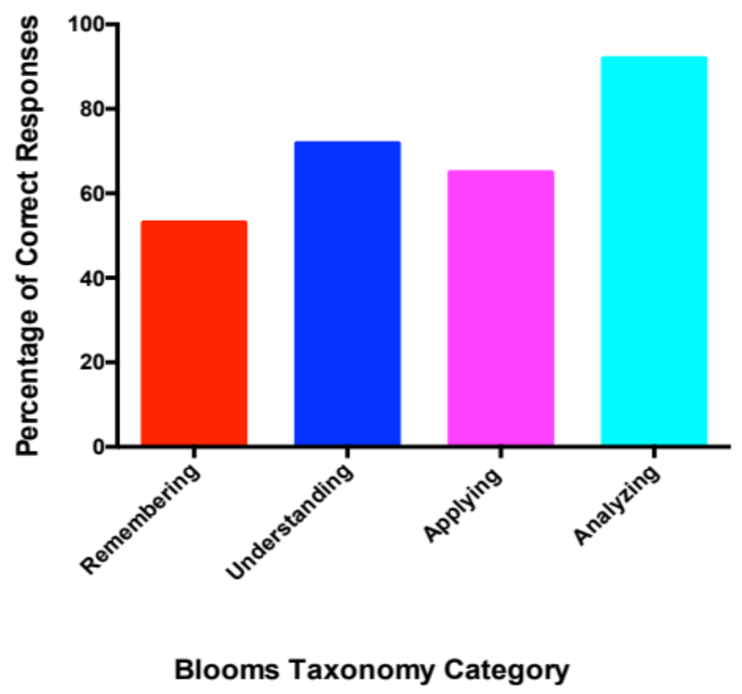
Evaluating the intervention in real time
Understanding which learning objective are being achieved
Understanding where knowledge gaps exist
Reinforcing the purpose and value of pre-requisites (taking the appropriate courses at the appropriate time)
Reinforcing the importance of gaining effective study skills
Highlighting the progressive property of science education
Can learner distinguish between different parts?
Can learner explain ideas/
concepts?
Can learner use infor-mation in a new way?
Can learner recall infor-mation?
Notes:
Self efficacy-–trying to address the issue of students not knowing how to present themselves (market their skills, etc)
Sustainability of intervention efforts and self-efficacy among students
Writing workshops; CV/resume workshops; networking (approaching Pis)
Inform students about the following:
Understanding the value of gaining effective study skills.
Understanding how to leverage the skills gained throughout the program
Learning how to take advantage of the opportunities available to them on the med campus
Learning how to articulate their thoughts about the science they are learning
Understanding how to seek advice about next steps
Understanding the purpose and value of pre-requisites (taking the appropriate courses at the appropriate time).

Slide 13
Lessons learned
Students and instructors are able to use assessment reports to gauge student learning and monitor retention of information
Instructors and the program can use ExamSoft generate reports as a tool to discern level of understanding on micro and macro levels (student/class)
Immediate feedback from ExamSoft generated assessments help to reinforce the importance of effective learning skills

Slide 14
Acknowledgements
Alexandra Bertran, Program Administrator
Izabela Panova, M. Sc., Program and Laboratory Manager
Linda Hyman, Ph. D., Associate Provost, Graduate Medical Sciences
Marcela Alvia, Graduate Student, Pathology Laboratory Sciences
Reha Jhunjhunwala, Graduate Student, Clinical Research
Boston University Provost Office, Academic Assessment

