Slide 1
Boston University 5th Assessment Symposium
Data Analytics for Assessment of Practice-based Teaching
March 2019
James Wolff, MD MPH MAT
Wes Sonnenreich
Rachel Pieciak, MPH
Notes:
Good Afternoon.
We are very happy to be able to present this afternoon on Data Analytics for Assessment of Practice-based teaching.
Brief Introductions
I am going to introduce our topic, Rachel is going to talk about our course, Program Implementation for Global Health and how we assess students. We are going to show you a short film to demonstrate the assessment workflow for our course. Then Wes is going to talk about the data analytics in Practera and I will return to offer some concluding remarks.
We are practice-based teachers. Our students are working with real clients to produce real products in the context of a traditional classroom course. Out of curiosity, how many of you in the audience are practice-based teachers?

Slide 2
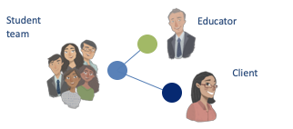
Practice-Based Teaching (PBT) = High Stakes
Clients have high expectations for student work
Quality student work products are critical for sustainability
A process of continuous improvement is necessary
Faculty and school reputation on the line
Notes:
Those of you that work with students and clients know that practice-based teaching is high-stakes.
Clients have high expectations for student work. The organizations are investing resources in working with the students and want a high-quality product.
Quality student work products and professional relationships are critical for sustainability of practice-based teaching. If clients don’t perceive value in the relationship, they will not engage or continue with the program.
This creates an imperative for a process of continuous improvement. Faculty have to be able to support student teams and work with them to improve their work products under the pressure of tight deadlines.
In the end, the reputation of the faculty and the school are on the line.

Slide 3
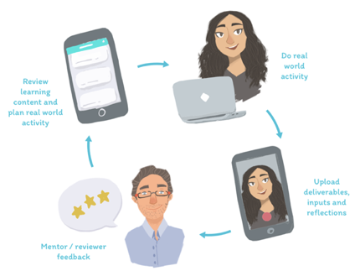
Producing Quality Products for Clients...
Requires a process for continuous improvement
that provides bidirectional feedback and collaboration from students, faculty, and clients
Notes:
Producing Quality Products for Clients…requires a process for continuous improvement
that provides bidirectional feedback and collaboration from students, faculty, and clients

Slide 4
The goal of assessment in PBT is achievement of consistent, high-quality deliverables for client partners
Not as easy as it sounds
Creating and managing these bidirectional feedback loops between three stakeholders is complicated
A robust learning management system is necessary
Notes:
One of the major goals of assessment in PBT is achievement of consistent, high-quality deliverables for client partners. And it is not as easy as it sounds because creating and managing these bidirectional feedback loops between three different stakeholders is complicated.
A robust learning management system is necessary.

Slide 5




Assessment Cycle - Traditional Classroom
Submission
Feedback
Value Assessment
Faculty
Students
Notes:
Assessment in a traditional classroom is straightforward. Students submit their work to the faculty and faculty provide feedback to the student. There is an assumption that the feedback is valuable to the student but the feedback loop usually ends there.
Now I am going to turn the presentation over to Rachel to talk about our course and bidirectional feedback loops we have developed for our class.

Slide 6
Program Implementation for Global Health
Practice-based teaching course in which students work as virtual, short-term consultants for global clients
Student consulting teams produce reports for clients on five implementation areas
Goal of the course to produce high-quality deliverables that are valuable to the client
Notes:
In our course, Program Implementation for Global Health, student teams are paired with a client for the semester and undertake a series of five consulting assignments with their client. Course faculty assess the students’ bi-weekly consulting reports and then provide feedback to the student consulting team in the form of an 8-12 minute podcast. Our expectation is that using the podcast feedback, the team will be able to improve their consulting report before they send it to their client who also provides feedback on the report from their professional perspective.

Slide 7
Assessment Cycle - PBT Classroom
Submission
Feedback
Value Assessment
Client
Faculty
Students

Slide 8
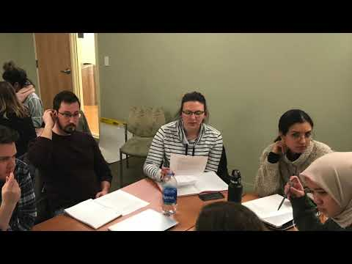
PBT Assessment Workflow
How do we operationalize this type of assessment?

Slide 9
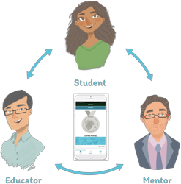

Why Practera
Complicated process involving three actors, faculty students and global clients
Practera provides a solution for managing the feedback loops between faculty, clients and students

Slide 10
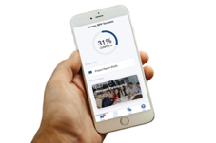
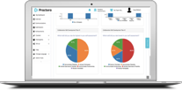
Practera - Data We Analyze
Direct data includes
helpfulness ratings from students after viewing feedback, quick comment tags, textual “detailed” responses
Indirect data includes
timing: e.g. between student submission, client review, client feedback read by student
Engagement with project materials pre/post feedback
Chat and other collaboration post-feedback

Slide 11
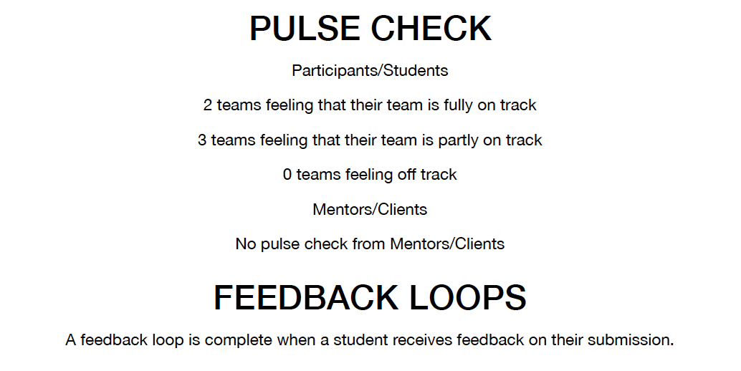
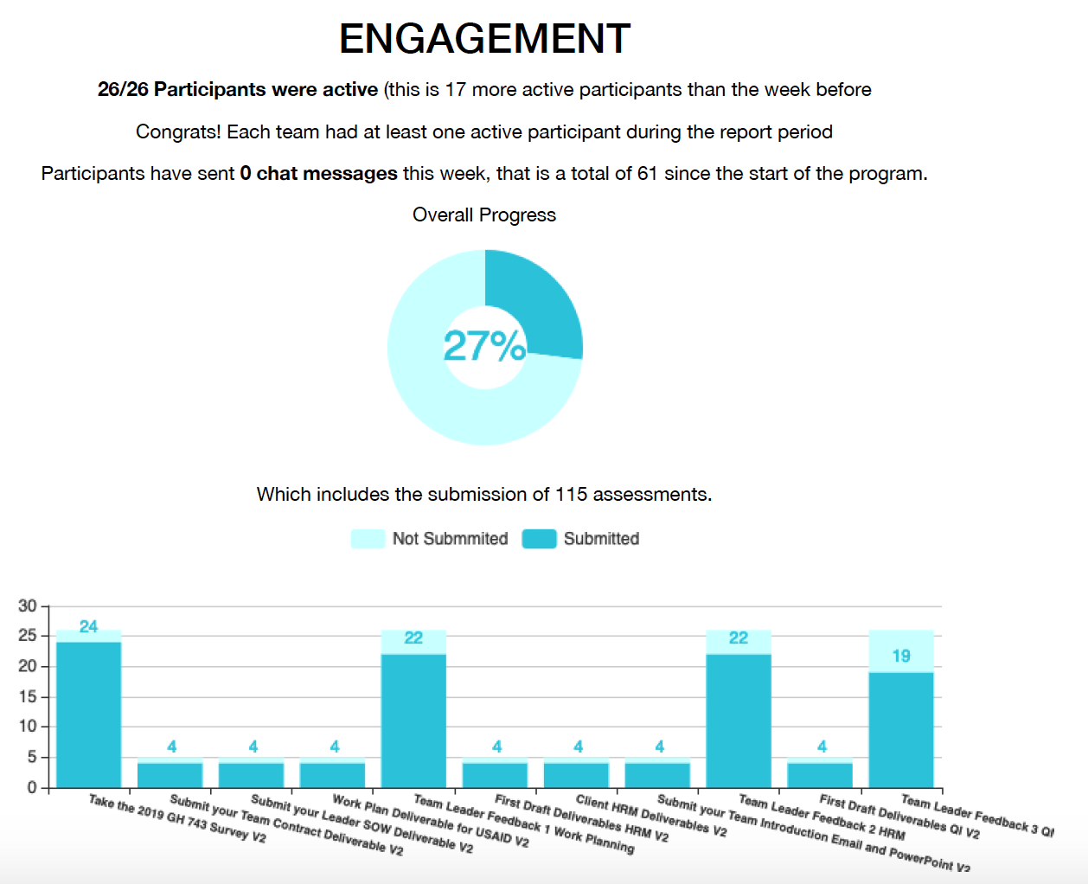
Practera - Weekly Reports
Notes:
Improving the quality and relevance of our assessments depends on having data about our assessments. Practera, a learning management system for experiential learning, provides novel data analytics to help instructors learn about the usefulness and value of assessments and feedback.

Slide 12
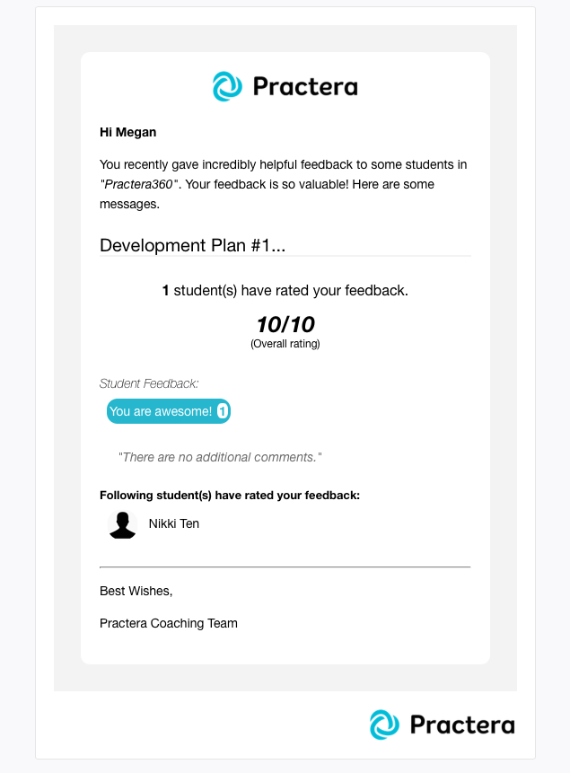
Value Added by PBT Assessment Cycle
Provides information to instructors on the value of their feedback which they can use to improve team coaching
Improves the quality of deliverables submitted to the client
Validates perceived quality and boosts team morale
Offers an opportunity for students to thank clients for their feedback
Offers an opportunity for clients to gage the helpfulness of their feedback
Improves retention and engagement of clients

Slide 13
Conclusion
For experiential learning data analytics from Practera go beyond traditional classroom assessments by:
Including real time, real world performance data from faculty and clients
Giving an insight as to what type of feedback is valuable to students
Providing data to improve the learning experience
Increasing student-faculty-and client engagement
Helping to focus student consulting team efforts on meeting client needs
Capturing the value of student-client partnerships that can be used to promote future engagement in experiential learning

Slide 14
Thank You
Rachel Pieciak: rpieciak@bu.edu
Wes Sonnenreich: Wes@practera.com
James Wolff: jwolff@bu.edu
For more about Practice-Based Teaching- check out
Collaborate.Health.bu.edu

