Slide 1
Assessment and Support for
Music Education and Art Education Graduate Student Academic Writing
Tawnya D. Smith, Ph.D.
Rébecca Bourgault, Ed.D.
Karin S. Hendricks, Ph.D.
Andrew Goodrich, DMA
Ronald P. Kos Jr., Ph.D.
College of Fine Arts

Slide 2
Problem
Prior year student learning outcomes assessment:
While we accept students who are leaders in the field of music and art education, a number of our students enter the program with less academic writing ability and experience as compared to their peers.
These students face a steep learning curve and need additional support in order to thrive in the program.

Slide 3
Writing Support Proposal
Writing Documents on Info Central
Writing Modules
  Self-paced modules designed to review scholarly writing conventions
Writing Support Facilitator Program

Slide 4
Assessment Mini Grant Proposal
Four-Step Action Plan:
Create writing assessments to identify student needs
Implement writing support facilitator program
Design online support system to address needs
Assess student writing progress after support

Slide 5
Step 1:
Create Writing Assessment to Identify Student Needs
Designed rubric with writing criteria, for use in classes
Piloted in Fall 2018 semester in ME doctoral capstone course
  Brainstormed criteria based on real concerns in course
  Used to target and define student need
  Instructors and writing support facilitator made edits
Used in Spring 2019 semester with 5 ME and AE courses

Slide 6
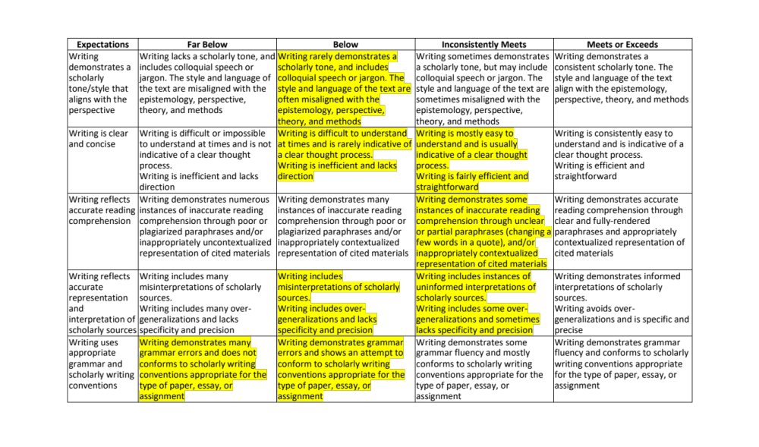

Slide 7
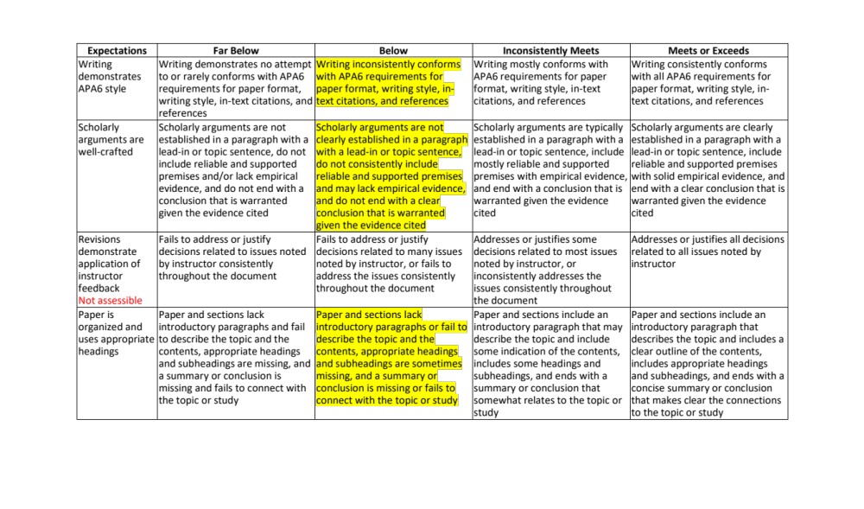

Slide 8
Step 2:
Implement Writing Support Facilitator Program
Wrote job description for writing support facilitator
Hired and provided orientation for facilitator
Piloted program in Fall 2018 ME doctoral capstone course
  Calibration and revision of focus (beyond editing)
Used in 3 ME and 2 AE classes in Spring 2019
  Rubric used to determine students with most need
Students notified by instructor, put in touch with facilitator

Slide 9
Step 3:
Design Online Support System to Address Needs
Modules for Information Central (Blackboard, online)
APA Citation Basics
Colloquial Writing
Editing and Proofreading Checklist
Teacher Feedback
Unlocking the Power of Microsoft Word

Slide 10
Step 4:
Assess Support Program
Support Facilitator Feedback
Instructor/Course Facilitator Feedback
Student Survey

Slide 11
Support Program Assessment:
Writing Facilitator Feedback
15 students were referred during Spring 1
  All 15 returned for additional help on either initial or subsequent assignments
  2 of those have contacted her for assistance during Spring 2
“I’d like to think their writing improved.”
She would like to have a better sense of what courses the students are taking and who the instructors are, as well the number of students in each section/course

Slide 12
Support Program Assessment:
Course Facilitator Feedback
“I was pleased to have a resource to which I could refer struggling students.”
J referred three students
  Two expressed appreciation. Both students’ writing improved over the semester.
  One did not acknowledge the referral. His writing did not improve.
  Would have referred a fourth, but believed that the program was for “critical” cases.
K referred three students
  One had requested assistance prior to the referral; there was a “HUGE, dramatic change in his writing from Week 1 to 7.
  One showed improvement in clarity and organization, but papers were less polished when she stopped working with the facilitator.
  One showed no improvement; it was not clear if that student ever read any feedback he received.

Slide 13
Support Program Assessment:
Student Survey Responses
Question | Scale | Mean
How helpful was the writing support you received in terms of improving your writing? | 1 (Not helpful at all) 7 (Extremely helpful) | 7
How responsive was the facilitator with feedback and answers to your questions? | 1 (Extremely unresponsive) 7 (Extremely responsive) | 7
Please rate your overall experience with the writing facilitator. | 1 (Extremely negative) 7 (Extremely responsive) | 7

Slide 14
Support Program Assessment:
Student Survey Responses
Please describe how you felt when you were contacted by your instructor about receiving writing support.
At first I felt insecure about my writing because of the suggestion. After receiving my first reviewed paper I was very happy about the suggestion and wish that I knew about the program earlier!
It really helped to have more feedback with my paper.
Initially I was upset because I did not think of myself as someone needing writing assistance, but over time I realized that this was a great opportunity to receive help and become a better writer.

Slide 15
Support Program Assessment:
Student Survey Responses
What was the BEST aspect of receiving writing support?
There are really so many. The best would be learning how to become a better writer and getting individual help.
Having some provide specific feedback on our paper.
My writing assistant, A, was very prompt and sent feedback to me often in less than five hours.

Slide 16
Support Program Assessment:
Student Survey Responses
What was the WORST aspect of receiving writing support?
Not really anything except maybe feeling embarrassed about being suggested to use it.
Seeing all the red in my paper.
There was a little bit more pressure to make sure that I finished my writing assignments before the deadline so that I could send them to my writing assistant, but this was a good pressure.

Slide 17
Support Program Assessment:
Student Survey Responses
Please share any suggestions you have for improving the writing support program.
Advertise more about the program! I wish I knew it existed a year ago.
I would like to continue to be apart of it.
Academic writing for the courses in the BU online master's in music education is very important, but I felt that it was never emphasized in any of the courses. I think it would be good if there were presentations or seminars on academic writing that were recommended to students in my program.

Slide 18
Next Steps
Continue to track the progress of the 15 students who have qualified for writing support
Embed the writing support documents in Info Central into courses and track how often they are accessed
Design the Writing Modules and imbed those in relevant courses

