Slide 1
Feedback on Learning in the Language Classroom: The Self-Assessment that Immediately Improves Instruction
Alison D. Carberry Gottlieb, PhD
Senior Lecturer in Spanish
Head of Spanish Language Program

Slide 2

Spanish Language Program
Department of Romance Studies
First Year (111 & 112)
Second Year (211 & 212)
Third Year (300-level, writing-intensive, topics-based courses)
Rotation Policy for Faculty
Placement test = Work in (slow) progress…
FIRST SEMESTER SPANISH (LS 111)
  True Beginners vs. False Beginners
  Flipped (re: explicit grammar/vocab)
  Differentiated instruction

Slide 3

My concerns about teaching 111 after ten years…
Markedly different approach to grammar instruction, vocabulary acquisition, AND testing. Emphasis on oral proficiency. — No longer teaching for discrete grammar point memorization, definition matching, etc.
Far less able to use textbook as source of class exercises, readings, etc. >> Far more reliant on myself — more time and energy in advance of each week.
(Backwards Design + Thematic Units & Essential Questions)
New generation of students — more diverse backgrounds, more diverse educational experiences, more digitally native.
Wider array of student proficiency at lowest level.
Inductive/implicit instruction can leave problematic gaps in comprehension if not assessed quickly.

Slide 4
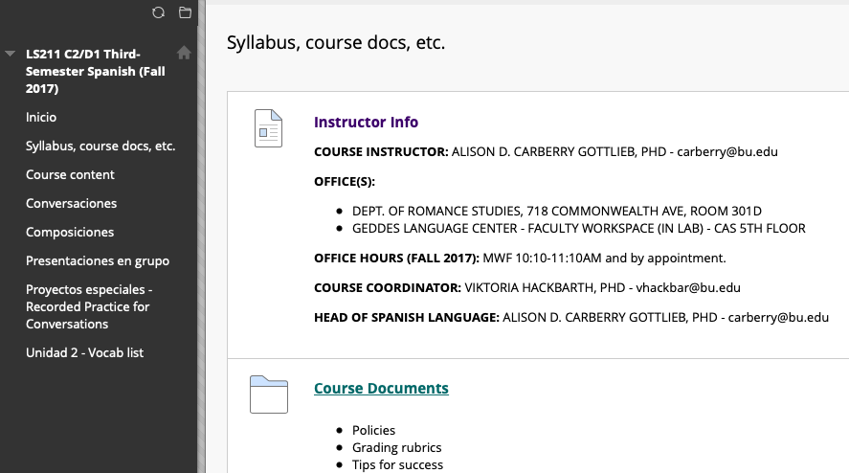

Slide 5


Content-based Blackboard Site

Slide 6
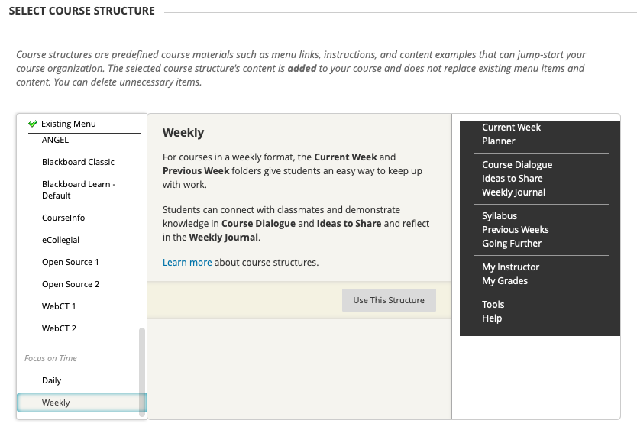

Slide 7

Time-focused Blackboard Site

Slide 8
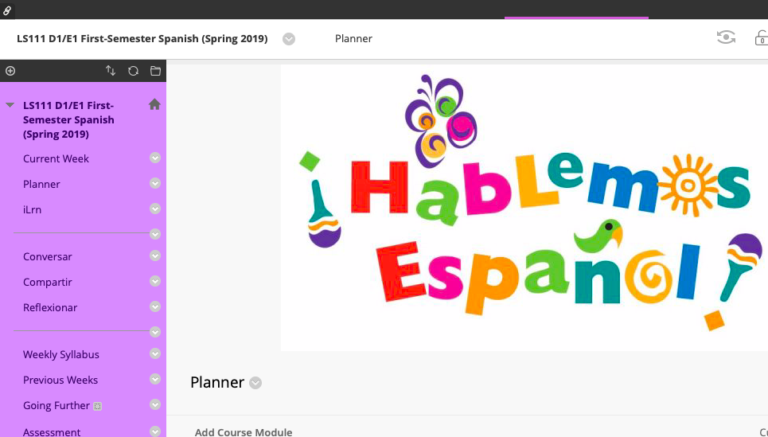

Slide 9


Informal Interpersonal Writing
Shared Thematic Vocab Lists
Weekly Self-Assessment Task

Slide 10

Informal Interpersonal Writing
Shared Thematic Vocab Lists
Weekly Self-Assessment Task

Slide 11
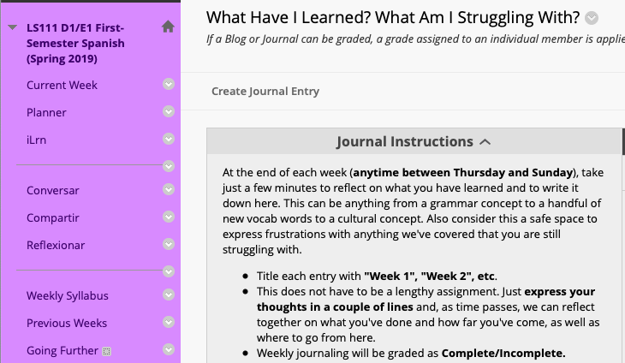

Slide 12

SELF-ASSESSMENT
Low stakes (grades)
Low stress (brief for them and for me)
Private interaction with me
Encourages ownership of learning process

Slide 13
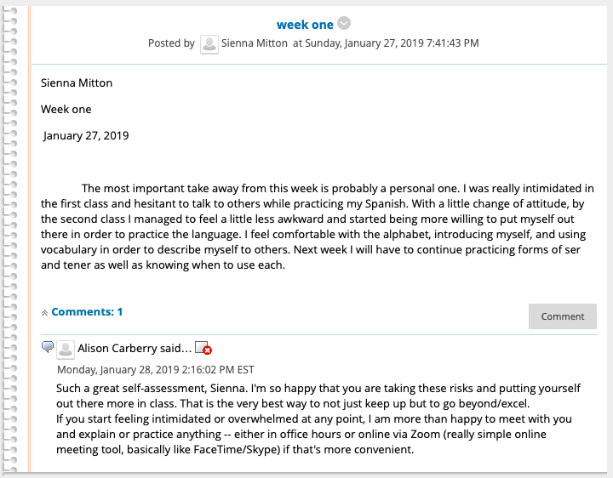
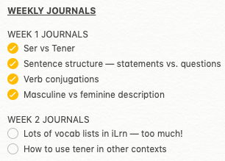
Student Name
Student Name
Treasure trove of useful info:
Who are they? What is their history with the subject? How do they feel in class?
What does the majority need now?
Student

Slide 14
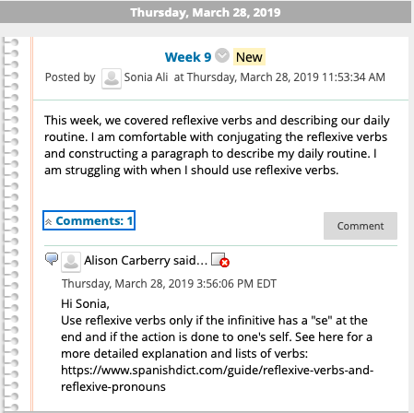
  What has been “internalized” (maybe)?
  What have I not made clear enough?
  Will the book exercises actually explain this clearly enough?
  What other sources are at my disposal to give this student more input?
Student
Student

Slide 15
  What has been “internalized” (maybe)?
  What have I not made clear enough?
  Will the book exercises actually explain this clearly enough?
  What other sources are at my disposal to give this student more input?
Student
Student

Slide 16

Instant Benefits of This Task:
Self-assessment that informs both student and instructor of gains/needs
Makes use of existing course platform (online, familiar)
Regular, ongoing dialogue with students as individuals and check-in with class as a whole — Immediate changes to next week
Requires students to take ownership of learning process without added stress / minimal added time commitment
Can be managed in 30-45 minutes per week (~36 students) — Maybe next year every other week?
Absolutely can be use in other disciplines!

Slide 17
Alison Carberry Gottlieb
carberry@bu.edu

