Slide 1
Learning Outcomes Assessment
BU WGS Minor & Graduate Certificate Program
Cati Connell, cati@bu.edu

Slide 2
Assessment Goals
Conducted as part of impending Academic Program Review – first of its kind for the program
Proposed a multi-stage evaluation process:
  Survey of all current and recent minors (and graduate certificate students)
  Focus groups with current minors (and graduate certificate students)
  Syllabus review to assess current learning objectives
  Curriculum mapping exercise
  Goal: develop program-wide learning outcomes to support revising and refining our core curriculum over next five years
  Grant: attend Program Administration and Development pre-conference at NWSA; conduct focus groups and transcribe; reward faculty time (no built in service incentives for WGS faculty)

Slide 3
Survey results
Course value: interdisciplinarity, (especially inclusion on natural sciences) self-discovery and affirmation of identity, applicability to real life, solving social problems
Areas of Improvement: 101 & 102 difficulty (especially science component), not enough courses to choose from/curriculum seems restricted, not enough faculty of color
Course wishlist: race/ethnicity, media, bisexual and transgender theory, sexualities
Events: career workshops, high-profile feminists & activists, artists, lectures, conferences, group outings to marches/protests/events, mixer with other minors

Slide 4
Focus Group Results
Team teaching format of WS 101 & 102 unique, memorable, and effective (if also challenging)
Appreciate opportunities to explore research, activism, events on campus through WGS courses that require participation in gender & sexuality events outside of class
Impressed and inspired by passion of faculty; course content feels relevant and interesting, often discussed with friends or in relation to current events outside of class
Women’s, gender, and sexuality studies is a “lens” for understanding anything and everything in the social and natural world; applicable across an endless number of domains
Interest in research methods training/research opportunities in WGS
Interest in internships and service learning
Lacking a sense of community with other minors, unsure about structure of minor/program

Slide 5
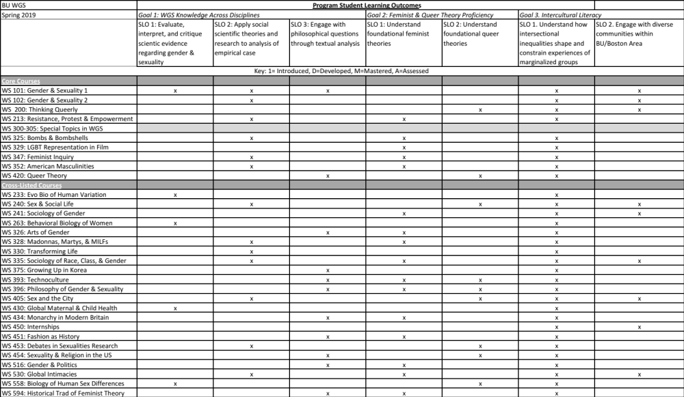
Curriculum mapping

Slide 6
Curricular Goals
Clear communication to faculty regarding program SLOs
Clear communication to students regarding program SLOs/course coverage
Build curriculum wishlist: disability studies, trans studies, postcolonial theory, body/embodiment
Continue to pursue faculty affiliations to meet curricular needs
Revisit minor requirements
Strategize for building towards a major

