Slide 1
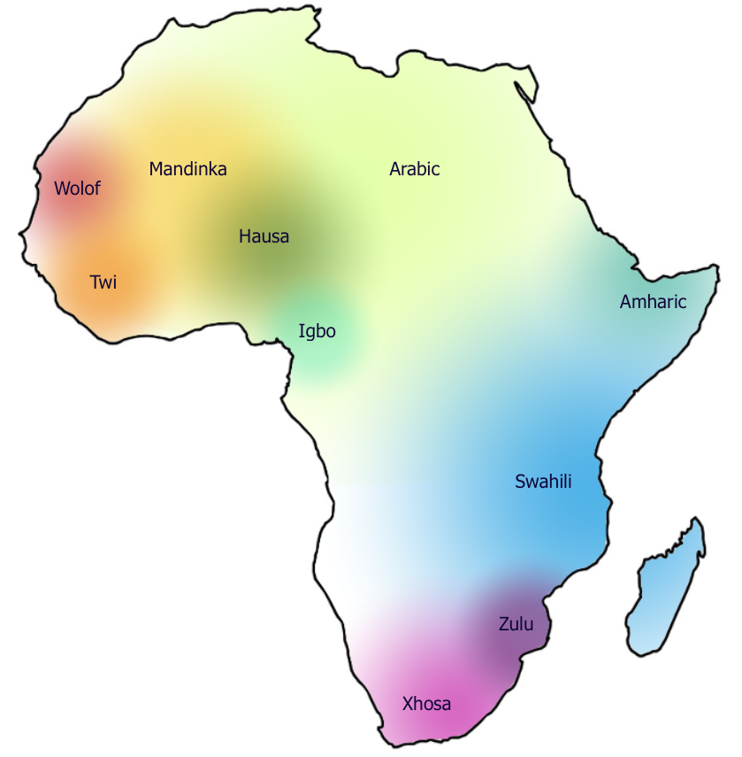
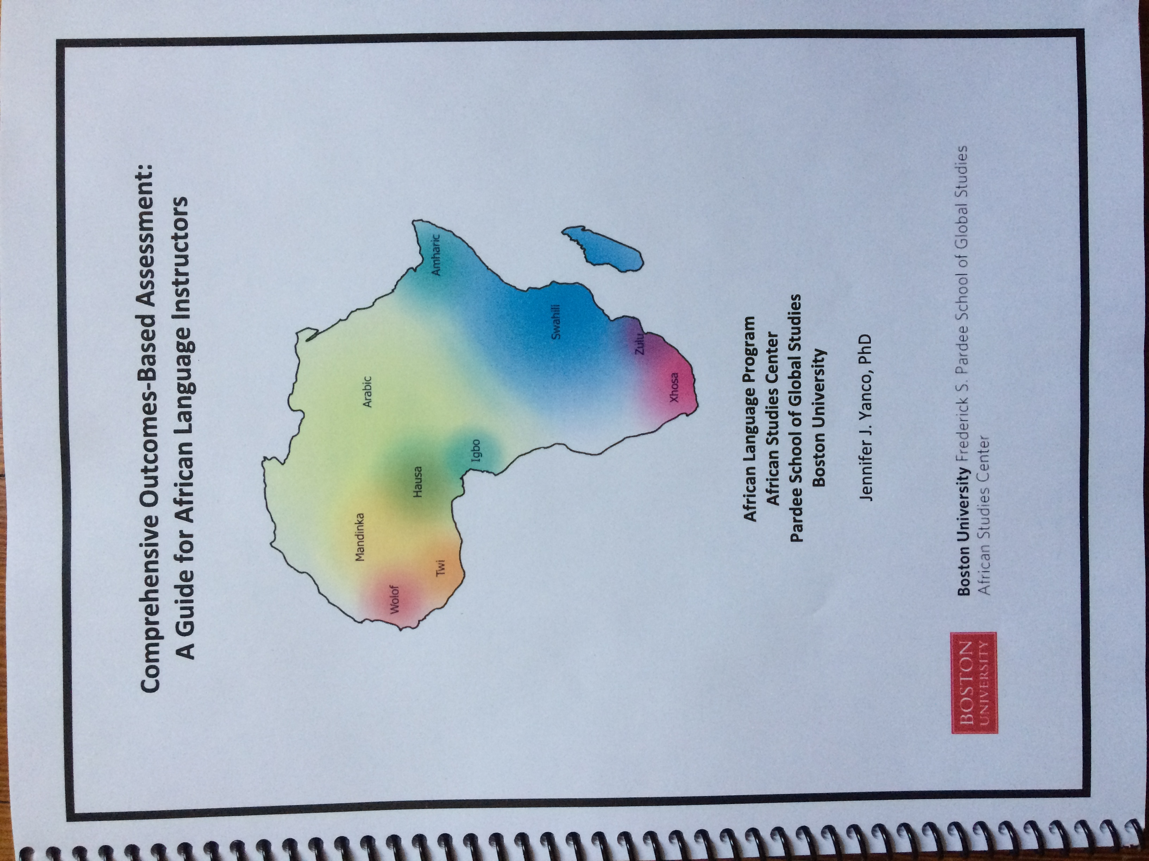
Comprehensive Outcomes-Based Assessment:
A Guide for African Language Instructors
PROMOTING STANDARIZATION, APPRECIATING DIVERSITY

Slide 2
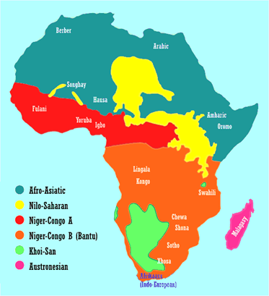
A note on The
Diversity of african languages
One-third of all known human languages are spoken in Africa, with some 2,000+ languages indigenous to the continent (compare this to about 300 in Europe)
Africa is home to two of the world’s four largest language families:
Afro-Asiatic (including Arabic, Hausa, Amharic)
Niger-Congo (including all the Bantu languages such as Swahili, Xhosa and Zulu, as well as West African languages such as Igbo, Twi and Wolof).

Slide 3
The Need for an assessment guide
Consistency/standardization, given
      Diversity of languages
      Diversity of writing systems (Ajami, Fidäl, Tifinagh, N’Ko)
      Evolving program
      Instructor profiles
      Student profiles

Slide 4
Developing the guide
OBJECTIVE
Creation of clear, performance-based outcomes for a range of categories and levels, flexible enough to apply to the diverse languages we teach
RESOURCES
ACTFL Materials
  Integrated Performance Assessment
  World Readiness Standards for Language Learning
Syllabi from current & past courses in a range of languages
Hausa and Wolof Ajami text books published by BU ASC

Slide 5
What is it?
A peEk into the Assessment guide
A 90-page first-edition book, which includes:
Introduction/Background
  Methods and Materials
  Backward Design
  Feedback
Performance Outcome measures
  For Beginning, Intermediate, Advanced, and Superior Levels
  Appendix with Outcome Reference Tables for each level

Slide 6
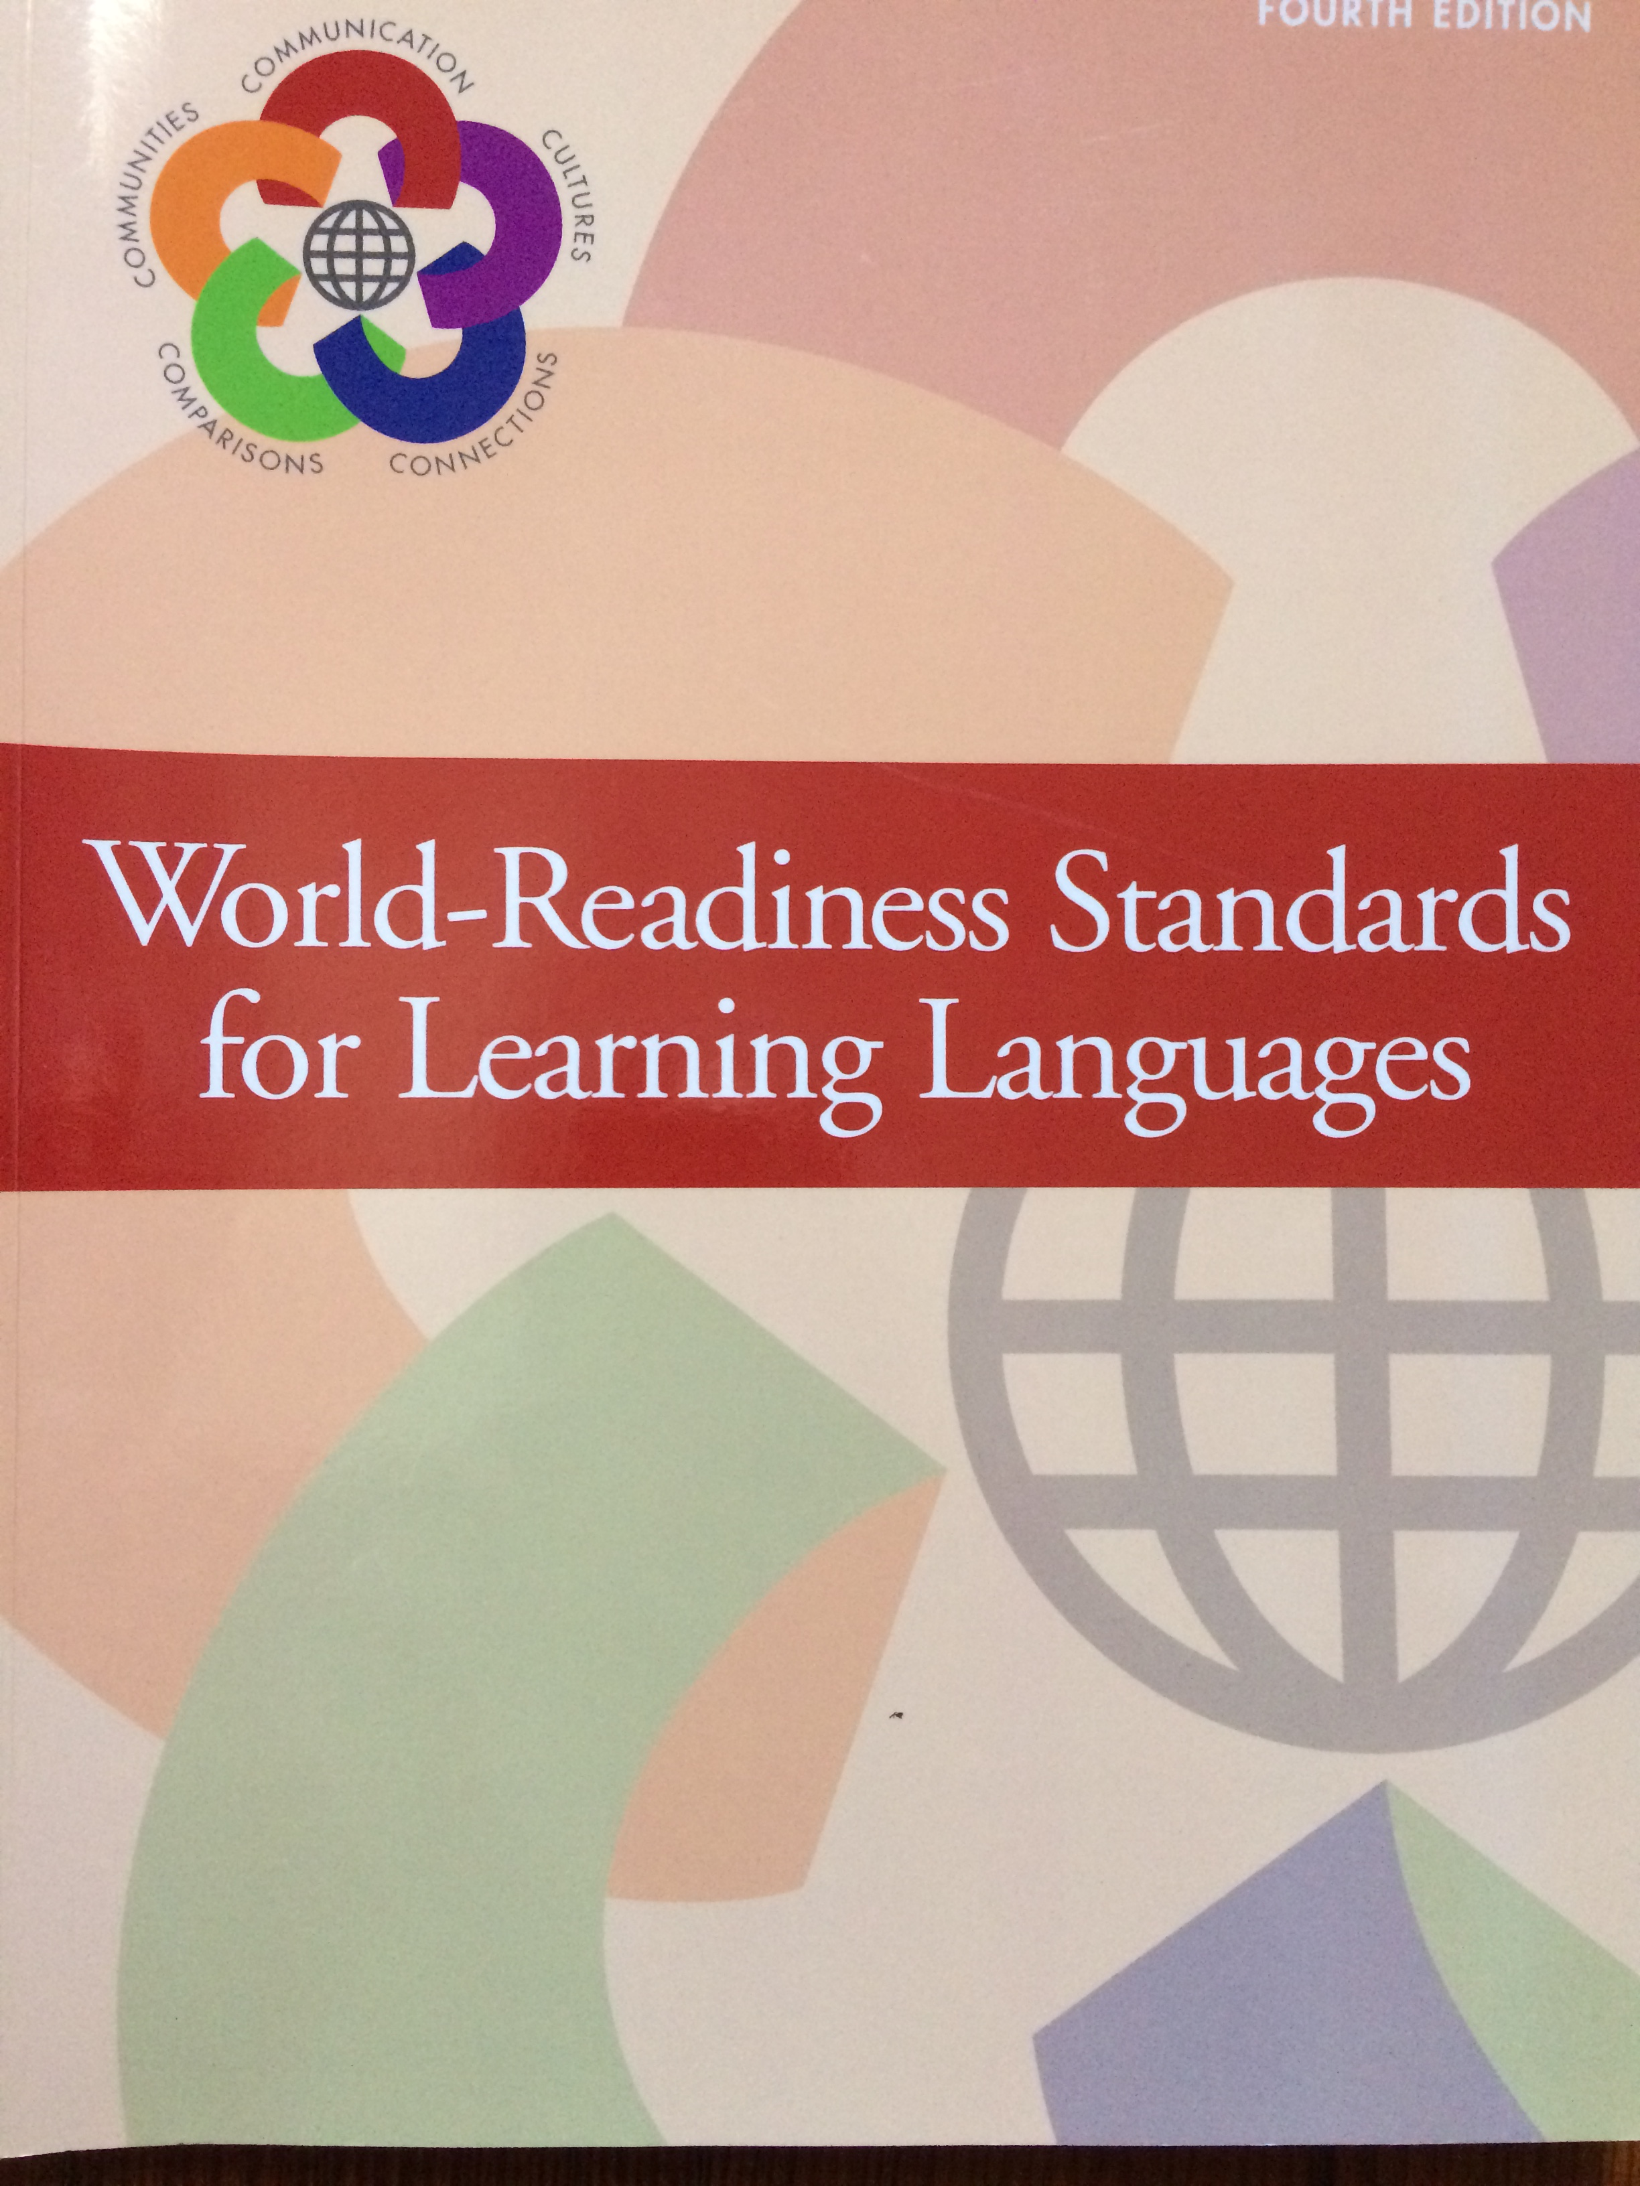
Five C’s
World-readiness standards
Communication
    Interpersonal
    Interpretive
    Presentational
Culture
Connections
Comparisons
Communities

Slide 7
communication
Assessment targets are provided for the three modes of communication:
Interpersonal
Interpretive
Presentational
All include measurement of ability to use the writing system

Slide 8
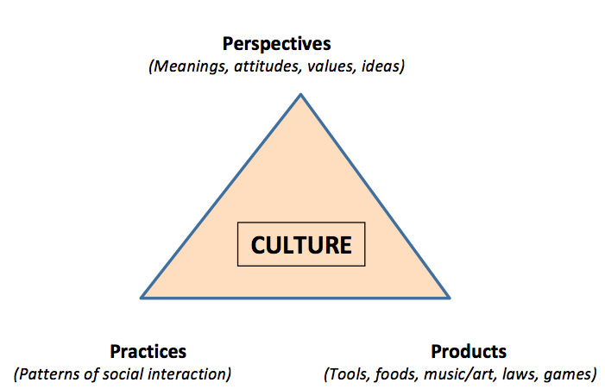
Culture
PERSPECTIVES
PRACTICES PRODUCTS
The Guide’s strong focus on culture is what sets it apart and is based on our students’ needs to:
Be aware of & act in accordance with local norms
Understand how cultural values are expressed
Compare and contrast with their home culture

Slide 9
CulturAL PRACTICES & PRODUCTS
Practice: Dress codes
Product: Clothing
 | PRACTICE Can describe some features of appropriate dress for self in formal and informal situations. Can describe characteristics of appropriate dress for men, women, and children, or other salient social categories. | PERSPECTIVE Respecting others by putting your best foot forward vs. being natural, casual, not trying to impress anyone. What is appropriate in different contexts (at home, going out, visiting, etc.) Keyed to social roles (gender and age), reflects attitudes towards the body.
 | PRODUCT Can describe pieces of clothing one might wear in different situations (school, wedding ceremony, meeting with elders, at home) in terms of cut, fabric, color, fit. | PERSPECTIVE Attitudes towards the body, gender, climate, sexuality, color, ‘standing out’ or ‘fitting in’, materials and their provenance

Slide 10

connections
Using the language to make connections to information in one’s field, to topics of interest.

Slide 11


comparisons
Encourages student to become “global citizens”
Being able to identify differences between one’s home language and culture and the target language and culture and to reflect on what these differences might mean

Slide 12
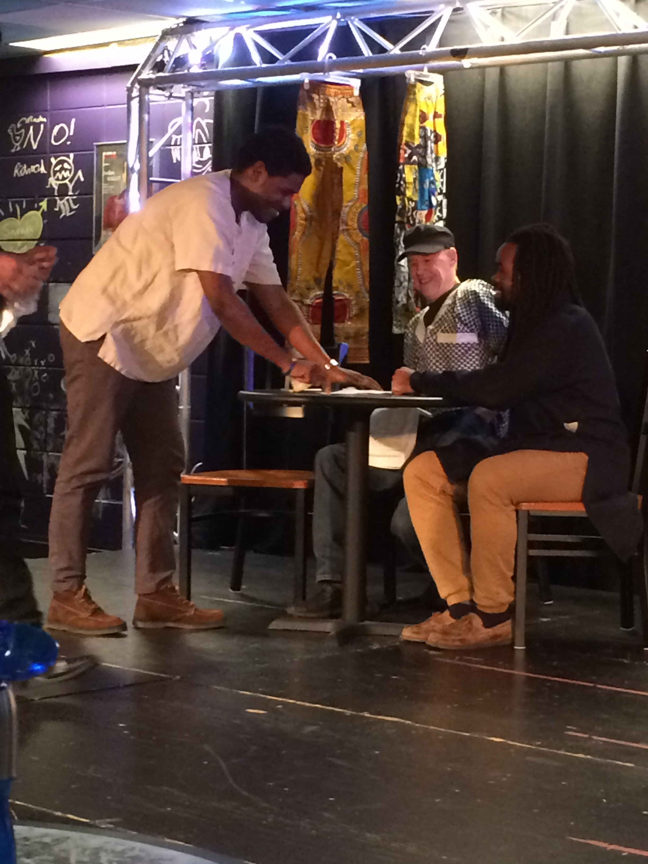
communities
Using the language as a ‘community member’
Interact with international students on campus who are members of the speech community
Connect with immigrant groups in the Boston area
Participate in African Language Theater Night

Slide 13
What we’ve learned/next steps
It’s complicated!
It’s a work-in-progress
  And a dialogue with instructors
Next steps:
  Workshop for instructors
  Presentation at professional conferences
  One-on-one work in classrooms

Slide 14
Thank you
This work is made possible through support from the US Department of Education, International and Foreign Language Education, Title VI Program, and the designation of the BU African Studies Center as a National Resource Center for Africa.
Sannu
Siyabonga
Jërejëf
Asante
Enkosi
Daalụ
አመሰግናለሁ

