Slide 1
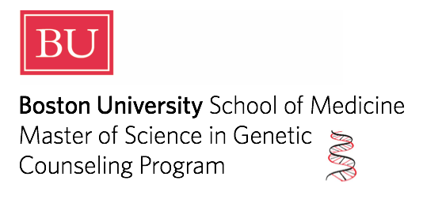
Simulation Learning Experiences in
Genetic Counseling Training
Kathleen B. Swenson, MS, MPH, CGC
Program Director, Boston University
Assistant Professor, Medical Sciences and Education
5th Annual Assessment Symposium
March 29, 2019

Slide 2


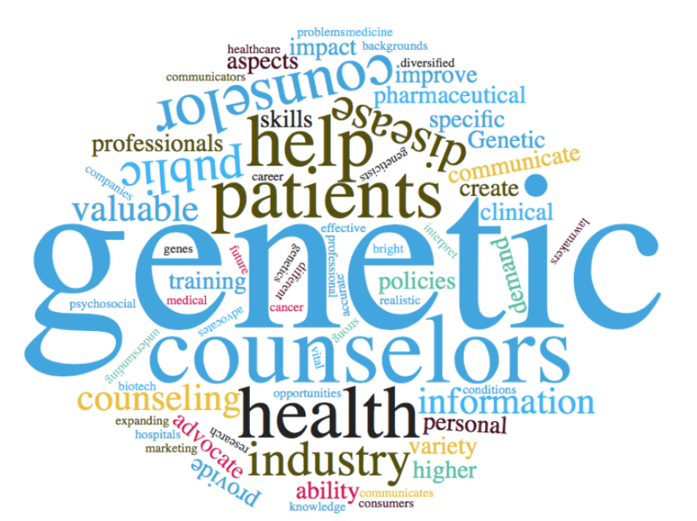

Slide 3
2 Year, Full-Time Program (48 credits)
Year 1
Professional Issues in Genetic Counseling (Year)
Clinical Applications in Human Genetics (Fall)
Embryology, Teratology, and Prenatal Genetics (Fall)
Counseling Techniques (Fall)
Genetic Diagnosis and Laboratory Methods (Spring)
Clinical Genetics (Spring)
Year 2
Advanced Genetic Counseling (Year)
Metabolic Genetics / Advanced Risk Assessment (Fall)
Cancer Genetic Counseling (Spring)
Research Methodology and/or Biostatistics elective (Fall)
Counseling, Education, and/or Public Health elective (Fall)
Advanced Topics in Medical Genetics (Spring)
Social, Cultural, and Ethical Issues in Genetics (Spring)
Genetic Counseling Seminar (Year)
Genetic Counseling Seminar (Year)

Slide 4
Field Experience
Year 1
Summer
Year 2
weekly observations on campus and throughout Boston
6 weeks full-time
prenatal, pediatric/adult, cancer, and non-clinical sites
four rotations: each one is 2 days/week for 7 weeks

Slide 5
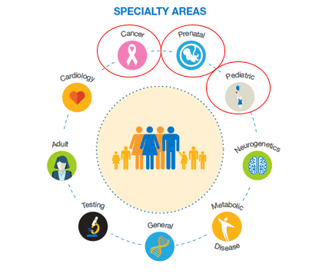

At a minimum each student will spend
14 days in a clinical rotation specific to each of these three disciplines.
https://www.nsgc.org/p/cm/ld/fid=68; accessed 3/26/19

Slide 6
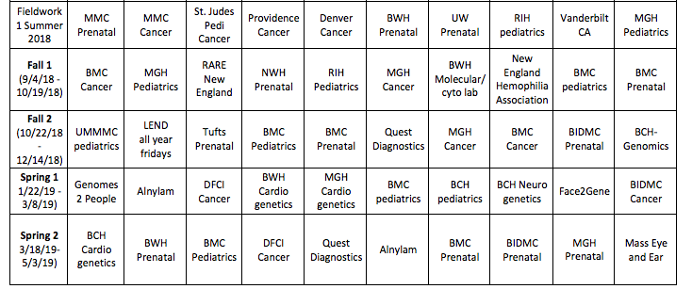

Slide 7

Goals of Patient Simulation Experience:
Reduce amount of time in observation role
  Set the students up for success with an informational pivot
Improved clinical learning experience
  Facilitate the process of entrustment by the clinical supervisor

Slide 8
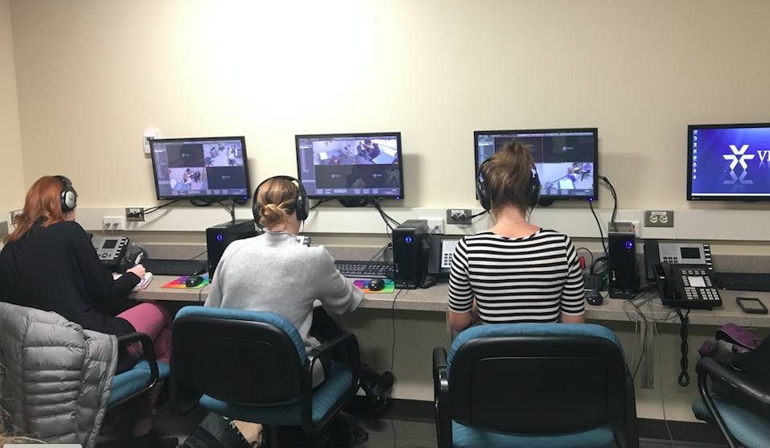
3. Opportunity for student self assessment and faculty review

Slide 9
Fall 1 (week of 9/3- week of 10/17)
Fall 2 (week of 10/22 - week of 12/17)
Spring 1 (week of 1/22 – week of 3/4)
Spring 2: (week of 3/18 – week of 5/10)

Slide 10
Student feedback: overwhelmingly positive
“This experience achieved what it was supposed to – preparing us to get ready for our next rotation setting. It was nice to have a “practice” round that felt so realistic. I really appreciated the feedback that my SP returned, including both the encouragements and the constructive criticisms.”
“I love the standardized patients and have learned a lot from them. The feedback they provide is extremely helpful and I love that they can pick up on both my strengths and weaknesses. It was an amazing experience!”

Slide 12
Future directions
Continued use of SPs and patient simulation experiences for students throughout training
  Pre-placement
  Advanced counseling skills
Incorporation of additional learning objectives
  Peer review
  Faculty review
  Student self-efficacy
  Development of entrustment in supervision

Slide 13
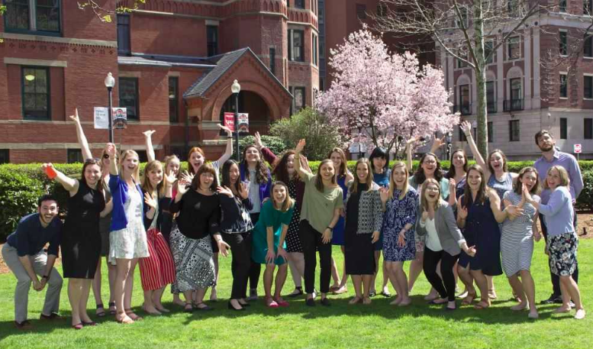
Acknowledgements:
Boston University
Lillian Sosa, MS, CGC
BUGCP Class of 2019
Ms. Patricia Ward
The UMass SP team
Contact information: kbb2010@bu.edu

