Slide 1
BU Study Abroad
Science and Engineering Program
Learning Outcomes
In Dresden, Germany

Slide 2

“The whole of life, from the moment you are born to the moment you die, is a process of learning.”
Jiddu Krishnamurti

Slide 3
Who we are....
What we did and why....
How we did it...
What lessons we learned...
What will be next...

Slide 4
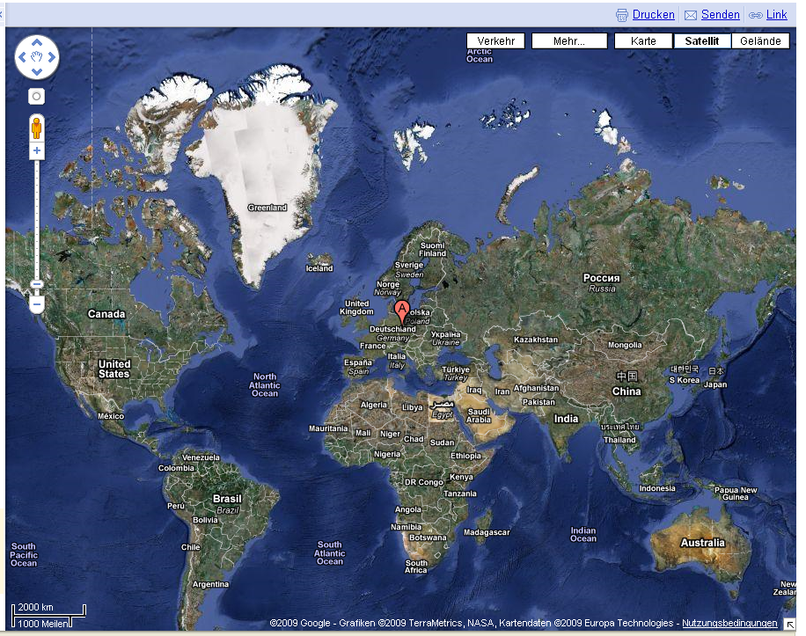
Who and where we are…

Slide 5
Boston University in Dresden, Germany
Dresden Engineering Program for 2nd semester sophomores (Spring only, BU courses on Differential Equations, Thermodynamics, Molecular Cell Biology, Modern Physics, Electric Circuits, Intercultural Communication + German)
Dresden Science Program for 1st semester sophomores (Fall only, BU courses on Organic Chemistry, Cell Biology, Statistics, Introduction to Scientific Research, Intercultural Communication + German) +
Dresden German Studies Program (Fall & Spring, direct enrollment at Technische Universität Dresden)
Internship Program (Fall & Spring)
Computer Science Program (Fall & Spring, direct enrollment at TUD – English)

Slide 6
What we did and Why
Indirect learning outcomes assessment through student surveys at the end of the program – not ideal, because:
      High degree of subjectivity
      Results were difficult to allign with program outcomes
      Low return rate

Slide 7
How we did it
Program Outcomes: a. Demonstrate basic proficiency in language skills in German: speaking, listening, writing and reading at a first-year level. b. Demonstrate a knowledge of foundational concepts and principles of Differential Equations, Molecular and Cell Biology, Waves and Modern Physics, Electric Circuit Theory and Thermodynamics; Organic Chemistry and Statistics at the second year level. c. Apply technical and/or analytical skills at the second year level. d. Gain a cross-cultural perspective on these scientific disciplines taught by German faculty. e. Acquire greater tolerance for ambiguity and a deepened awareness of cultural difference through coursework, excursions as well as extra-curricular student activities and integrational opportunities

Slide 8
BUSA Dresden Course Objectives - (ENG ME 304): Understand underlying principles of engineering thermodynamics: types of thermodynamic systems, concepts of property, process, energy, work, heat, thermodynamic temperature scale, and entropy, including reversible/irreversible process; properties of simple compressible fluids, use of "steam tables" for fluids, use of closed-form expressions for gases, including p-v-T diagrams; handling of the mass rate balance, and zeroth, first, and second laws of thermodynamics for closed and open systems. Understand and be able to analyze simple gas and vapor cycles: Carnot cycle, Rankine cycle, Brayton cycle, refrigeration/heat pump cycles, Otto and Diesel cycles. Be able to carry out experiments involving thermodynamic systems: application of 1st law to open and closed systems; calculation of the enthalpy of fusion/reaction and other thermodynamic parameters. Be able to write clear, concise, technical reports: individual reports are required for each laboratory exercise, in addition to group reports for the analysis of experimental data for a group work. Students are expected to succinctly describe the experimental system, present the measured results and compare results to the theory developed in class Be able to use computational tools: the analysis of experimental data from the lab and the group work require the use of computational programs such as Matlab or Excel. Be able to investigate and present a solution for a real simple problem: a real problem or data from a real experiment are given to the students to find different solutions from external sources in groups. The students are expected to investigate and find how to handle the different challenges, apply the subject knowledge and correctly present the results through a report and an oral presentation

Slide 9
Course Learning Objective | Below Expectation | Meets Expectation | Exceeds Expectation
1 Understand underlying principles of engineering thermodynamics: types of thermodynamic systems, concepts of property, process, energy, work, heat, thermodynamic temperature scale, and entropy, including reversible/irreversible process; properties of simple compressible fluids, use of "steam tables" for fluids, use of closed-form expressions for gases, including p-v-T diagrams; handling of the mass rate balance, and zeroth, first, and second laws of thermodynamics for closed and open systems. | Incomplete or incorrect knowledge of the underlying principles of engineering thermodynamics: especially wrong first/second law, energy, and entropy concepts as well as incorrect use or no use at all of "steam tables" for fluids, closed-form expressions for gases, including p-v-T diagrams and its application to closed and open systems. | Knowledge of the underlying principles of engineering thermodynamics: especially first/second law, energy, and entropy concepts as well as the use of "steam tables" for fluids, closed-form expressions for gases, including p-v-T diagrams is largely complete. | Complete and highly detailed knowledge of the underlying principles of engineering thermodynamics: types of thermodynamic systems, concepts of property, process, energy, work, heat, thermodynamic temperature scale, and entropy, including reversible/irreversible process; properties of simple compressible fluids, use of "steam tables" for fluids, use of closed-form expressions for gases, including p-v-T diagrams; handling of the mass rate balance, and zeroth, first, and second laws of thermodynamics for closed and open systems.
2 Understand and be able to analyze simple gas and vapor cycles: Carnot cycle, Rankine cycle, Brayton cycle, refrigeration/heat pump cycles, Otto and Diesel cycles. | The analysis of simple gas and vapor cycles lacks necessary details or is incorrect. | The analysis of simple gas and vapor cycles is sufficiently demonstrated. | The analysis of simple gas and vapor cycles is outstanding.
3 Be able to carry out experiments involving thermodynamic systems: application of 1st law to open and closed systems; calculation of the enthalpy of fusion/reaction and other thermodynamic parameters. | No ability to carry out experiments involving thermal systems. | The student can carry out experiments involving thermal systems with some additional help. | The ability to carry out experiments involving thermal systems with no help is outstanding.
4 Be able to write clear, concise, technical reports: individual reports are required for each laboratory exercise, in addition to group reports for the analysis of experimental data for a group work. Students are expected to succinctly describe the experimental system, present the measured results and compare results to the theory developed in class. | The technical reports lack fundamental details or are incorrect. Poor writing and presentation of the results. Incorrect, illogical or non-consequent conclusions. | The technical reports are sufficiently detailed. Decent writing and presentation of the results. Logical conclusions and basic understanding of the analyzed data. | The descriptions in the technical reports are outstanding. Excellent writing and presentation skills. Conclusions beyond expectations and very good reasoning behind the data analysis.
5 Be able to use computational tools: the analysis of experimental data from the lab and the group work require the use of computational programs such as Matlab or Excel. | Incomplete, incorrect use or no use of computational tools. | The use of computational tools is sufficient for a correct presentation of the requested data. | The ability to use computational tools is excellent. Use of non-mentioned software to improve the results.
6 Be able to investigate and present a solution for a real simple problem: a real problem or data from a real experiment are given to the students to find different solutions from external sources in groups. The students are expected to investigate and find how to handle the different challenges, apply the subject knowledge and correctly present the results through a report and an oral presentation | The investigated and found data is not related with the proposed case/data or no investigation was carried out. Poor collaboration with the fellow students. Lacking fundamental or necessary details during the presentation and report or they are incorrect. Questions after the presentation cannot be answered or they are fairly inaccurate. | The ability for solving unknown problems is sufficiently demonstrated: investigated and found data are representative of the proposed case. Basic teamwork abilities are shown. The details of the presentation and the report are sufficiently detailed. Questions after the presentation, regarding the shown work, are partially or fully answered. | The ability for solving unknown problems is excellent: investigated and found data are beyond the initial request. Teamwork is outstanding. The presentation and the report are very good written with exceptional details. Questions after the presentation, regarding the shown work, are fully answered with additional information/sources.
EXAMS
QUIZZES
HOMEWORK
LAB REPORTS
PRESENTATIONS

Slide 10
Engineering Program Outcomes (2017-2018) - Adapted from the ABET Student Outcomes (2017-2018) Graduates of the Boston University College of Engineering Undergraduate degree programs (Biomedical Engineering, Computer Engineering, Electrical Engineering, Mechanical Engineering) will have: (a) an ability to apply knowledge of mathematics, science, and engineering (b) an ability to design and conduct experiments, as well as to analyze and interpret data (c) an ability to design a system, component, or process to meet desired needs within realistic constraints such as economic, environmental, social, political, ethical, health and safety, manufacturability, and sustainability (d) an ability to function on multidisciplinary teams (e) an ability to identify, formulate, and solve engineering problems (f) an understanding of professional and ethical responsibility (g) an ability to communicate effectively (h) the broad education necessary to understand the impact of engineering solutions in a global, economic, environmental, and societal context (i) a recognition of the need for, and an ability to engage in life-long learning (j) a knowledge of contemporary issues (k) an ability to use the techniques, skills, and modern engineering tools necessary for engineering practice.
Course Learning Objectives (ENG ME 304) As an outcome of completing this course, students will: i. Understand underlying principles of engineering thermodynamics: properties of simple compressible fluids, use of "steam tables" for fluids, use of closed-form expressions for gasses, first and second laws of thermodynamics for closed and open systems, concept of entropy, thermodynamic temperature scale, concept of humidity. ii. Understand and be able to analyze simple gas and vapor cycles: Carnot cycle, Rankine cycle, Brayton cycle, Refrigeration cycle, Otto and Diesel cycles. iii. Be able to carry out experiments involving thermal systems: application of 1st law to open and closed systems; refrigeration system performance. iv. Be able to write clear, concise, technical reports: Individual reports are required for each laboratory exercise. Students are expected to succinctly describe the experimental system, present the measured results, and compare results to the theory developed in class. v. Be able to use computational tools: The analysis of experimental data and a selection of homework problems require the use of computational programs such as Matlab or Excel.

Slide 11
Course Learning Objectives mapped to Program Outcomes – ENG ME 304 @ BU:
Program: | a | b | c | d | e | f | g | h | i | j | k
Course: | i,ii | iii, iv | i,ii,iv | iii,iv | i,ii,iii,iv | - | iv, iv | i,ii,iv | i,ii,iv | i,ii,iv | v
Emphasis: | 5 | 3 | 3 | 2 | 5 | 1 | 3 | 2 | 2 | 2 | 3
Topics (time spent in weeks):
1. Introductory concepts and definitions (1)
2. Energy, energy transfer, work, first law of thermodynamics for open and closed
systems, zeroth law of thermodynamics (1.5)
3. Properties of pure substances, state diagrams, thermodynamic tables, ideal gas law
(1.5)
4. Control volume analysis (0.5 weeks)
5. Second Law of Thermodynamics, Carnot cycle (1.5)
6. Entropy, TdS equations, entropy balance for closed systems and control volumes (1.5)
7. Isothermal, isobaric, isometric, isentropic, and polytropic processes; thermodynamic
efficiencies (2.5)
8. Humidity (0.5)
9. Engine cycles, refrigeration cycles (2.5)
10. In-class exams and labs (1)

Slide 12
Course Learning Objectives to Mapped to Program Learning Outcomes
– ENG ME 304@ BUSA Dresden
Course: | 1 | 2 | 3 | 4 | 5 | 6
Expectations: | MET | MET | MET | MET | MET | EXCEEDED
Program: | b, c, d | b | c,d | c,d | c,d | c,e
Course: | 1,2 | 1,3,4,5,6 | 1,3,4,5 | 6
% | 100 | 100+ | 100 | 100+
Program: | b | c | d | e
Topics (time spent in weeks):
1. Introductory concepts and definitions (1)
2. Energy, energy transfer, work, first law of thermodynamics for closed systems and simple cycles, zeroth law of thermodynamics (1.1)
3. Properties of pure substances, state diagrams, thermodynamic tables, ideal gas law (1)
4. Control volume analysis: first law of thermodynamics and applications (1.2)
5. Second Law of Thermodynamics, Carnot cycle (0.8)
6. Entropy, TdS equations, entropy balance for closed systems and control volumes (0.6)
7. Isothermal, isobaric, isometric, isentropic, and polytropic processes; exergy and thermodynamic efficiencies (1.8)
8. Humidity (0)
9. Engine cycles, refrigeration cycles (3)
10. In-class exams and labs (2)

Slide 13
The Lessons Learned
Advantages | Disadvantages
of direct learning outcomes assessment
Rubrics make it easier to refer course outcomes back to the program level | Rubrics do not allow us to receive any information on how the students themselves had experienced their learning, what they had perceived as particularly challenging and what they felt had helped them along the course.

Slide 14
Perspectives
Working alongside our colleagues at BU on the revision of course evaluations to carefully craft reflective questions regarding our students´ learning process in a way, which will allow us to map their anwers to our course objectives and program learning outcomes.

Slide 15
“The whole of life, from the moment you are born to the moment you die, is a process of learning.”
Jiddu Krishnamurti

Slide 16
THANK YOU!
Silke Fimmel
Director
BUSA Dresden Programs
fimmel@bu.edu
www.bu.edu/abroad

