Slide 1
Novel Use of 3D-Printed Models in Undergraduate Medical Education for Teaching and Assessment of Endoscopic Anatomy
Ling Ling Lok MS
Alexander Valentine MS
Ann Zumwalt, PhD
James Weaver, PhD Wyss Institute
Michael Platt, MD Otolaryngology
Christopher Brook, MD Otolaryngology

Slide 2
Outline for today
Intro to sinonasal and skull base anatomy
  How we currently teach it and how it should improve
Study design
  Bumps along the way, solutions
Results
  Future and other applications
Notes:
Intro to skull-base anatomy:
what were we trying to teach?
why does this matter and how can we improve it?
Study design:
hands-on station with tutorial; test based on ability to use endoscope and apply anatomy knowledge on 3D model
Bumps along the way, solution:
Used a video in lieu of student use of endoscope
Future and other applications

Slide 3
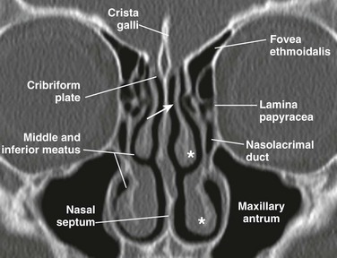
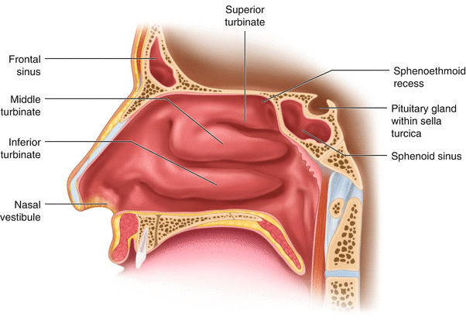
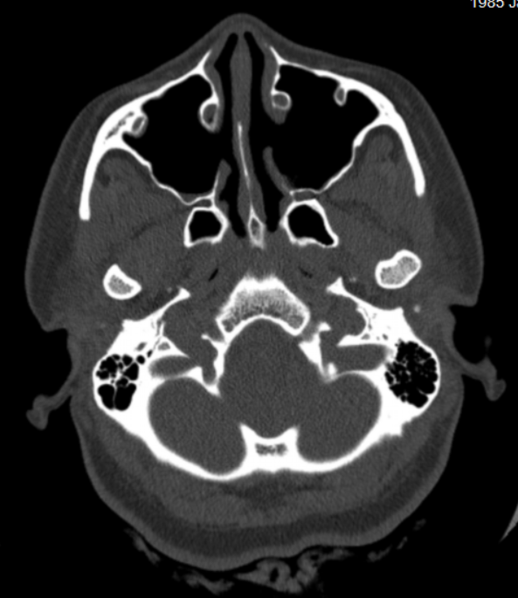
Intro to Skull-base Anatomy
https://radiologykey.com/nose-and-sinonasal-cavities/
https://link.springer.com/chapter/10.1007/978-3-319-33323-6_1
Courtesy of Michael Platt, MD
Notes:
What is it and why is it so hard to learn?
Sinonasal and skull-base anatomy is notoriously complex and may be difficult to conceptually grasp. The head is made of structures and cavities that are 3 dimensionally complex and not accurately conveyed through 2D images. These images all convey the same structure from different angles. Imagine trying to put these 3 images of the head together as a first year medical student.

Slide 4
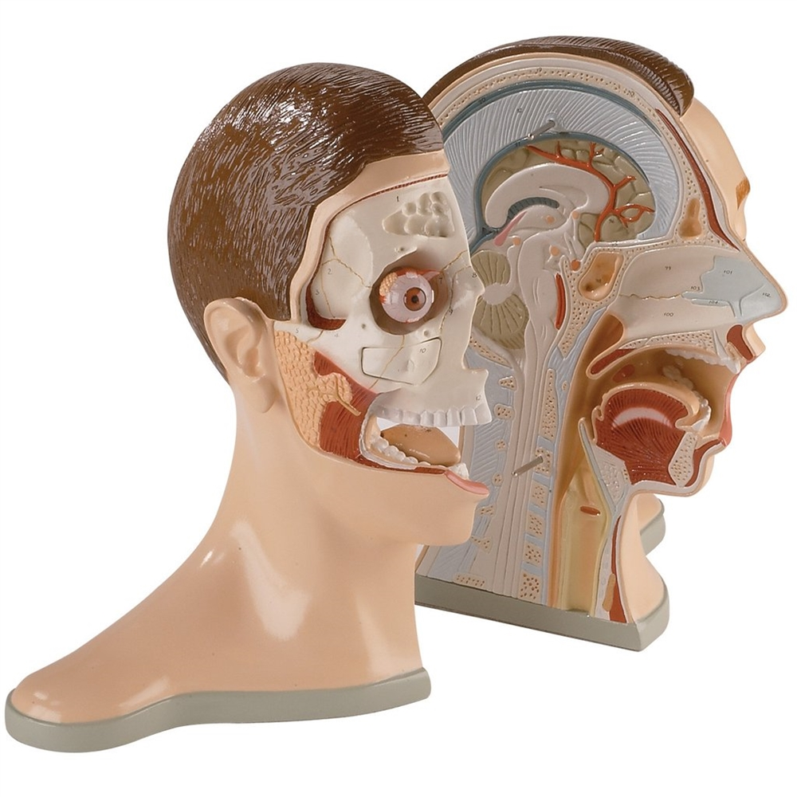
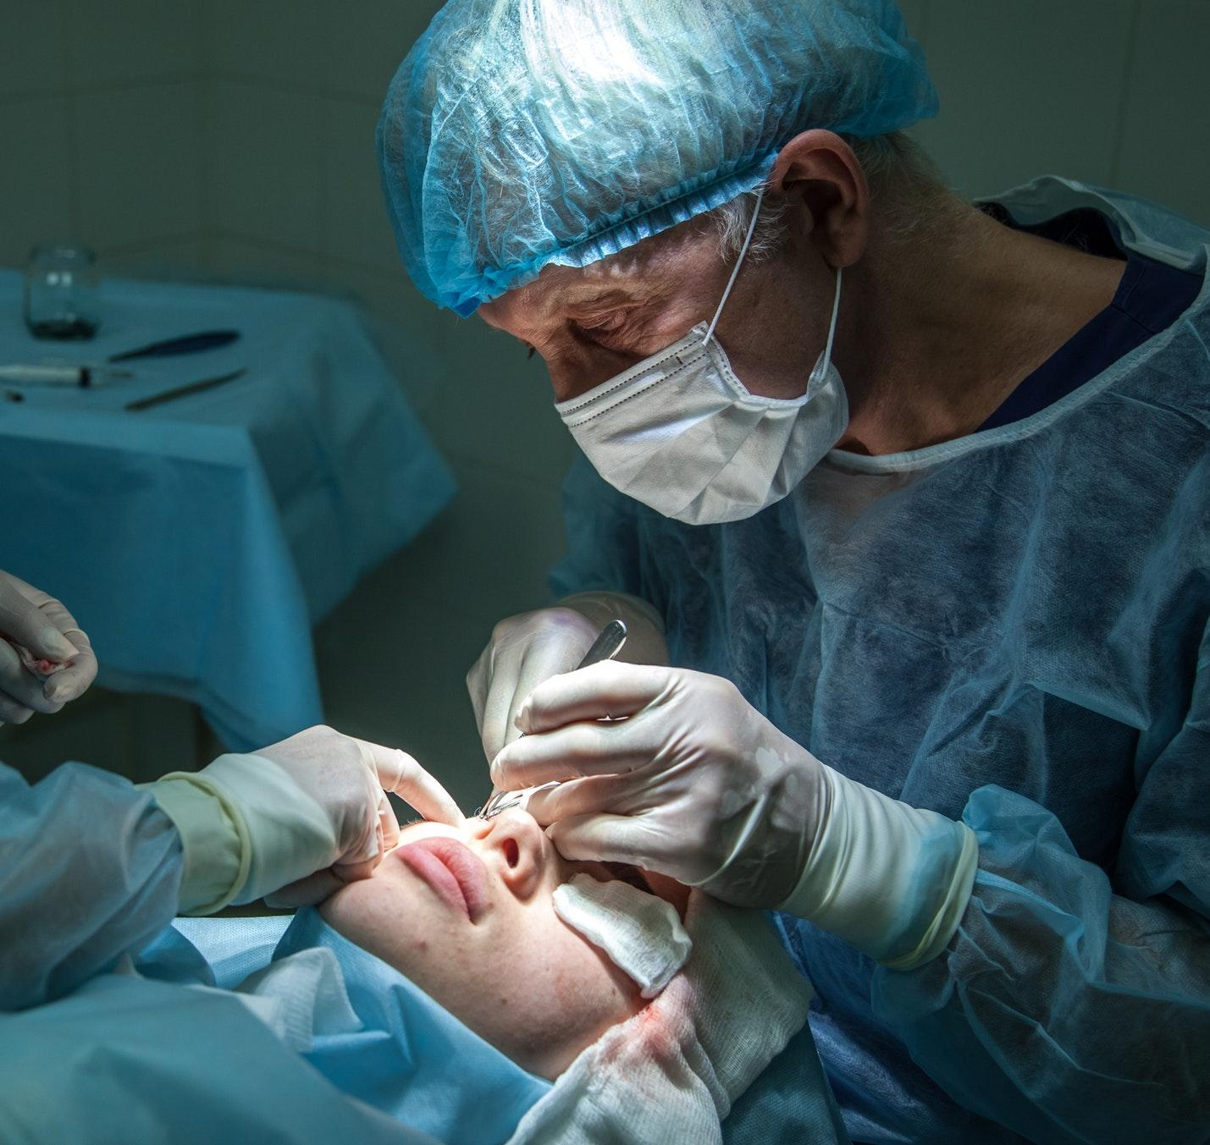
Intro to Skull-base Anatomy
www.gtsimulators.com/Five-Part-Bisected-Head-Life-Size-p/dga76.htm
Unsplash.com
Notes:
Not only is it complex, but it is difficult to access. Currently, medical students learn anatomy on cadavers, and the head is studied by first bisecting it as shown in the left image. Obviously, this is not something you’d see in clinic and very hopefully not in surgery.
Unfortunately, this also means that students often aren’t exposed to the clinical view of sinonasal anatomy until their 3rd or 4th year of medical school, likely when they start to see patients. This means they’ll be attempting challenging techniques and knowledge application for the first time on live patients while trying to reconcile limited anatomic knowledge. For this reason as well as others, medical school and surgical residency have notoriously steep learning curves. We hope to ameliorate this challenge by providing earlier opportunities to apply content-based knowledge in physical ways, such as by exploring anatomy using an endoscope on a 3D model in a way that mimics how anatomy.

Slide 5
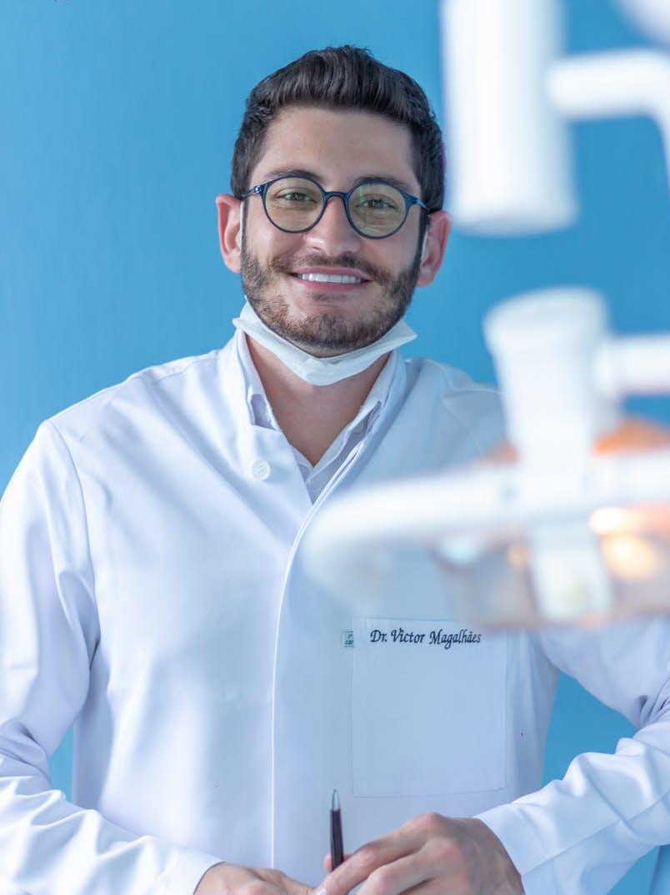
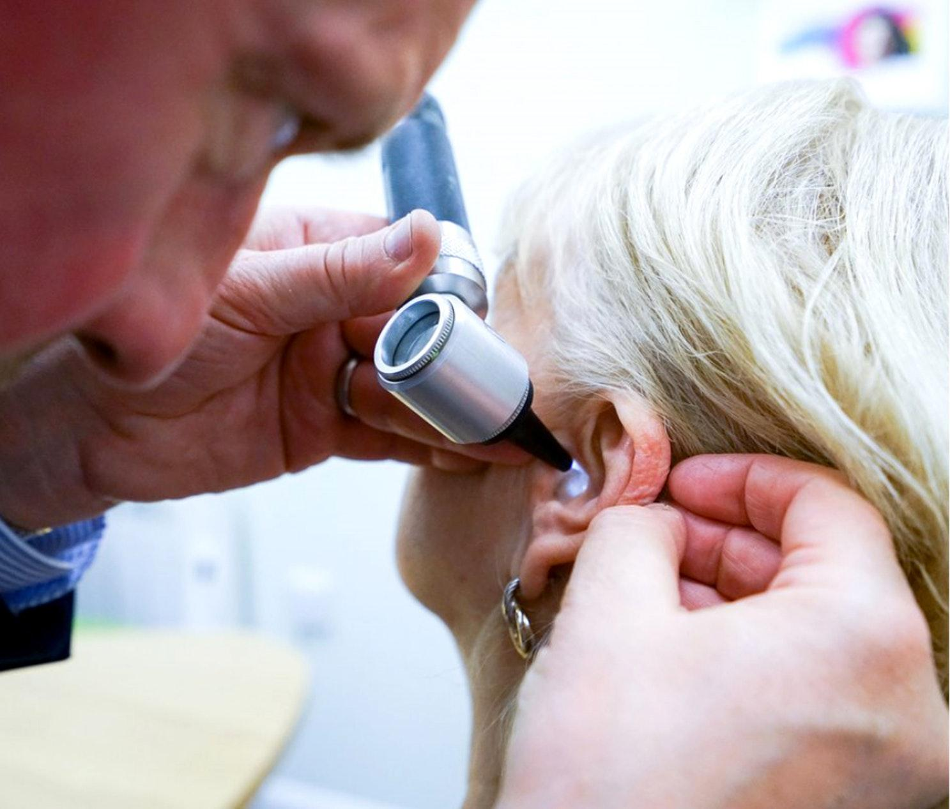
Intro to Skull-base Anatomy
… OH YES!
Here you look,
do you see the incus?
unsplash.com
https://www.pexels.com/photo/man-wearing-white-long-sleeved-shirt-1323864/
Notes:
Another issue with teaching is that there is often some disconnect between what the attending thinks they are teaching and what the student is learning. The student does not know what they are looking at but also does not want to appear to be incompetent, so the answer is always an enthusiastic “Yes!” So once we give someone practice in using an endoscope, and how do we know when they’re ready?
To address this problem, this project was designed to not only teach sinonasal and skull-base anatomy in a hands on manner but also assess the student’s preparedness for hospital experiences by allowing them to demonstrate their capacity in using a clinical tool to look for pathology and communicate their findings.

Slide 6
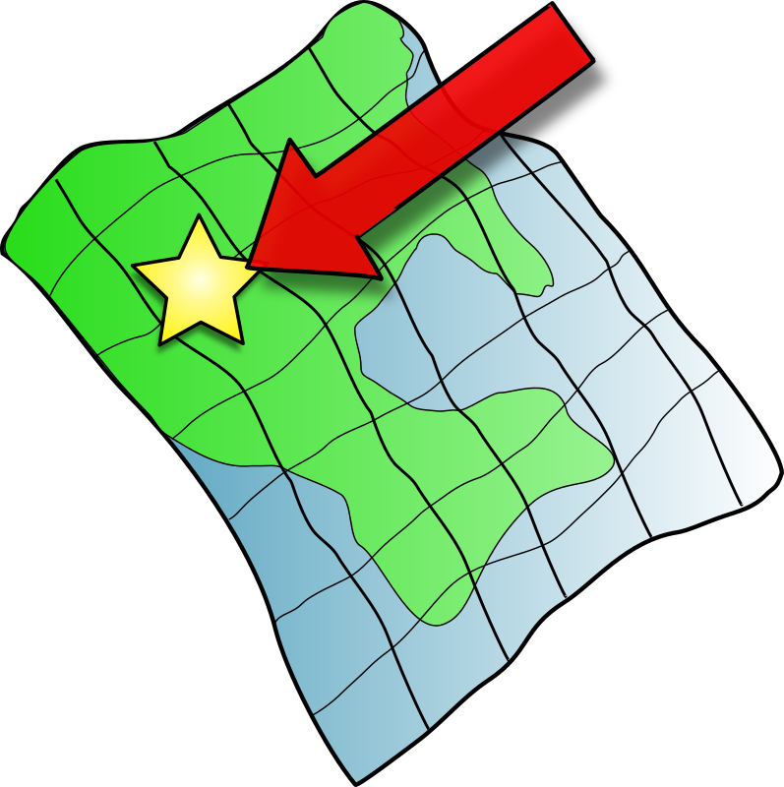

Intro to Skull-base Anatomy
Notes:
This also requires us to frame the questions to reflect clinical settings. Currently, anatomy exams test knowledge by labeling a structure and asking the student to name it or describe its function. This is a more passive approach to teaching someone to find a clinical diagnosis. (If this structure is faulty, what happens?) By asking a student to go in with the problem first (as in a clinical setting), they have to know what they’re looking for ahead of time.

Slide 7
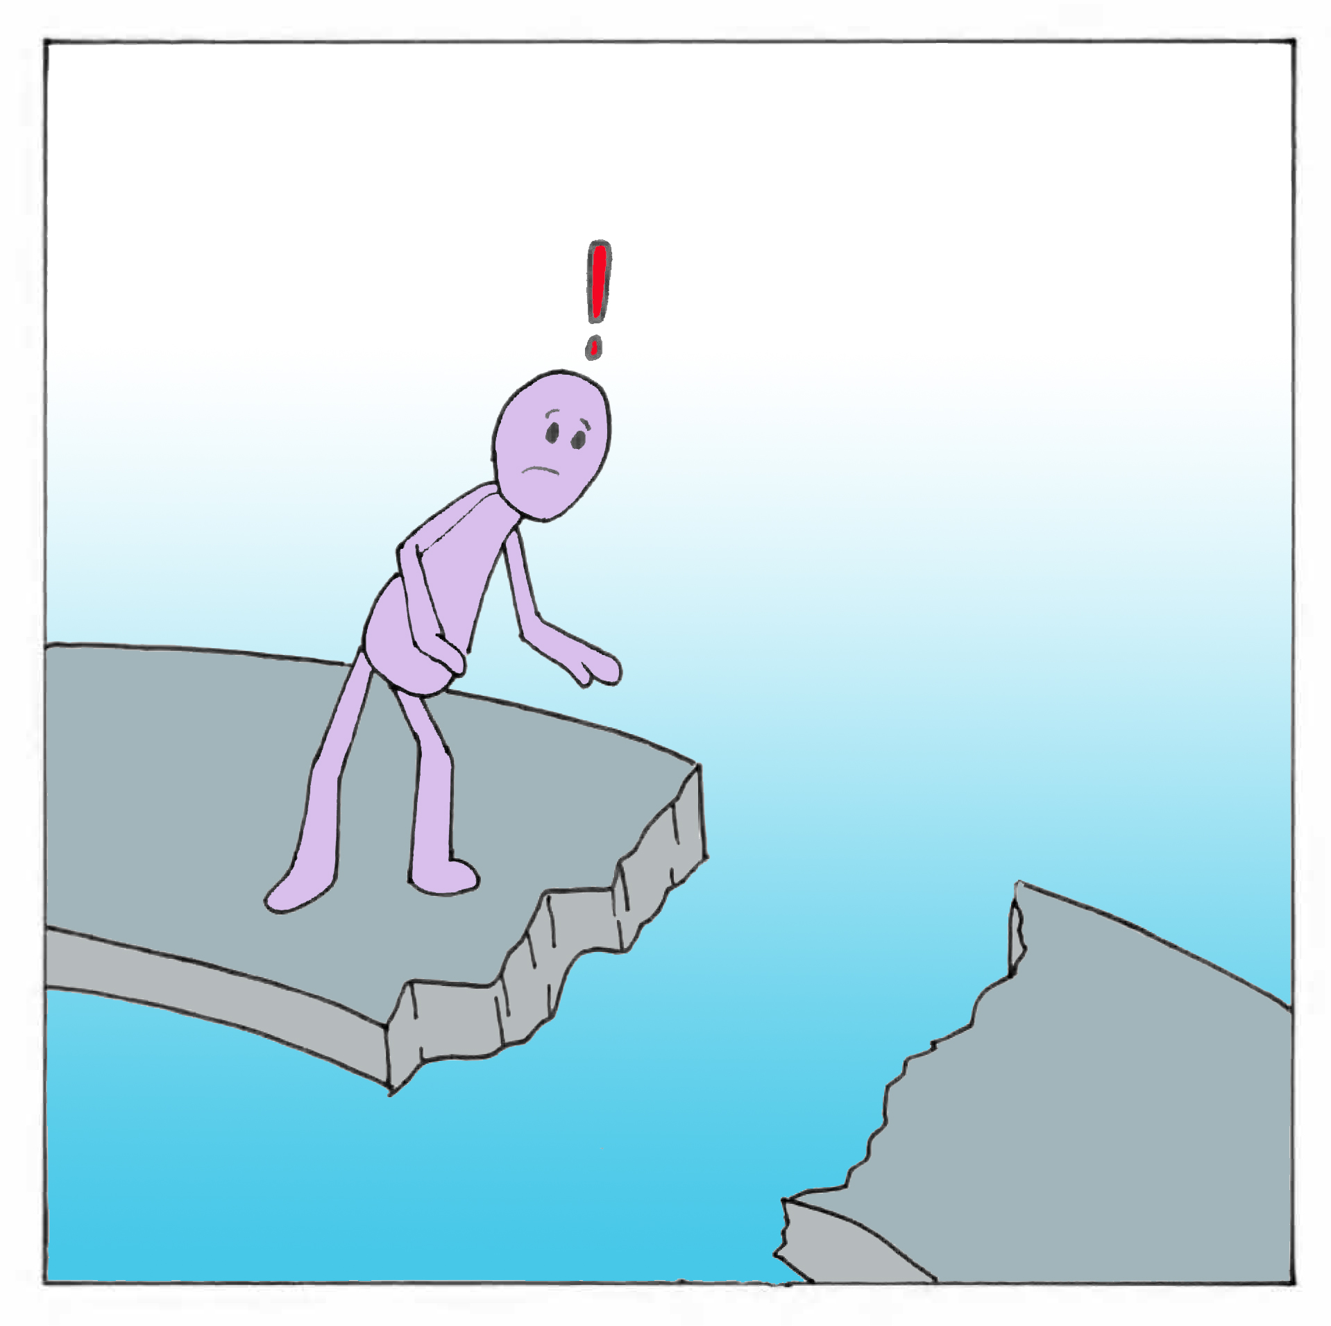
Summary so far:
Problem:
Sinonasal anatomy is complex and taught using 2D images
Sinonasal anatomy is presented in ways that do not prepare students for clinic
How do we assess the students’ anatomical knowledge as well as proficiency in using an endoscope?

Slide 8
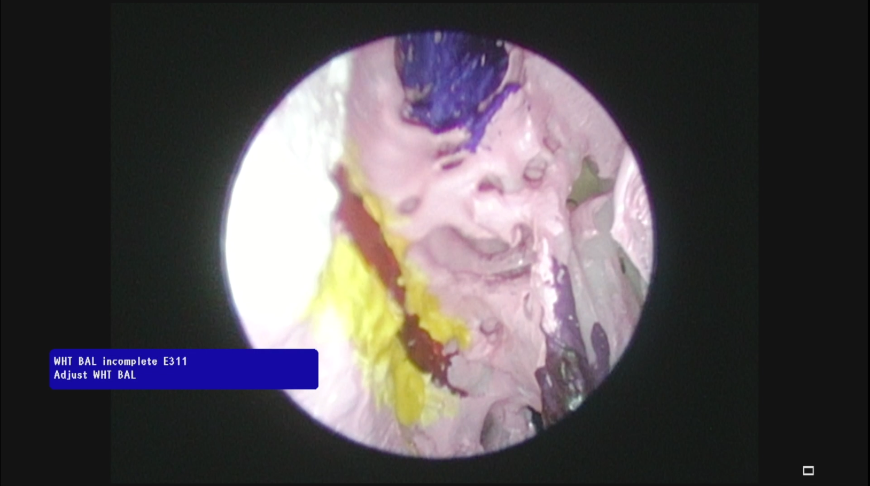
Study design
Where would the medial rectus muscle be found?
Student answer
Notes:
Then, our student’s response is recorded as an image file.

Slide 9
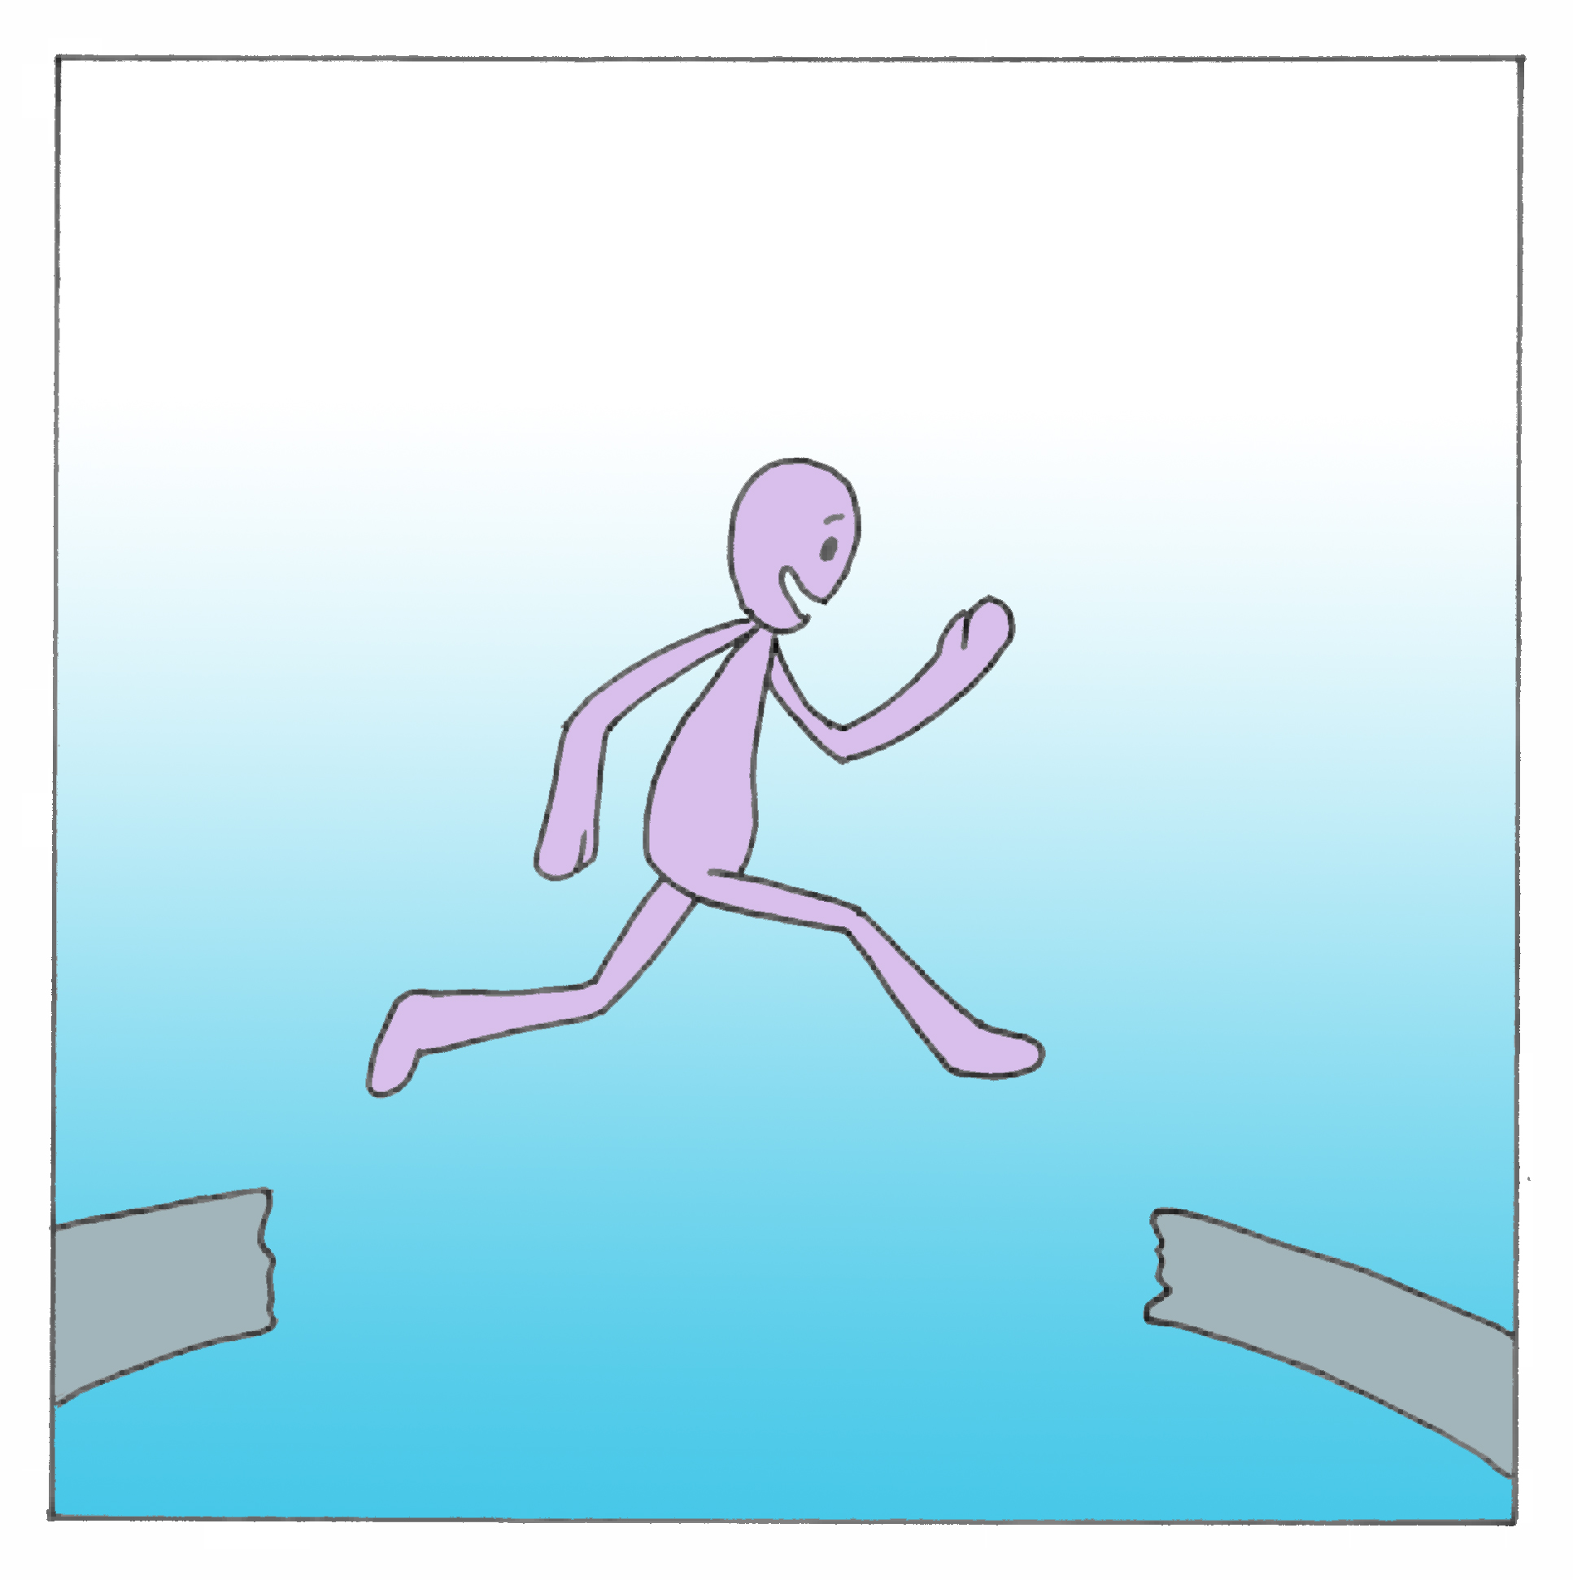
Summary so far:
Problem:
Sinonasal anatomy is complex and taught using 2D images
Sinonasal anatomy is presented in ways that do not prepare students for clinic
How do we assess the students’ anatomical knowledge as well as proficiency in using an endoscope?
Proposed Solution:
Teach anatomy using a 3D model that has labeled features
Introduce clinical tools early in medical curriculum to ameliorate the steep learning curve
Use a camera attachment to allow students to take a picture of the anatomy as an answer to the test question

Slide 10
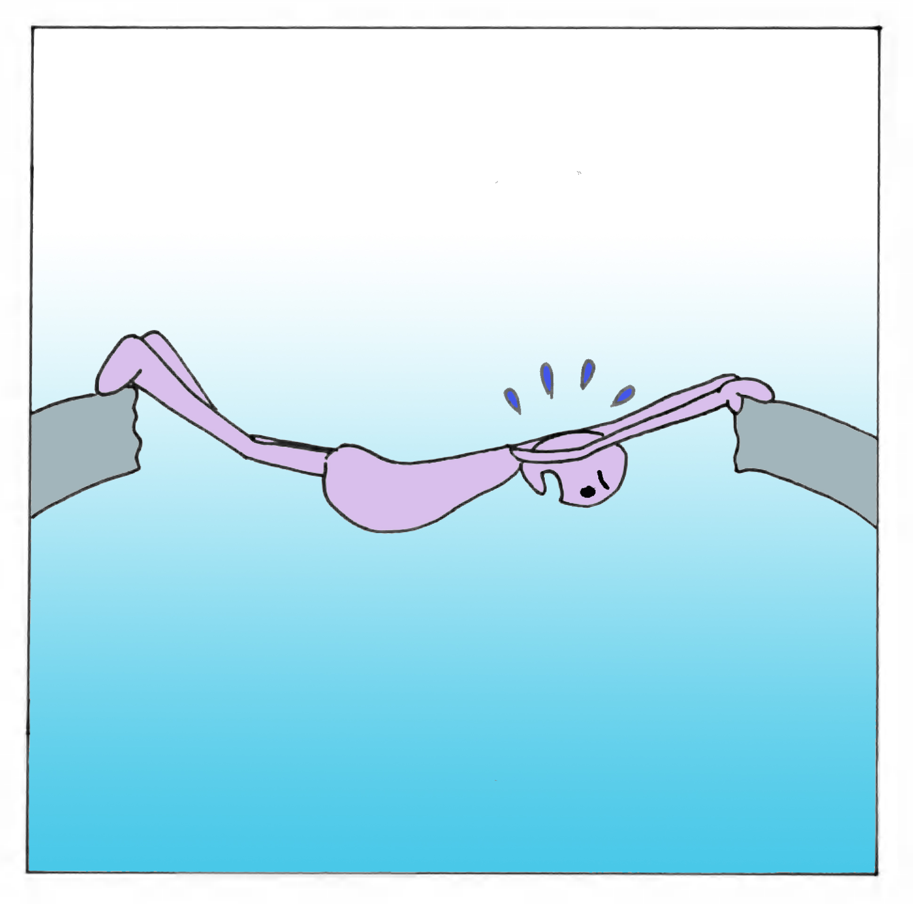
Bumps along the way
Notes:
Due to financial constraints, we were only able to acquire one scope when two were needed to accommodate the testing environment.

Slide 11
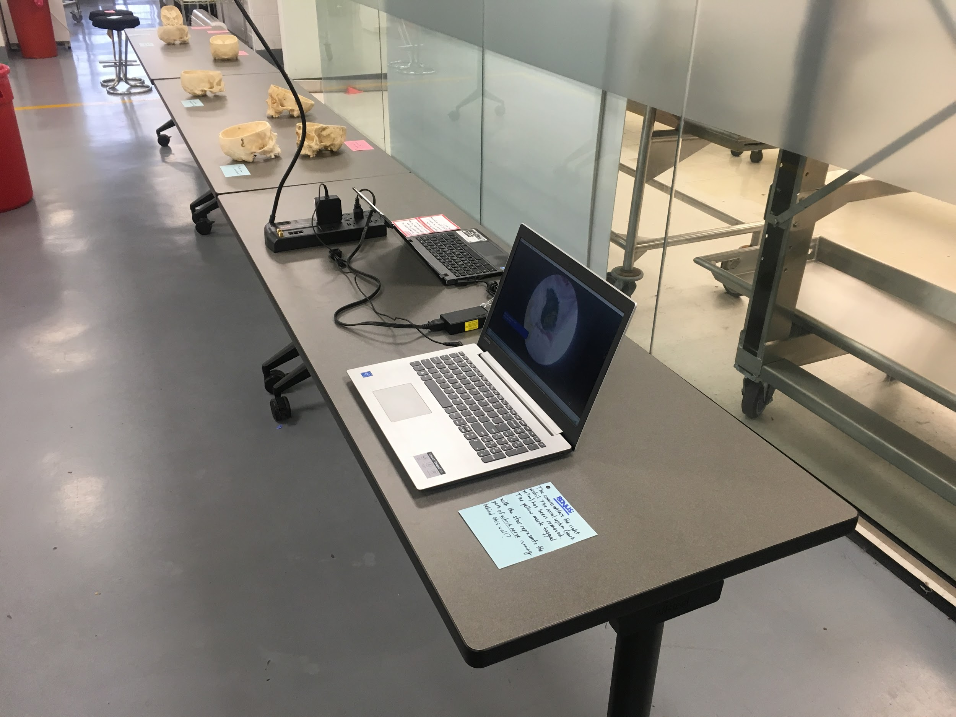
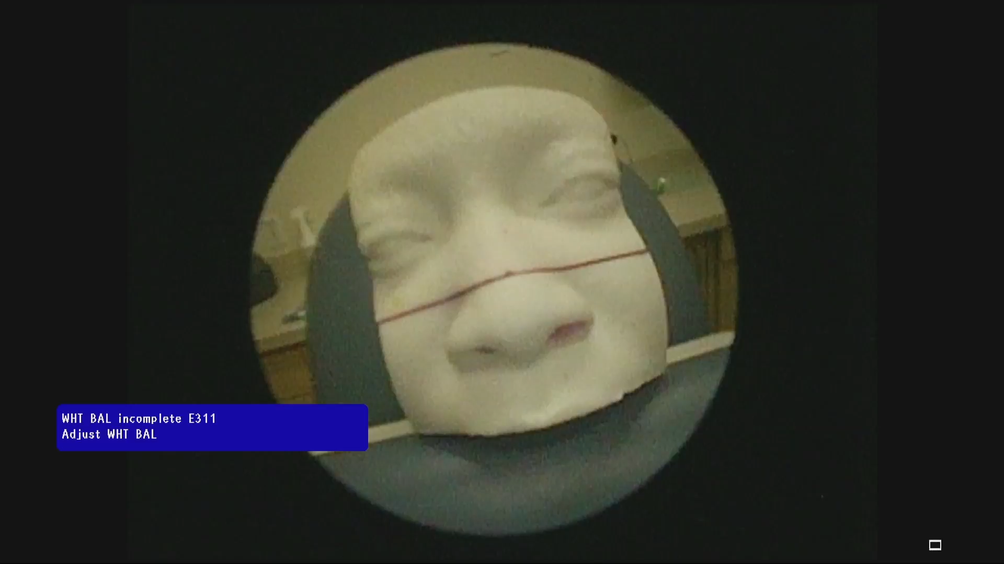
Bumps along the way
Notes:
We used a video in lieu of student use of endoscope in which students were asked to name the labeled structure.

Slide 12
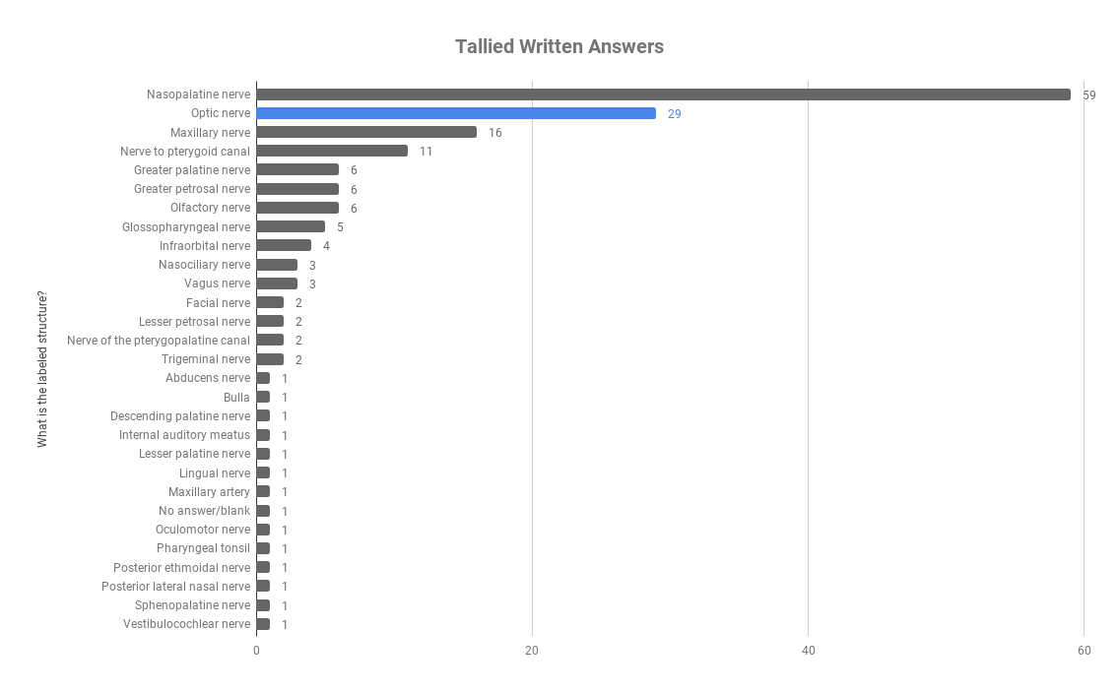
Results - exam
Answers were tallied from 170 students
-17% of students chose correctly
Notes:
In future years we would hope to increase that percentage; this year it was used as a bonus. With students more comfortable with using and with a more integration into the curriculum, we could make it a regular part of examinations.
It would also help to regularly send out teaching videos to help students practice seeing the anatomy in such a manner.

Slide 13
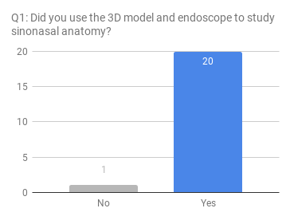
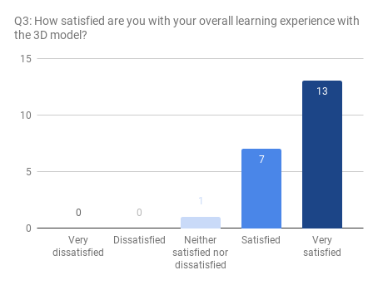
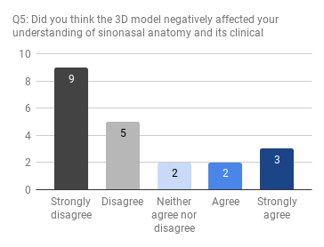
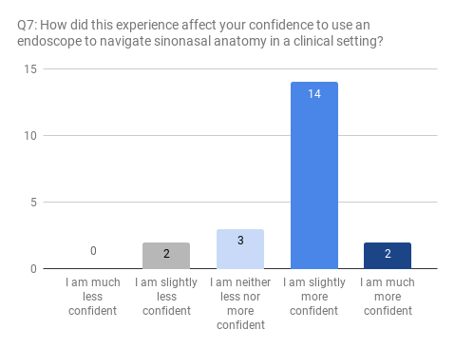
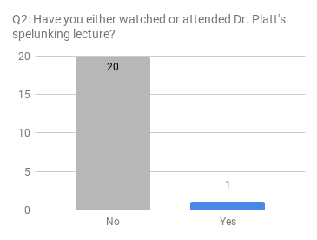
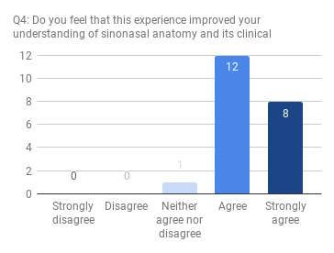
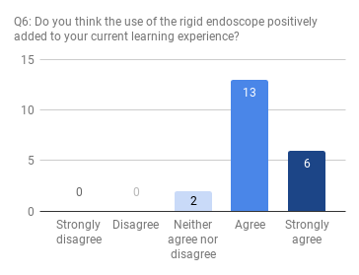
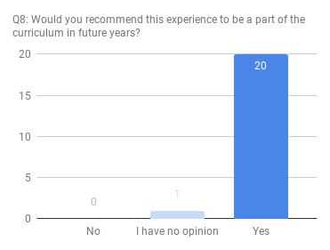
Results - survey
Notes:
A brief look into our survey results suggest that the students benefited from this change in perspective and that they enjoyed learning from the model. Survey questions ranged from asking if they thought it positively impacted or negatively impacted their learning, and if they had watched the corresponding lecture beforehand. In future years, we hope to see a difference before and after watching the corresponding lecture.

Slide 14
Results - survey
Notes:
A brief look into our survey results suggest that the students benefited from this change in perspective and that they enjoyed learning from the model. Survey questions ranged from asking if they thought it positively impacted or negatively impacted their learning, and if they had watched the corresponding lecture beforehand. In future years, we hope to see a difference before and after watching the corresponding lecture.

Slide 15
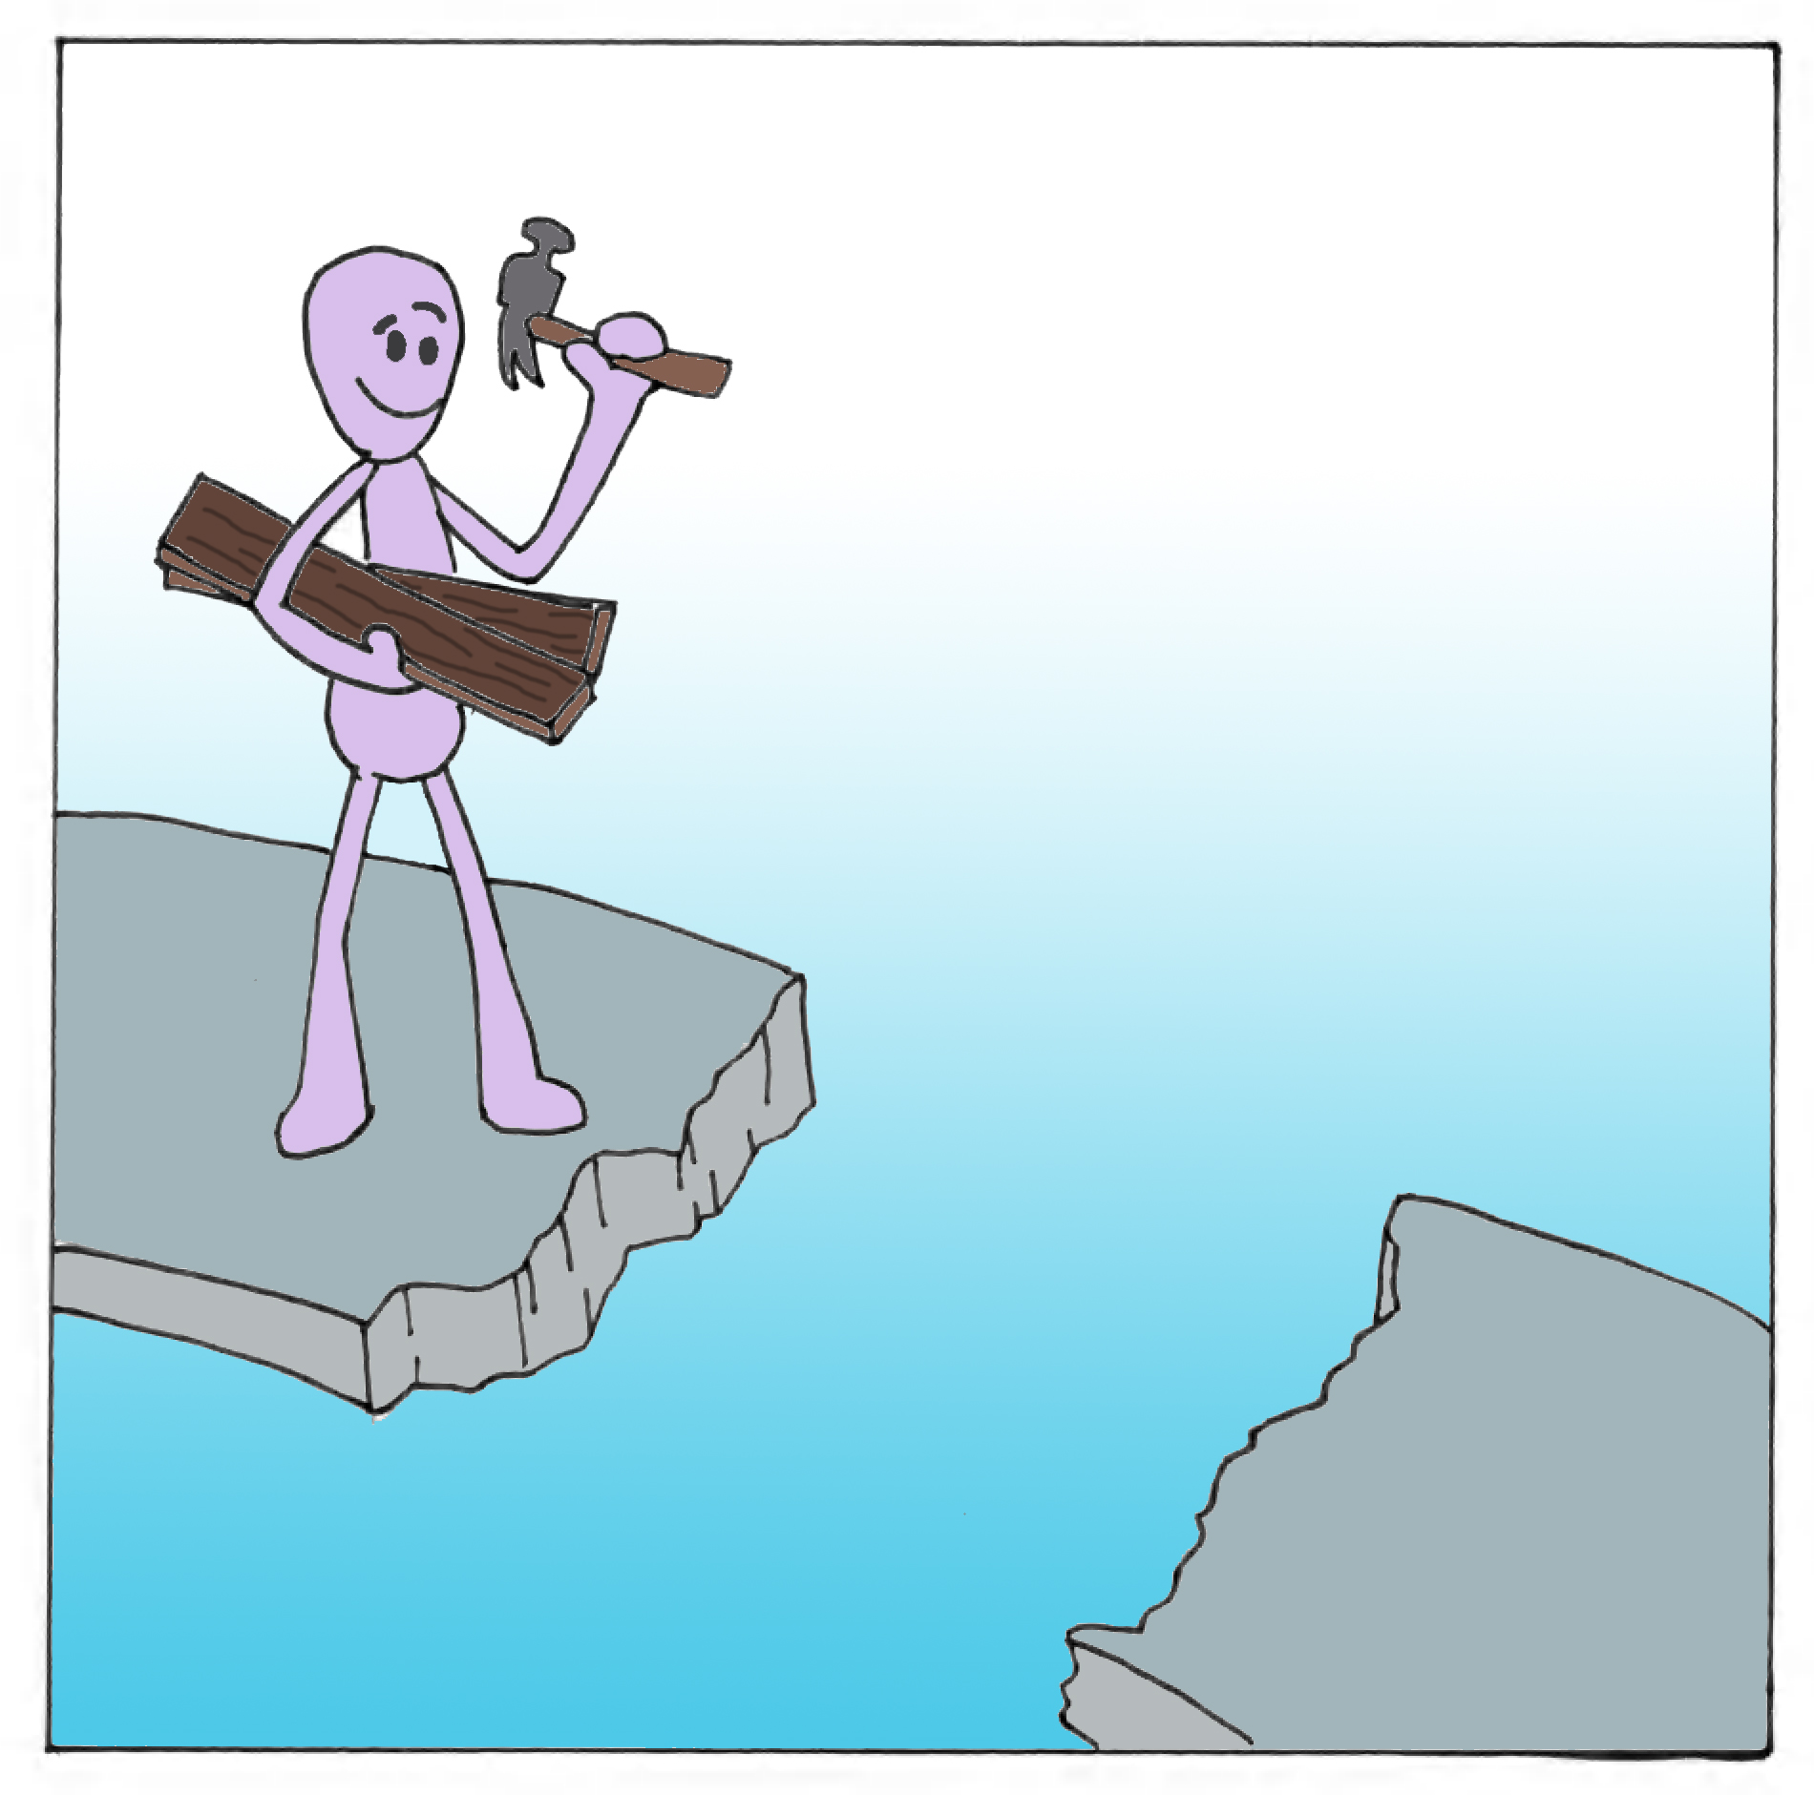
Future
Use the endoscope and camera more fully for teaching and testing – limited by availability/resources
Test students by asking them to take pictures as their answer, as originally intended
Broaden use to fourth year medical students and residents
Notes:
Use the endoscope and camera more fully for teaching and testing – limited by availability/resources
Focus on teaching physical manipulation of endoscope
Test students by asking them to take pictures as their answer, as originally intended
Broaden use to fourth year medical students and residents
Adapt for use in the simulation lab
Assess capabilities of future residency applicants

Slide 16


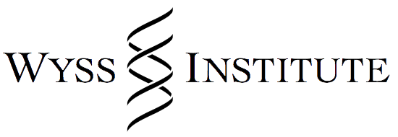

Acknowledgements
BU’s Office of the Provost
Dr. Gregory Grillone, BMC Department of Otolaryngology
Dr. Ann Zumwalt, BUSM Anatomy and Neurobiology
Robert Bouchie, BUSM Anatomy and Neurobiology
Dr. James Weaver, Wyss Institute
BU EPIC
Notes:
BU’s Office of the Provost for the Assessment Mini Grant
Dr. Zumwalt, BUSM for collaborating with us on this new curriculum
James Weaver, Wyss Institute for helping us create our 3D printed model
BU EPIC

