Slide 1
Assessing Translation of Critical Pre-Requisite Concepts through the Undergraduate Curriculum in Chemistry
Monday, July 2nd, 2018
Binyomin Abrams
Master Lecturer, Department of Chemistry
abramsb@bu.edu
BU’s 5th Annual Assessment Symposium

Slide 2
Five-course sequence(s) for non-majors
General Chemistry is the first-year sequence of courses for students in:
  Chemistry, Biochemistry
  Biology, Marine Science, Neuroscience, Biomedical Engineering
  Pre-health students
Non-majors with a pre-health focus will take five (5) semesters of chemistry:
  General Chemistry (2 semesters, freshmen year)
  Organic Chemistry (2 semesters, sophomore year)
  Biochemistry (1 or 2 semesters, junior year)

Slide 3
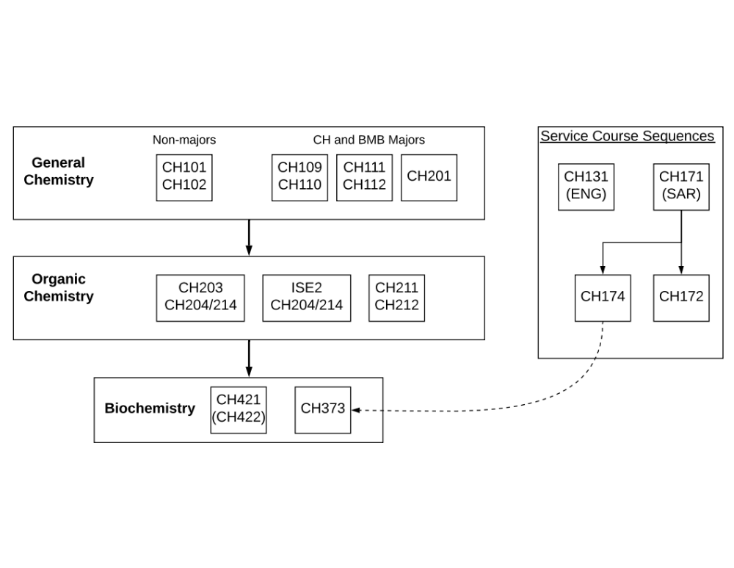
Five-course sequence(s) for non-majors

Slide 4
Motivation for this project
Faculty (and students) in organic chemistry and biochemistry report students struggle with pre-requisite general chemistry (GC) concepts
Remediation / review of fundamental concepts:
  Out-of-class workshops (increased contact hours, faculty effort)
  Assignments and pre-tests (increased student anxiety, inconsistent)
  In-class review (consumes valuable class time from new material)

Slide 5
Underlying questions we seek to answer
What are the necessary concepts that students moving from GC through organic chemistry and biochemistry must master to be prepared?
Do students completing GC courses demonstrate mastery of these necessary skills?
If the students are proficient in these concepts at the end of GC, what is the underlying cause of the struggle in upper-level courses?
If it is due to attrition of knowledge, at what point is that occurring?

Slide 6
Multi-phase assessment plan overview
Phase 1: develop and validate concept inventory (AY 2018/2019)
Phase 2: baseline pre-/post- data collection
Phase 3: yearly assessment of cohort as they pass through the sequence
Collected and analyzed existing concept inventories in chemistry
  Very few chemistry-focused concept inventories (compared to physics)
  Overly-specialized on specific concepts
  No concept inventory for collection of transferable skills

Slide 7
Phase 1: develop and validate concept inventory
Interviewed faculty to determine their perception of necessary pre-requisite skills for success in upper-division (organic, biochemistry) courses
Collected and authored questions based on faculty interviews
Returned to interviewed faculty for feedback on questions (Face validity)
Asked general chemistry faculty to assess correctness of the test (Content validity)
Preliminary field test with previous students:
  Sophomores and juniors (volunteers, N = 60)
  Two distinct cohorts (CH101, CH109/111) to suggest concurrent validity

Slide 8
The Chemistry Skills Concept Inventory (name?)
Length = 25 questions
Duration = 23 ± 15 minutes
Concept areas assessed:
  Bonding (Lewis structures, MO theory), hybridization, and resonance
  Spectroscopy and Beer’s Law
  Acid-base chemistry
  Equilibrium and chemical kinetics
  Intermolecular forces and composition of condensed phases
  Stoichiometry, mass/moles relationship

Slide 9
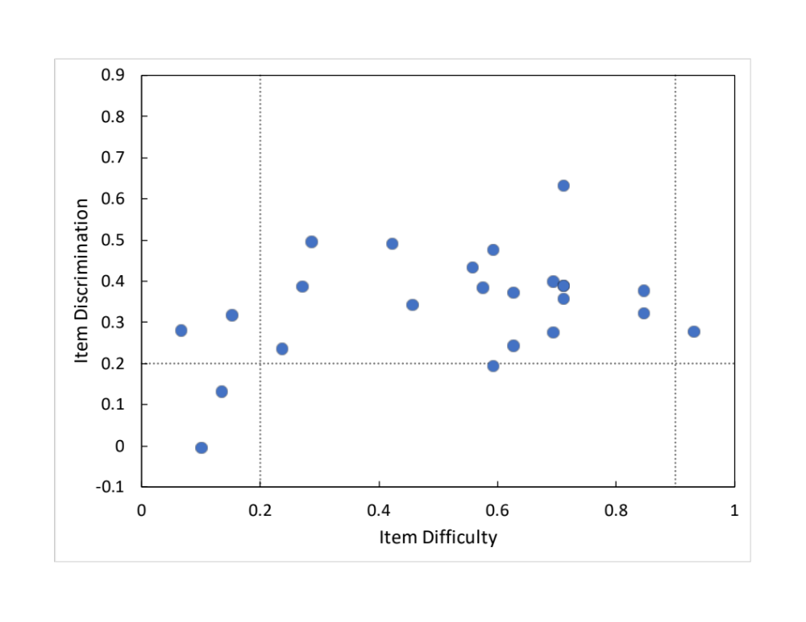
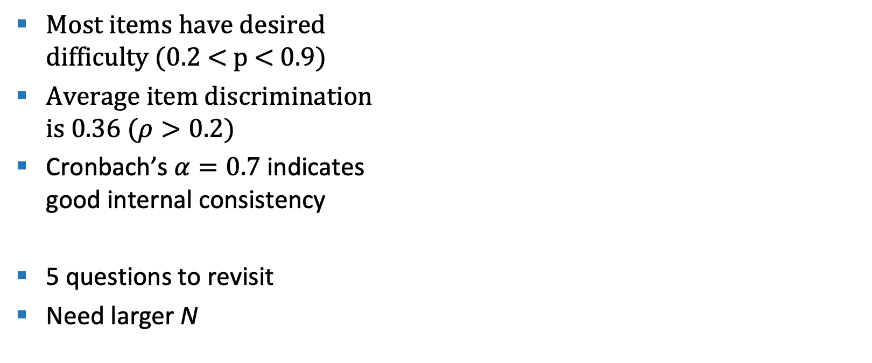
Preliminary assessment of the concept inventory
Most items have desired
difficulty (0.2 < p < 0.9)
Average item discrimination
is 0.36 ($ρ>0.2)$
Cronbach’s $α=0.7$ indicates
good internal consistency
5 questions to revisit
Need larger N

Slide 10
Next steps
Complete Phase 1:
Interviews with students to get feedback on problematic questions
Work with LASSO to deploy the concept inventory for large data collection
Deploy at conclusion of Spring 2019 in CH102, CH110, and CH112
Complete validation with data collected in Spring 2019
Phase 2 (AY 2019/2020):
Collect pre-semester data for incoming students in CH101, CH109, CH111
Study gains during the 2019/2020 AY (post-test at end of spring 2020)
(Follow students over next four years, repeat CI entering into organic and
biochemistry)

Slide 11
Acknowledgments
Anna Manevich (Research student)
Julia Jesielowski (CH Undergraduate Coordinator)
John Snyder (DUS, Chemistry)
Faculty consulted: Deborah Perlstein, John Staub,
Didem Vardar Ulu, Karen Allen,
Rebecca Loy, John Snyder

