Slide 1

Climate Survey for PhD Program in Mechanical Engineering
Elise Morgan
Professor and Associate Chair for Graduate Research Programs
March 16, 2018

Slide 2
Ph.D. Climate Survey
Creation
  Draft was created by drawing from existing surveys at other institutions and from the Provost’s exit survey
  Revisions by an external consultant (JaggerMoon Consulting)
  Revisions by the department’s Ph.D. Program Committee
Format: 2 separate surveys in SurveyMonkey
  I. Ph.D. program
  II. Advisor-advisee relationship
Administration
  Late October 2017
  Invitations—and several reminders—sent to all 76 Ph.D. students in ME
Response rate: 52 (68%) to Survey I; 43 (57%) to Survey II

Slide 3
Survey I: Program

Slide 4
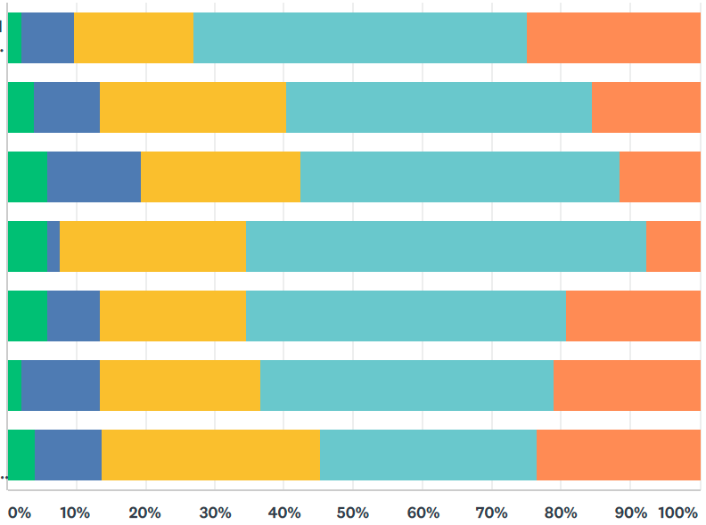
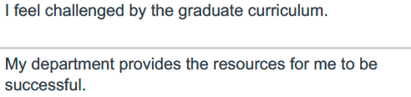
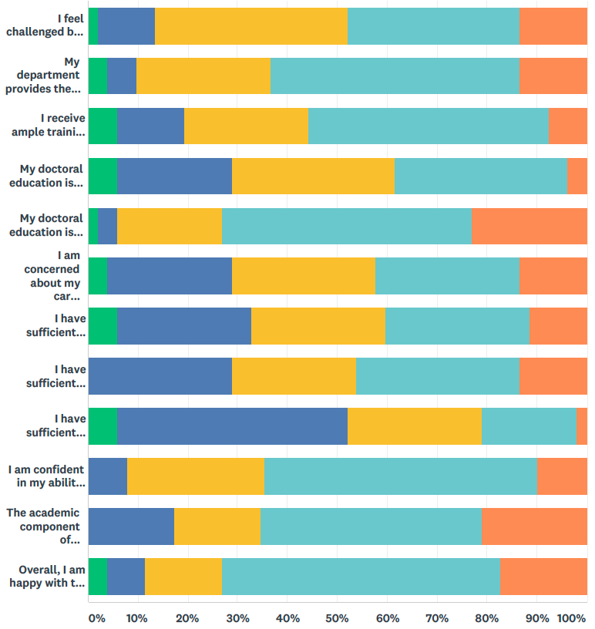
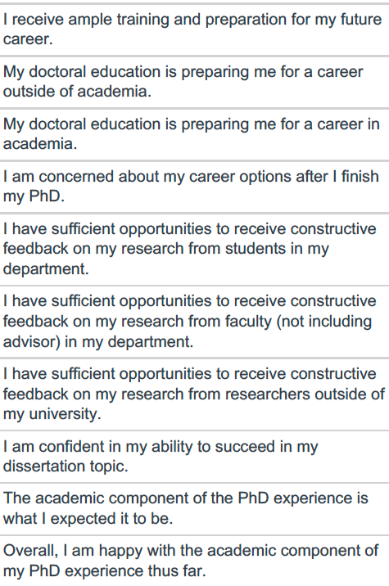
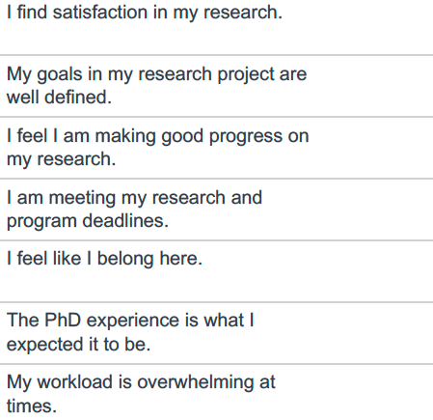
Questions on Academics and Research

Slide 5
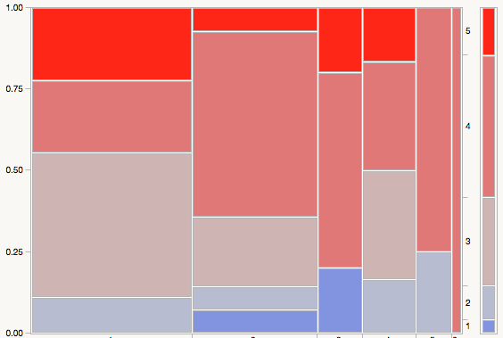
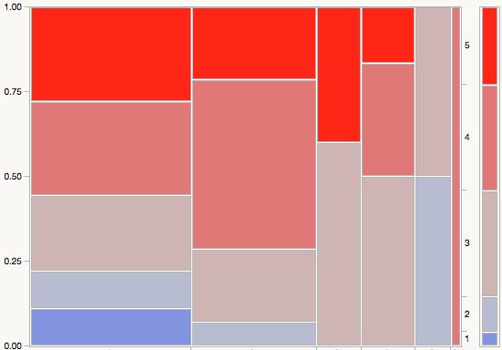
Questions on Academics and Research
Strongly Agree
Agree
Neither Agree
Nor Disagree
Disagree
Strongly Disagree
1
2
3
4
5
6
1
2
3
4
5
6
Year in Program
Year in Program

Slide 6
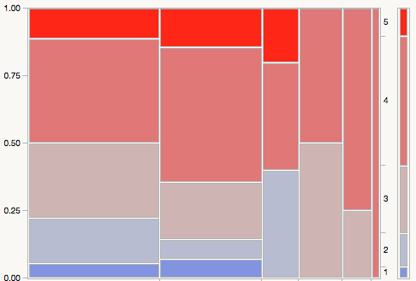
I feel like I’m making good progress on my research.
Strongly Agree
Agree
Neither Agree
Nor Disagree
Disagree
Strongly Disagree
1
2
3
4
5
6
Year in Program

Slide 7
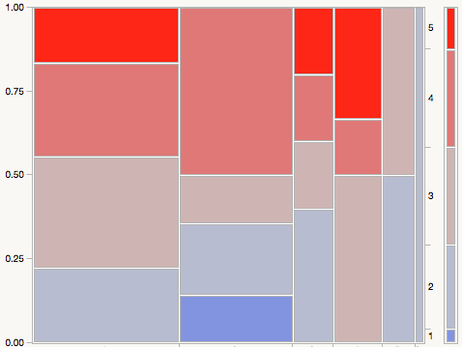
Questions on Career Preparation
Strongly Agree
Agree
Neither Agree
Nor Disagree
Disagree
Strongly Disagree
1
2
3
4
5
6
Year in Program

Slide 8
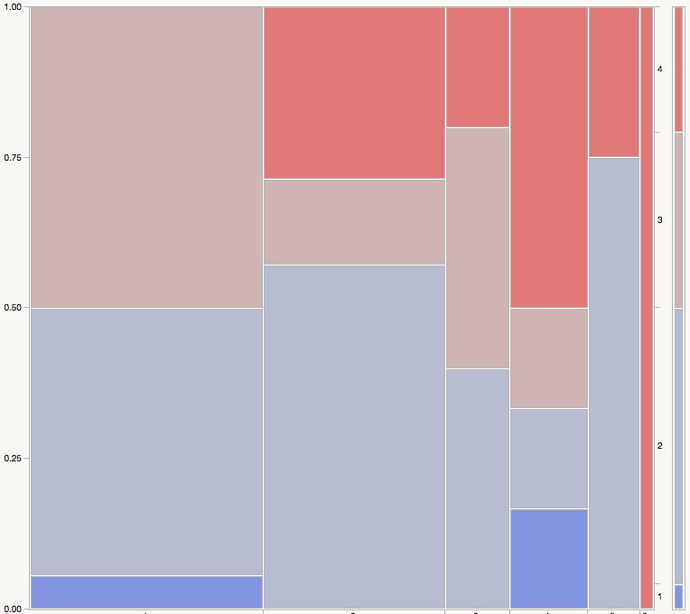

I have sufficient opportunities to receive constructive feedback on my research…
…from students in my dept.
…from faculty (not including my advisor) in my dept.
…from researchers outside of my university.
Agree
Neither Agree
Nor Disagree
Disagree
Strongly Disagree
1
2
3
4
5
6

Slide 9
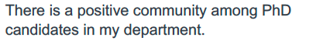
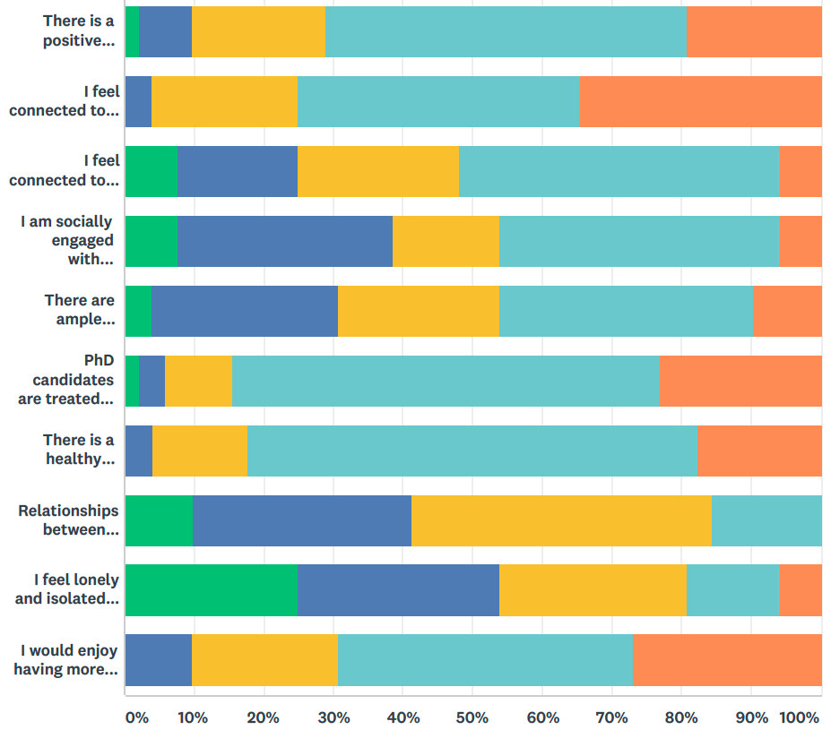
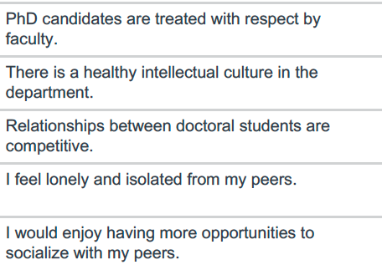
Questions on Community (10 questions total)

Slide 10
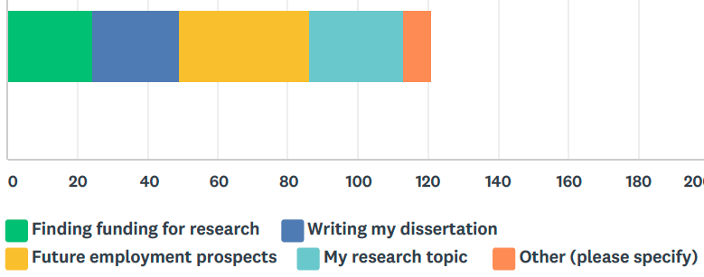
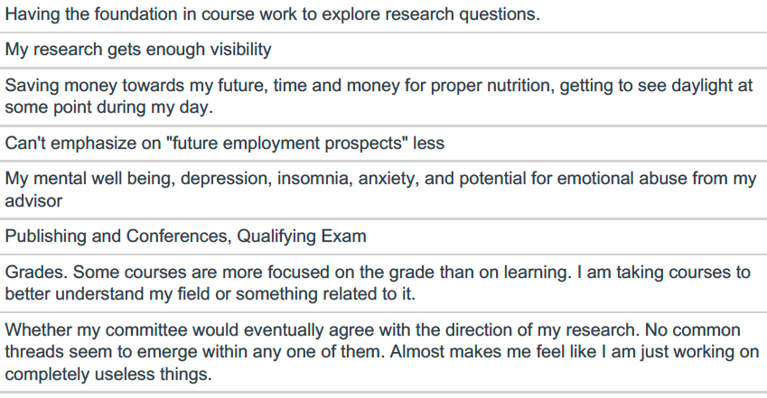
I worry about…

Slide 11
Survey II: Advisor-Advisee Relationship

Slide 12
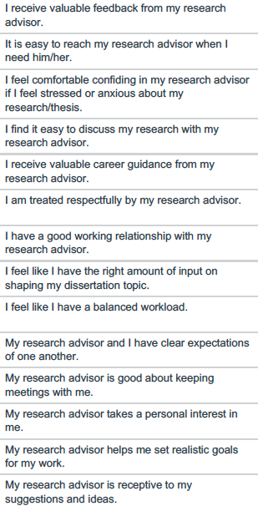
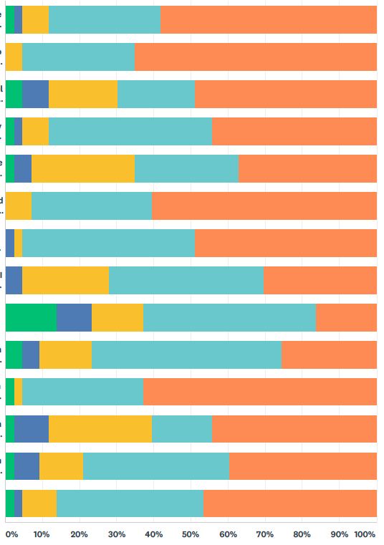

Slide 13
Action Items
Compare to benchmark data?
Analyze potential correlations among responses to questions
  e.g. happiness in program vs. making good progress
Better messaging to incoming students about program’s nuts and bots, and expectations
Department travel grants for PhD students
Hold more industry “meet and greet” events for PhD and MS students
Next year, include question about post-graduation plans: academia, industry, unsure

Slide 14
Misc. Comments
There are several courses which are listed but have not been offered in many years. Often these are higher level courses which have more specific topics.
I do not think anyone should TA in their first semester unless they request to
I would have liked to know more information about the logistics of the program WAY sooner (perhaps at least a month in advance) AND on an individual basis (i.e. stipend payout and timelines, less vagueness about rotations, health insurance…
There's not as much support at BU for incoming students as my friends who started programs at other schools.
The department could provide more easily accessible resources and documentation for graduate students.
The format of the qualification exam is strange
Thank you for your consideration. Have a good day.

Slide 15
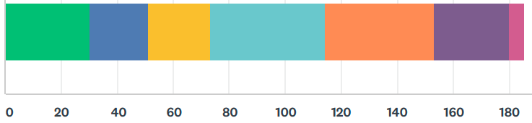
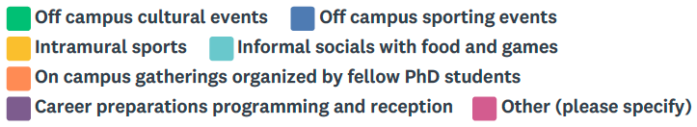
What kinds of PhD social events would you like to see?

