Slide 1
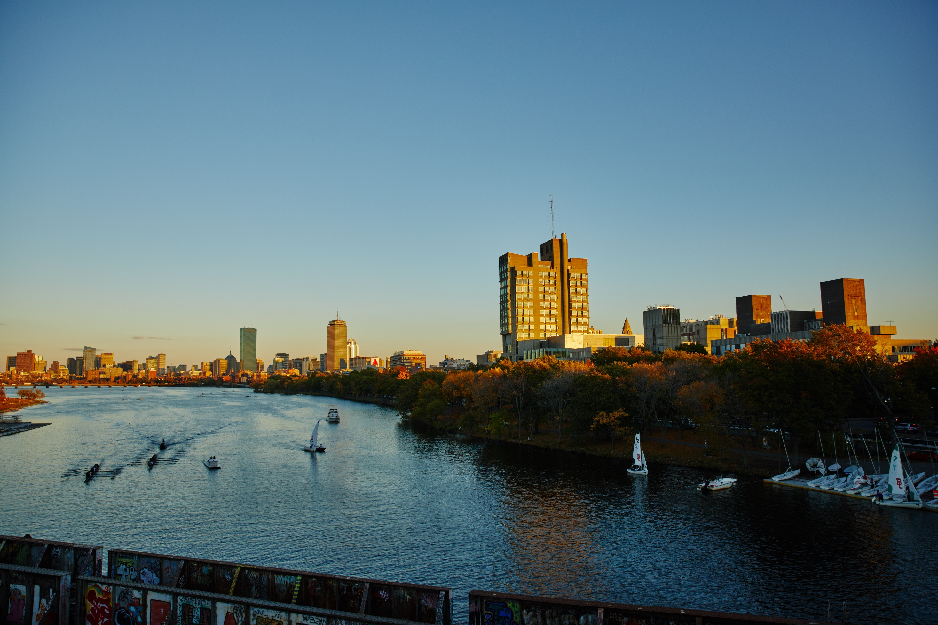
Welcome to BU Physics !
David Campbell, Director of Graduate Studies
March 25, 2022

Slide 2
Outline
Welcome to BU Physics!! http://bu.edu/physics
Our Community
  By the numbers
  In pictures
Our Facilities
  By the numbers
  In pictures
Academics
PhD Outcomes 1998-2018 (pre-COVID)
Boston !

Slide 3
Our Community: by the numbers
Primary faculty ~40 primary faculty, ~20 affiliated faculty:
http://bu.edu/physics/people/faculty-lecturers
Graduate Students: ~90 graduate students
  http://bu.edu/physics/people/graduate-students
UG Majors: ~150 undergraduate physics majors (including joint majors)
Notes:
Our graduate community is closelhy knit and has regular events

Slide 4
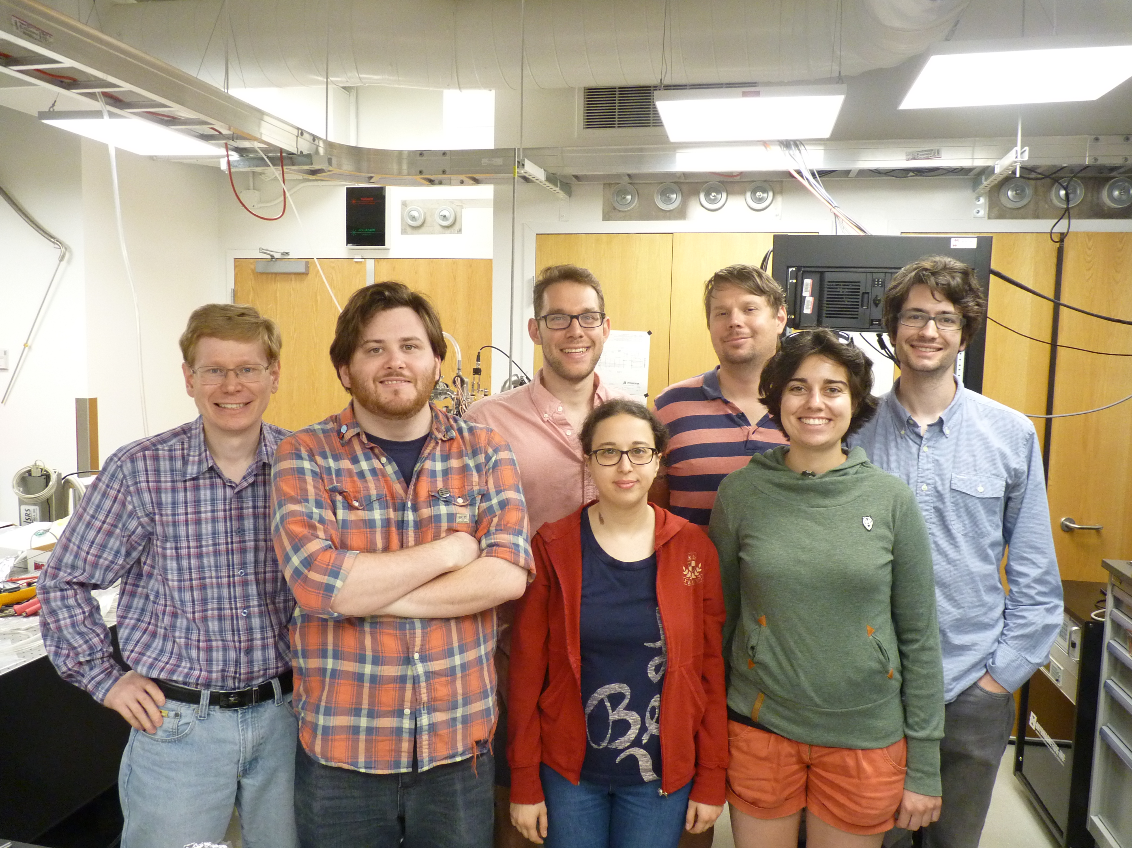
Our Community: in pictures
Prof. Alex Sushkov’s group in the lab
Notes:
Your lab mates will be your small family

Slide 5
You’re a master in the lab !

Slide 6
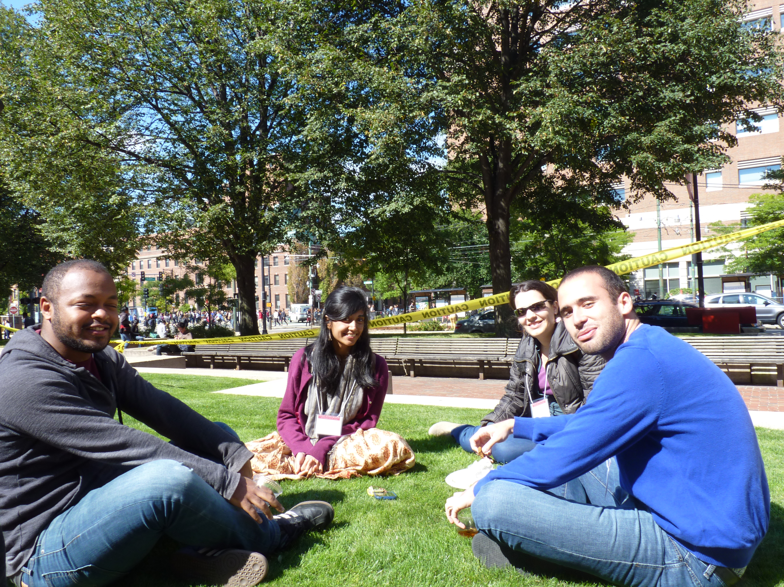
Or Sometimes you’re with friends on the (always sunny!) front lawn

Slide 7
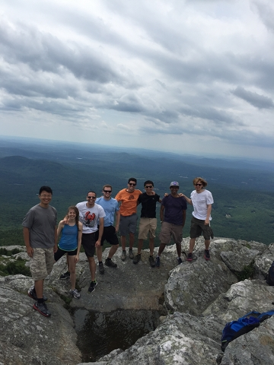
Or on an outing to the mountains of New England

Slide 8
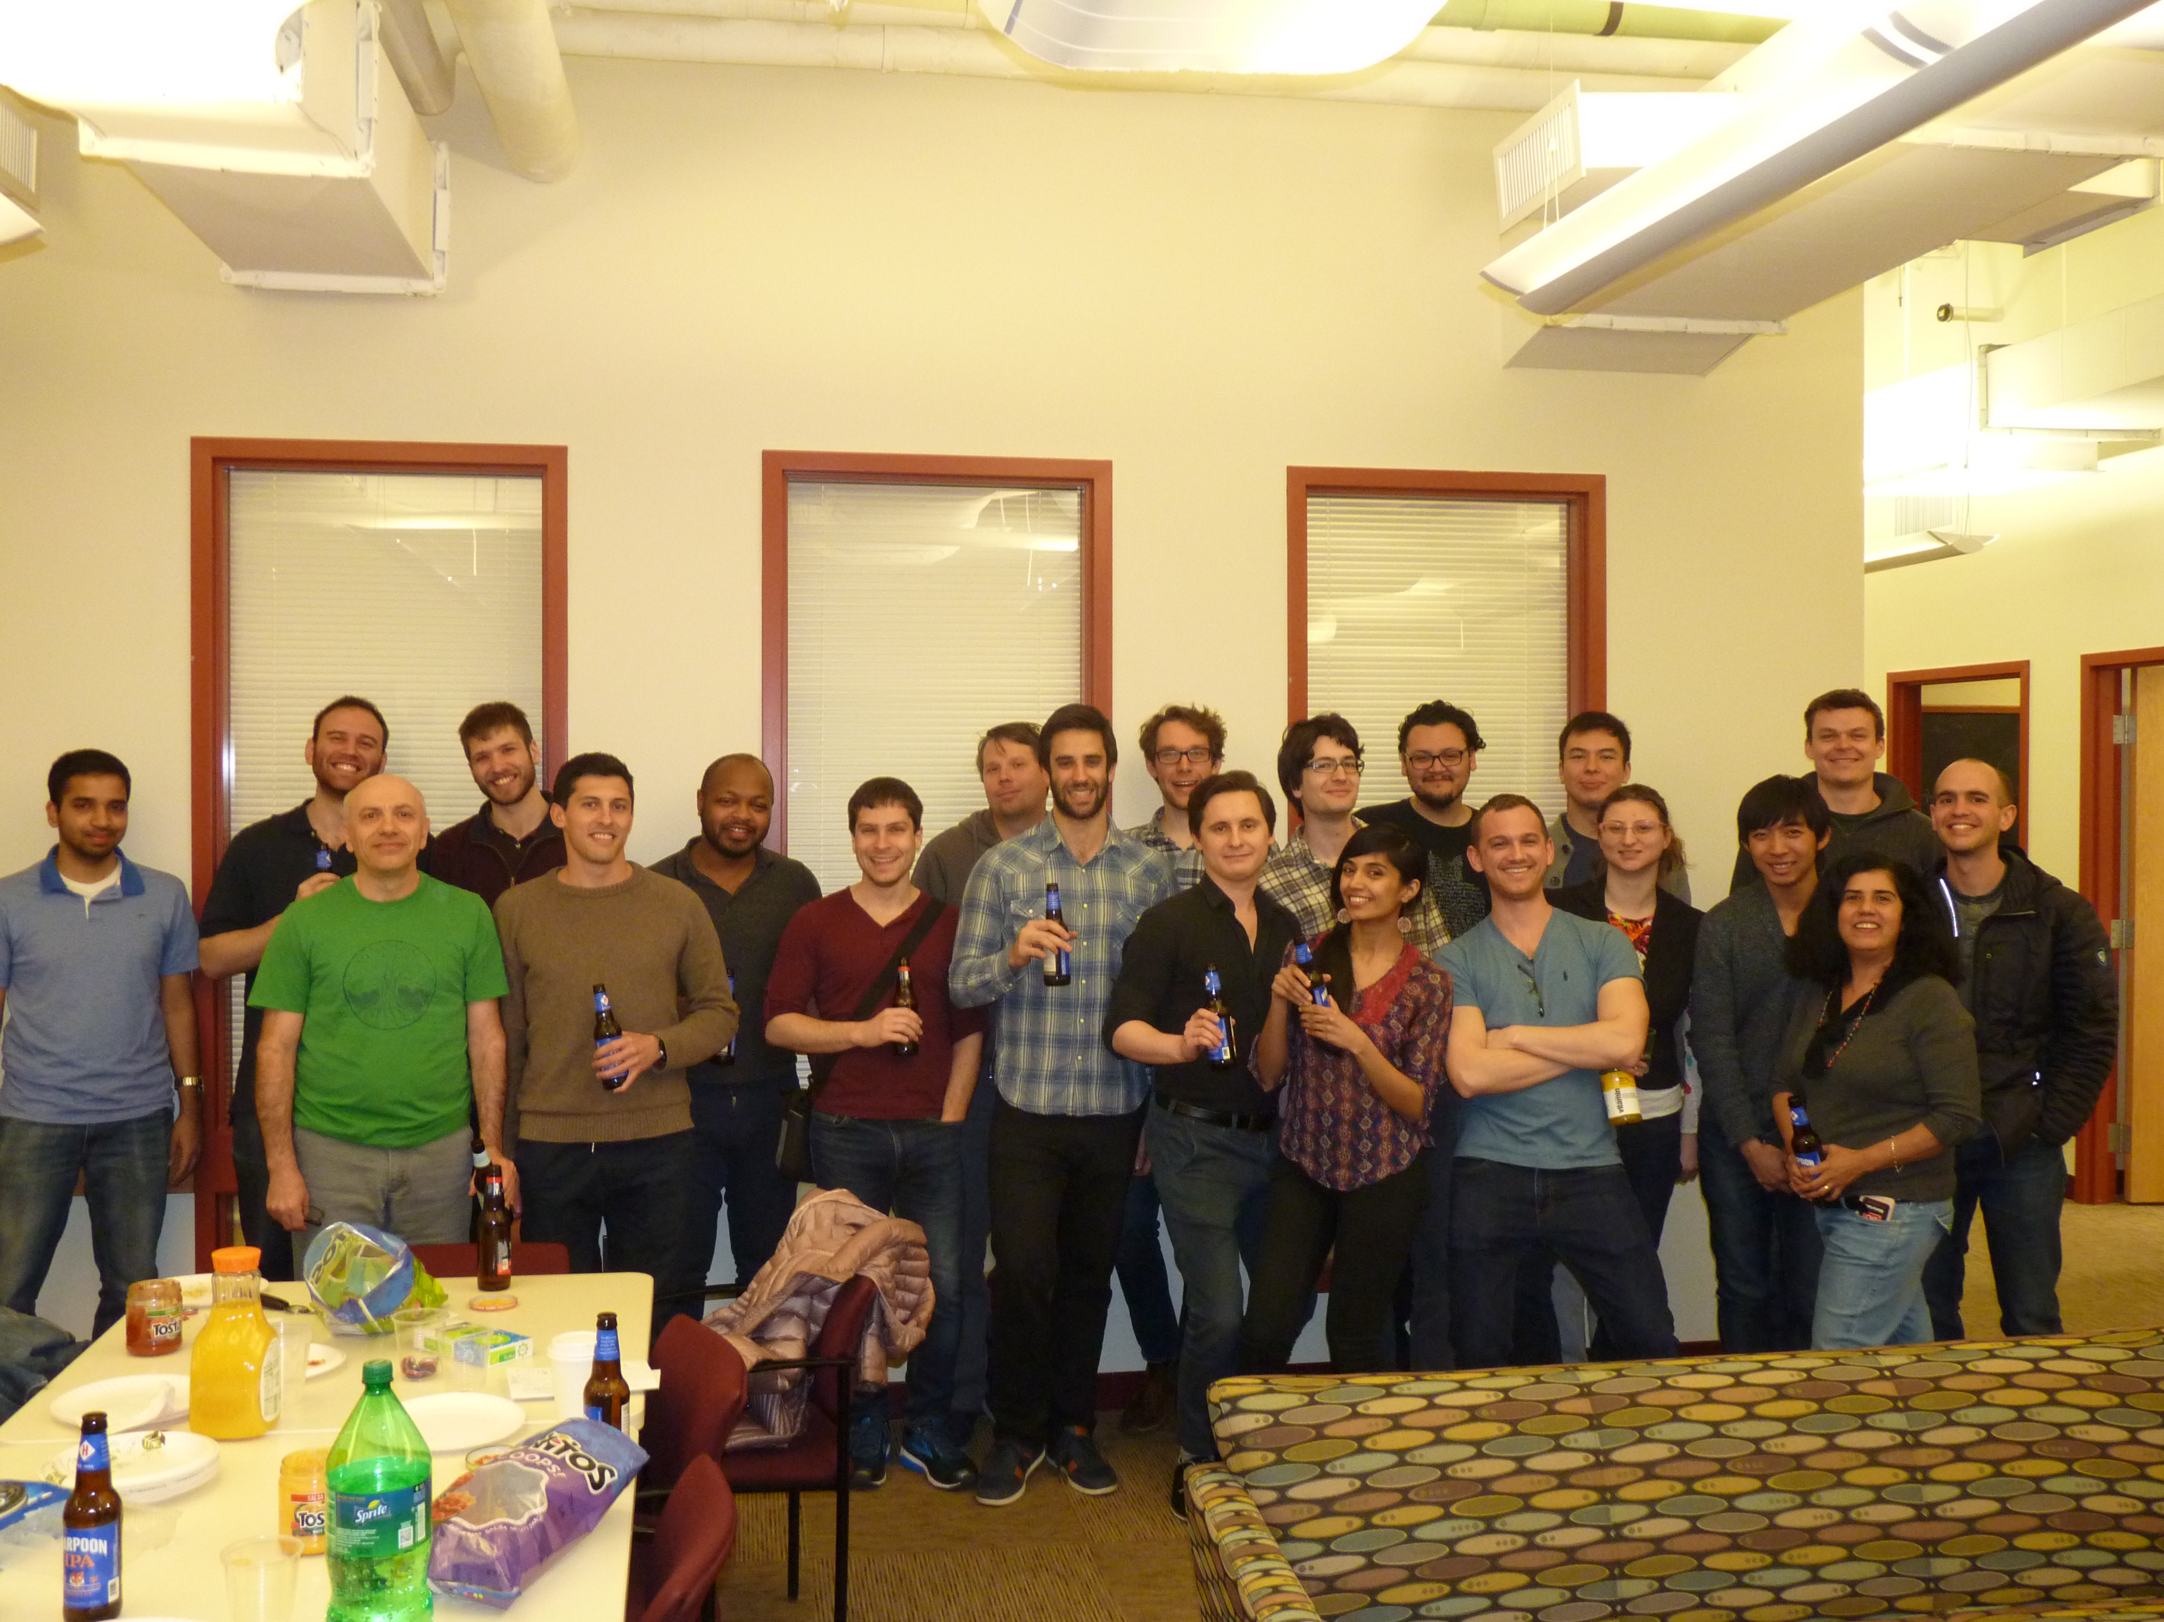
Our monthly graduate student socials
Notes:
Our graduate community is closelhy knit and has regular events

Slide 9
Our Facilities: by the numbers
Metcalf Science Center (SCI), 590 Commonwealth Avenue
  Main office
  First-year grad offices
  CMT and BioT offices, CME offices/labs
  Undergraduate resource room, SCI 121 – TF office hours & tutorials
Physics Research Building (PRB), 3 Cummington Mall
  EDF and SIF
  Particle theory offices
Photonics Center (PHO) 8 St. Mary’s Street
  CME labs and offices
  Many affiliated faculty have labs here
Be sure to tour offices and labs in your area(s) of interest !

Slide 10
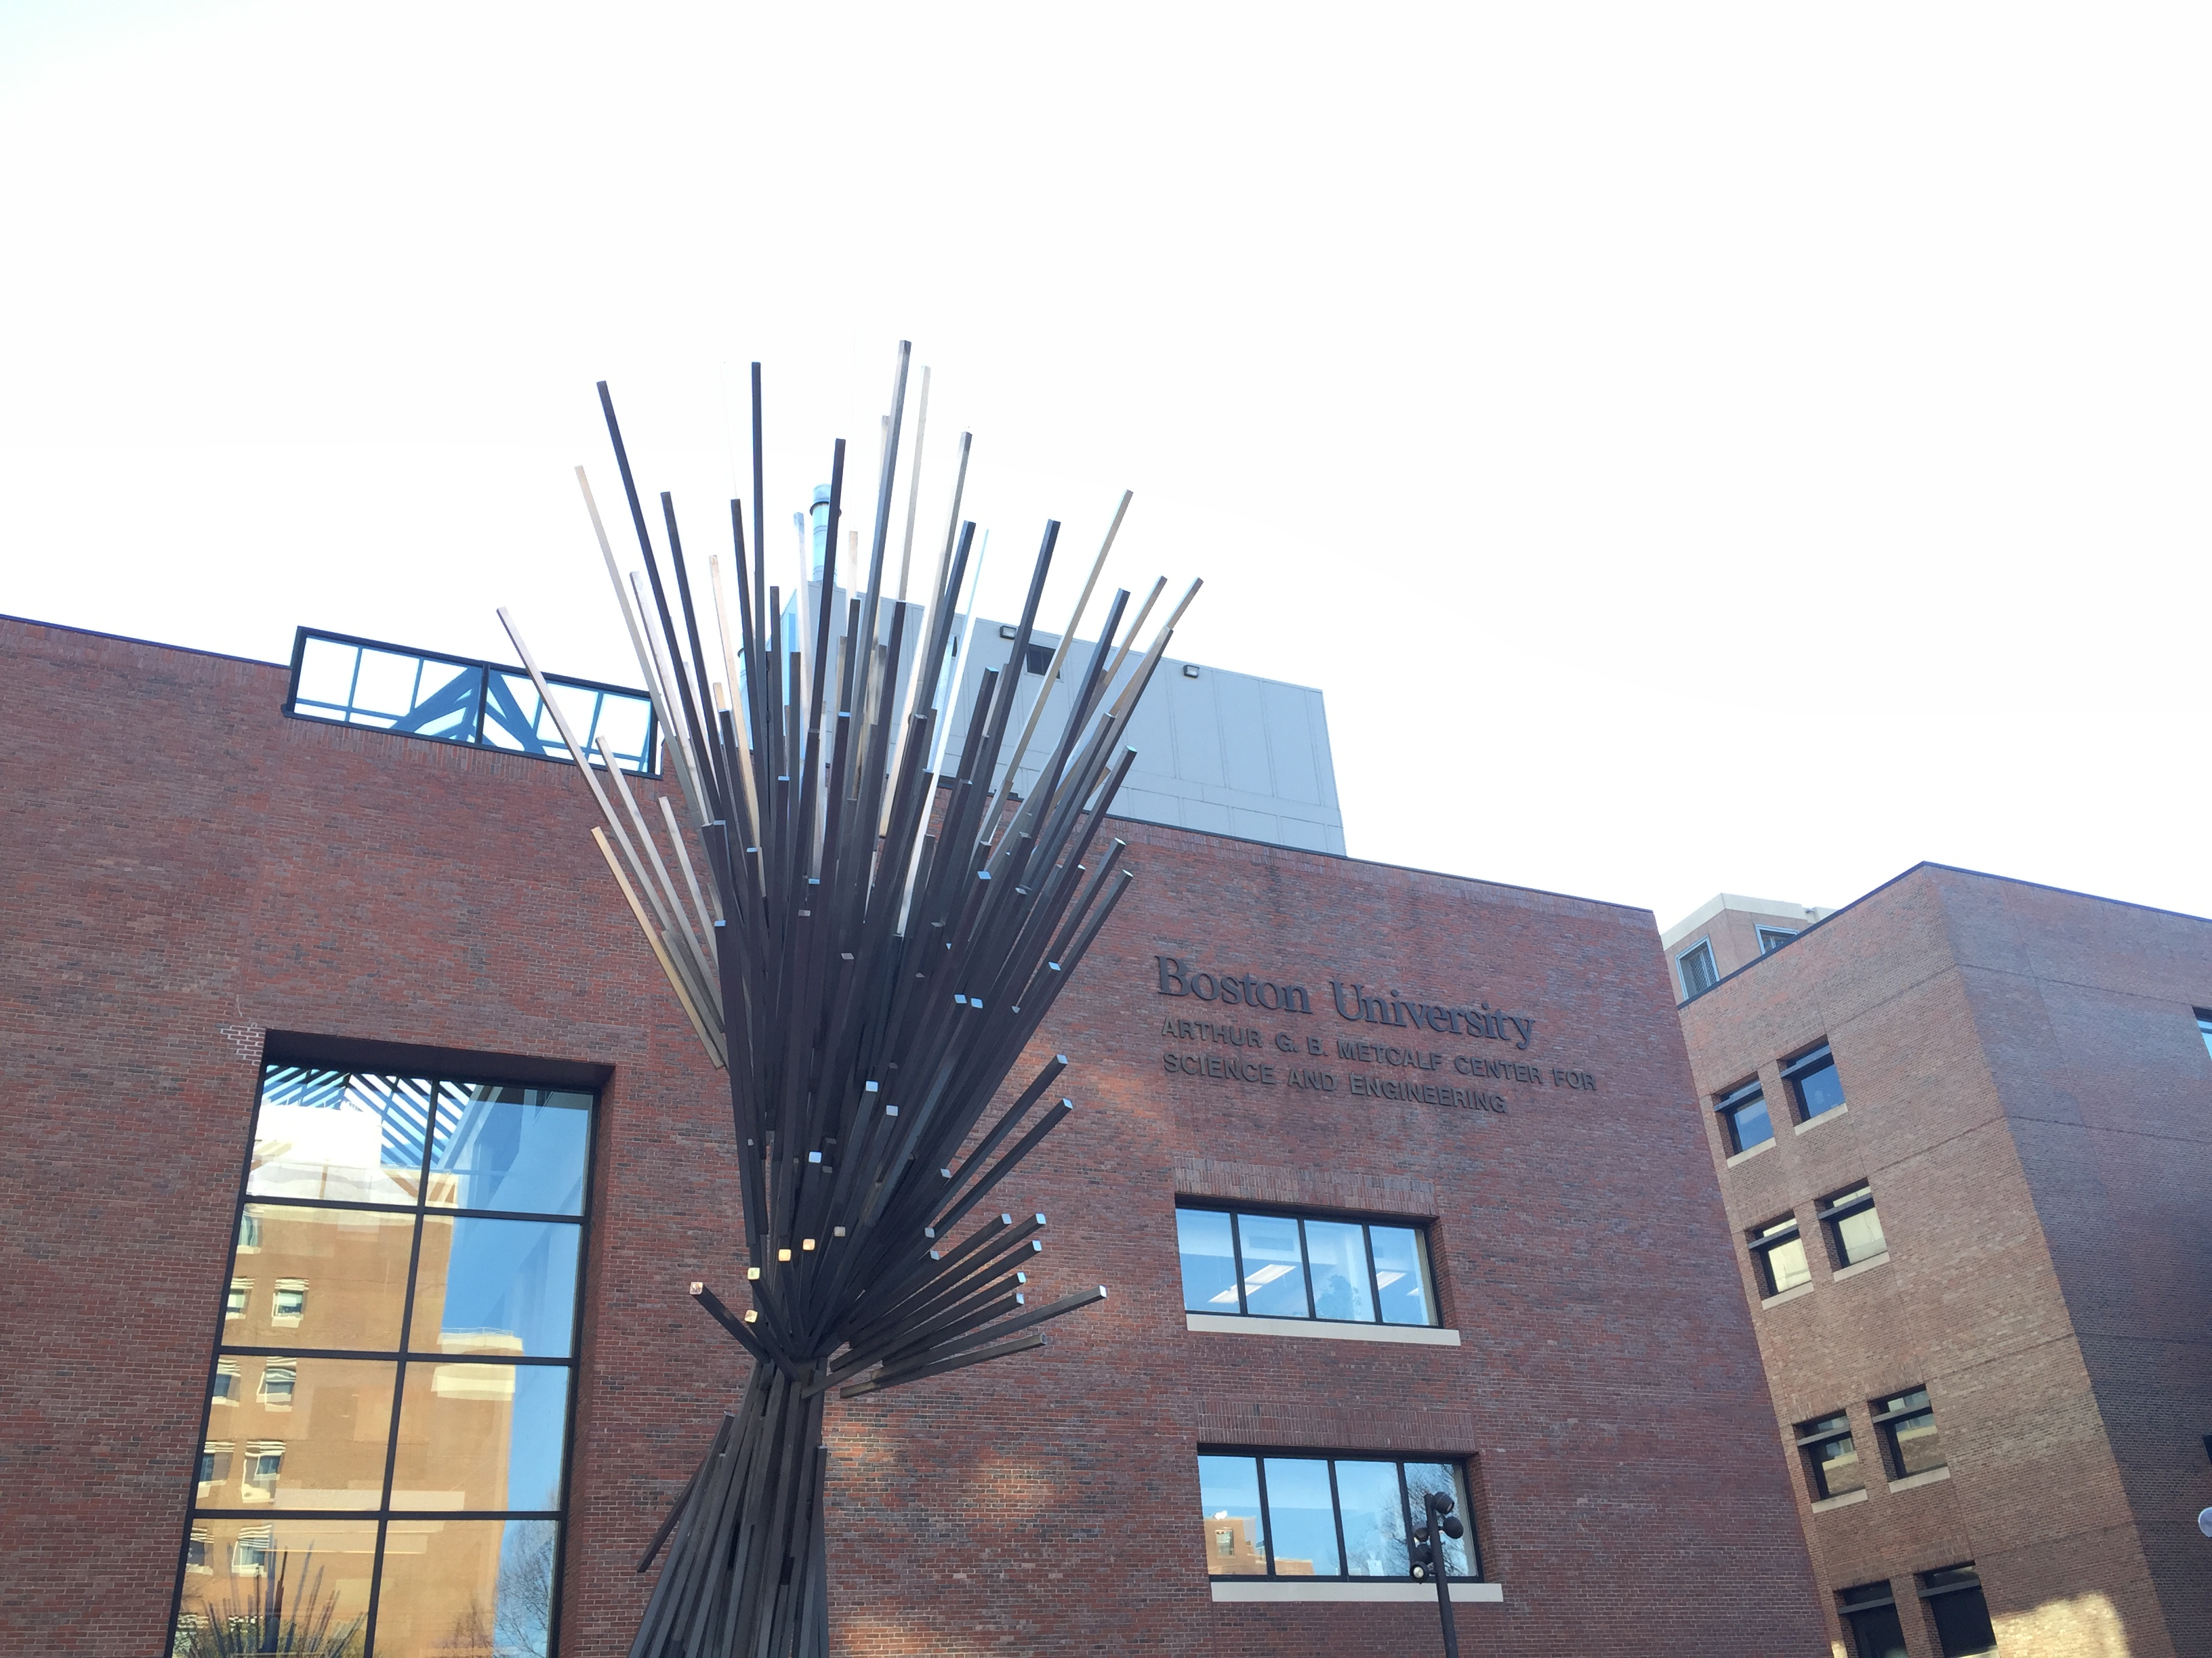
Our Facilities: in pictures
590 Commonwealth Avenue, The Main Physics Building

Slide 11
Our Facilities: in pictures
The Photonics Center
The BU Photonics Center is a 10 floor, 235,000 sq. ft. building.
Faculty from Physics have offices and labs here, as well as faculty from Chemistry, Engineering, and the Division of Materials Science and Engineering.

Slide 12
Academics: Time to PhD
Year 1: Entering orientation/TF workshops
TF or RA/Fellowship
Training in teaching for TFs: Prof. Jarawala
Core courses: 5+electives+PY961
(No grade less than B- accepted)
Preferably Join a Research Group (summer)
Year 2: Advanced/Topical courses TF/RA
Definitely join a Research Group (Summer)
Year 3: Complete Preliminary Oral Exam by start of year 3
Year 4: Interim Progress Report
Year 5-6: Departmental Seminar (T-6 months)
Dissertation defense 🎉🎉
Notes:
Our goal is to have everyone finish PhDs within 6 years, many sooner. We can deal with extensions beyond that period on an individual basis.

Slide 13

PhD Outcomes by Future Careers, 1998-2018 (pre-COVID)
Boston University, Physics Department
(Grouped by Graduation Year)

Slide 14
PhD Outcomes by Future Careers, 1998-2018 (pre-COVID)
Boston University, Physics Department
(Grouped by Graduation Year)

Slide 15






Boston!
Intellectual Community

Slide 16
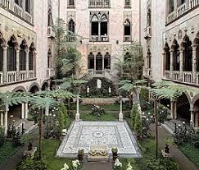
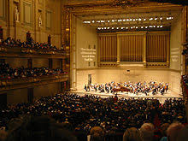
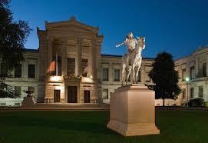
Boston!
Museums, Music and Arts
Gardner Museum
Boston Symphony Hall
Museum of Fine Arts

Slide 17
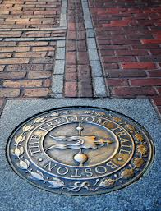
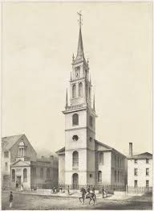
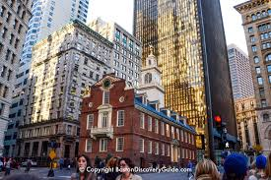
Boston!
History
Freedom Trail
Old State House
Old North Church

Slide 18


Boston!
Sports

Slide 19
Thanks, and once more, welcome to BU Physics !
Questions ?

Slide 20
The many resources available to you
Read the graduate brochure on the web at
  https://www.bu.edu/physics/files/2021/10/Boston_University_Physics_Graduate_Brochure.pdf
Read research webpages and contact faculty members directly. Senior graduate students are also a good source of info.
Physics colloquia – Attendance is compulsory for all graduate students
Departmental seminars – attend seminars in fields of interest
Boston Area Physics calendar (BAPC) – combined calendar of Physics talks at local universities. http://cosmos.phy.tufts.edu/bapc.html
Student seminars – organized by students
Science & Engineering Library, 38 Cummington Mall
Mugar (University) Library has access to many other libraries and digital resources http://www.bu.edu/library/
Preprint archive arxiv.org https://www.library.cornell.edu/arxiv
Graduate Student Council, Women in Physics, other interest groups
Join the American Physical Society as a student member (free Physics Today and meeting registration discount) http://www.aps.org/membership/student.cfm

Slide 21
Academics: Brief Overview of PhD requirements
Details on web; https://edit.bu.edu/files/1/Fall-2020-Physics-PhD-Requirements-FINAL.
No written qualifying/comprehensive examination
Initial Sequence of Five Courses with average B or better and no grade lower than B- serves as exam: PY501 (Mathematical Physics), PY511/512 (Quantum Mechanics I and II),
PY521 (Electromagnetic Theory), PY541 (Statistical Mechanics)
PY 961 “Scholarly Methods in Physics” taken in first year (1 credit)
Advanced Lab (PY581 or waiver)
Total of 16 courses, at least 10 lecture courses from 500-800 levels (including initial sequence) no more than 6 non-lecture courses
Successful PhD thesis research project

