Slide 1
Boston University Photonics Center National Science Foundation Research Experiences for Undergraduates Site in Integrated Nanomanufacturing
Co-Directors: Prof. Xin Zhang and Prof. Helen Fawcett
Faculty Mentor: Aaron Schmidt

Slide 2
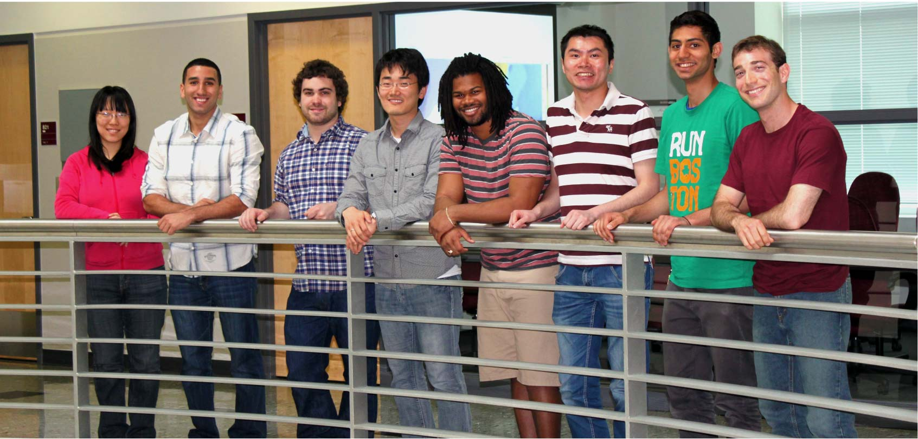
Nano Heat Transfer Lab

Slide 3

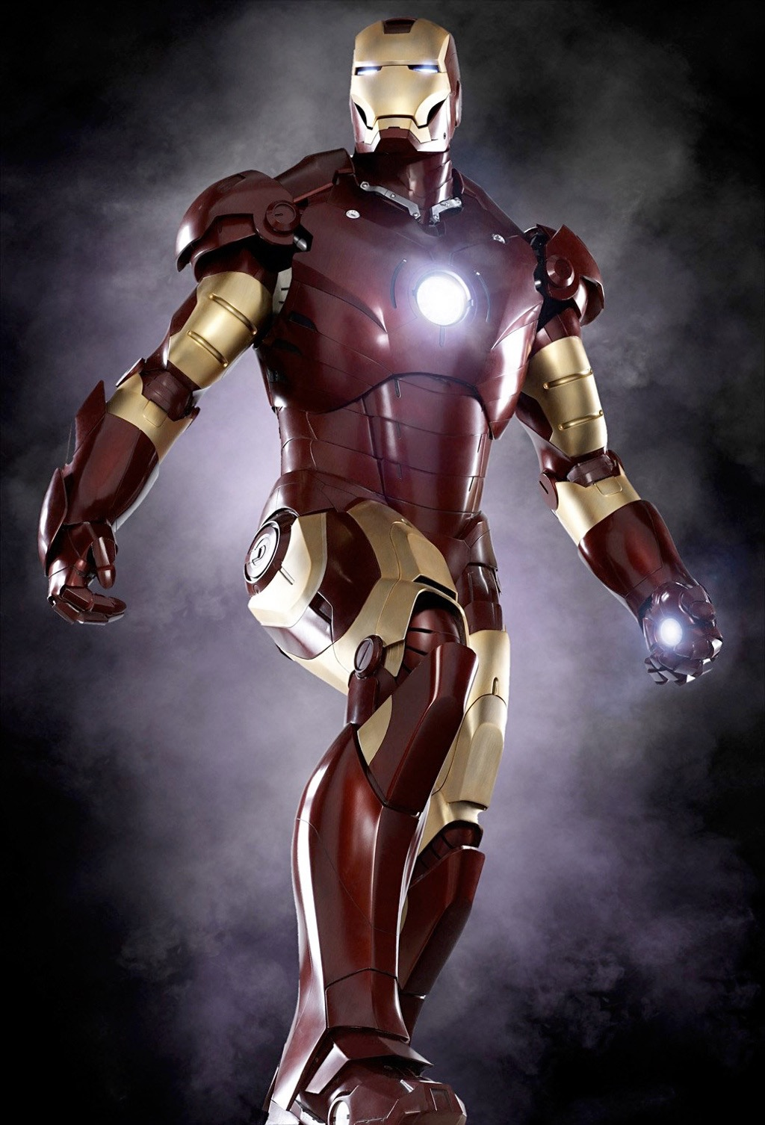
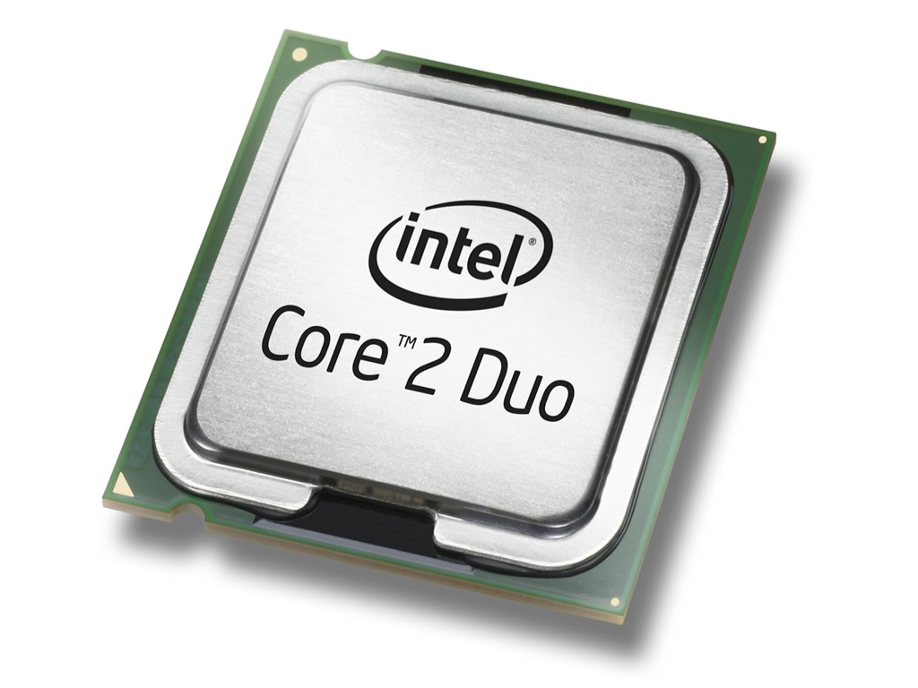
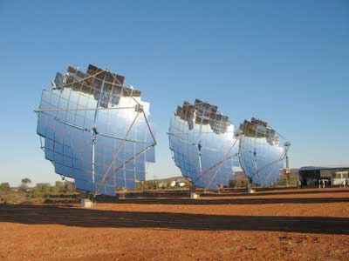
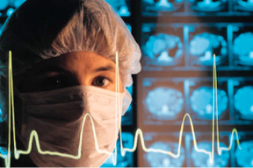
Nanoscale thermal transport
Materials
Microelectronics
Energy
Medicine

Slide 4
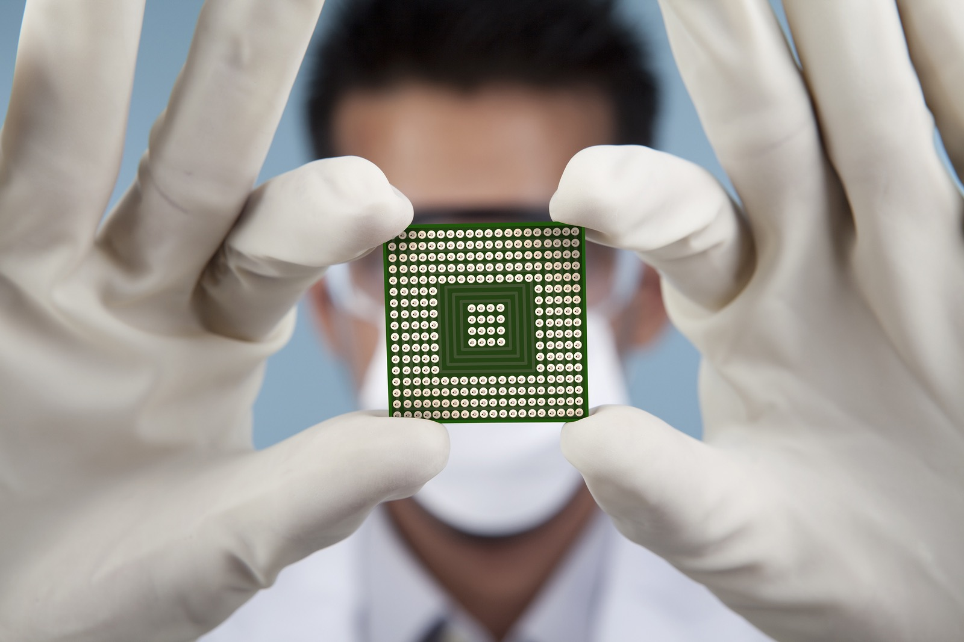

Slide 5
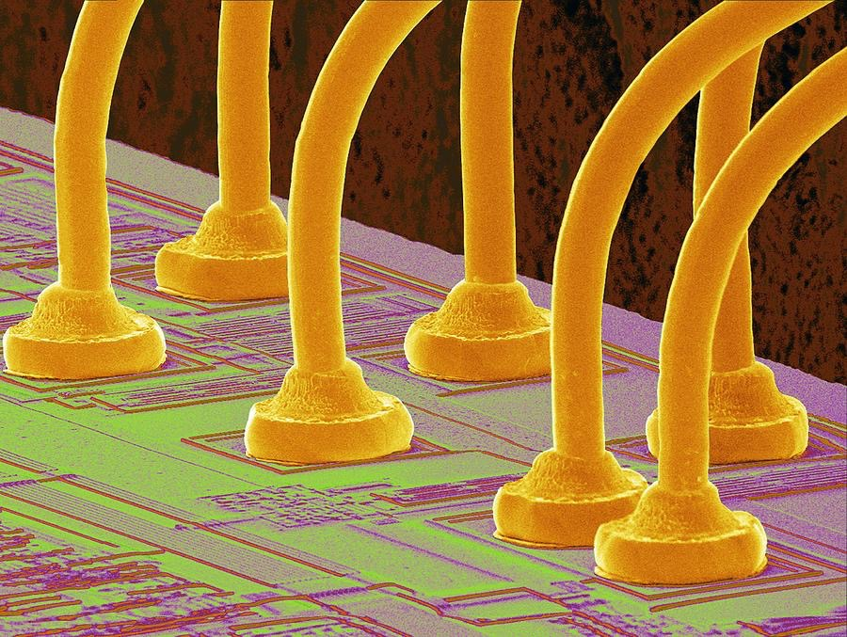

Slide 6
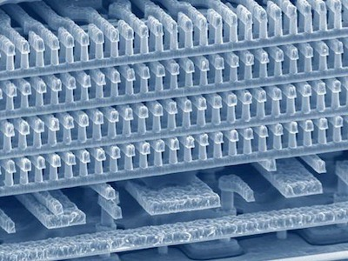
5 µm

Slide 7
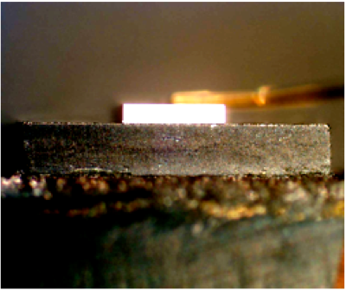
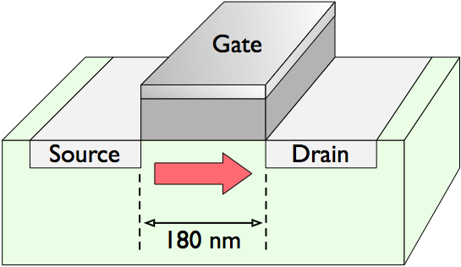
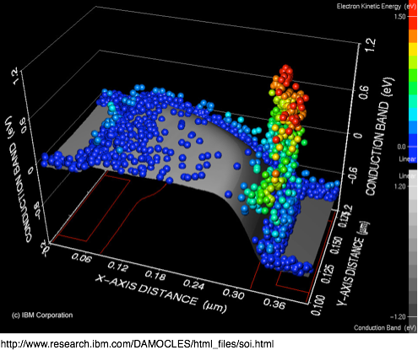
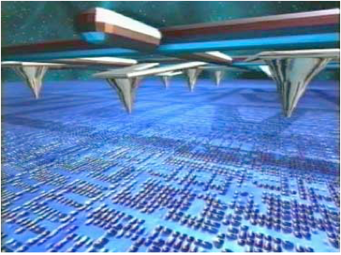
Semiconductor lasers
Heat generation in a MOSFET
Data storage (“Millipede”)
IBM Research Journal, DOI: 10.1147/rd.443.0323

Slide 8
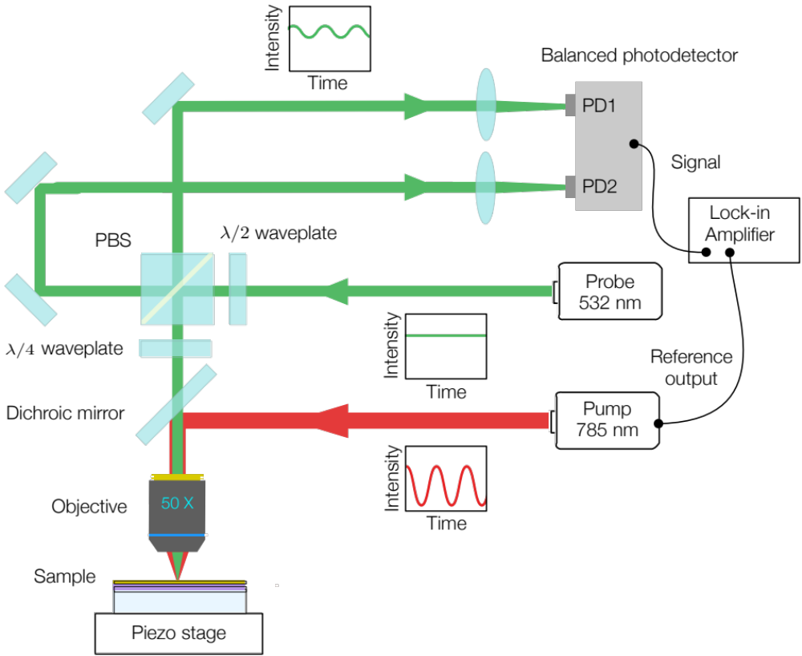
Thermoreflectance microscopy

Slide 9
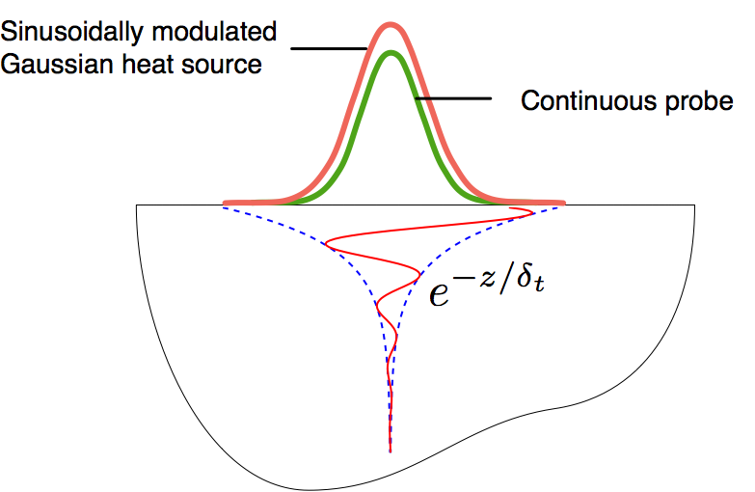
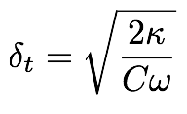

Slide 10
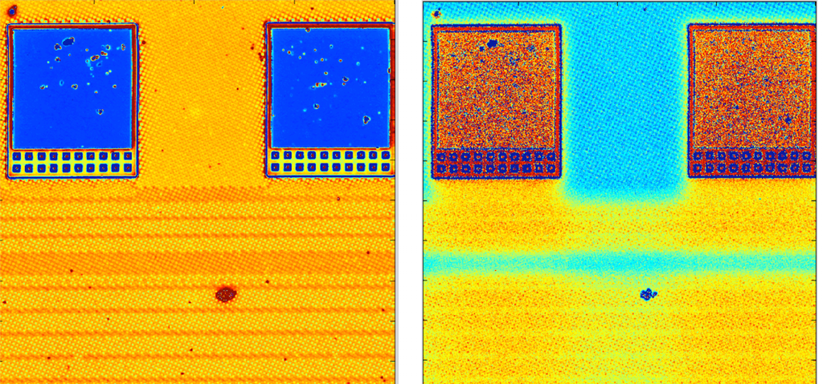
Thermal Amplitude (5 MHz)
Thermal Phase (5 MHz)

Slide 11
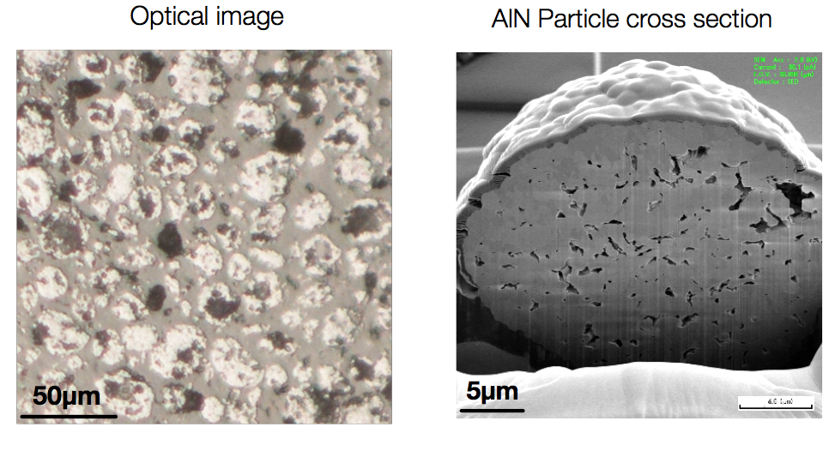
Thermal Properties of Composites

Slide 12
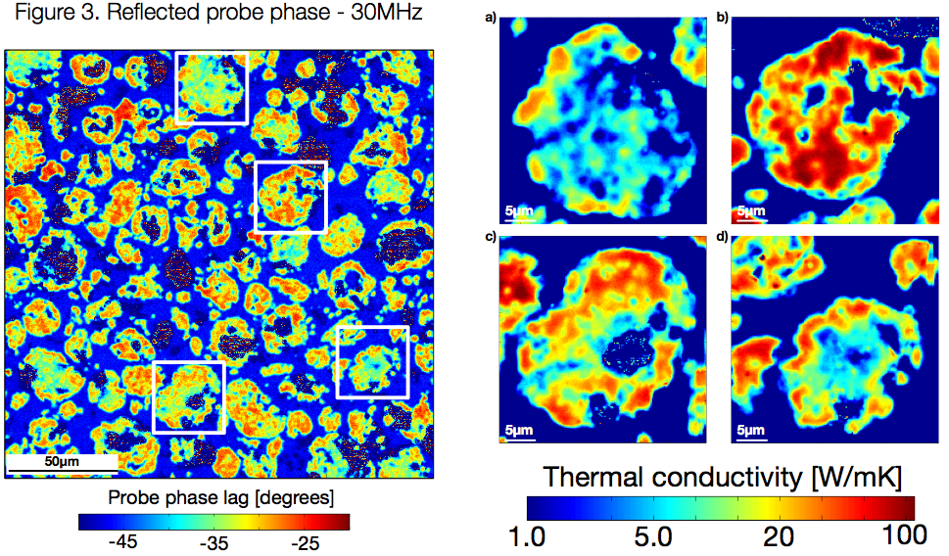

Slide 13
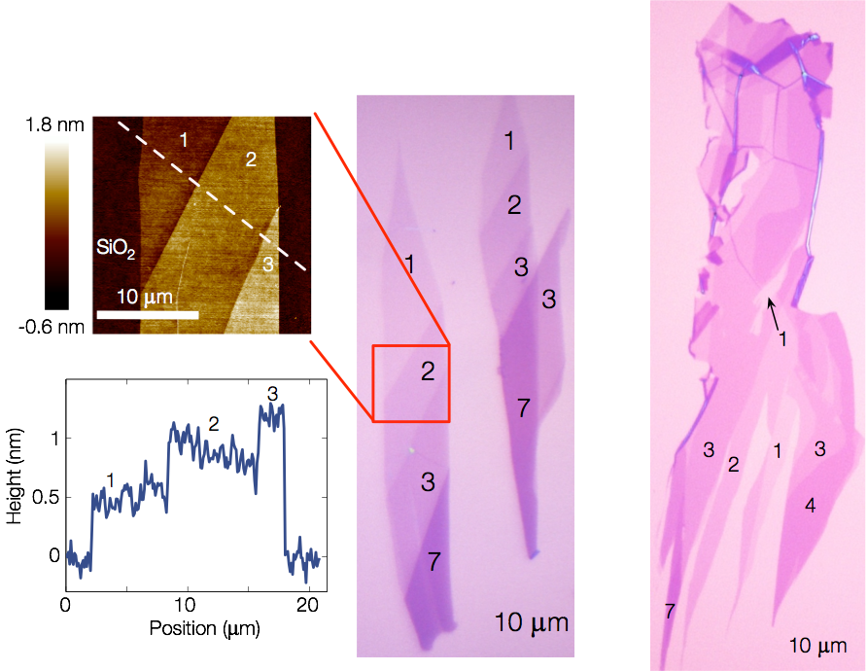
Graphene

Slide 14
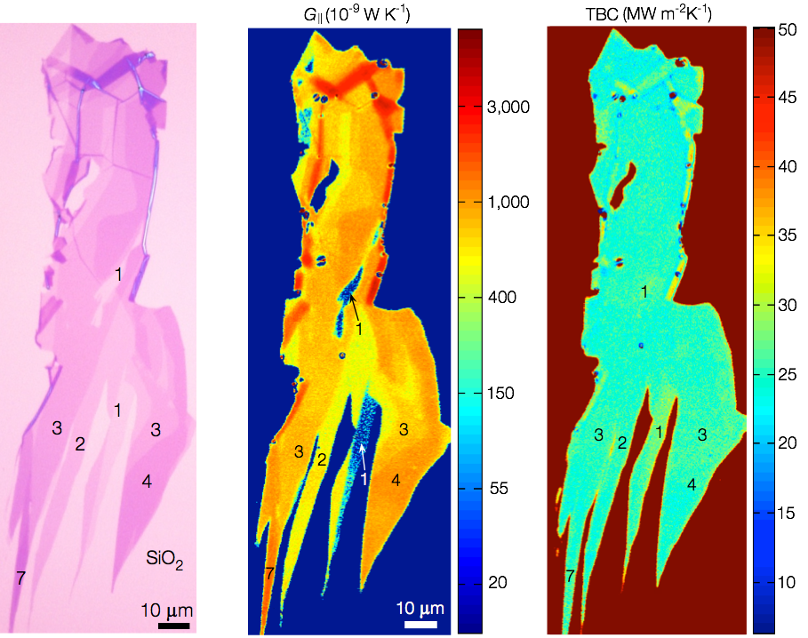

Slide 15
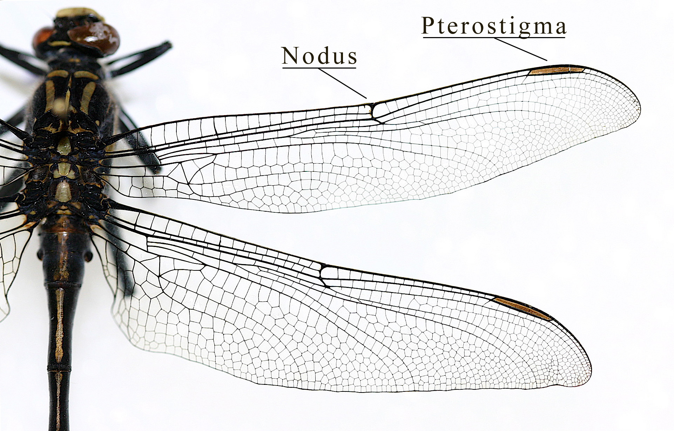
REU Project Description

Slide 16
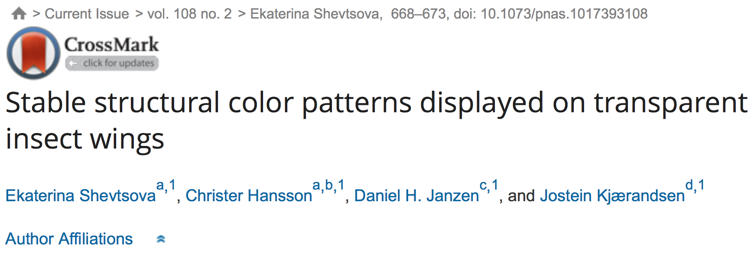
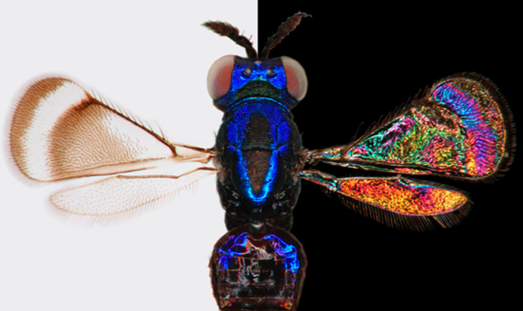

Slide 17
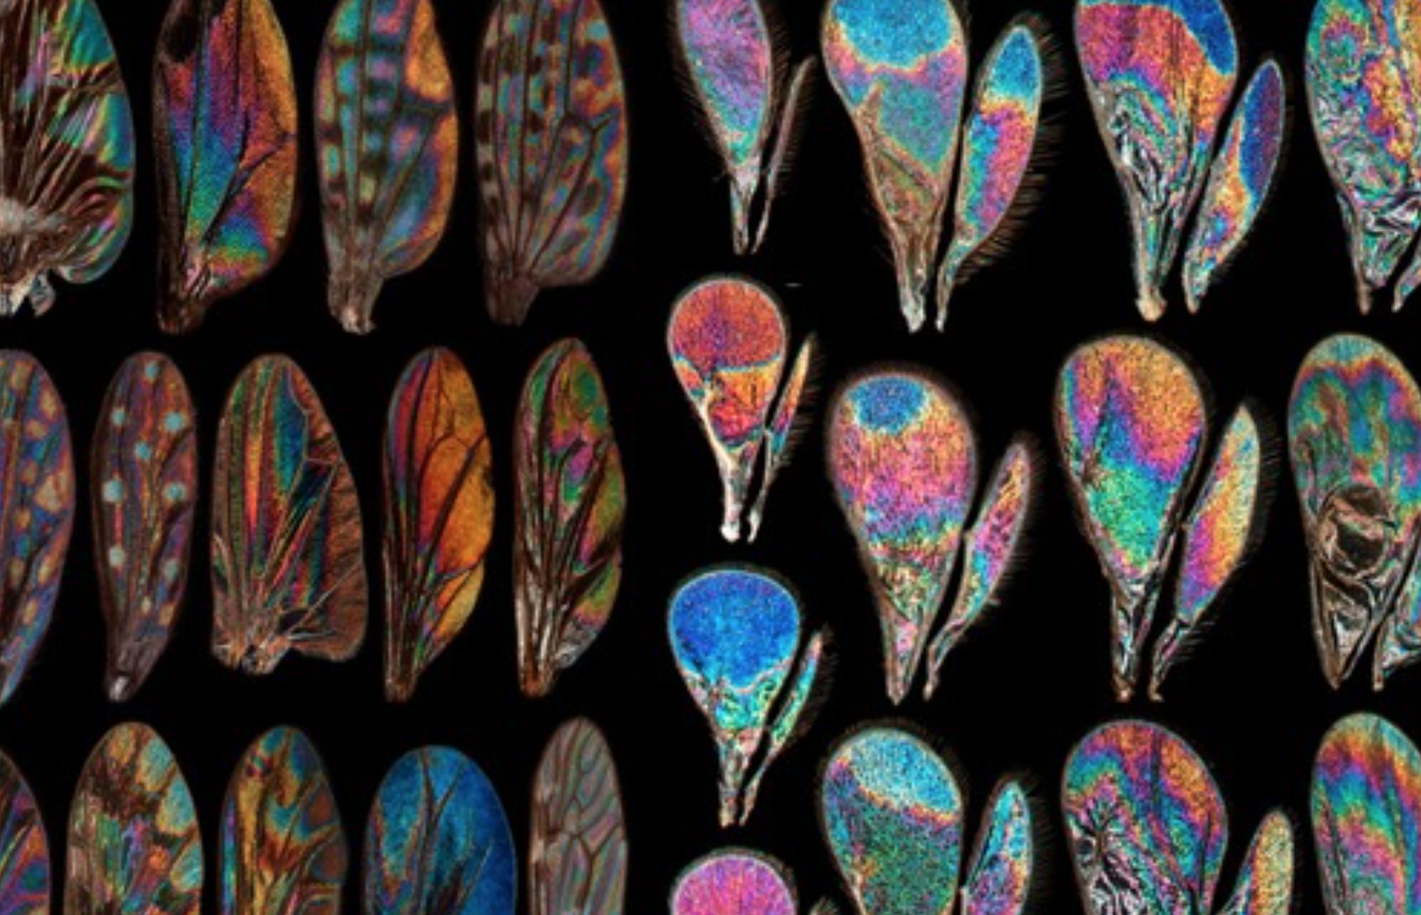

Slide 18
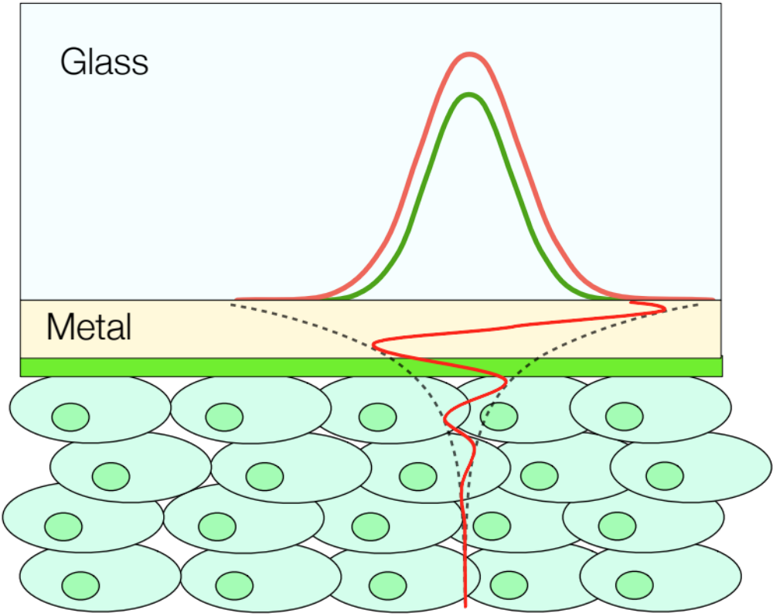

Slide 19
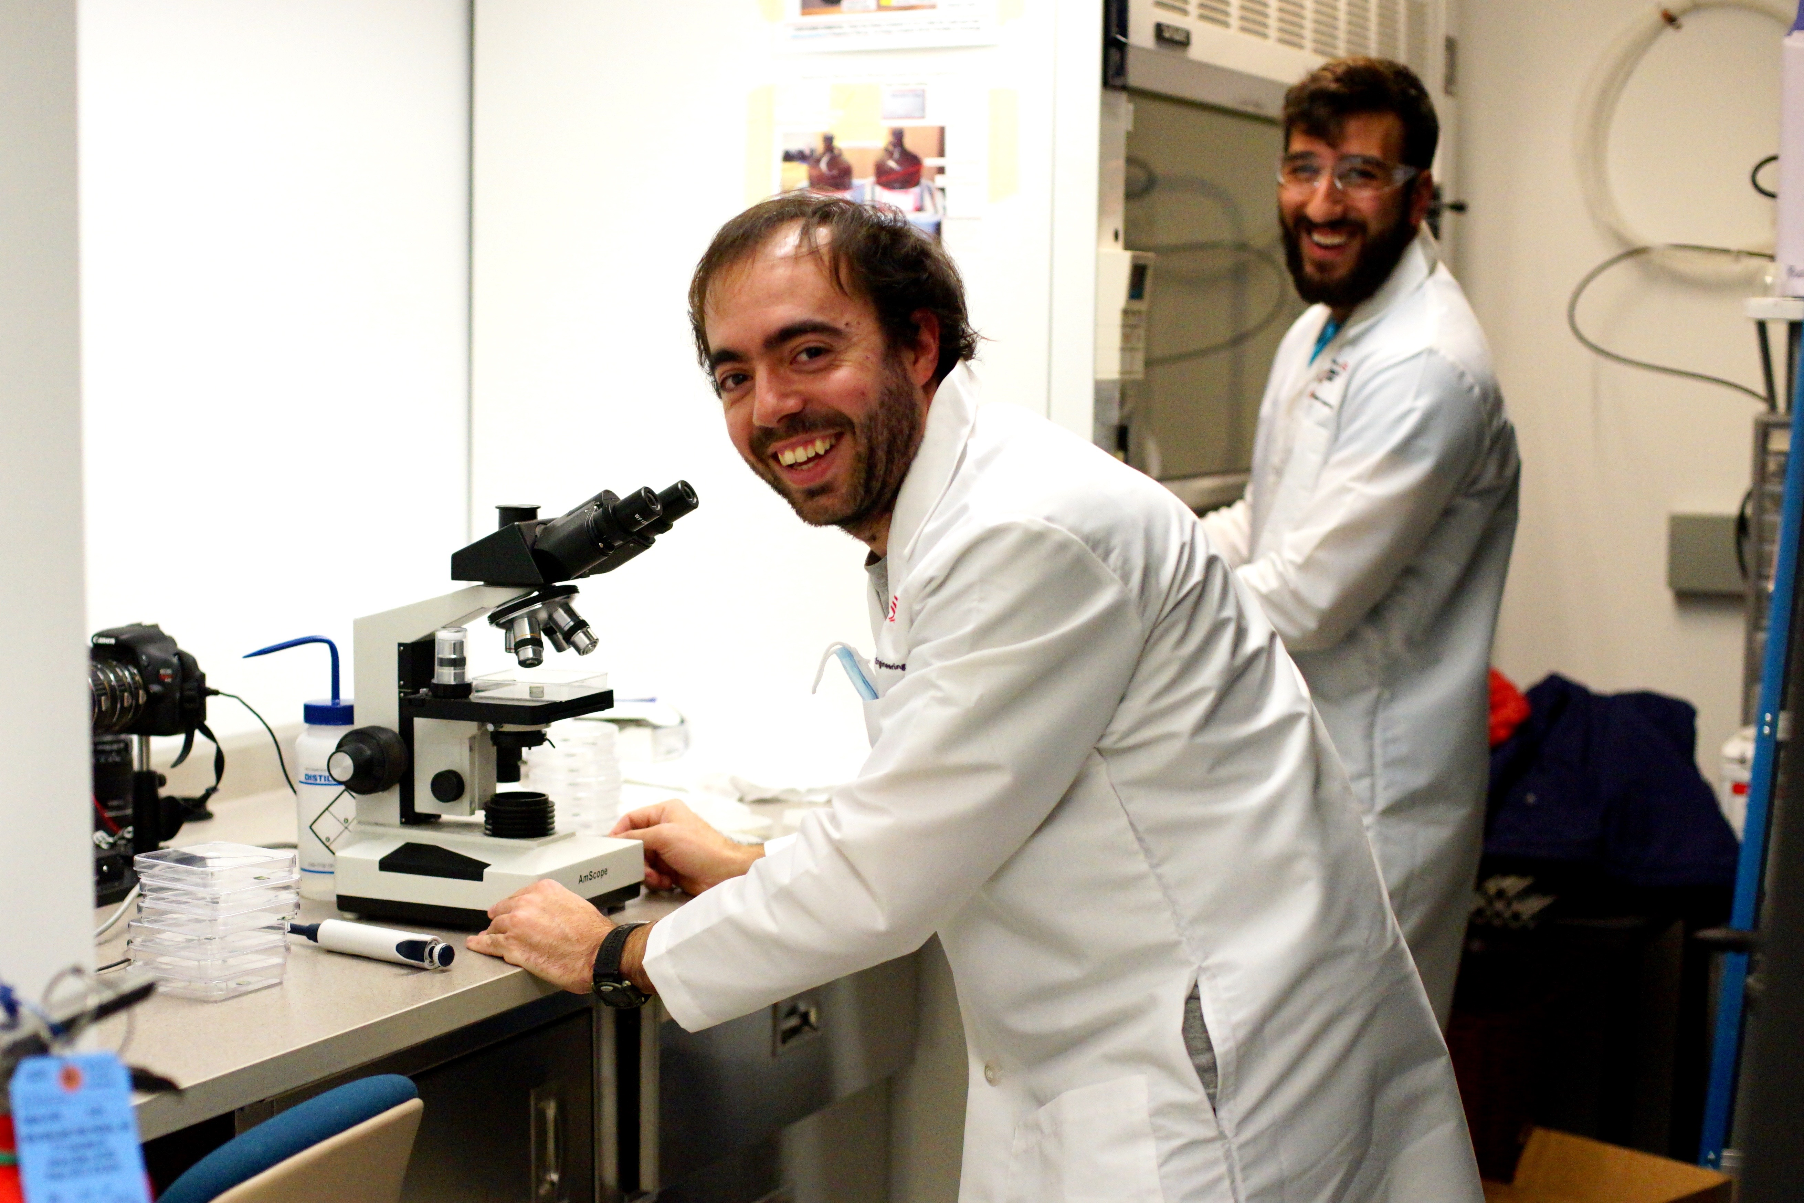
Mentors
Elbara
Miguel

