Slide 1
Boston University Photonics Center National Science Foundation Research Experiences for Undergraduates Site in Integrated Nanomanufacturing
Co-Directors: Prof. Xin Zhang and Prof. Helen Fawcett
Faculty Mentor: Prof. Jillian Goldfarb

Slide 2

Understanding environmental impacts of energy by-products and novel contaminants
Developing renewable materials for pollutant remediation and fuel refinement
Investigating economically viable alternative energy sources
Thermodynamics of complex mixtures
Fate and transport in subsurface media
Conversion of biochars to active materials at micro and nanoscales
Mechanisms of competitive adsorption of mixtures
Use of oil shale as alternative fossil fuel
Thermochemical conversion of biomass

Slide 3
EME²Lab Summer 2015
Prof. Jillian Goldfarb, PI Boston University
Prof. Thiago Chepella, Visiting Researcher (Brazil)
Tom Leger, Visiting Undergraduate (France)
Ami Vyas, BU Undergraduate (Electrical Engineering)
Alex Billias, BU Undergraduate (Physics)
Junjie Xue, Visiting Graduate Student (China)
Stephanie Menyonu Dartmouth Undergraduate (NSF REU)

Slide 4
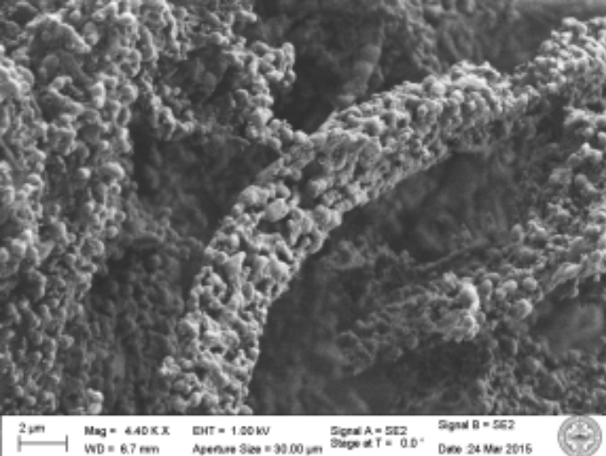
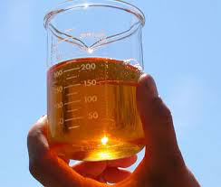
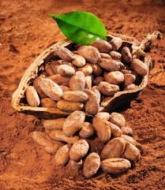
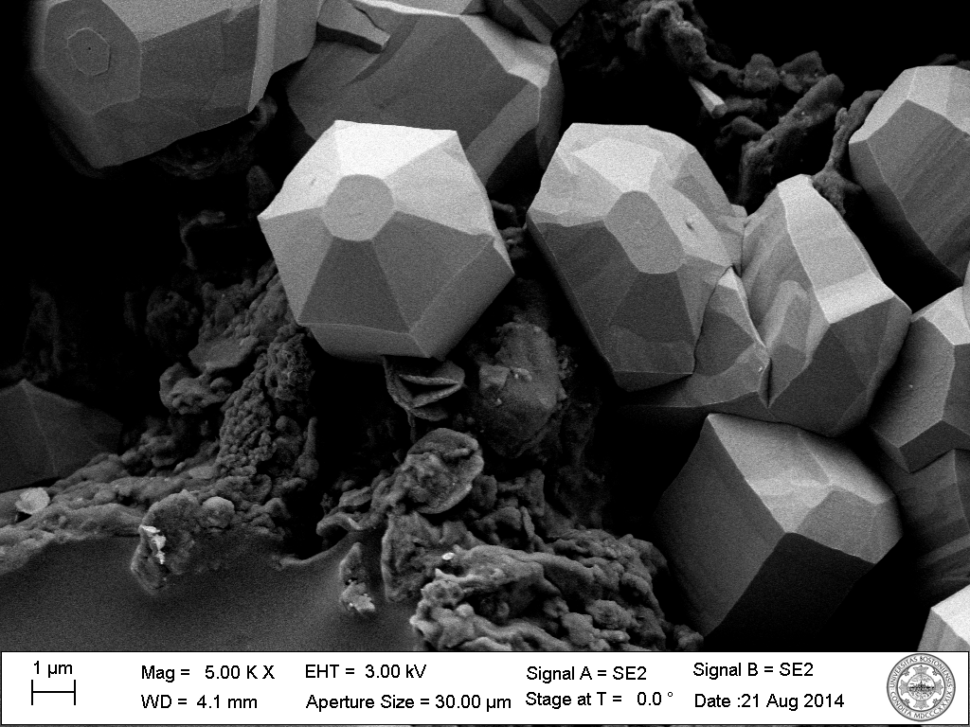
Improving Biofuels by Making Nanoparticles
Ag nanowires ZnCl₂ nanoparticles
Notes:
There is an expanding body of knowledge within Materials Science using biomass as a template to form unique nanowires and nanocatalyst particles⁷. In the biomass thermochemical conversion realm we find a plethora of catalytic options to upgrade bio-oils. Combining these two fields’ preliminary results show the ability to tune syngas and bio-oil properties. Initial data collected in PI Goldfarb’s lab shows higher H₂, CH₄, and H₂O syngas is produced and lower acidity (and water content) of bio-oil – while simultaneously producing silver nanowires (Fig.3) and zinc oxides nanoparticles with BET surface areas greater than 64 m²/g. In this novel approach to the biorefinery, we can increase the diversity of products while decreasing overall process steps, lowering pyrolysis temperatures, while performing in situ upgrading and dehydration of bio-oil.

Slide 5
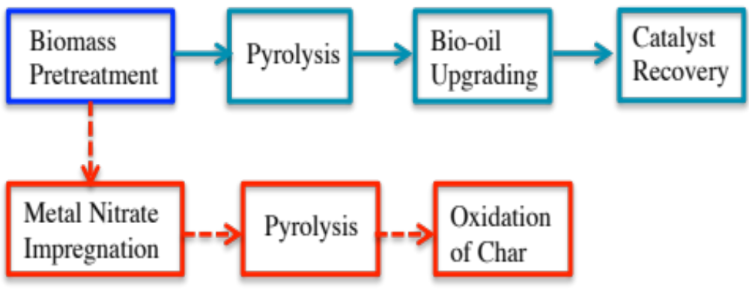
Reimagining the Integrated Biorefinery
Traditional Pathway
In situ Upgrading Pathway
Notes:
In recent years, biomass-to-biofuel conversions have come under scrutiny in terms of their total energy balance, fiscal, and environmental externalities. This is partly overcome by the modern concept of the integrated biorefinery^{1,2}. A promising route to obtain liquid biofuels and chemicals from biomass is pyrolysis. However, one of the primary issues with pyrolysis is the high oxygen content and acidity of pyrolysis oils, which render them corrosive to engines and refinery units, as well as unstable for storage due to intense aging^{3,4}. It is possible to upgrade pyrolysis bio-oils through chemical and thermal means, such as high pressure and catalytic transformations⁵, though these methods may suffer from catalyst poisoning and high materials and operation costs⁶. These issues are addressed by a new approach to the integrated biorefinery concept: by incorporating metal nitrates into the cellulosic feedstocks we can simultaneously engineer high-value nanomaterials and upgrade pyrolysis bio-oils in a single step, eliminating the need for costly upgrading; rendering the process more economically advantageous ¹Koonin, S.E. Science, 2006, 311, 435 ² Cherubini, F. Energy Conversion and Management. 2010, 51, 1412. ³ Mohan,D.,et al. Energy and Fuels, 2006, 20, 848. ⁴Hilten, R.N., Das, K.C. Fuel, 2010, 89, 2741. ⁵ Vispute, T.P. et al. Science. 2010, 330, 1222. ⁶ Bridgwater, A.V. Biomass and Bioenergy. 2012, 38, 68. ⁷ Fan,T.-X. et al. Progress in Materials Science. 2009, 54, 542.

Slide 6
Lab Expectations
Be inquisitive, take initiative, think before doing
Communicate with lab members daily
Don’t start something if you can’t finish it – this includes clean up!
Weekly status reports via Dropbox (by Friday@5pm)
Attendance at lab group meetings (Tuesdays@10am)
Notify Prof. Goldfarb of any equipment issues or supply needs immediately – don’t squander research time!

