Slide 1
Boston University Photonics Center National Science Foundation Research Experiences for Undergraduates Site in Integrated Nanomanufacturing
Co-Directors: Prof. Xin Zhang and Prof. Helen Fawcett
Faculty Mentor: Prof. Tom Bifano

Slide 2
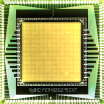
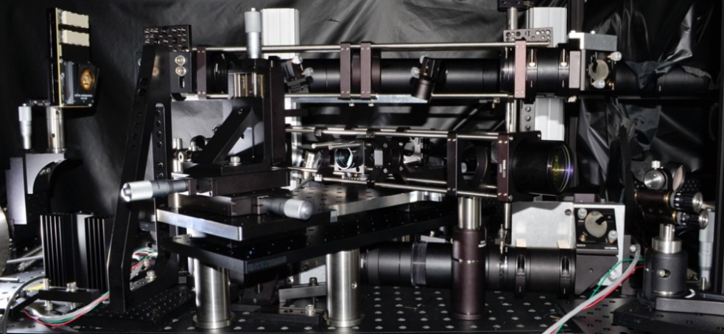
Introduction of Laboratory
Precision Engineering Research Lab:
We use deformable mirrors to improve optical imaging systems such as microscopes and telescopes, and we build optical instruments.

Slide 3
Lab Members
Thomas Bifano, Professor of ME, Director, BU Photonics Center
Chris Stockbridge (doctoral student, ME)
Hari Paudel (doctoral student, ECE)
Will Shain (doctoral student, Physics)
Devin Beaulieu (masters student, ME)
Sarah Taoudi (masters exchange student, optics, France)
Jesus Ramos (REU undergraduate intern, EE, Univ. Puerto Rico Mayaguez)
George DeGregorio (RET teacher intern, Biology, East Boston High School)

Slide 4
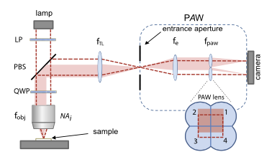
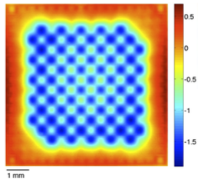
REU Project Description
Build, with Sarah Taoudi, a partitioned aperture wavefront (PAW) reflective optical surface mapping instrument that will be able to measure topography at high speed on any continuous surface with nanometer-scale precision

Slide 5
How the REU project integrates with lab research
Along with colleagues in the Mertz lab, we have recently demonstrated an improved way to compensate aberrations in biological microscopes. The transmissive PAW sensor is a key enabler for us because it allows us to measure wavefront shape. Our industry partner (Thorlabs) would like to see a reflective version of PAW, as a possible commercial product. This will be that prototype.

Slide 6
Day to Day expectations for lab work
We work from about 8:30AM - 4:30PM
Lasers in the lab are potentially dangerous. Follow all instructions and be careful around all light sources.
We value cooperation and mutual support.
Dr. Bifano is frequently away, so collaboration with grad students is essential.
We have large group meetings on Friday at 11AM.

