Slide 1

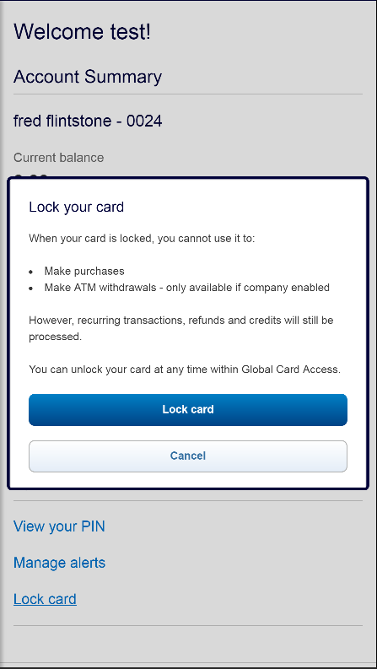
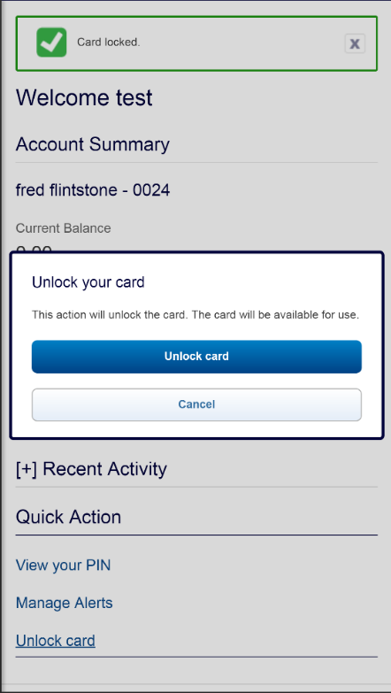
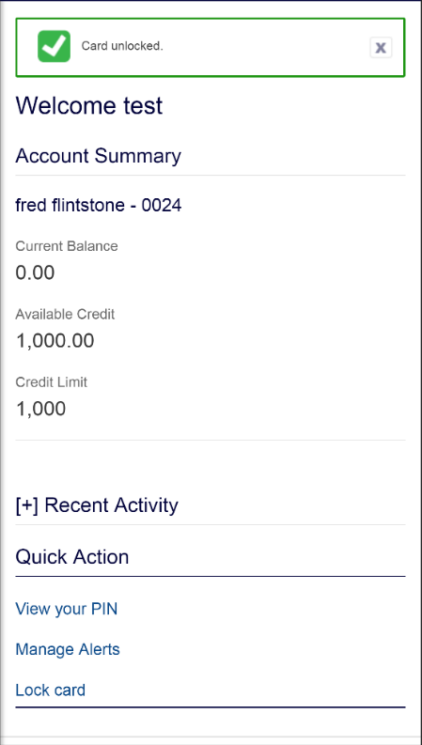
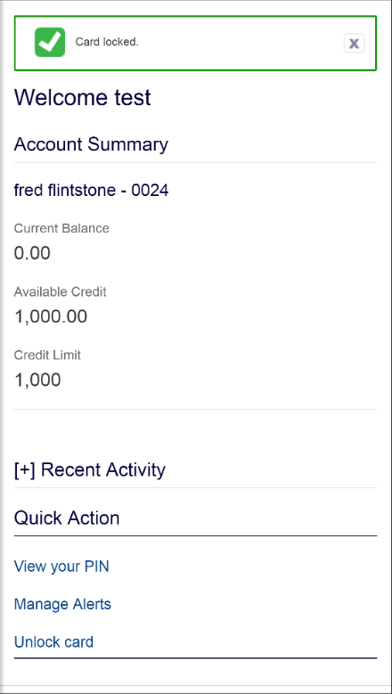

New feature - Lock/Unlock card
New feature - Lock/Unlock card
The Lock/Unlock Card feature is available to all cardholders globally
3
6
Notification that card is locked.
Notification that card is unlocked.
2
Action box displays providing explanation of the feature and how to enable.
5
Action box
displays providing explanation to disable the feature.
1
4
Select
Lock Card from the Quick Action Menu
Select
Unlock Card
from the Quick Action Menu
Lock/Unlock is a cardholder-controlled feature.
Cardholder servicing can proxy in and lock/unlock card as needed.
PAs can “opt out” of this tool for their program, if desired.
* Subject to EMEA and APAC Strong Customer Authentication Requirements

