Slide 1
The Business of Energy
The John E Sawyer Seminar: Energy and Society
Paul McManus
Executive-in-Residence & Lecturer Strategy & Innovation Department
Managing Director Institute for Technology Entrepreneurship and Commercialization (ITEC)
Boston University
School of Management
595 Commonwealth Avenue
oston, MA 02215

Slide 2
The Business of Energy
Revolutions
Challenges
Innovations
Opportunities

Slide 3
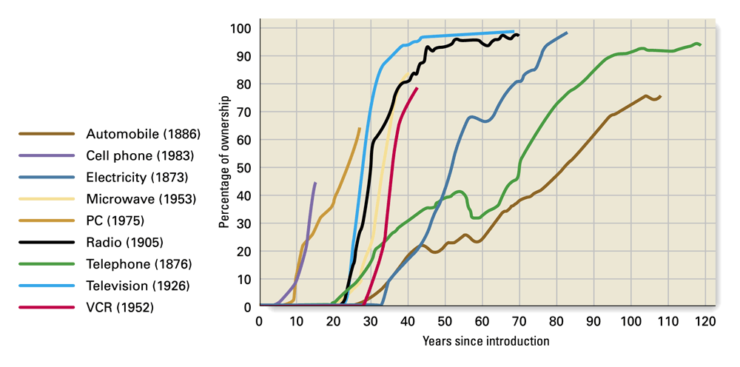
Innovation Adoption Follows a well studied and Predictable Pattern at the Product Level
Source: Peter Brimelow, “The Silent Boom,” Forbes, July 7, 1997, pp. 170-171. Reprinted by permission of Forbes Magazine © 2002 Forbes, Inc.

Slide 4
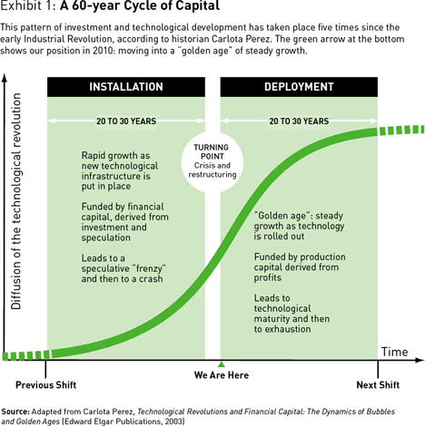
Powering Waves of Change for Industries and Society:
The 60 Year Capital Cycle

Slide 5
A History of
Technological Revolutions & Paradigm Shifts

Slide 6
Or Perhaps, Paradigm “Drifts”
Why?

Slide 7
Challenges: Product Attribute-Based Diffusion
Roger’s Five Rules
Relative Advantage
  Is the new recognized as being superior to the old?
Compatibility
  Is the new recognized as compatible and consistent with existing values?
Complexity
  Is the new perceived as familiar and easy to use?
Trialability
  Can the new be tried out on a limited basis?
Observability
  Are the benefits visible to others?
Diffusion of Iinovaitn, Everett Rogers, The Free Press 199
Corssing the Chasm, Georfrey Moore ,

Slide 8
Challenges: Consumer Attribute-based Diffusion
Laggards
Late
Majority
Market
Penetration
Early
Majority
Early
Adopter
Innovators
Embryonic Growth Maturity
Stage of Development
Diffusion of Iinovaitn, Everett Rogers, The Free Press 199
Corssing the Chasm, Georfrey Moore ,

Slide 9
Consumers Are Normally Distributed
25%
45%
1%
5%
24%
Innovator
Early Adopter
Early Majority
Late Majority
Laggards
Diffusion of Iinovaitn, Everett Rogers, The Free Press 199
Corssing the Chasm, Georfrey Moore ,

Slide 10
But Don’t Behave Consistently across the Spectrum
Geoff Moore’s
Chasm
Innovator
Early Adopter
Early Majority
Late Majority
Laggards

Slide 11
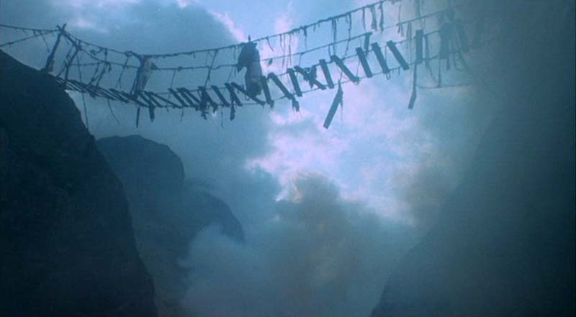
Innovations must cross the chasm to reach mainstream markets….
Underlying assumption: You’ve got to get the pricing right

Slide 12
Reference-ablity Between
EA’s and EM’s is Weak
Geoff Moore’s
Chasm
Innovator
Early Adopter
Early Majority
Late Majority
Laggards
Early Adopter | Early Majority
Visionary Adventurous Eager to try new things Think “big picture” Act independently Strategic Investor First mover advantage Think pragmatists are pedestrian | Pragmatists Prudent No need to rush, see if it works Manage expectations Part of “the herd” ROI-based spender Sustain competitiveness Thinks visionaries are dangerous loose cannons

Slide 13
Innovation: The Business Model is increasingly becoming the tool of the revolutionary
INFRASTRUCTURE
PARTNER
NETWORK
OFFER
CUSTOMER
RELATIONSHIP
CUSTOMER
CORE
CAPABILITIES
VALUE
PROPOSITION
TARGET
CUSTOMER
VALUE
CONFIGURATION
DISTRIBUTION
CHANNEL
COST
STRUCTURE
FINANCE
REVENUE
STREAMS
A business model describes the value an organization offers to various customers and portrays the capabilities and partners required for creating, marketing, and delivering this value and relationship capital with the goal of generating profitable and sustainable revenue streams
Source Alexander Osterwalder:

Slide 14
More than Half of the New Fortune 500’s Since 1995
Have Been Business Model Innovators
Amazon.com
AutoNation
BJ’s Wholesale Club
Blockbuster
CarMax
Community Health Systems
DaVita
eBay
Express Scripts
GameStop
Google
Qualcomm
Starbucks
Yahoo

Slide 15
Business Model Innovations that Address the Rogers/Moore Challenges will be key to the Success of the Energy Industry in the 6th Wave
Servicizing of Products
  Soaltage Inc. - PV Solar Servicizer
  ZipCar – Transportation Sevicizer
Aggregation of Services
  ActewAGL - Australia's first multi-utility to offer electricity, natural gas, water and wastewater services under one roof
Franchising
  SunPower – PV Installation Franchiser

Slide 16
Innovations within Existing Business Models will Complement
Cross Ecosystem Partnerships
  Entrepreneurial new ventures will continue to drive innovation
  MNC bring global scale and scope
Resurgence of Corporate Venture Capital
Pubic/Private partnerships will be important tools

Slide 17
Opportunities:
Taking the Lead from the Sustainability Movement
Constraints are an opportunity
Drive programs conservation and efficiency
Design products and services
Develop new business models
Create “Next Practice” platforms
  Driven by changes in fundamental assumptions about industries, markets and value chains
Adapteed form:
“Why Sustainability Is Now the Key Driver of Innovation",
Ram Nidumolu, C.K. Prahalad, M.R. Rangaswami, HBR R0909E

Slide 18
Opportunities:
Game Changing Next Practice Platforms
The Smart Grid a a Two-Sided Business Platform
Both information and power will flow in multiple directions
New Businesses & business models emerge to leverage the exponential increase in information flow on the network, tremendous value will be added to the ecosystem.

Slide 19
Conclusions About the Business of Energy
Going through a revolutionary change
  But we’ve done this sort of things before
Facing major challenges in to diffusion/adoption
  Must get the pricing, packaging right & deal with the human side of adoption
Need for Innovation
  On both the technology and business model sides
Opportunity for us to enter a new “Golden Age”
  Shift toward new practices platforms will create smooth transitions to new paradigms, economic growth and prosperity.

