Slide 1
Guided BUying QRG
Quick Reference Guide
Invoice Payment Holds

Slide 2
Invoice Payment Hold

Slide 3
Invoice Payment Holds
How does the Guided BUying process stop invoices?
The requisitioner is responsible for validating all invoices. Requisitioners will be able to view invoices in the system and place them on hold if there is a discrepancy on the invoice or services/orders delivery is not complete.
Invoice over $5,000*
Invoice under $5,000
Requisitioners approve all invoices over $5,000 and Contract BPO Non-Release invoices
Approvers are notified via email and the invoice will be available in the “To Approve” list in Guided BUying.
Approvers are required to act in the system and approve the invoice to generate payment.
Requisitioners will be added as a watcher for invoices under $5,000.
Watchers are notified via email to validate the invoice and the invoice will be available in the “To Watch” list in Guided BUying.
After three days, invoices under $5,000 will auto-release payment unless placed on hold by the requisitioner in BUworks.
Hold Process
Hold Process
When approval is required, the invoice will hold for the approver to perform certain actions such as:
  Validate the invoice
  Perform modifications to the invoice such as “Manage Accounting”
  Add another Ariba user as a watchers or approver in the approval flow tab for colleagues to review an invoice.
Payment is generated when all approvers in the “Approval Flow” tab on the invoice has completed approval.
When the requisitioner requires the invoice payment to be held longer than three days, the requisitioner can place a hold on the invoice payment in BUworks.
The requisitioner will contact Accounts Payable when ready to complete one of the two actions below:
  Release Invoice Payment
  Reverse Invoice Payment
Submit a ticket to Accounts Payable via the Financial Affairs Customer Service Portal.
*Applies to Contract BPO Non-Release Invoices as well.

Slide 4
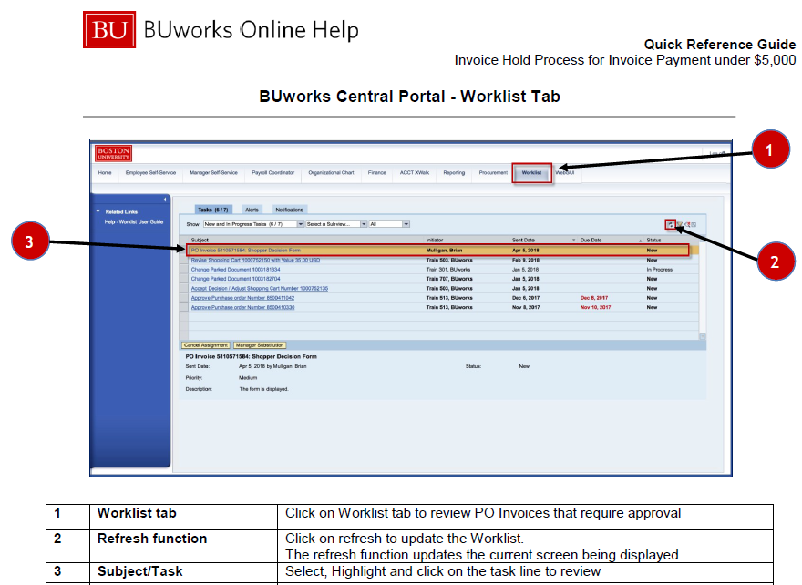
Invoice Payment Hold Process in BUworks

Slide 5
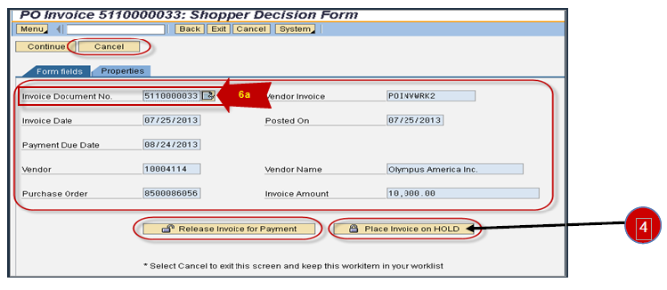
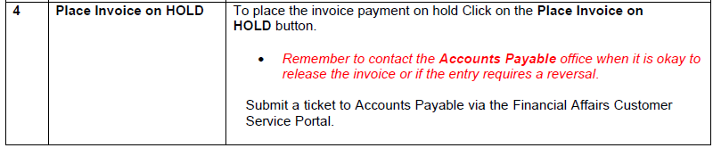
Invoice Payment Hold Process in BUworks

Slide 6
Additional Resources: Guides, FAQ, and Assistance
Guides & FAQs
How to Place Orders
FAQs
Invoice Guides and FAQ
Contact Us
Ordering Information: Submit a ticket to Sourcing & Procurement via the Financial Affairs Customer Service Portal.
Invoice & Payment Information: Submit a ticket to Accounts Payable via the Financial Affairs Customer Service Portal.
6

