Slide 1
Guided BUying QRG
Quick Reference Guide
Invoice Notifications:
Approval and Exception

Slide 2
Invoice Approval Notifications

Slide 3
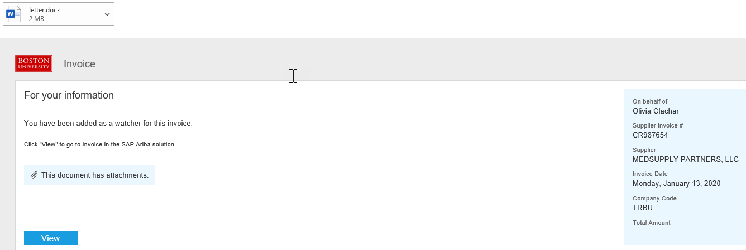
Invoice Watcher: Email Notification
All invoices require validation from the Requisitioner. Requisitioners are added as a Watcher to review all invoices for purchase orders submitted to a supplier.
1
Clicking View will redirect you to Guided BUying
to validate the invoice.
1
Note: Watcher email notifications are sent to Requisitioners for invoice validation for all invoices under $5000 in value.

Slide 4
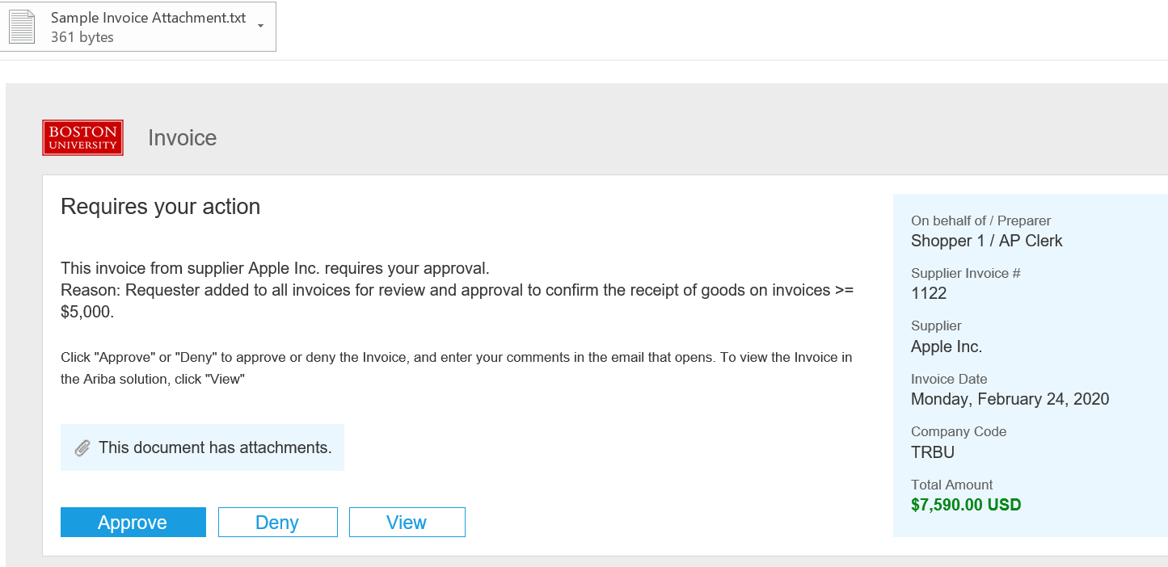
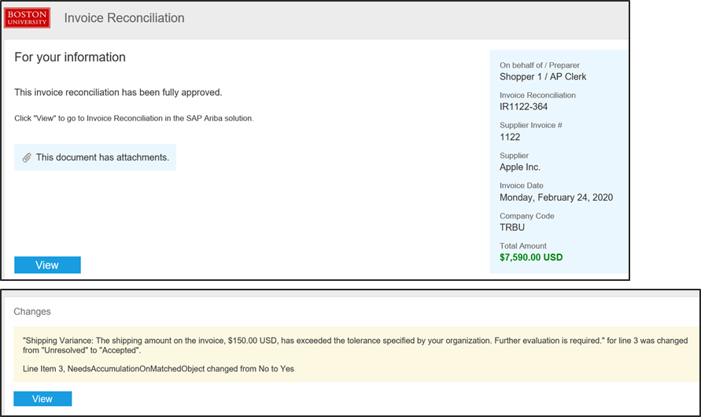
Invoice Approval: Email Notification (1 of 4)
Invoice approval email notifications alerts the requisitioner when an invoice is ready to be approved.
Note: Invoice approval is forwarded to the Requisitioner for all Invoices exceeding $5000 in value.

Slide 5
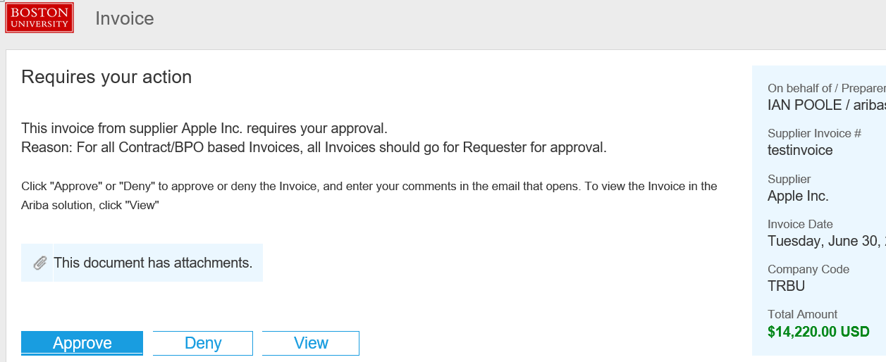
Invoice Approval: Email Notification (2 of 4)
Invoice approval email notifications for a Contract Non-Release that requires accounting information, select View to navigate to Guided BUying to add the appropriate cost center.
1
Click on View for Contract Non-Release invoices.
1
Note: Invoice approval is forwarded to the Requisitioner for all Contract Non-Release Invoices.

Slide 6
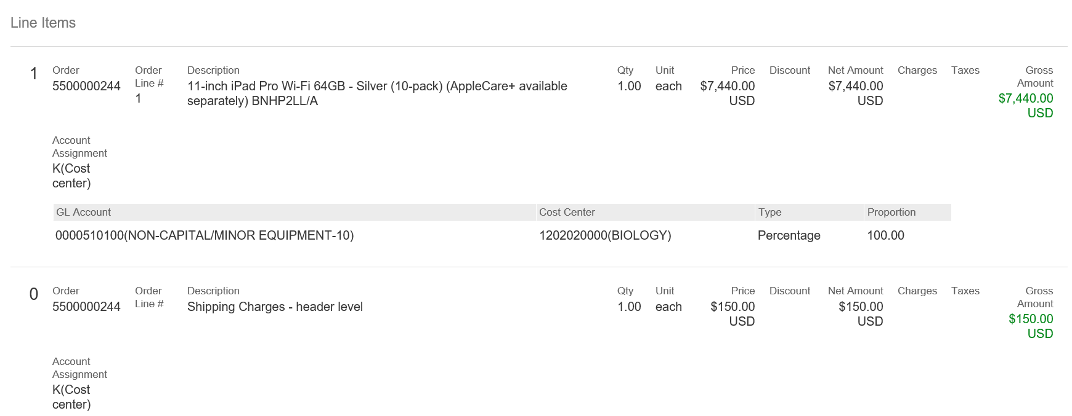
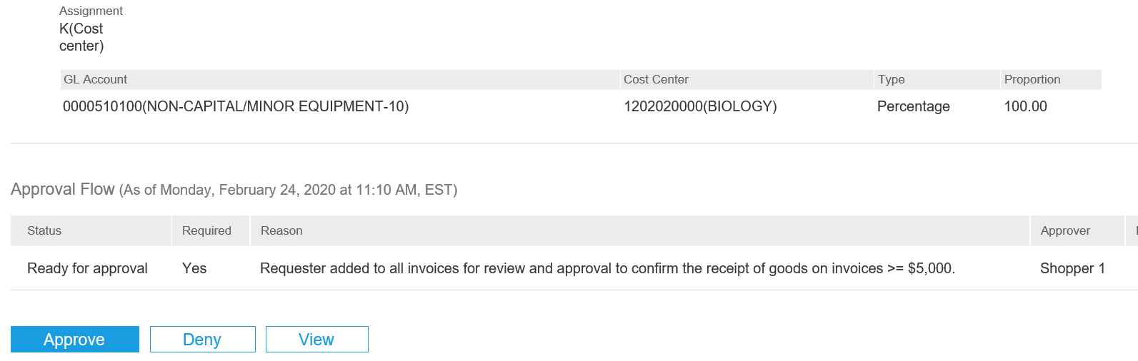
Invoice Approval: Email Notification (3 of 4)
Invoice approval email notification
2
Scroll down in the email body to view line item details.
Once you have reviewed the information, click Approve or Deny as applicable.
Note: This does not apply to Contracts Non-Release. Click on View for Contracts.
2
3
4
If information available in the email is not sufficient, you can click View to review each section of the requisition in Guided BUying.
3
4

Slide 7
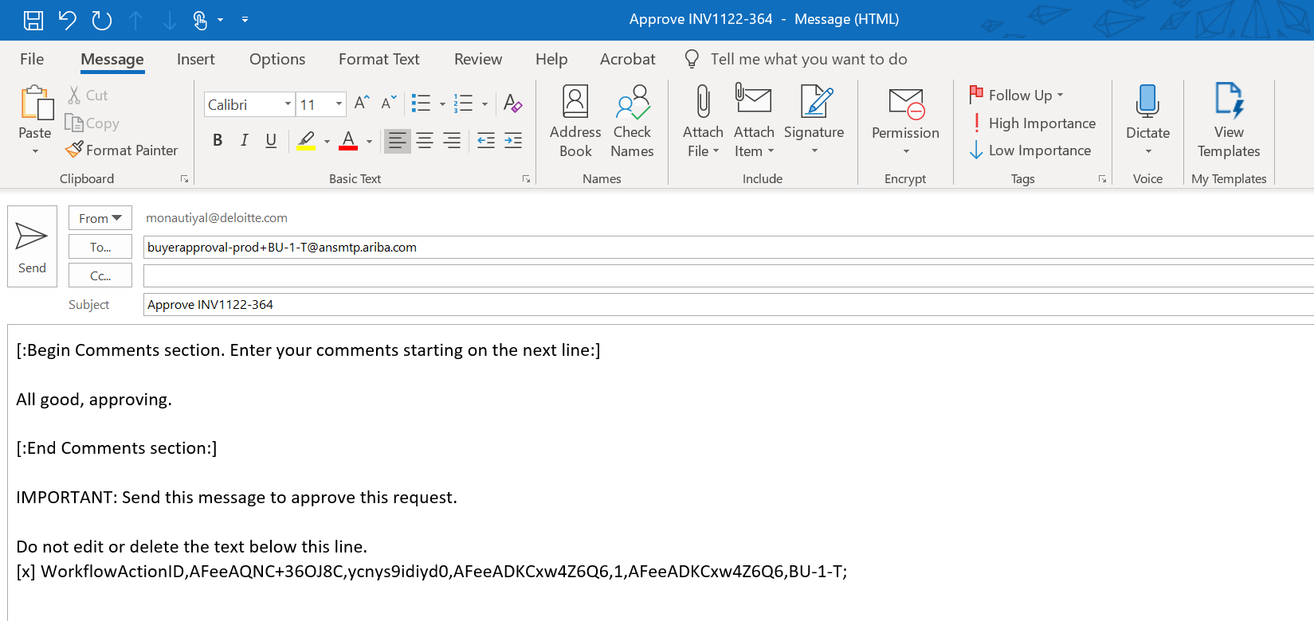
Invoice Approval: Email Notification (4 of 4)
Invoice approval email notification
5
A new email window will open. Enter any comments below the Begin Comments section in the body of the email. This is an optional step. However, it is recommended to include comments when denying a request.
Click Send.
6
5
6

Slide 8
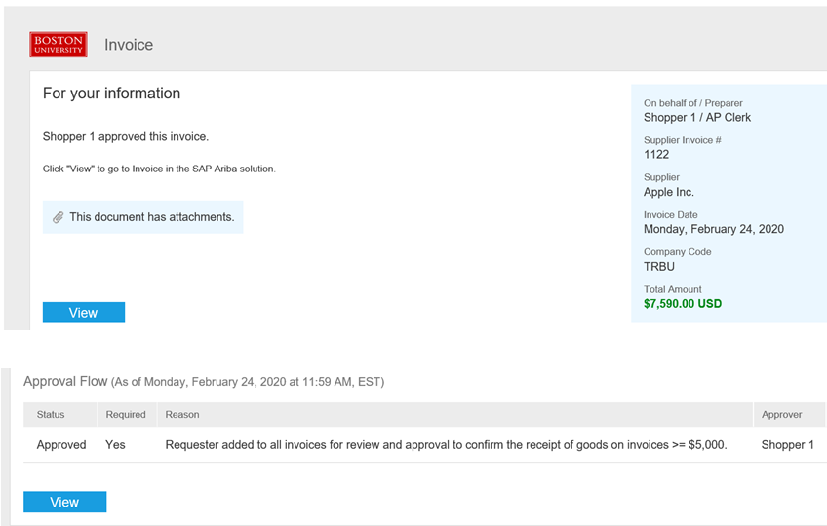
Invoice Approval
Once invoice is approved, an email notification will be sent to you.
1
Upon completion of invoice approval, an email notification is sent to the requisitioner, approvers and watchers. The approver information is displayed in the email.
17
Scroll down to bottom of the email to view current status of the invoice.
18
1

Slide 9
Invoice Exceptions Notifications

Slide 10
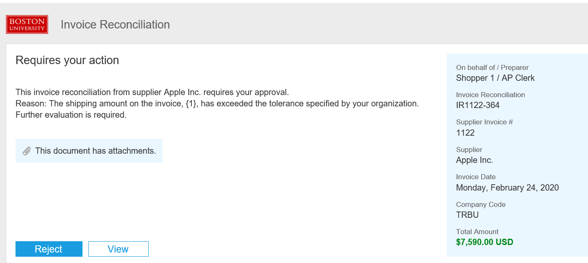
Invoice Exceptions
Invoice Exceptions Notification (1 of 2)
If an invoice exception is generated, the requester will be notified through email stating exception reason.
1
Open the email notification and click view.
You will be redirected to the invoice exception page in Ariba Guided Buying.
1
1

Slide 11
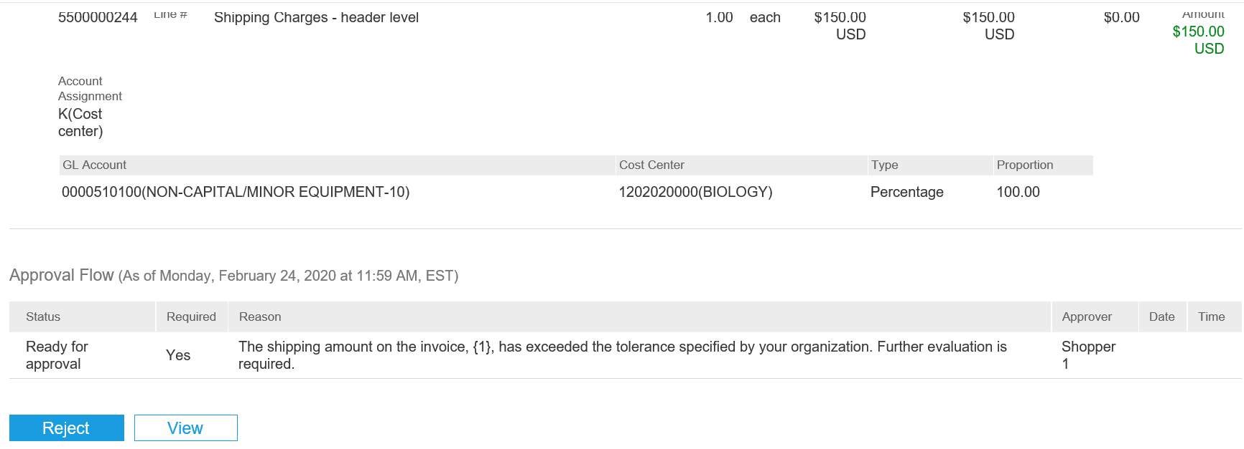
Invoice Exceptions
Invoice Exceptions Notification (2 of 2)
The notification also contains invoice status, line item detail and invoice attachment.
2
Alternately, scroll down to view the current status, line item detail and reason for rejection.
3
Click View.
2
3

Slide 12
Invoice Exceptions Confirmation Notification
A confirmation email is received once exception has been cleared stating the modifications to the invoice.
1
The invoice reconciliation status can be seen in the notification.
1
2
The details of the exception are available at the bottom of the email.
2

Slide 13
Additional Resources: Guides, FAQ, and Assistance
Guides & FAQs
How to Place Orders
FAQs
Invoice Guides and FAQ
Contact Us
Ordering Information: Submit a ticket to Sourcing & Procurement via the Financial Affairs Customer Service Portal.
Invoice & Payment Information: Submit a ticket to Accounts Payable via the Financial Affairs Customer Service Portal.
13

