Slide 1
Guided BUying QRG
Quick Reference Guide
Manage and Split Accounting

Slide 2
Manage Accounting and Split Accounting

Slide 3
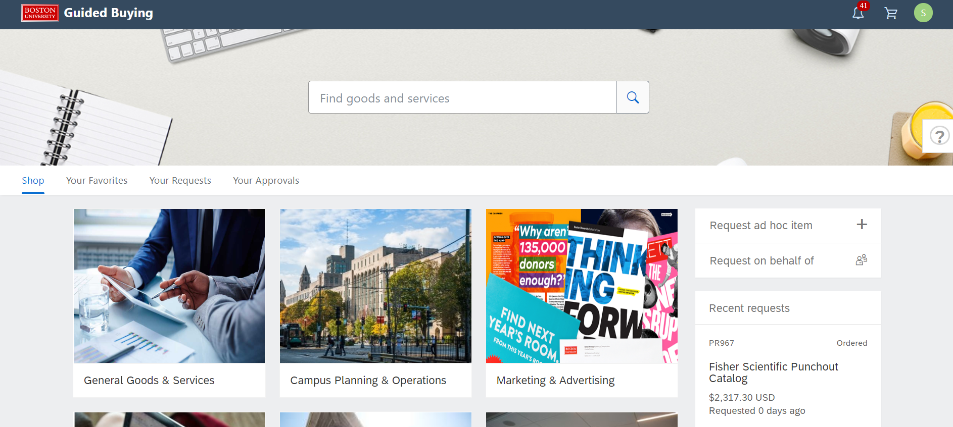
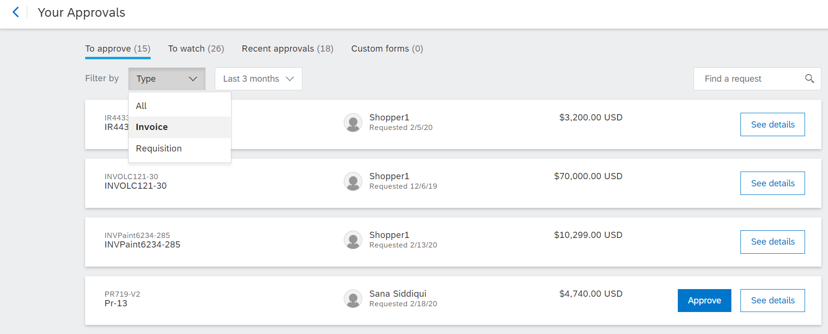
Invoice Approval Page
Search for the Invoice.
1
Click on Your Approvals
1
2
Make sure that To Approve tab is highlighted.
3
From the Filter by drop down, click Invoice.
2
3

Slide 4
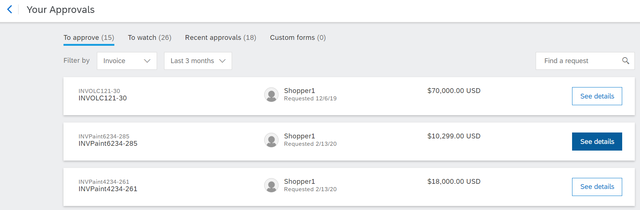
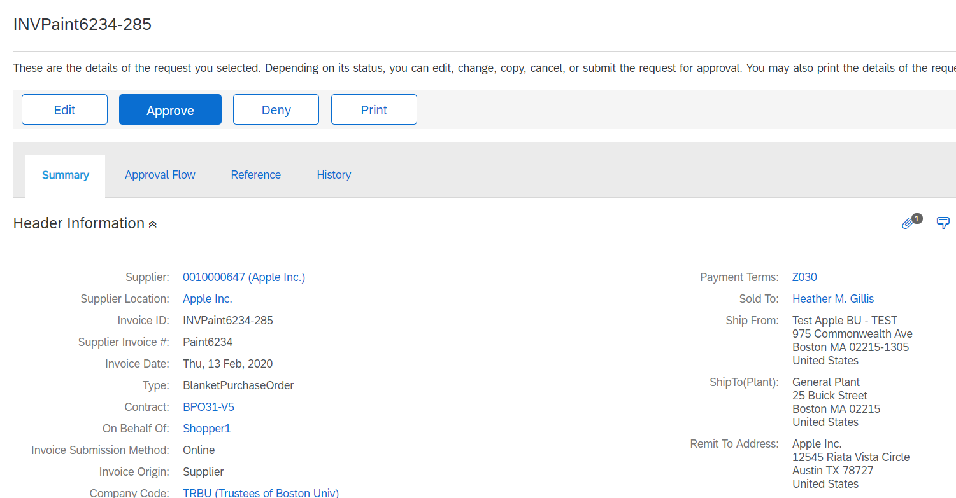
Invoice Approval
Summary Tab - The initial step of the approval process is to review the Summary of the Invoice.
4
Click See details on the Invoice that you want to approve. The invoice number is prefixed with INV and located to the right of the details button.
4
The Summary tab of the selected Invoice will display.
Note: All blue hyperlinks allow you to drill-down to additional information.

Slide 5
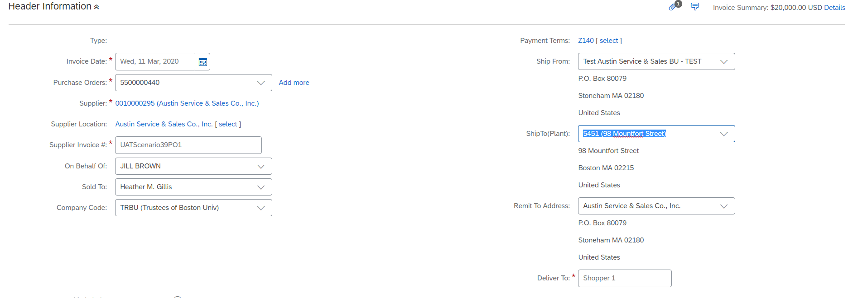

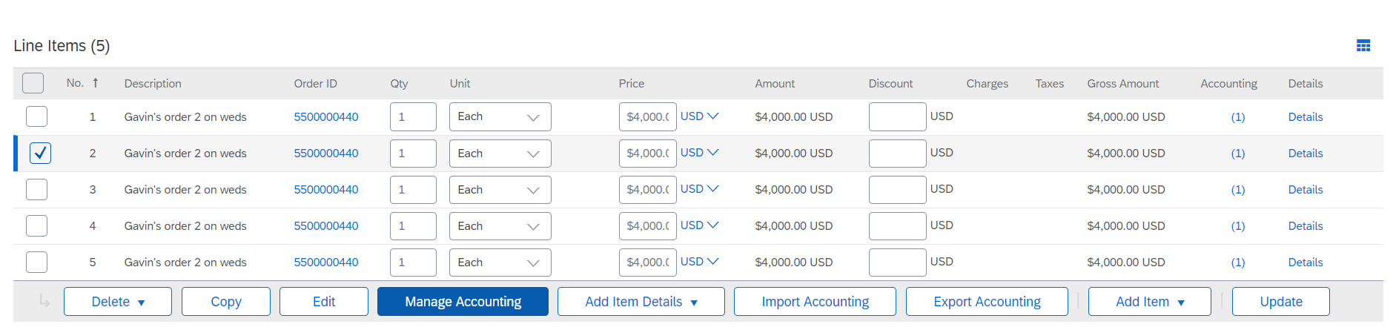
Invoice Approval
Manage Accounting (1 of 2)
At the invoice line item level, modify Cost Object, GL Account Number, and Account Assignment where applicable.
5
Click on Edit and then check off the box next to each line item that require accounting modifications.
5
Click Manage Accounting to update line level accounting details such as cost object or GL account.
Note: Multiple lines can be selected at the same time to make a single modification for all lines.
6
5
6

Slide 6
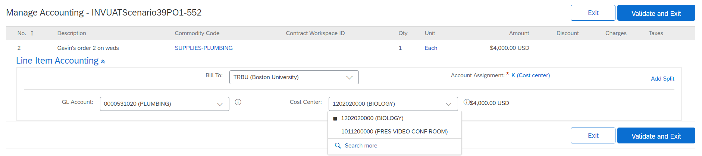
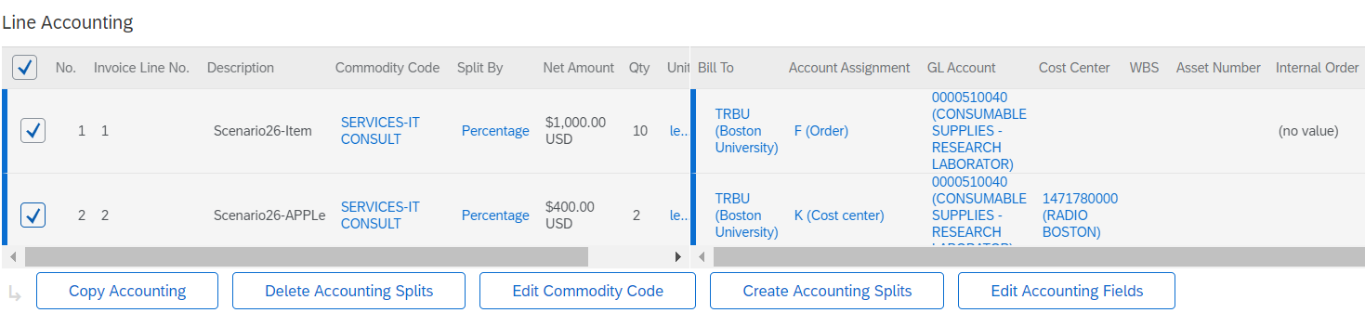
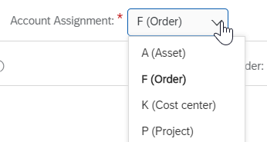
Invoice Approval
Manage Accounting (2 of 2)
Modify an invoice on a single line or multiple lines simultaneously. Contracts require Cost Object and GL Account modification. Purchase Orders also can have the accounting modified prior to invoice submission when needed.
Update the required Cost Center and GL Account by entering the number. To Search, click on drop down arrow and click on Search More. Once accounting is complete, click on Validate and Exit then Submit.
7
7
8
Multiple lines can be modified simultaneously by selecting the line items and clicking managing accounting then click on Edit Accounting Fields. Update the cost accounting fields as noted in step 19. Once complete, scroll to the top and click on Submit.
8
Note: Account Assignment change for an invoice can occur for contracts only. If an invoice for a standard purchase order requires account assignment, then the purchase order will need to be modified.

Slide 7
Invoice Approval
Split Accounting on an Invoice (1 of 2)
9
Create split accounting on a single line by clicking on Add Split.
9
10
Multiple lines can be modified simultaneously by selecting the line items and clicking on Create Accounting Splits.
10

Slide 8
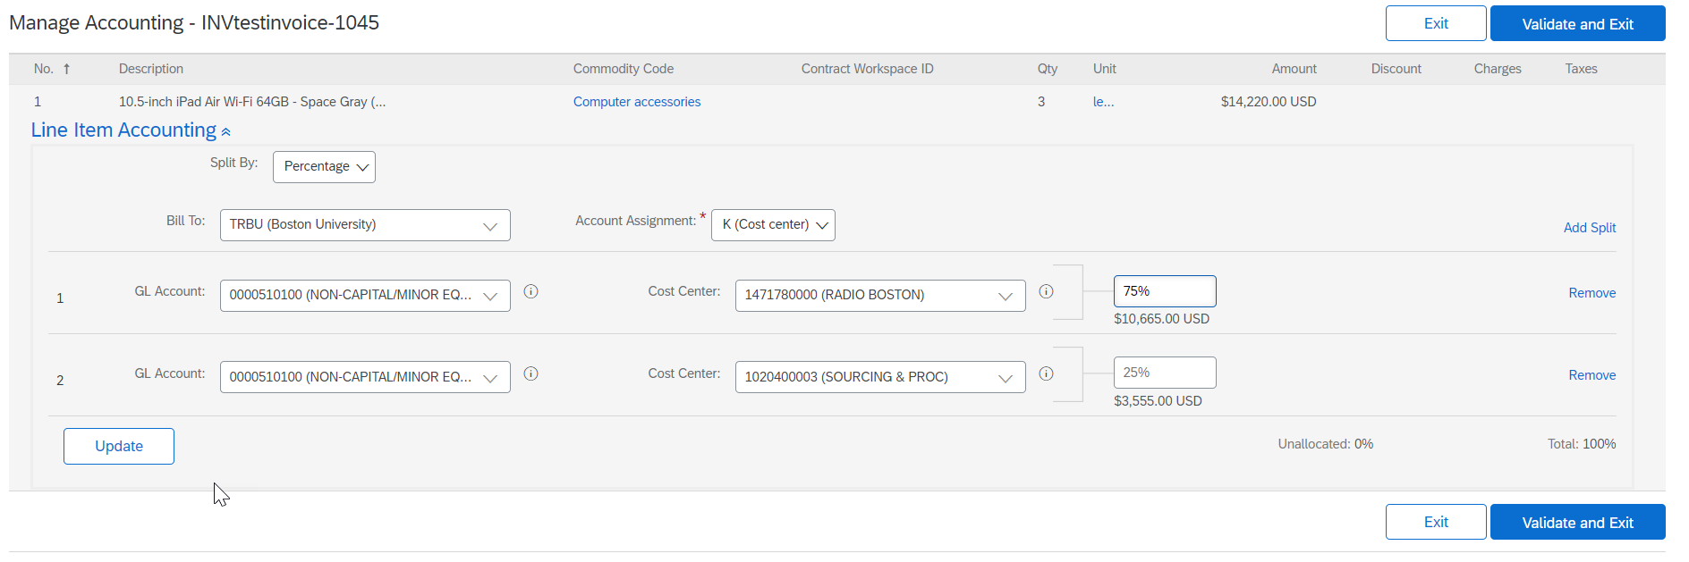
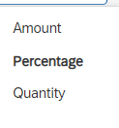
Invoice Approval
Split Accounting on an Invoice (2 of 2)
Create split accounting based on percentage, amount, or quantity in the drop down menu of the Split By field. Enter the corresponding amount.
11
11
12
12
Clicking on Validate and Exit then click on Submit.

Slide 9
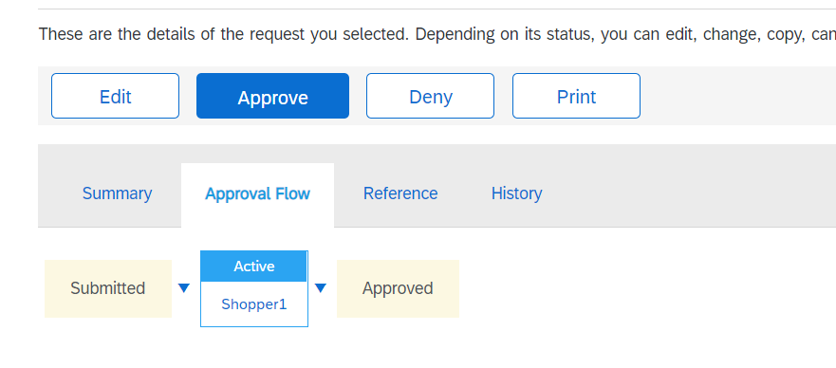
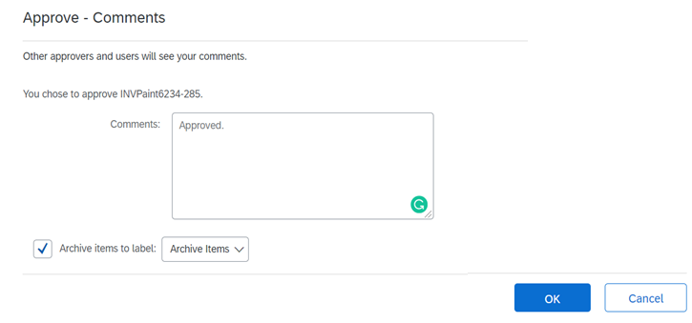
Invoice Approval
Final step after complete review of the invoice is to approve or deny the Invoice.
13
Click on Invoice and click on Approve or Deny.
Note: Click Deny if you want to reject the invoice.
13
14
Enter comments in the comments box (Comments are optional).
14
15
Click OK.
15

Slide 10
Additional Resources: Guides, FAQ, and Assistance
Guides & FAQs
How to Place Orders
FAQs
Invoice Guides and FAQ
Contact Us
Ordering Information: Submit a ticket to Sourcing & Procurement via the Financial Affairs Customer Service Portal.
Invoice & Payment Information: Submit a ticket to Accounts Payable via the Financial Affairs Customer Service Portal.
10

