Slide 1
Guided BUying QRG
Quick Reference Guide
Add an Invoice Watcher or Approver

Slide 2
Add an Invoice Watcher or Approver

Slide 3
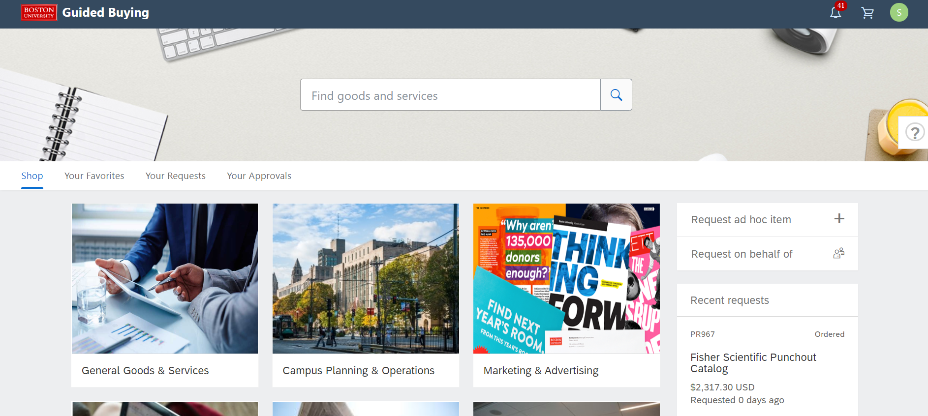
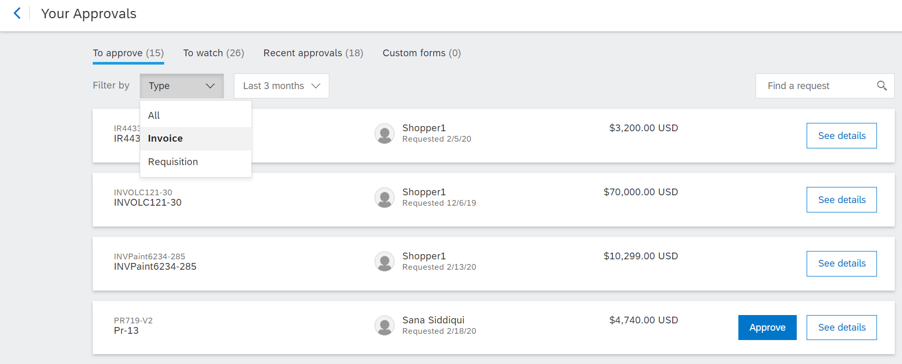
Invoice Approval Page
Search for the Invoice.
1
Click on Your Approvals
1
2
Make sure that To Approve tab is highlighted.
3
From the Filter by drop down, click Invoice.
2
3

Slide 4
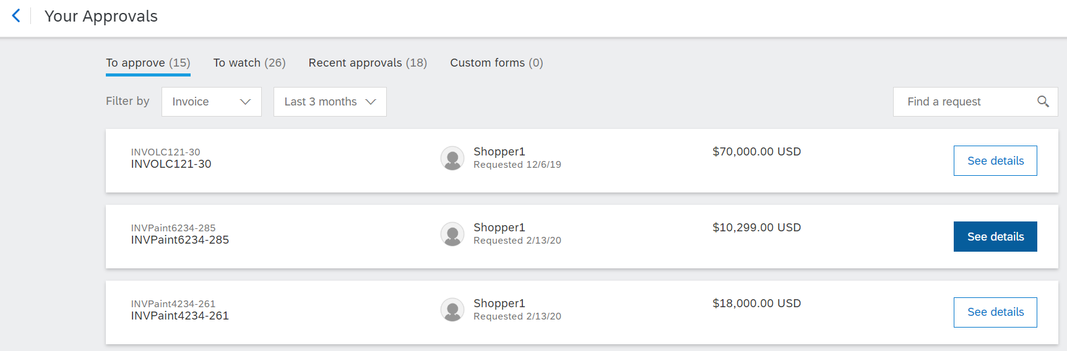
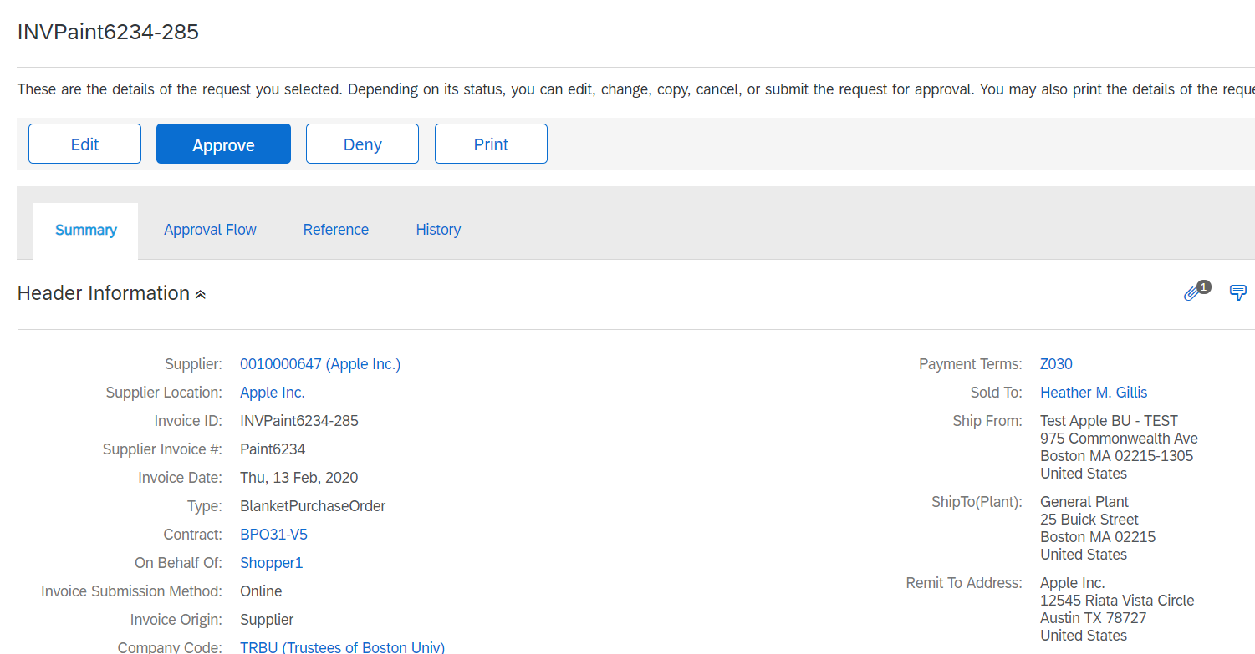
Invoice Approval
Summary Tab - The initial step of the approval process is to review the Summary of the Invoice.
4
Click See details on the Invoice that you want to approve. The invoice number is prefixed with INV and located to the right of the details button.
4
The Summary tab of the selected Invoice will display.
Note: All blue hyperlinks allow you to drill-down to additional information.

Slide 5
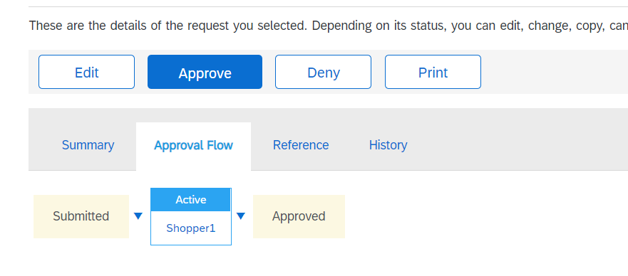

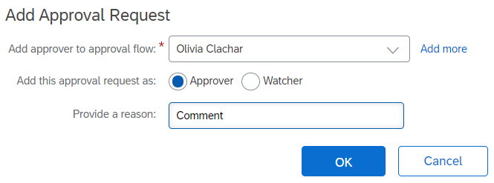
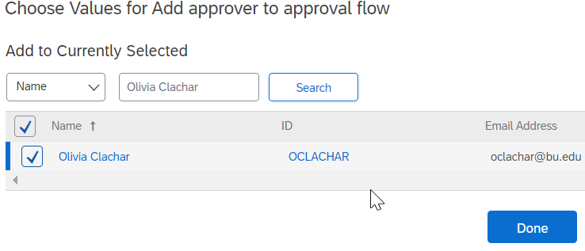
Invoice Approval
Manually Adding Approvers or Watcher to an Invoice
Click on Approval Flow to view approvers or to Add Approvers to the invoice.
5
5
Add Approvers by clicking on the triangle and select Add Serial Approver.
6
6
Enter Approver Name and provide a reason to the approver. Select either Approver or Watcher. Click on OK.
Note: Click on down arrow and select Search More to find employee name.
7
7

Slide 6
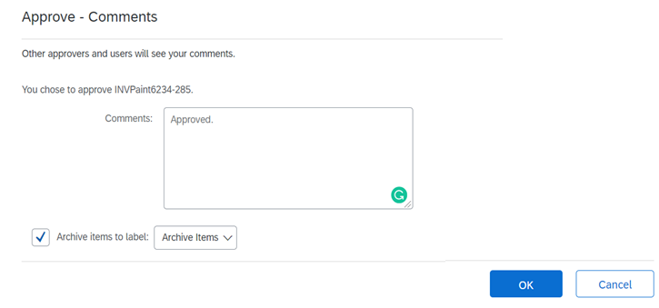
Invoice Approval
Final step after complete review of the invoice is to approve or deny the Invoice.
8
Click on Invoice and click on Approve or Deny.
Note: Click Deny if you want to reject the invoice.
8
9
Enter comments in the comments box (Comments are optional).
9
10
Click OK.
10

Slide 7
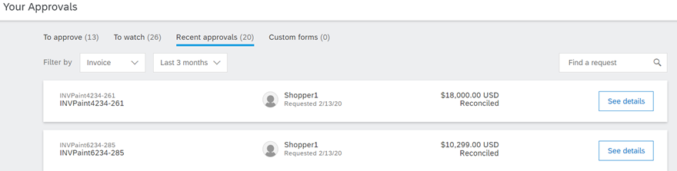
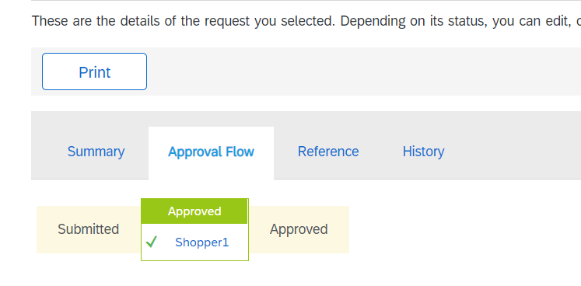
Invoice Approval
Reviewing Approvers or Approval Status - You can review the approvers on an invoice and the invoice approval status.
1
1
Once you are redirected to Your Approvals screen, click on Recent Approvals.
2
2
Click See Details.
3
Click on Approval flow tab. The status has been updated to approved.
3

Slide 8
Additional Resources: Guides, FAQ, and Assistance
Guides & FAQs
How to Place Orders
FAQs
Invoice Guides and FAQ
Contact Us
Ordering Information: Submit a ticket to Sourcing & Procurement via the Financial Affairs Customer Service Portal.
Invoice & Payment Information: Submit a ticket to Accounts Payable via the Financial Affairs Customer Service Portal.
8

