Slide 1
Networks
NetSci High 2014-2015
Student Team

Slide 2
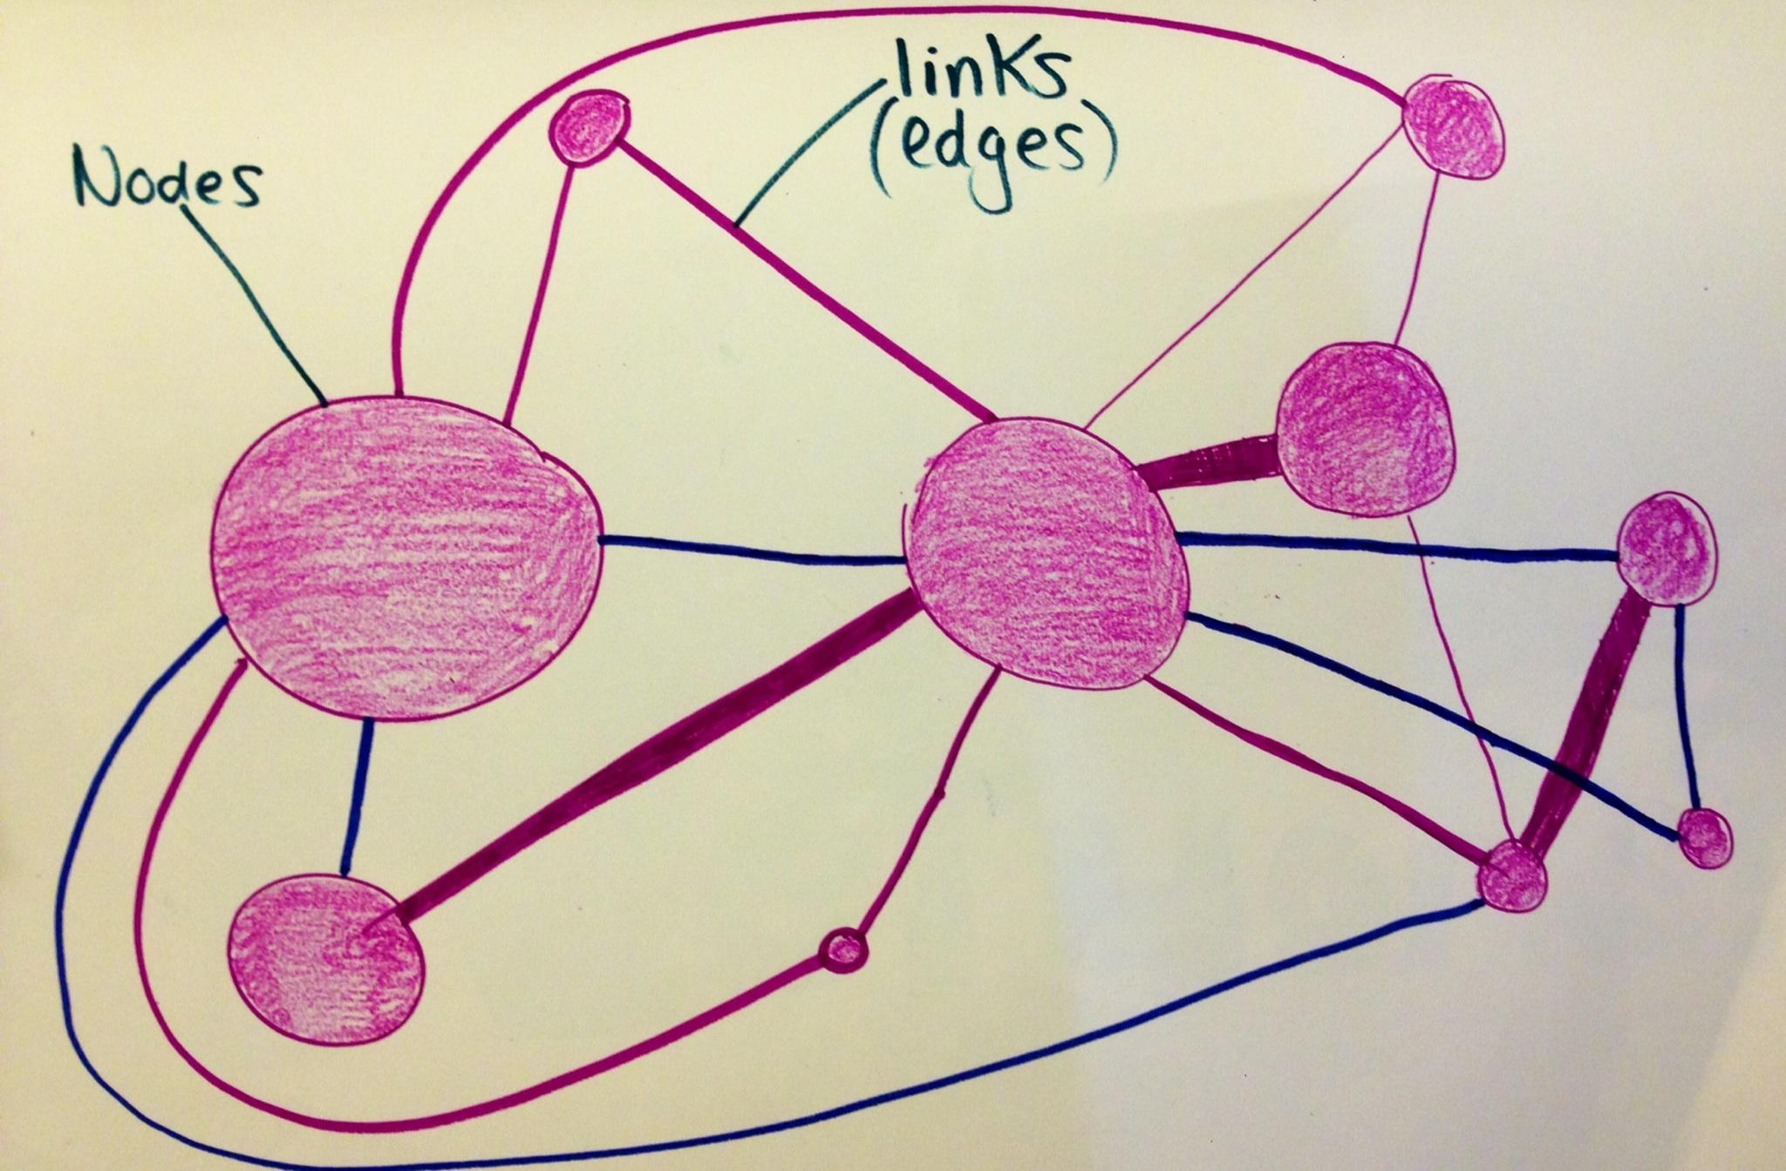
Networks are a series of connections and interactions which can be manipulated and analyzed to draw conclusions.

Slide 3
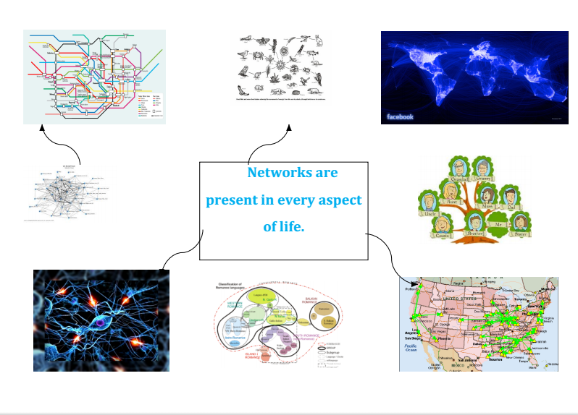
Networks are present in every aspect of life.

Slide 4
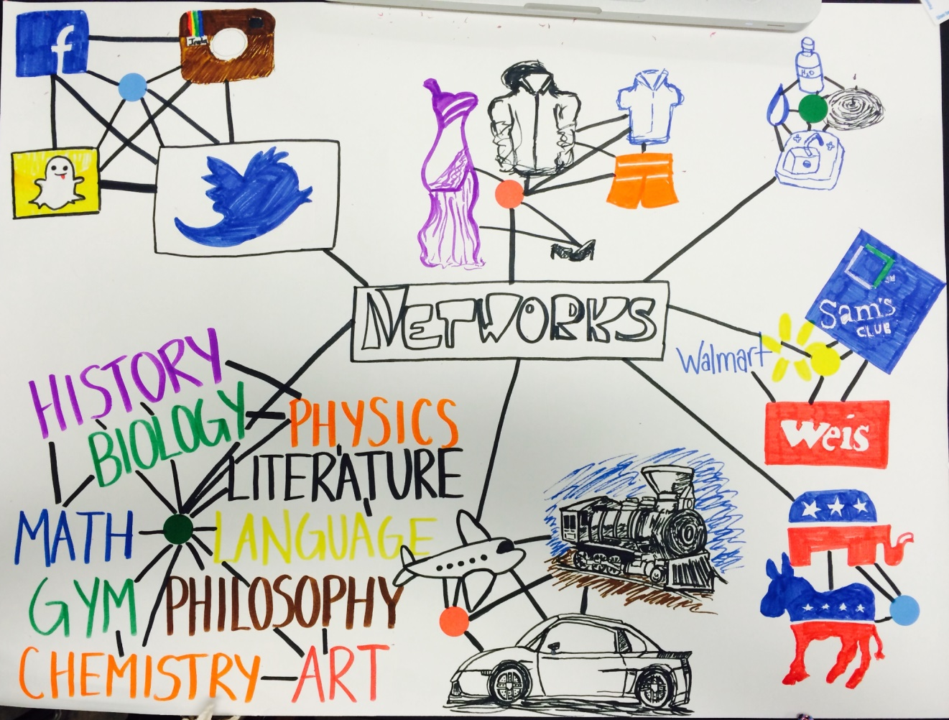
Examples of networks are in the fields of economics, social and political sciences.

Slide 5
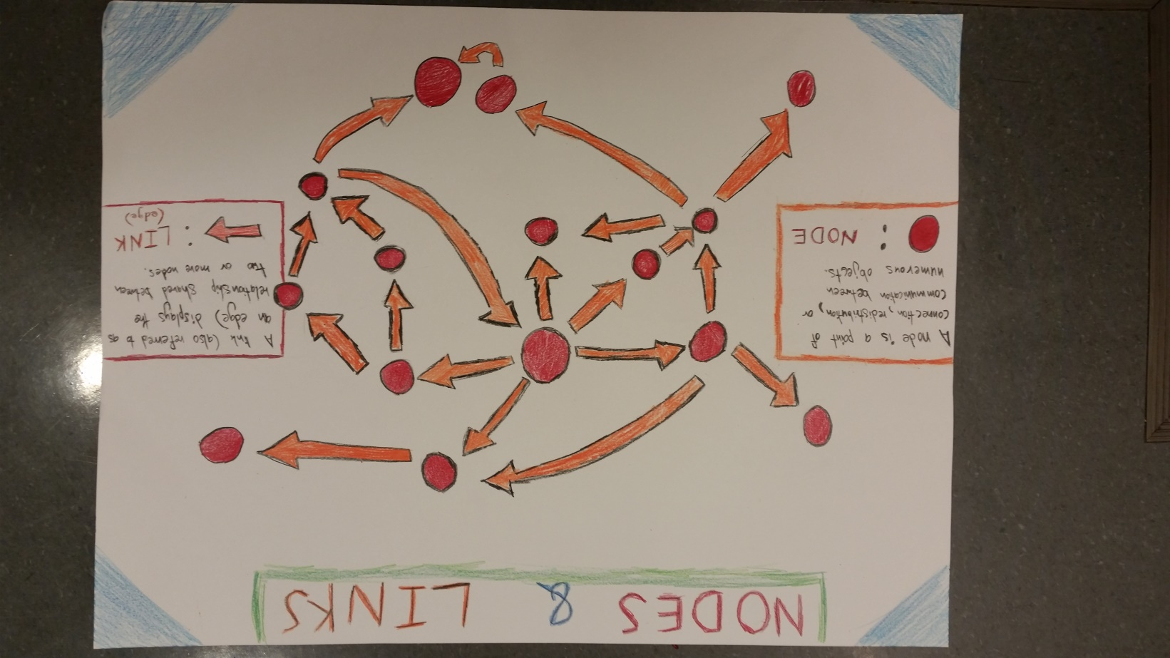
Networks consist of nodes, which are connected by links (directed or undirected), whose degree is used to determine hubs.

Slide 6
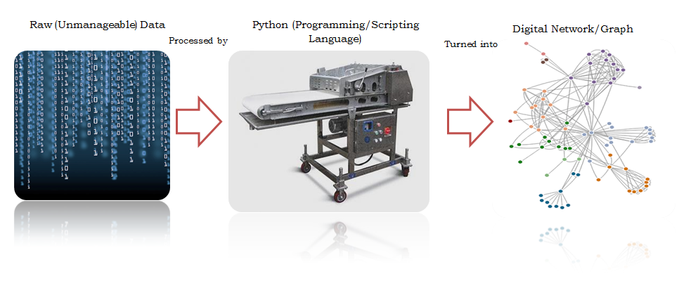
Computer programs are often used to view and manipulate data that make up networks.

Slide 7
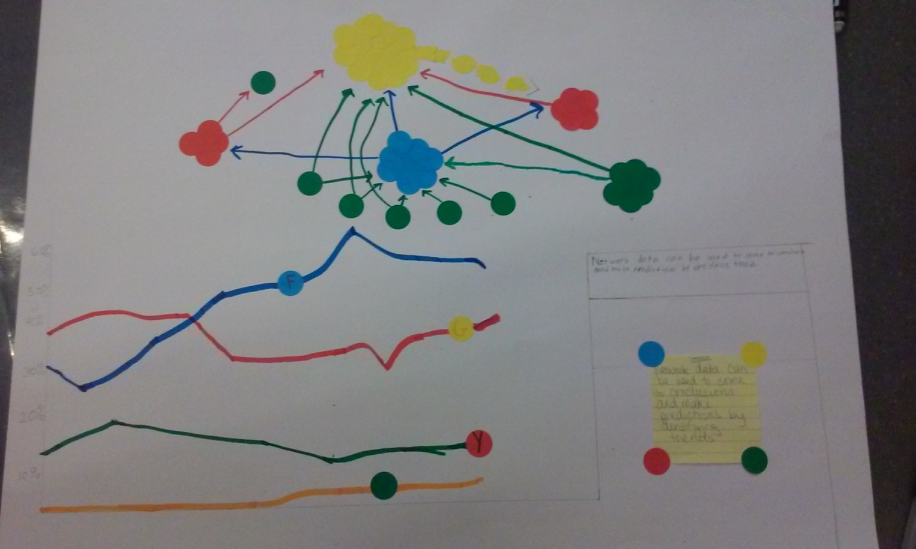
Network data can be used to come to conclusions and make predictions by identifying trends.

Slide 8
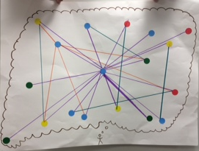
Visualization of networks help create a better understanding of a specific network and can be a great tool for analysis.

Slide 9
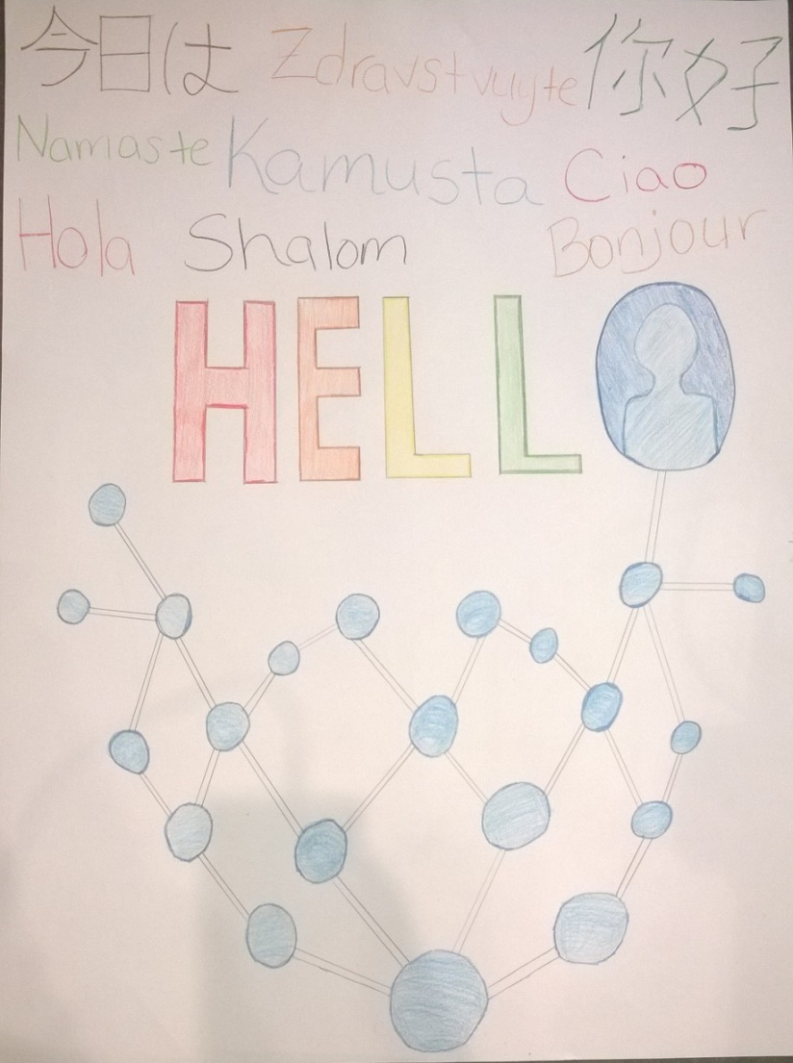
Networks allow us to analyze human interactions in everyday life, and see how these connections influence our choices and can help spread ideas by coming to conclusions like the friendship paradox.

Slide 10
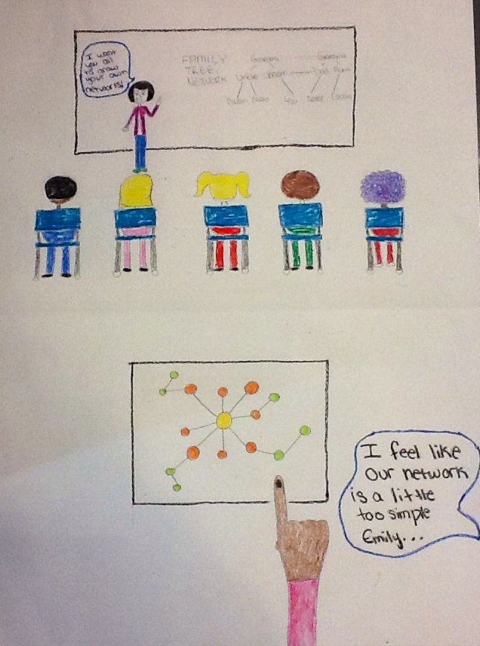
Network science is an important area and should be incorporated into schools.

Slide 11
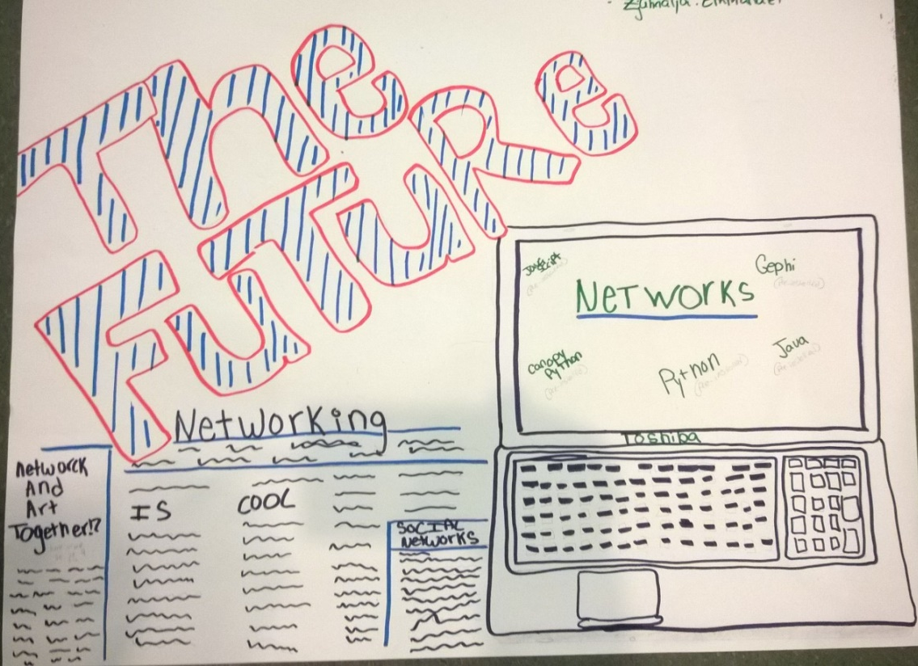
The future of network science can include pre-installed programs and networks in media.

Slide 12
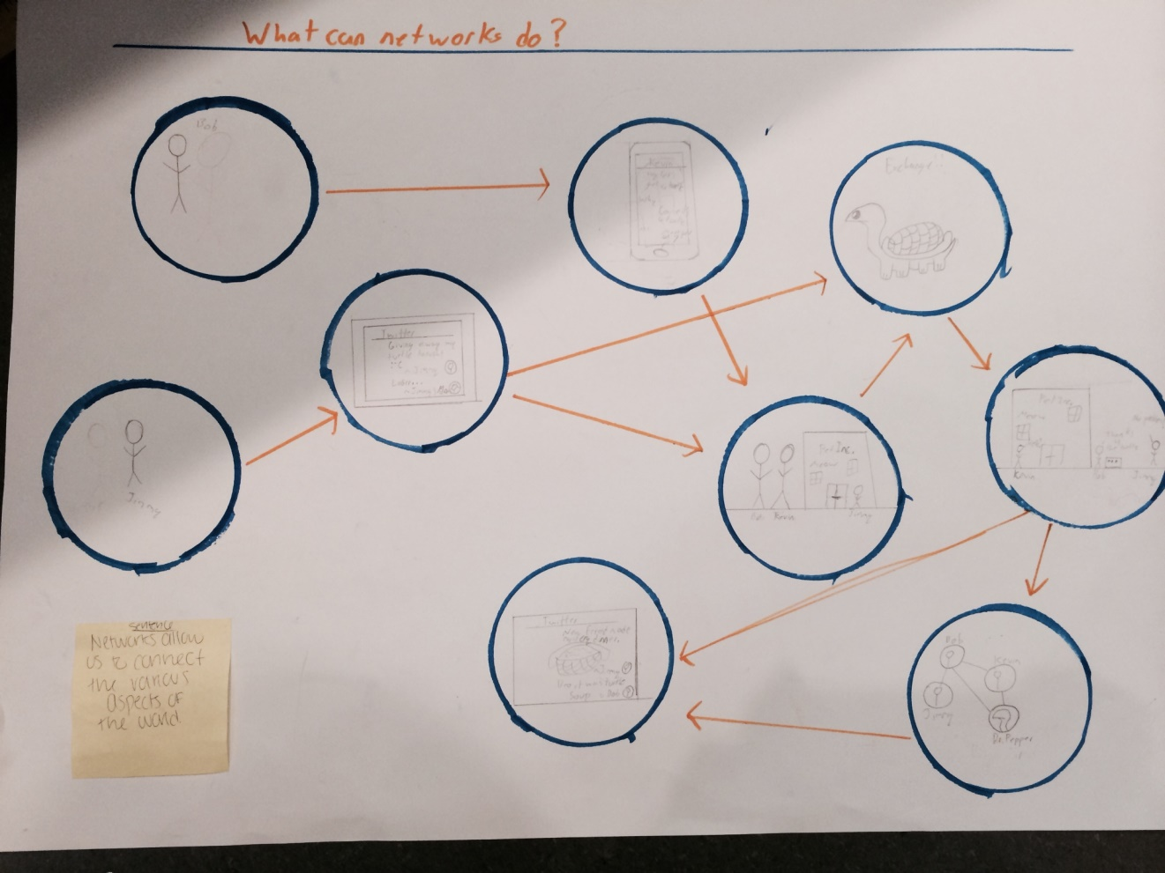
Networks allow us to connect various aspects of our world.

