Slide 1
Networks
NetSci High 2013-2014
“Old” Student Team

Slide 2
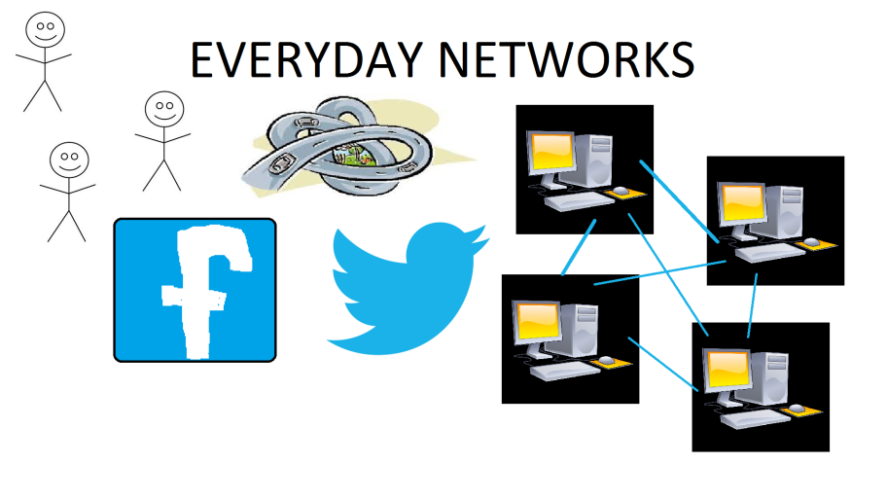
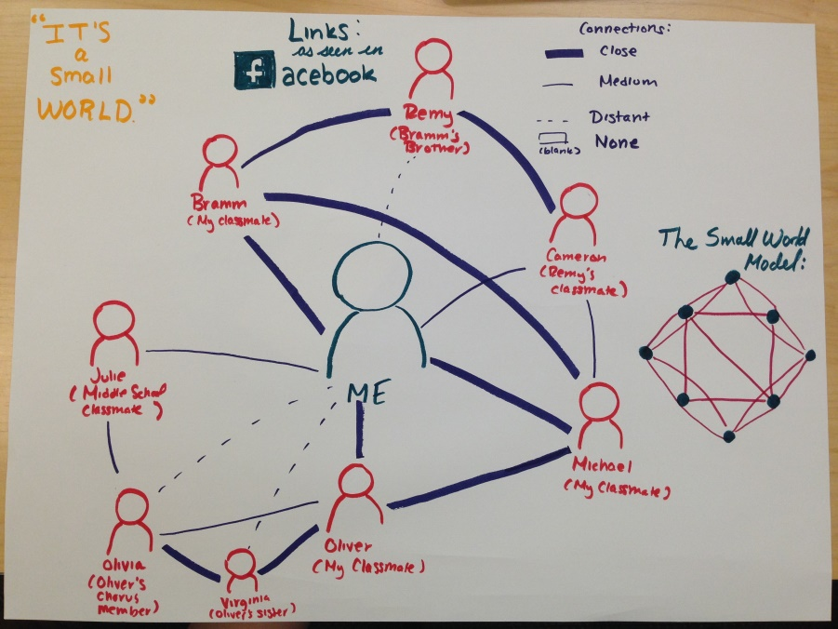
“Networks are everywhere.”
-- Gandhi

Slide 3
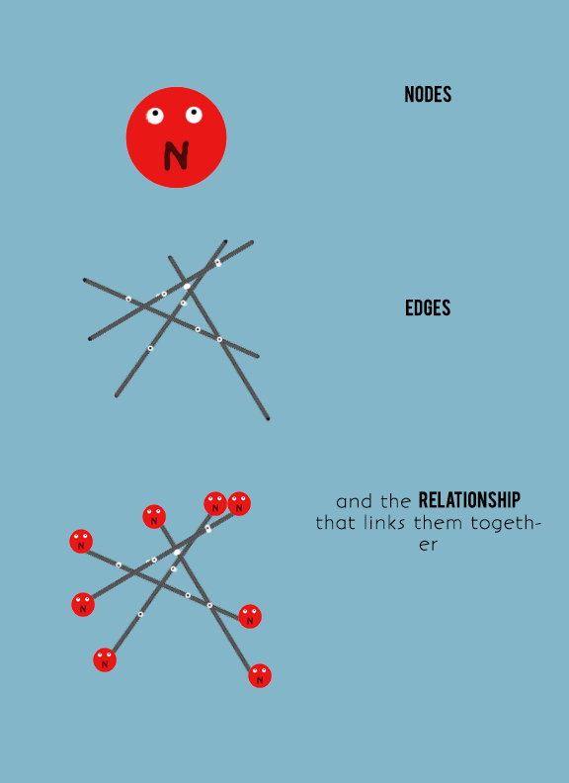
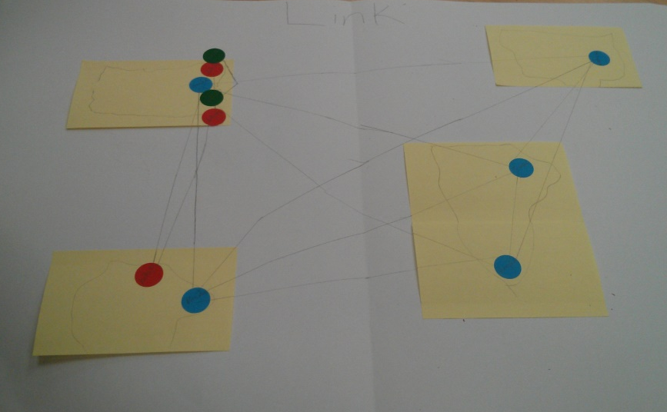
A connection between more than one person can form a link.

Slide 4
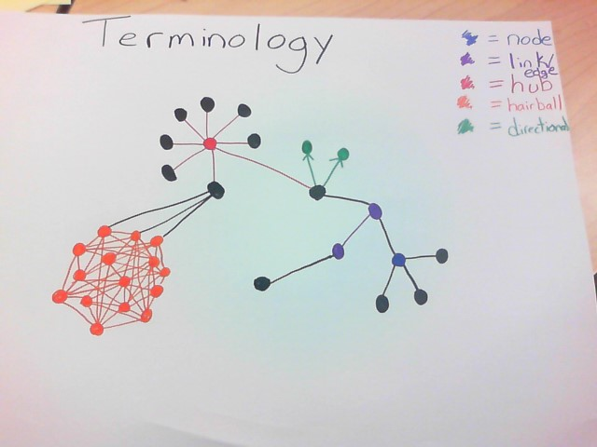
People should understand basic terminology in a network such as nodes, edges and hubs.

Slide 5
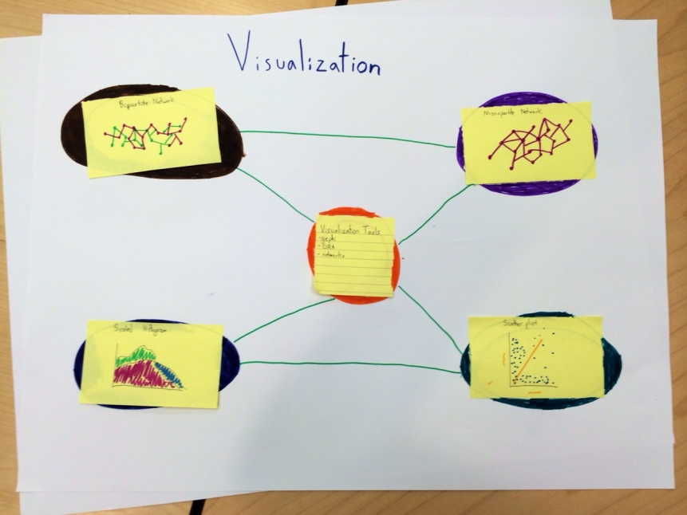
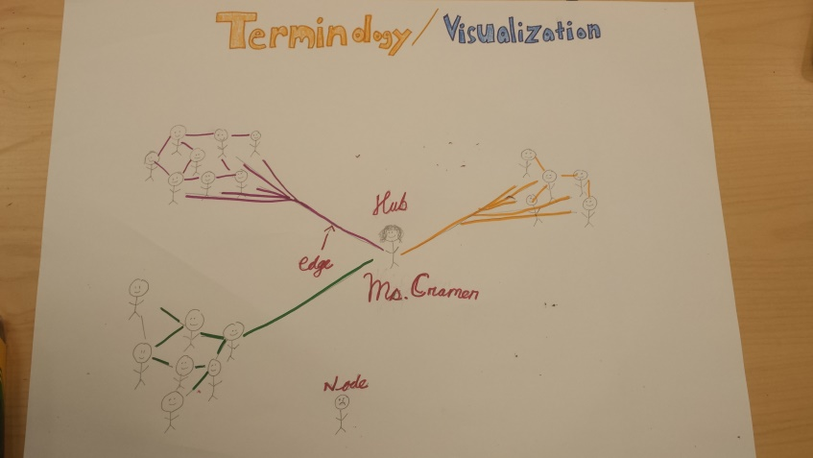
“A picture is worth 1,000 words.”
-- Gandhi
Visualizations are the key to understanding the network.

Slide 6
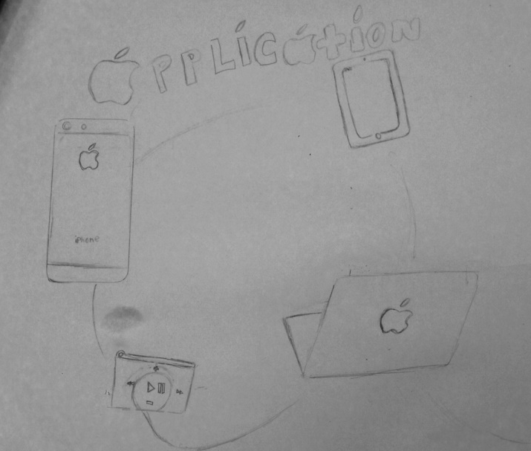
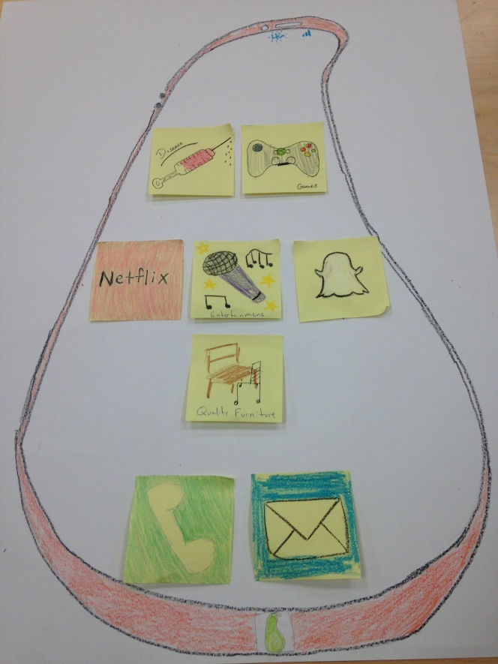
Networks can be applied to various fields, whether through entertainment, disease spread, finding quality furniture, etc.

Slide 7

“Life is hard… then you die.”
-- Gandhi

