Slide 1
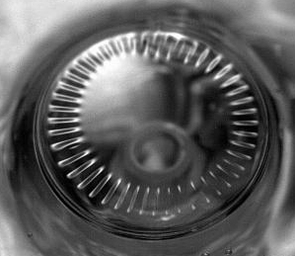
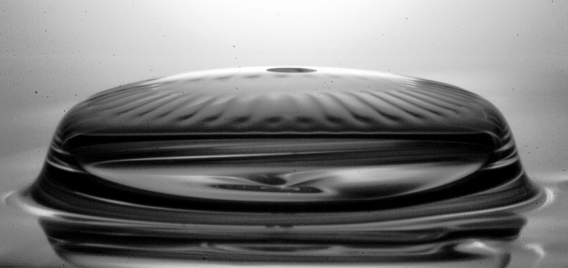
Dynamic buckling of collapsing viscous bubbles
A. Oratis¹, J. W. M. Bush², H. A. Stone³ and J. C. Bird¹
ME 712
¹Boston University
²Massachusetts Institute of Technology
³Princeton University
TexPoint fonts used in EMF.
Read the TexPoint manual before you delete this box.: AAAAAAAAAA

Slide 2
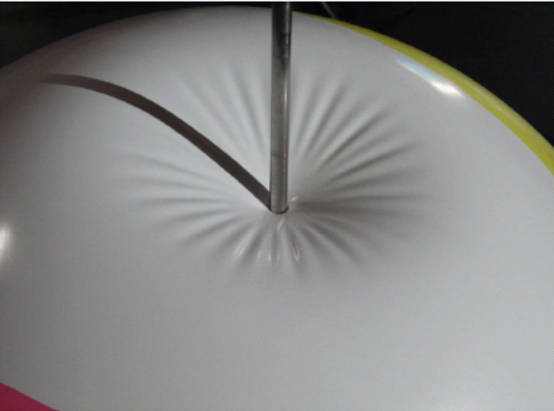
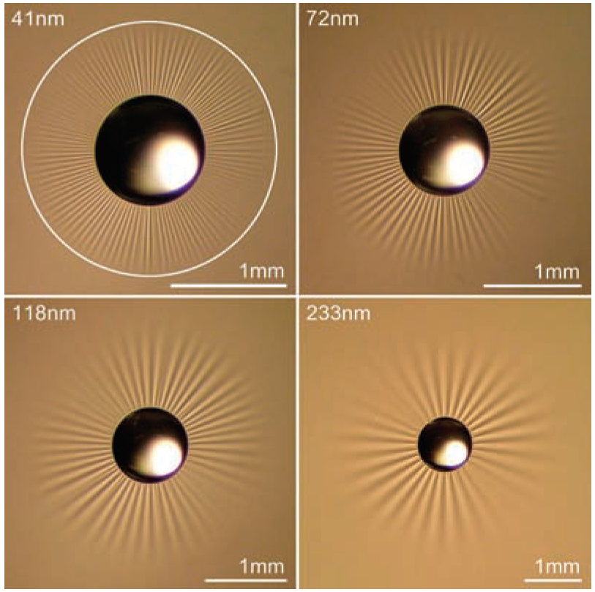
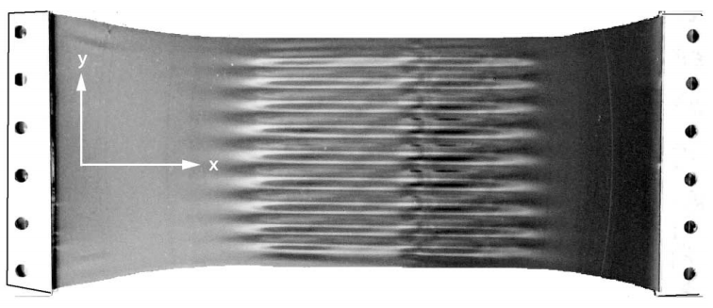
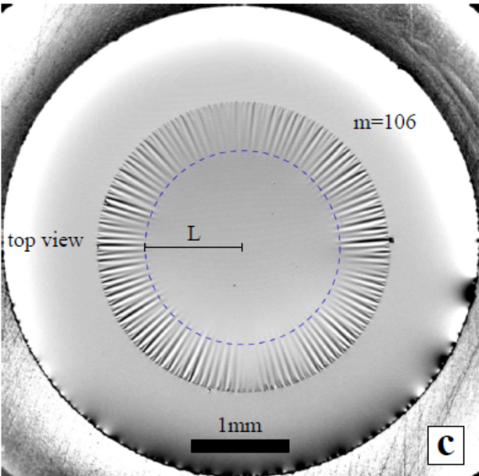
Elastic Wrinkling
Design Flexible
Electronics
Vella et al.
(Phys. Rev. Lett. 2011)
Huang et al.
(Science 2007)
Cerda and Mahadevan
(Phys. Rev. Lett. 2003)
King et al.
(Proc. Natl. Acad. Sci. 2011)

Slide 3
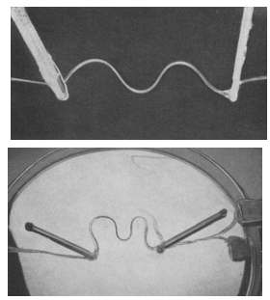
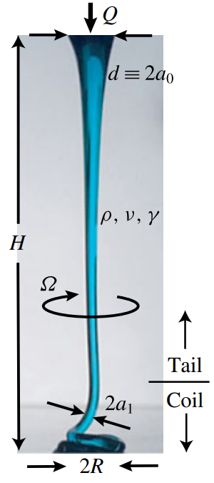
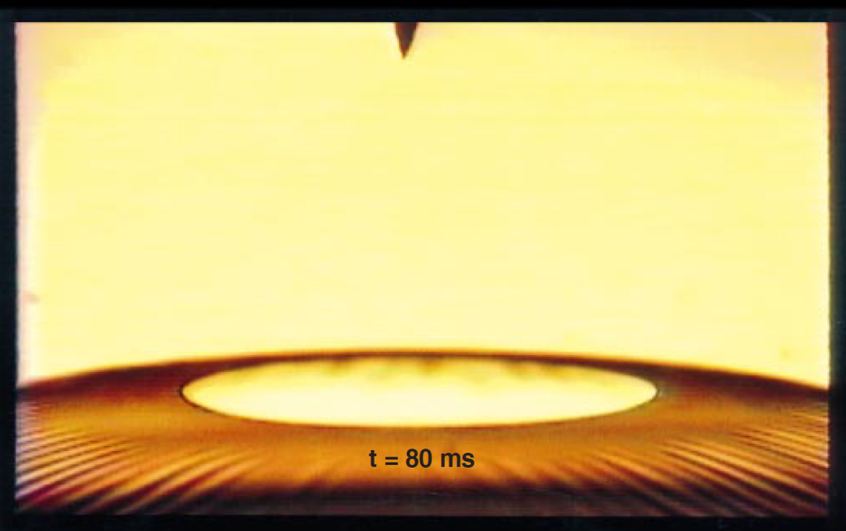
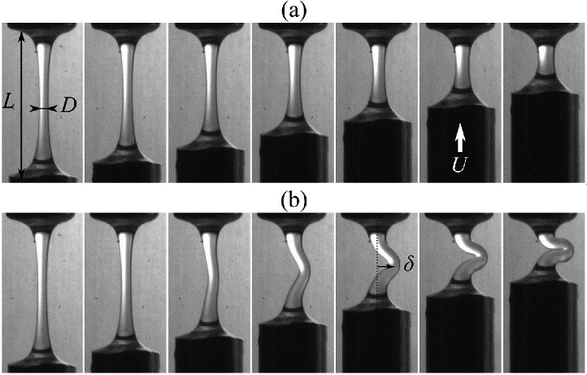
Viscous Buckling
G. I. Taylor
(Applied Mechanics 1969)
N. Ribe
(J. Fluid Mech. 2016)
Debregeas, De Gennes and Brochard-Wyart
(Science. 1998)
Le Merrer, Clanet and Quere
(Phys. Rev. Lett. 2012)

Slide 4
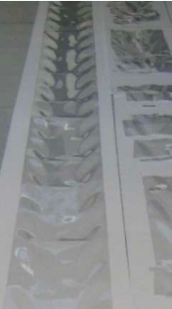
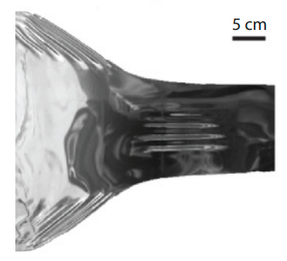

Viscous Buckling Applications
Glass manufacturing
O’Kiely 2017
Srivasan et al
(Phys. Rev. Fluids 2016)
Volcanology

Slide 5

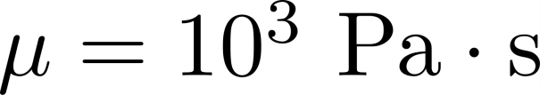
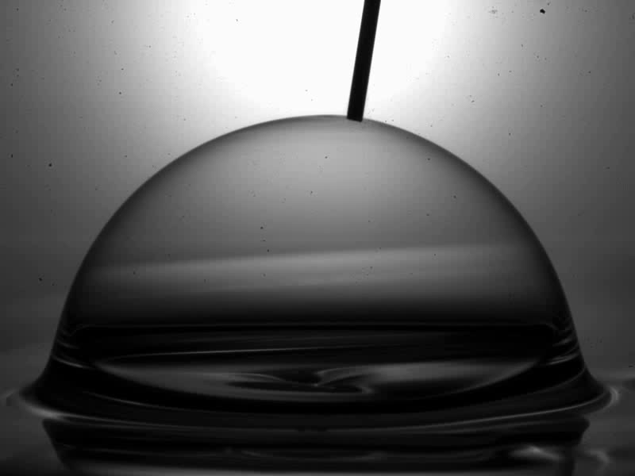
Bubble Collapse

Slide 6

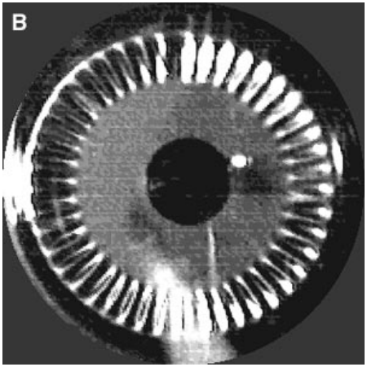
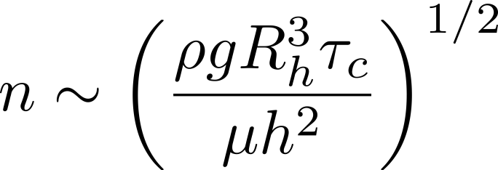
Viscous Wrinkling
Rippling Instability of a
collapsing bubble
Debregeas, De Gennes and Brochard-Wyart
(Science. 1998)
da Silveira, Chaieb and Mahadevan
(Science 2000)
Collapse and wrinkling driven by gravity and resisted by viscosity

Slide 7
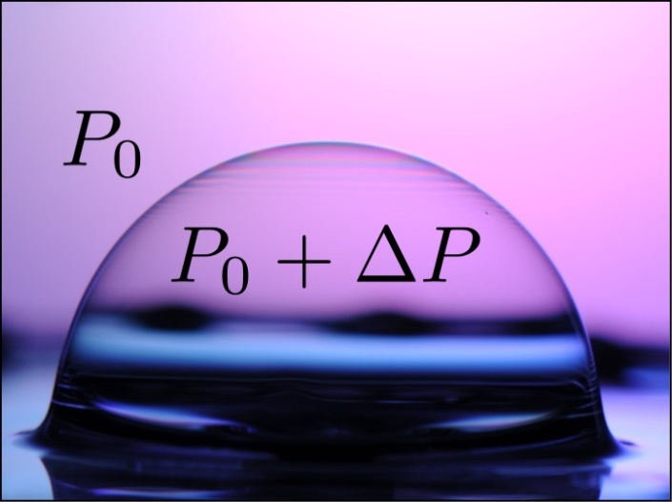
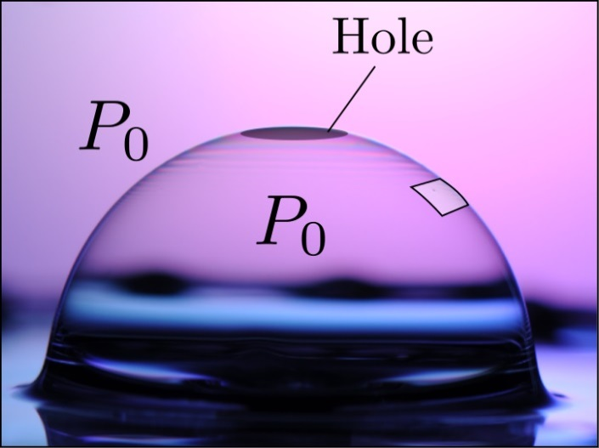
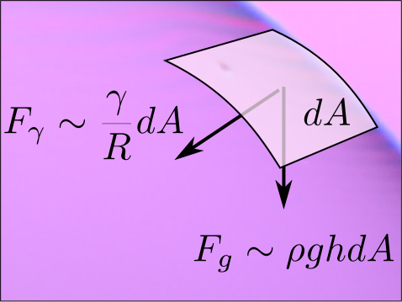
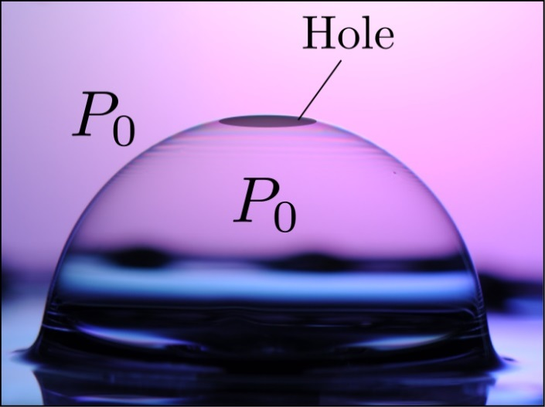

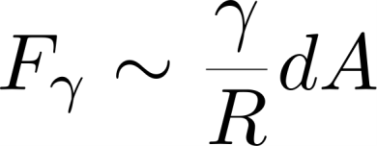

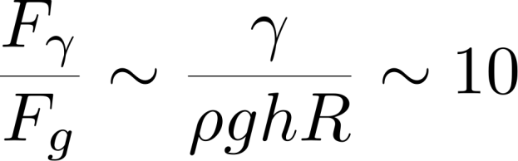




Importance of Surface Tension
Gravitational drainage causes variation in thickness
Hole equilibrates pressure difference
Gravitational and capillary forces unbalanced

Slide 8
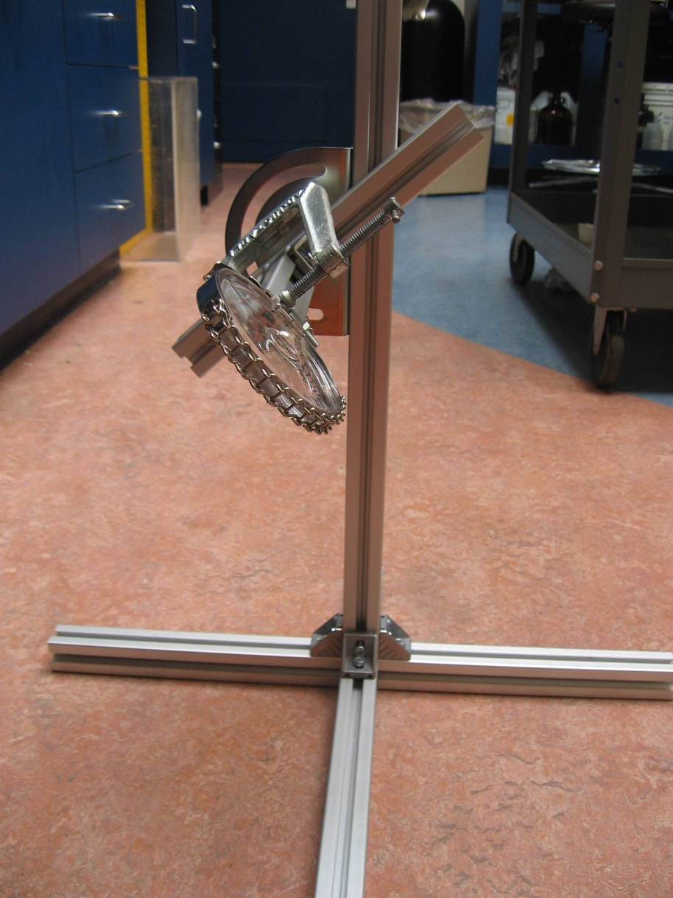
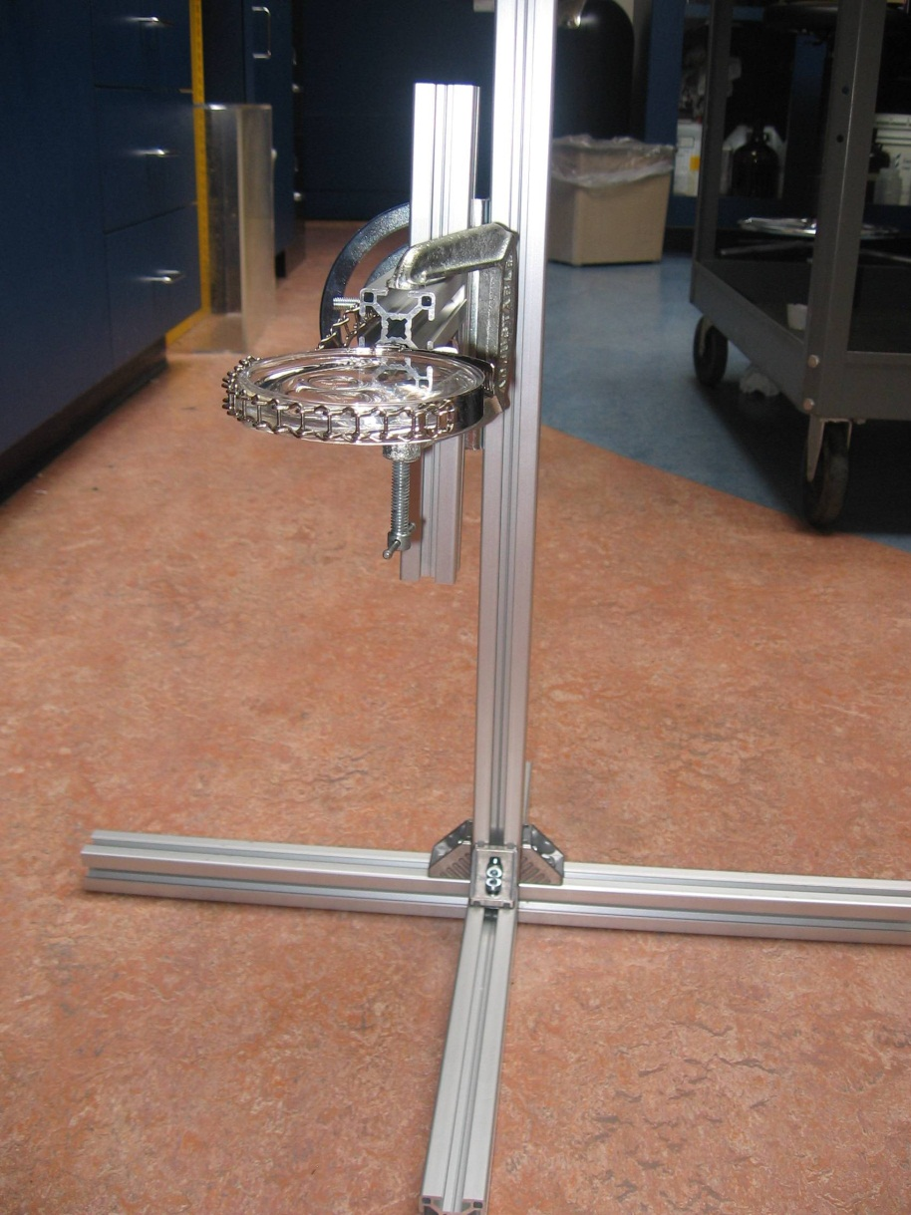
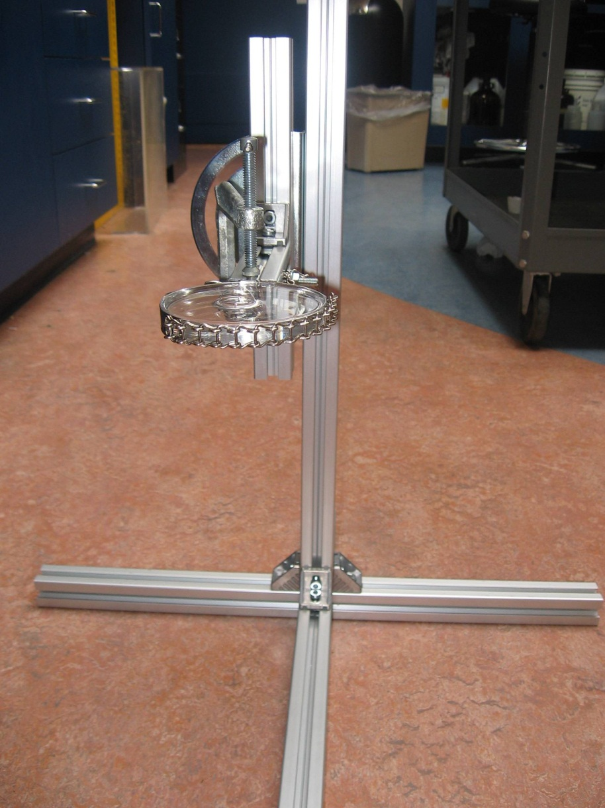

Turning Collapse Upside-Down
Notes:
cm sized bubble with 10 microns thickness

Slide 9
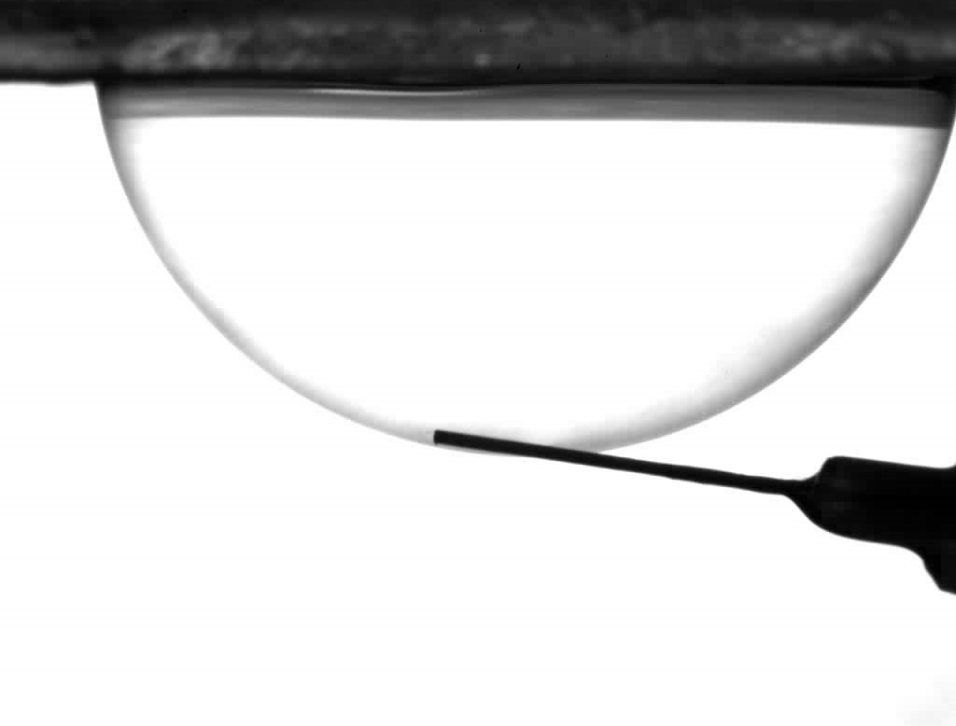

Notes:
cm sized bubble with 10 microns thickness

Slide 10
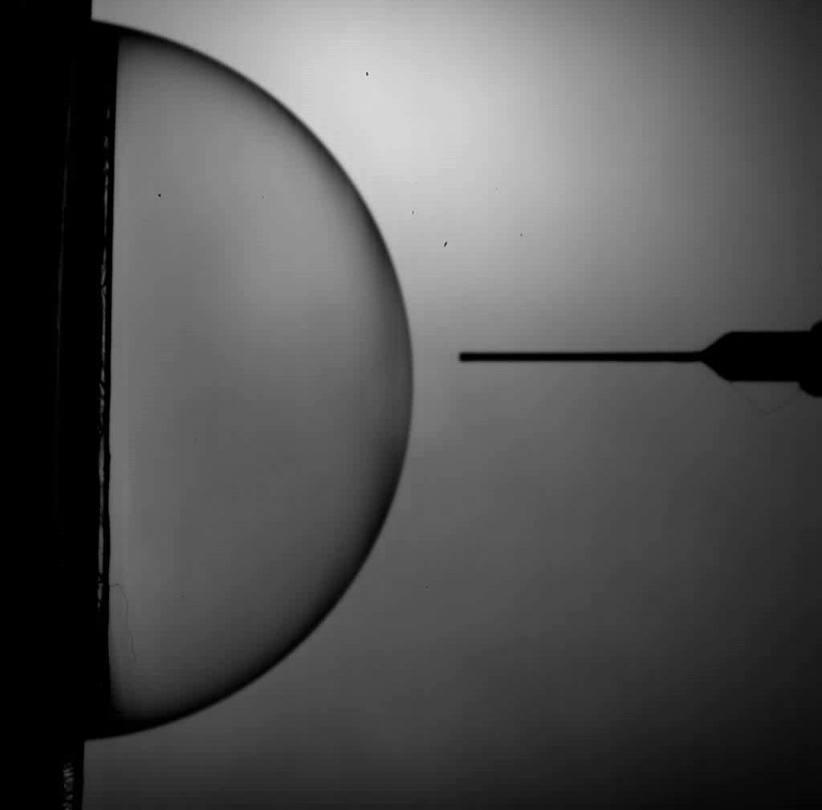
Notes:
cm sized bubble with 10 microns thickness

Slide 11
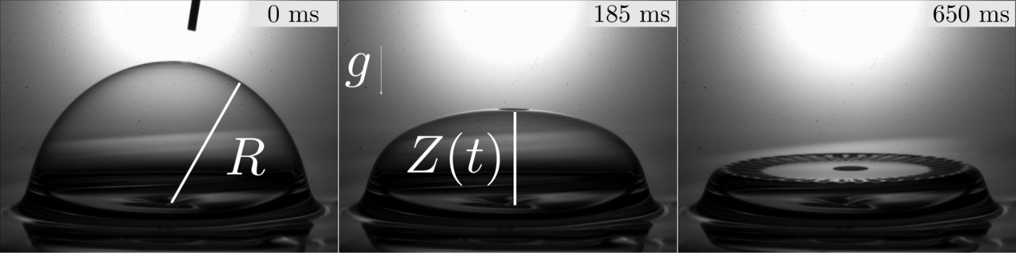
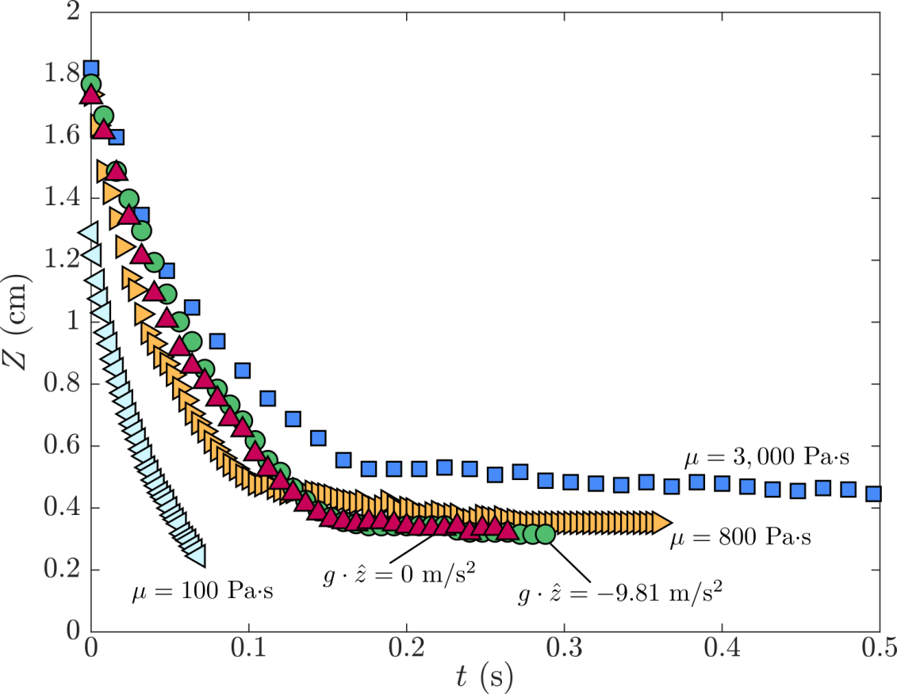
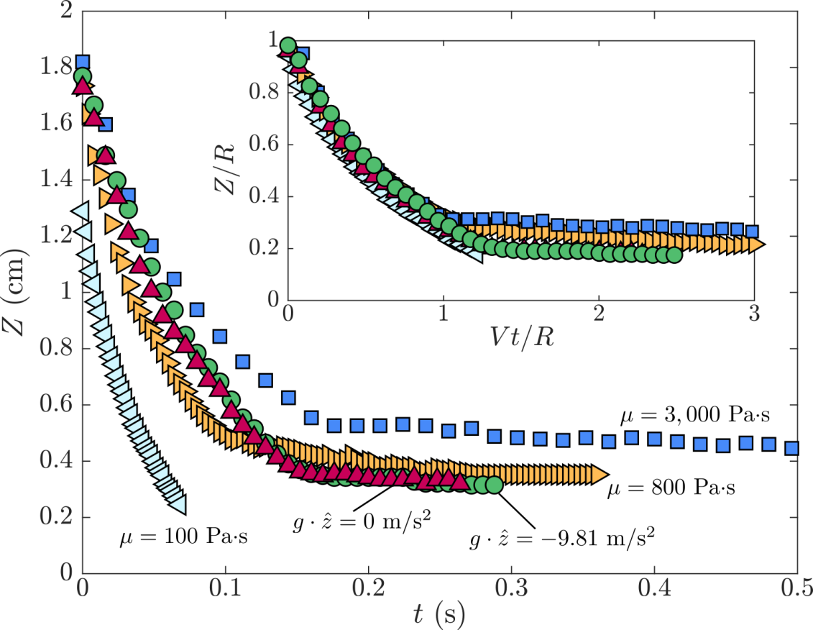


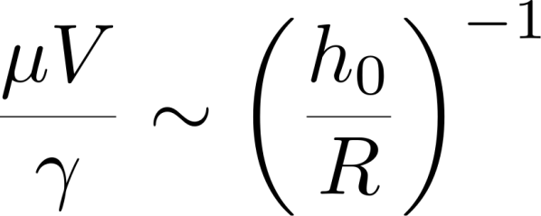
Model Collapse
Gravity not important
Surface tension drives
the collapse
Resisted by viscosity

Slide 12


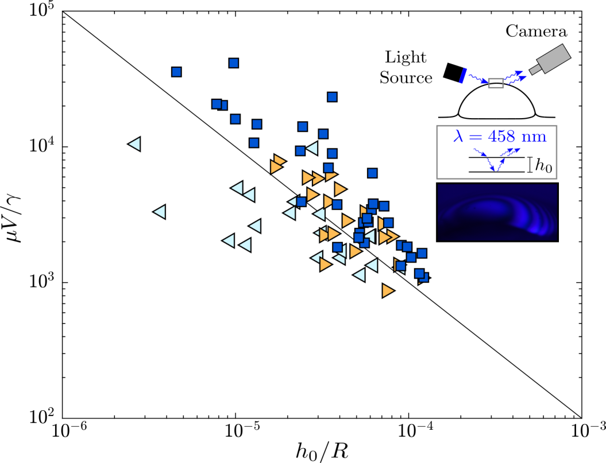


Inteferometry
Measure thickness
Thin-Film Interferometry
Utilize exponential decay
model of Debregeas et al.

Slide 13
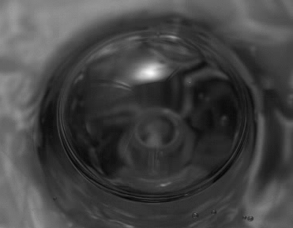
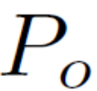
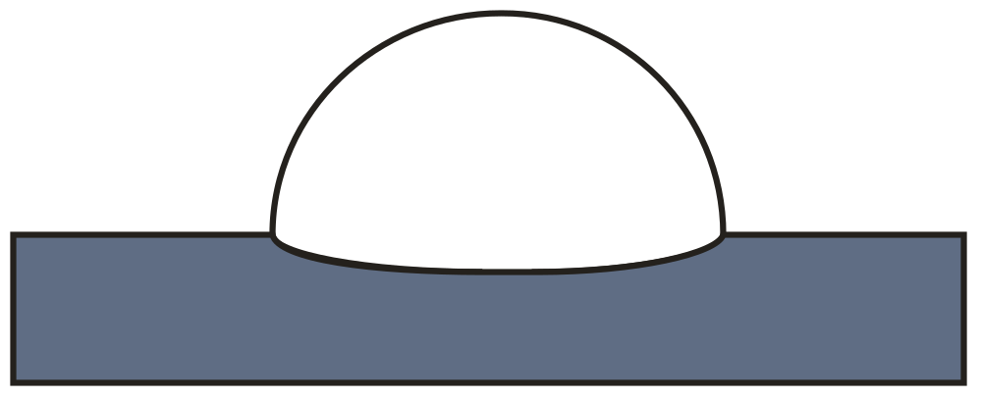
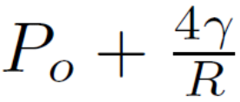


Importance of hole for wrinkling
Current models suggest
[Debregeas et al., 1998;
Da Silveria et al., 2000]
Wrinkling should not occur if
Need new explanation for wrinkling

Slide 14
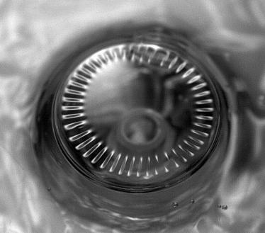
Wrinkling Pattern
What is the number of wrinkles n?
What is the radial extent of the wrinkles?
Number of wrinkles set by:
compression and elastic bending
Could inertia be important?

Slide 15
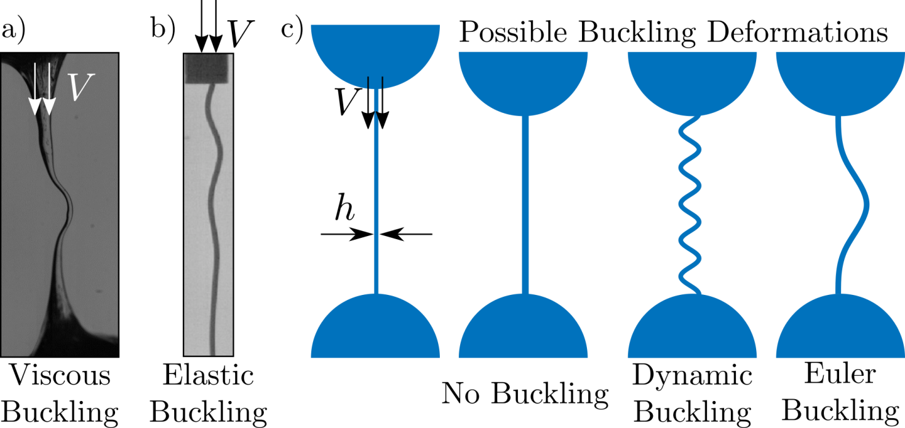




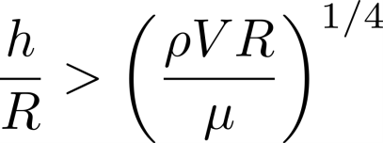
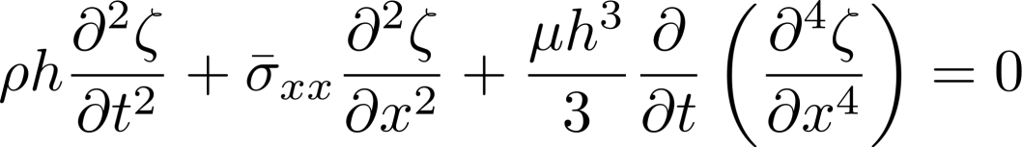

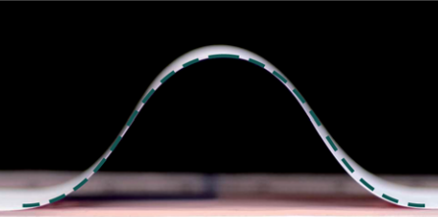
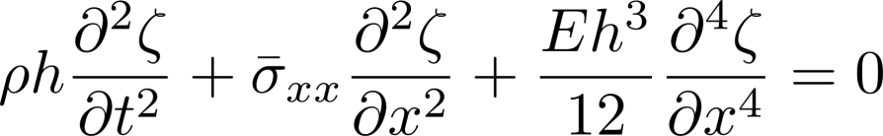


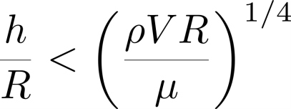

Role of inertia
Compression
Viscous Bending
Elastic
Inertia
Elastic

Slide 16




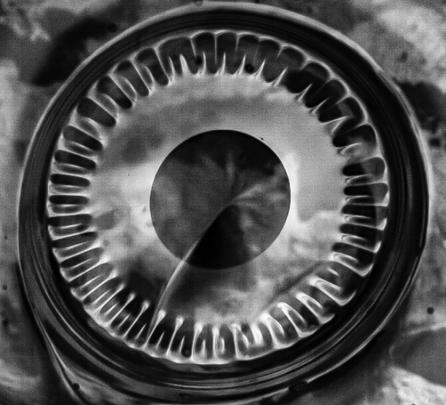
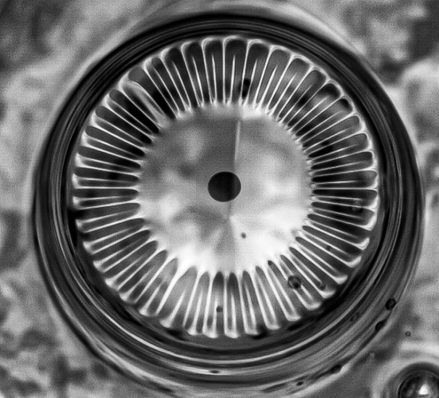
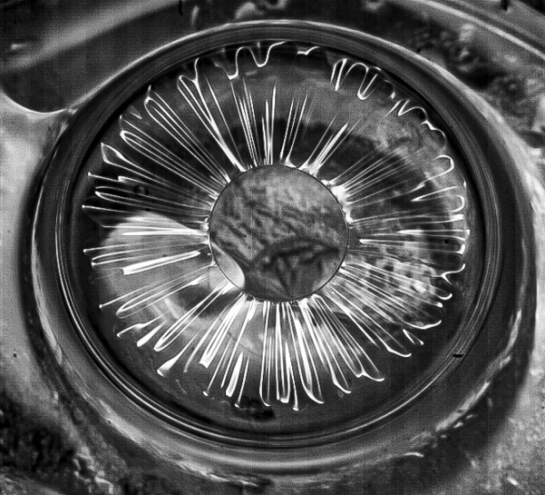


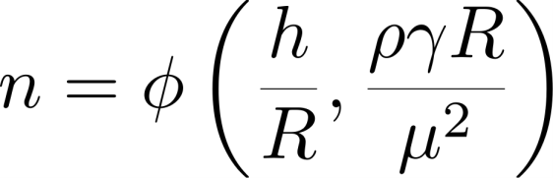


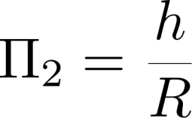
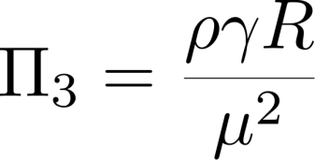

Dimensional Analysis

Slide 17
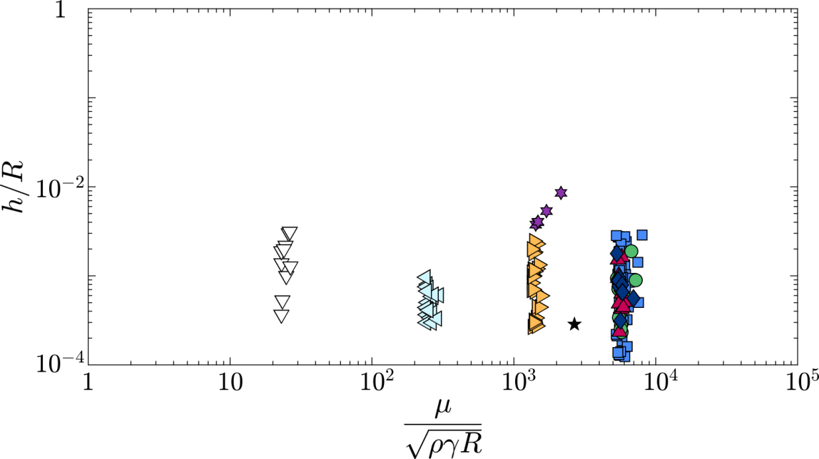




Dimensional Analysis
Inertia important if:
Inertia Important
Viscosity Important
Recall:
Dynamic Buckling when:

Slide 18











1D Model
Inertia
Compression
Viscous Bending

Slide 19









1D Model

Slide 20

1D vs 2D Model

Slide 21







2D Model

Slide 22


2D Model

Slide 23






Dimensional Analysis
No wrinkling if collapse time exceeds wrinkle growth rate
Inertia Important
Viscosity Important
No Wrinkling when:

Slide 24

Conclusions
Provided new explanation for wrinkling
Gravity negligible
Surface tension drives bubble collapse
Wrinkling results from compression, inertia and viscosity

Slide 25

Thank you

