Slide 1
Portfolio Management:
The Implementation Gap
Chadwick Fellowship
2016-2017
Roger D. H. Warburton

Slide 2
My Audience
Average Project Management student:
  is 35,
  is female,
  usually has a family,
  has 10 years of work experience,
  has a full-time job,
  is pursuing a Master’s degree
In 5 years?

Slide 3
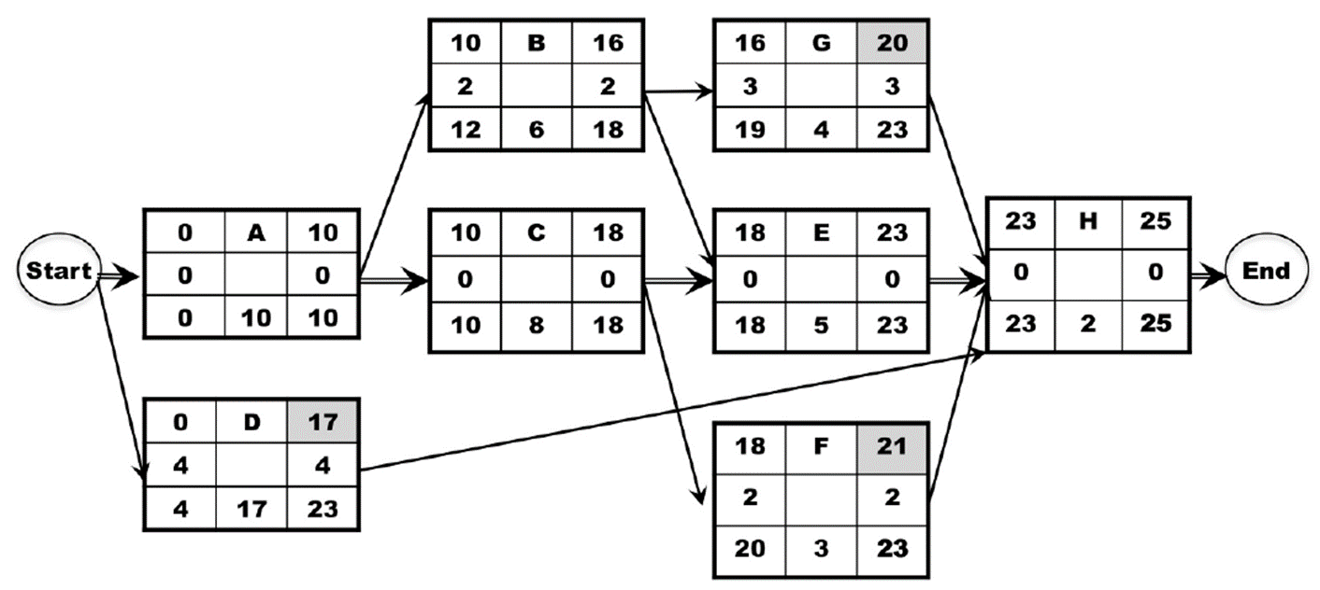
What do we Teach?
Fundamentals
  Easy: Develop a schedule

Slide 4
What do we Teach?
Fundamentals
  Easy
Practical, useful concepts
  New
  Validated research
  Easy to implement
  Will have an impact

Slide 5
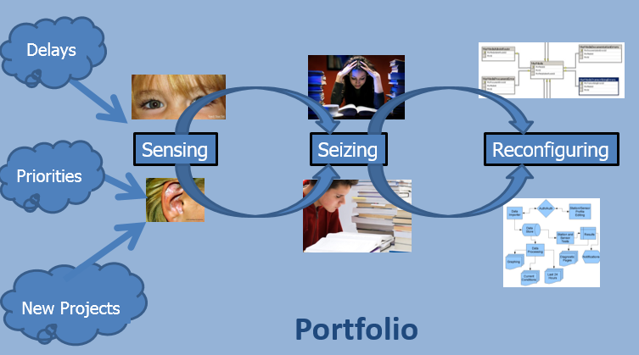
What do we Teach?
Fundamentals
  Easy
Practical, useful concepts
  Portfolio Management

Slide 6
Which New Products Should a Company Invest in?
Old Way
  Largest Return on Investment
  President’s favorite project
Better Way:
  Unique & Valuable Products have:
    85% success rate
    4 x market share
    4 x profitability
  80% of Copycat Products Fail

Slide 7
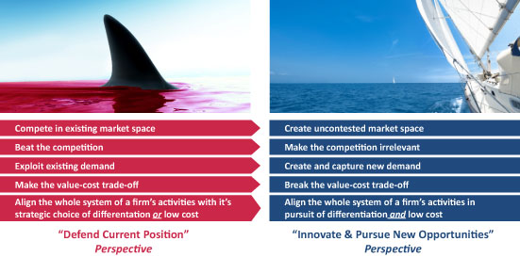
We Can Teach That!
Red Oceans
Blue Oceans
Notes:
7

Slide 8
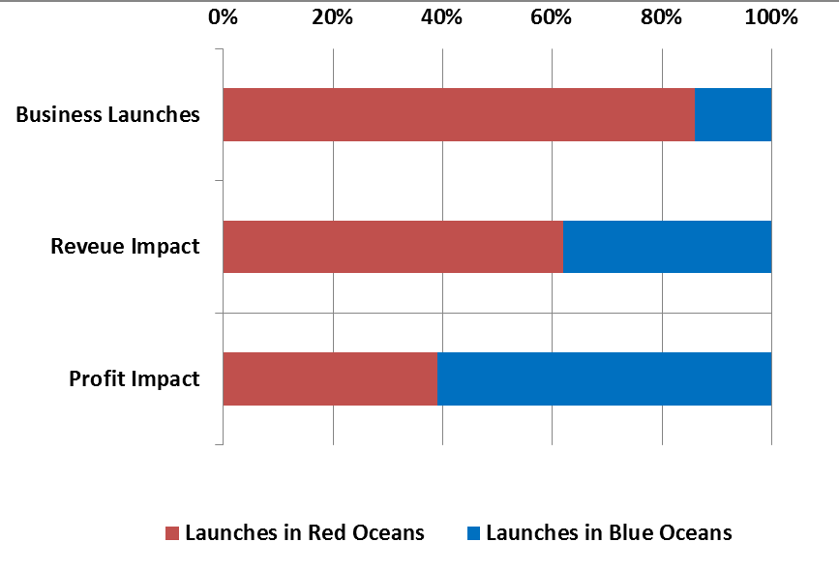
Unique & Valuable

Slide 9
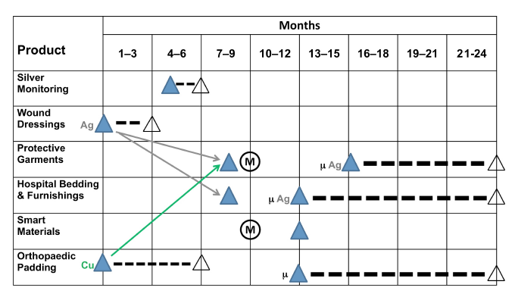
The Bargery Fabrics Case
Notes:
9

Slide 10

What do we Teach?
Fundamentals
  Easy
Practical, useful concepts
  New
  Validated research
  Easy to implement
  Will have an impact

Slide 11

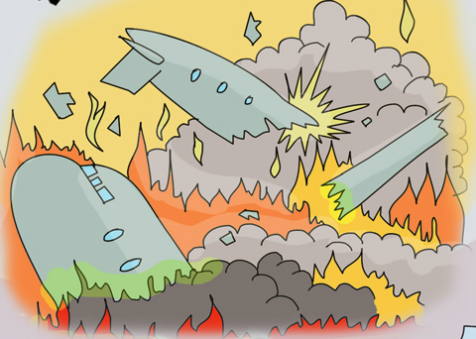
Reality Intervenes
Chadwick to the Rescue
Notes:
11

Slide 12


What Happened?
Tony Attard, OBE
New Product Gridlock:
  Fashion fabrics
  More products, shorter life cycles
  Constantly changing product lines
  Constant additions & revisions
  Changing customer preferences

Slide 13
Panaz Training
Tony: We need some of that!
2 Day Course at Panaz
  Bargery Fabrics Case
  Panaz Product Evaluations
  New Product Roadmap for 24 months
  Presented to upper management
Wildly Successful:

Slide 14
Panaz Training
Tony: We need some of that!
2 Day Course at Panaz
  Bargery Fabrics Case
  Panaz Product Evaluations
  New Product Roadmap for 24 months
  Presented to upper management
6 Months Later:
  Most of the Team Quit

Slide 15
What Happened?
Implemented:
  Product Evaluations (unique, no copycats)
  New → Product Roadmap
  Tradeshows
Included:
  Killing underperforming products
  Killing underperforming customers
Upper Management:
  “Yes, but not my products”

Slide 16
Why Quit?
Staff too well trained
  Staff “knew” the right way
  Understood the research, why
  Saw it working
Upper Management:
  Tried to go around the system
  Didn’t trust the staff

Slide 17
Chadwick Fellowship
“Implementation Gap”
Professional Development
  One week in UK
Talk to Upper Management:
  NWTexnet Trade Association in U.K.
  Host a workshop for Senior Managers
Deliverables:
  Upgrades to curriculum, publications

