Slide 1

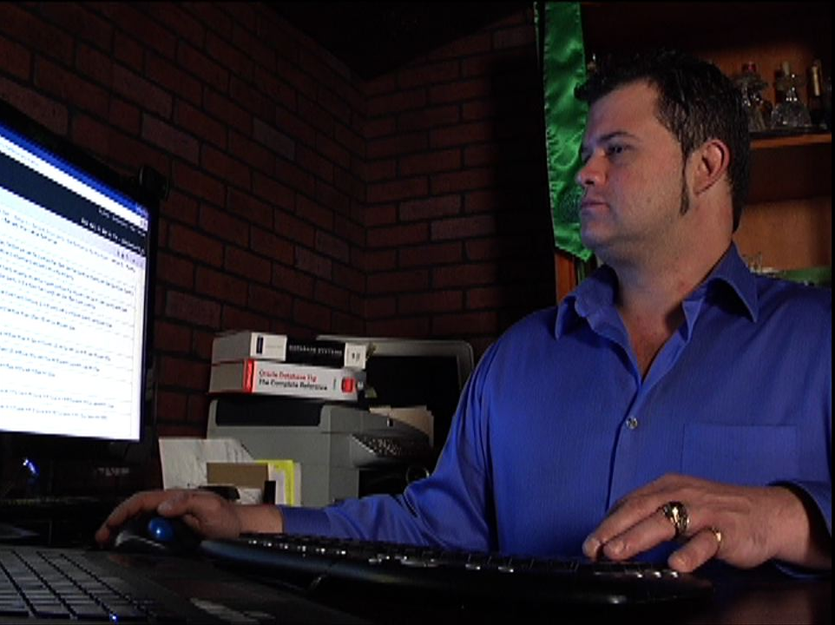
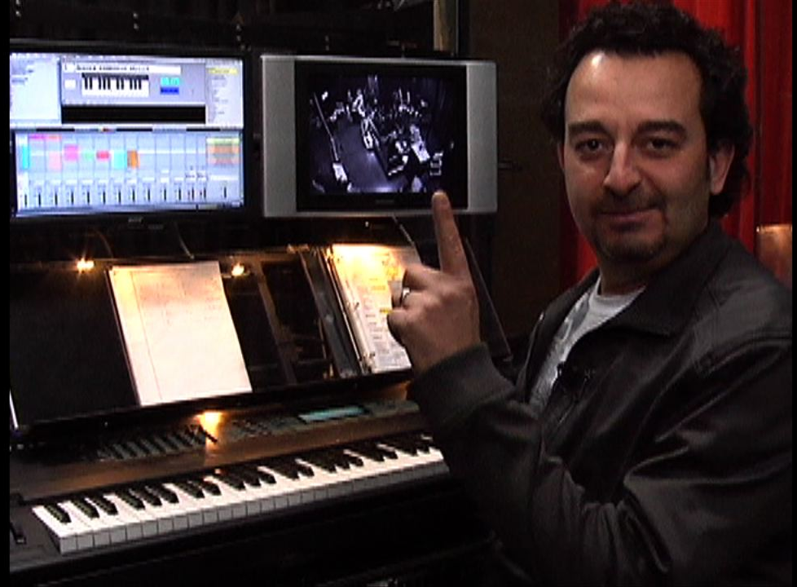
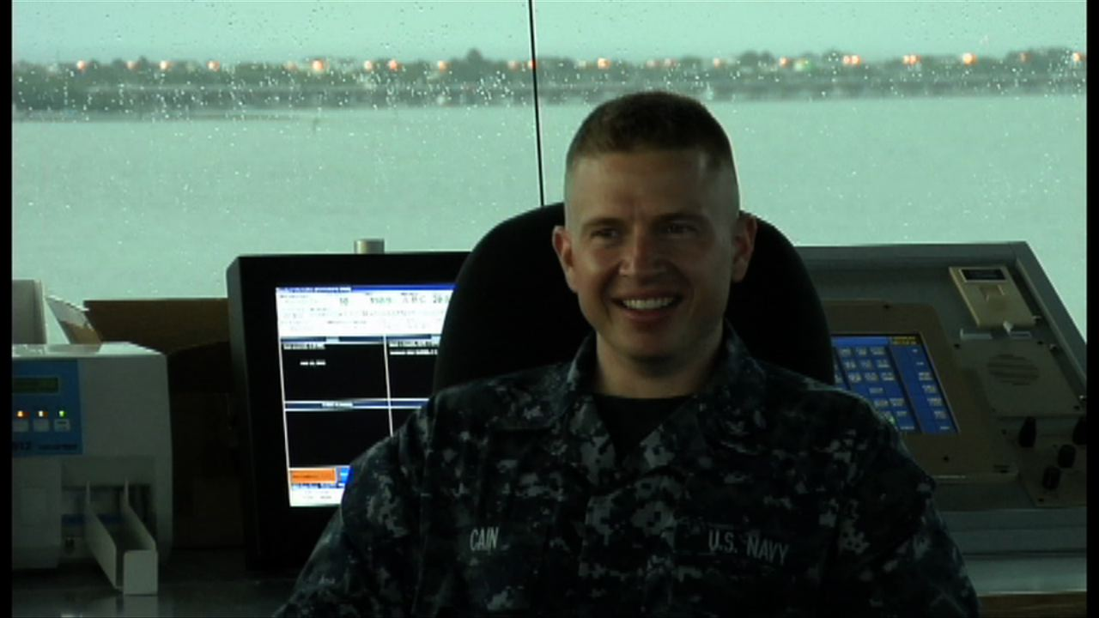
A Day in the Life: Rob Haley’s Chadwick Experience

Slide 2
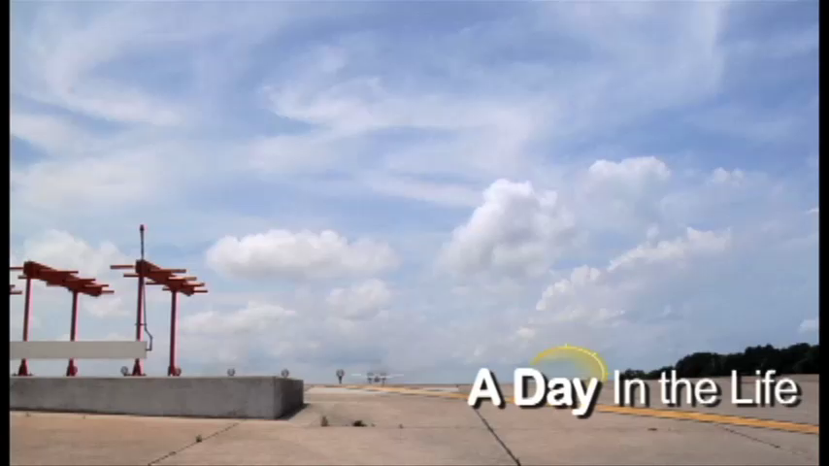
A Day in the Life: Rob Haley’s Chadwick Experience
https://www.youtube.com/watch?v=9skd79sh6Cc

Slide 3

A Day in the Life: Rob Haley’s Chadwick Experience
Biggest Takeaways
Getting the Chance to Meet the Students We Help Each Day
Understanding the Student Experience
Allowing Prospective Students to Relate

