Slide 1
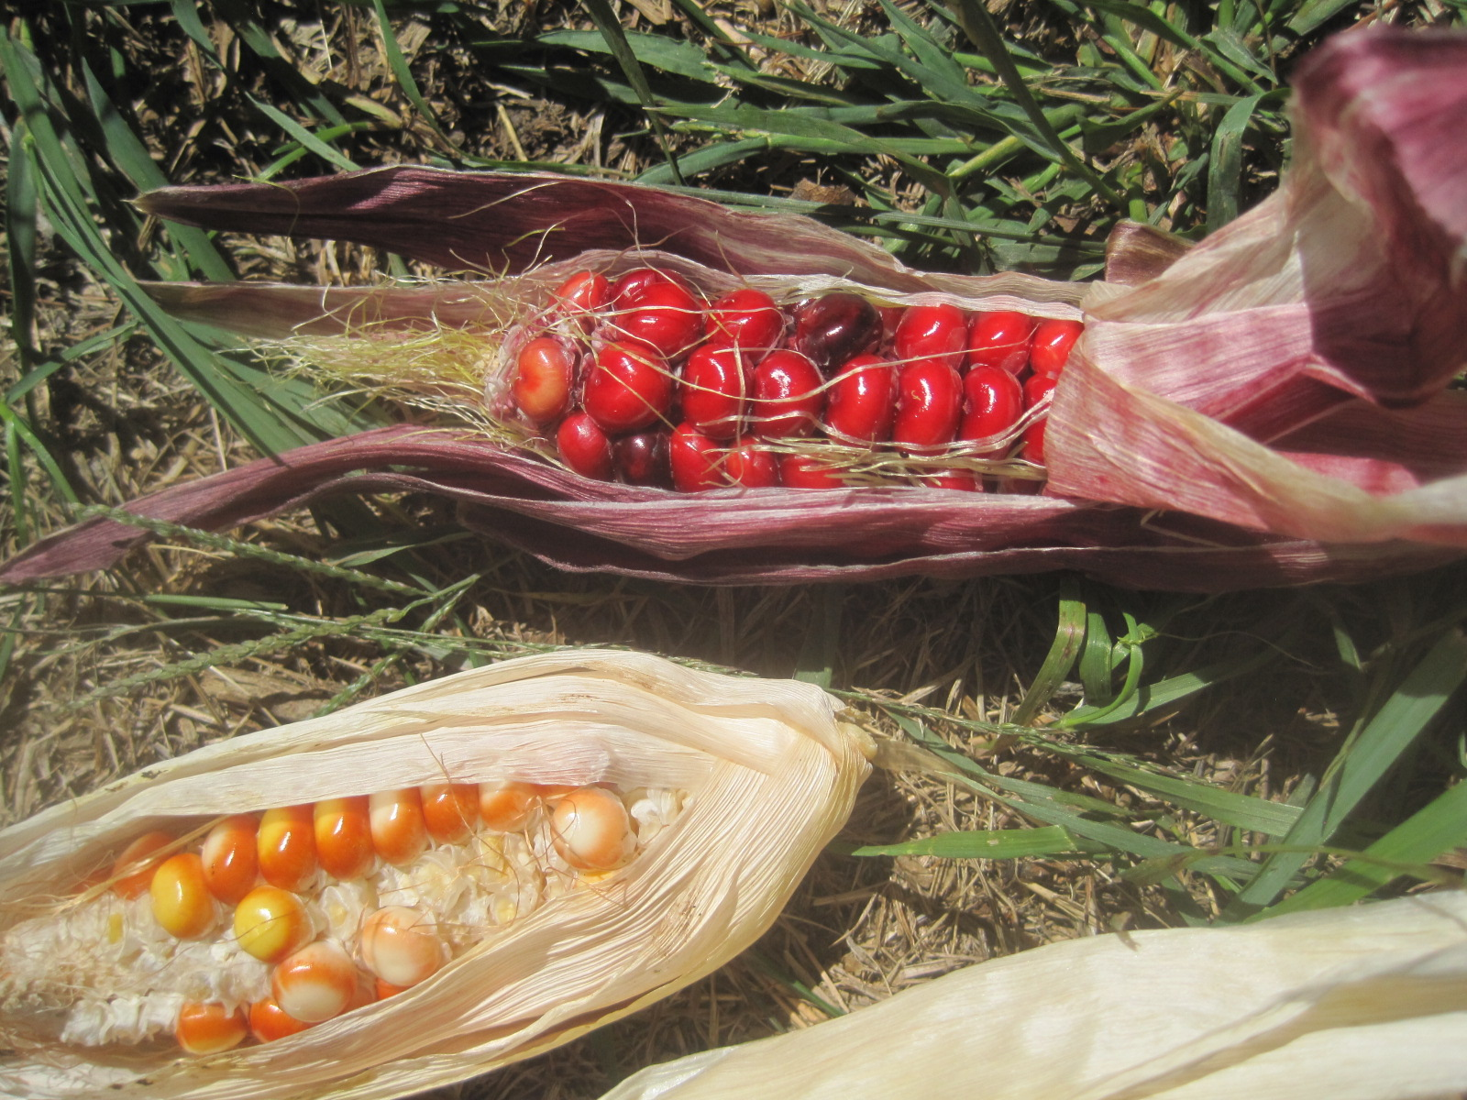
Maize and Identity Formation in Colonial New England
Karen Metheny
Gastronomy Program
Metropolitan College, Boston University

Slide 2
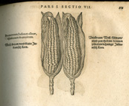
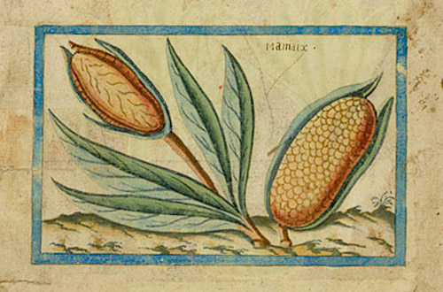
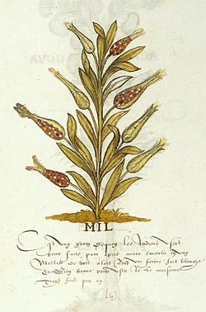
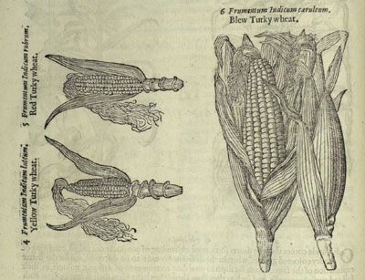
Notes:
Iacobus Theodorus Eicones plantarum seu stirpium, arborum nempe, fructicum, herbarum, fructuum, lignorum, radicum, omnis generis : tam inquilinorum, qu�m exoticorum : qu� partim Germania sponte producit, partim ab exteris regionibus allata in Germania plantantur : in gratiam medicin� reique herbari� studiosorum, in tres partes digest� : adiecto indice gemino locupletissimo.
Francofurti ad Moenum : [N. Bassaeus], 1590.
[8], 1128, [16] p. : ill. ; 20 x 23 cm.
Call no.: QK41 .T34 1590
Brief discours des choses plus remarquables que Samuel Champlain de Brouage a reconneues aux indes occidentales,’Samuel Champlain, plate 43 (1599–1602)
http://www.themorgan.org/collections/works/drake/pageEnlarge.asp?id=1214
Histoire Naturelle des Indes—inscriptions in French, linked to Sir Francis Drake but not conclusive
The Herball or Generall Historie of Plantes, gathered by John Gerarde

Slide 3
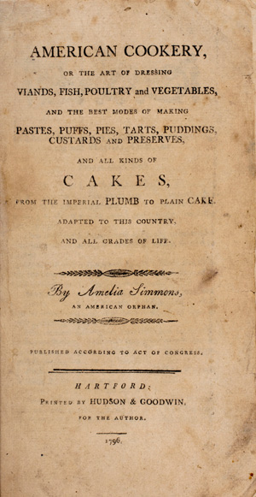
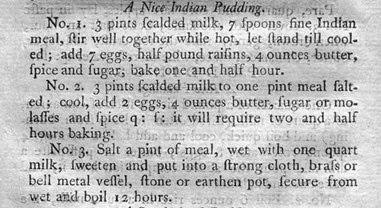
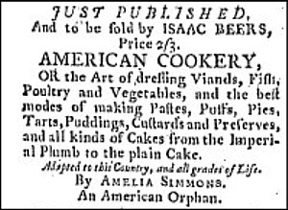
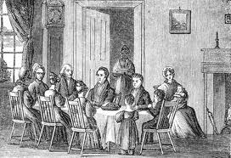
Notes:
Indian meal for puddings; https://www.youtube.com/watch?v=-f3CfXaq_xk

Slide 4
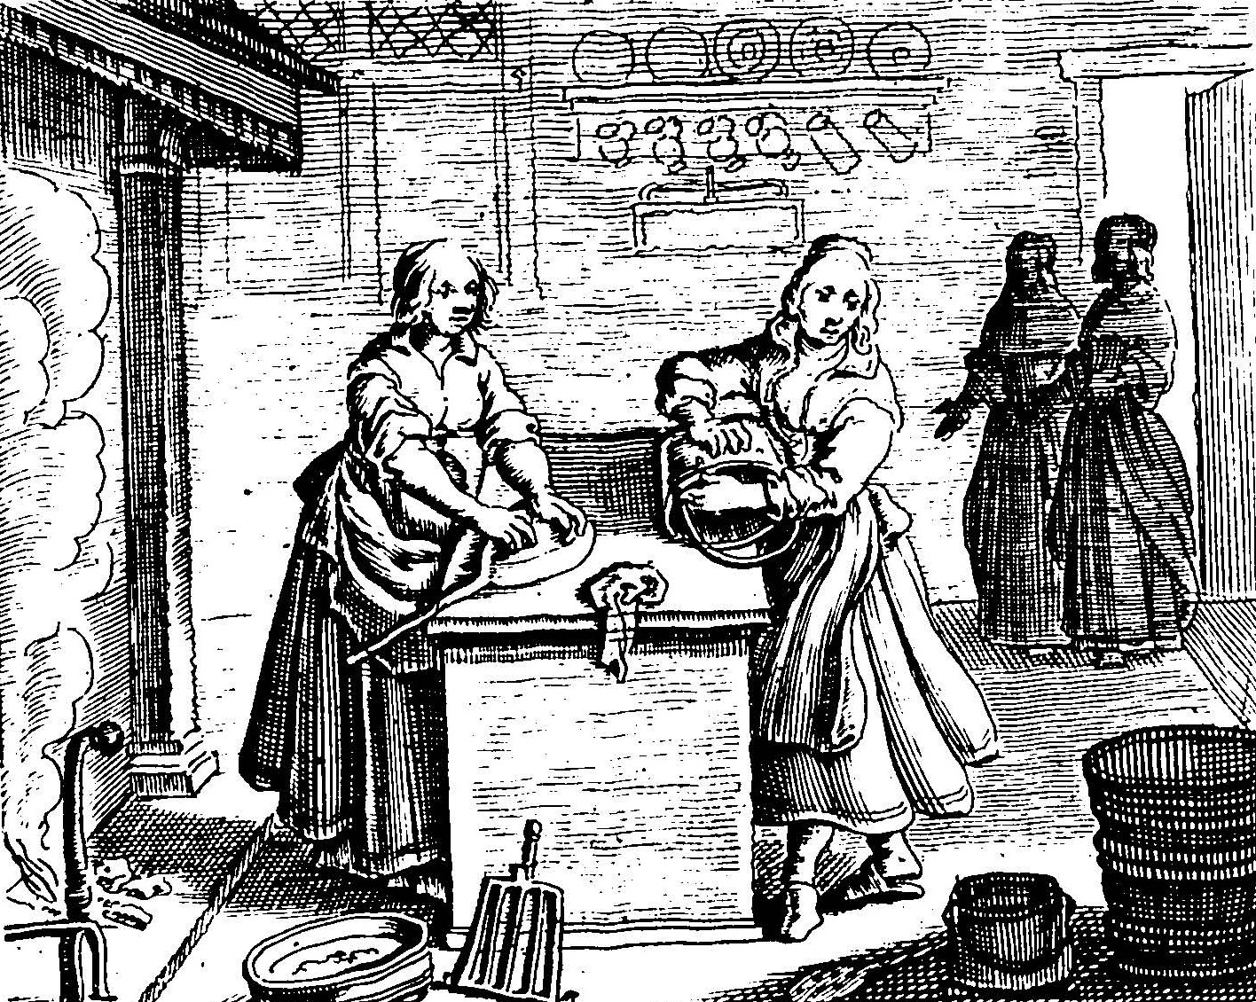
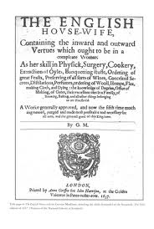

Slide 5
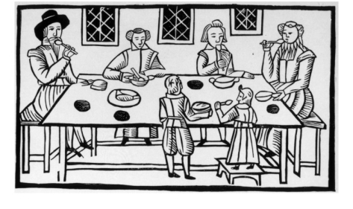
Notes:
A Puritan family meal in the 17th century

Slide 6
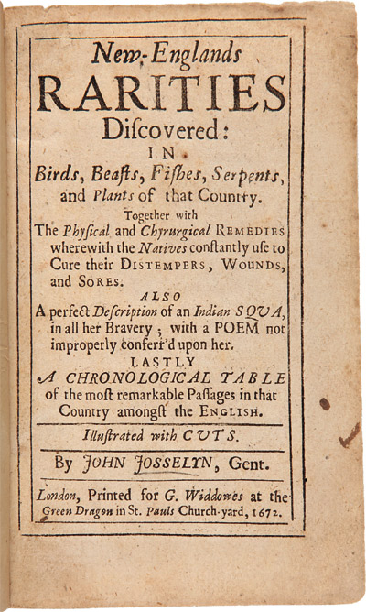
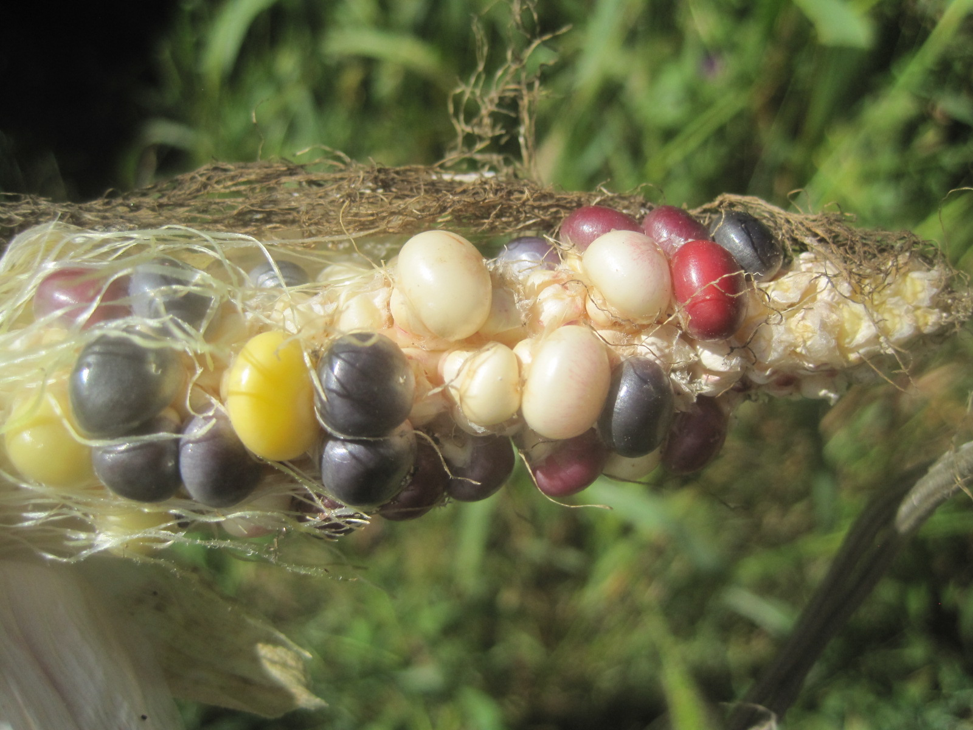

Slide 7
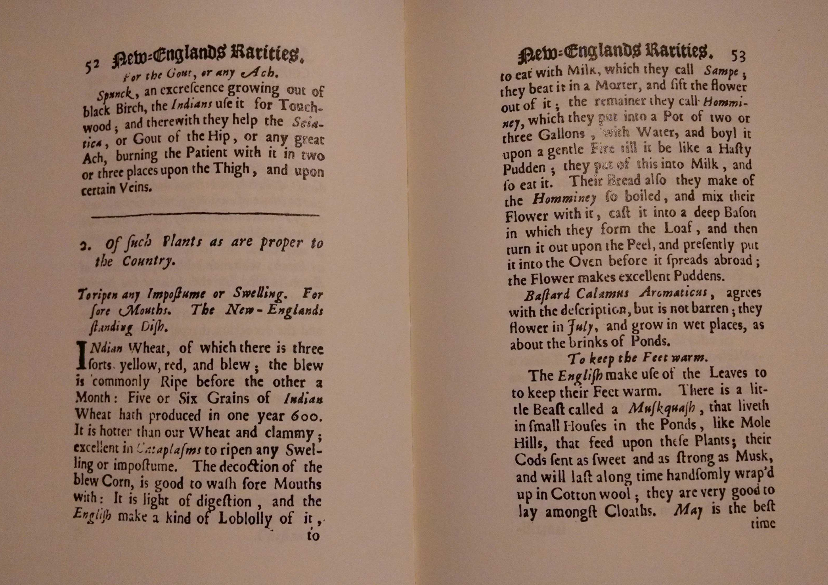

Slide 8
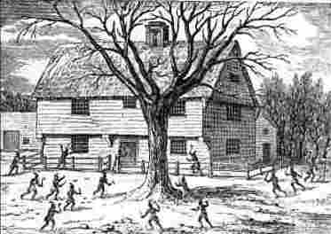
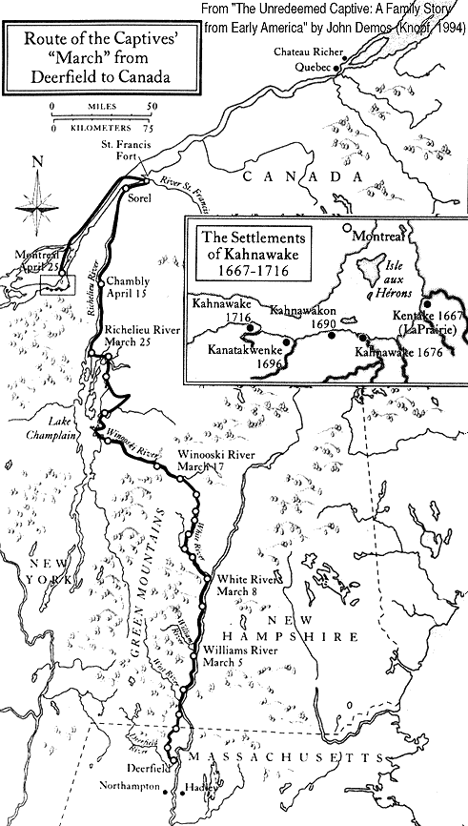
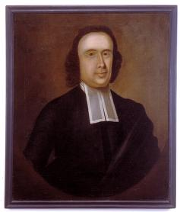
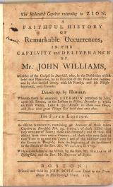
What’s good to eat?
Deerfield captives in 1704

Slide 9
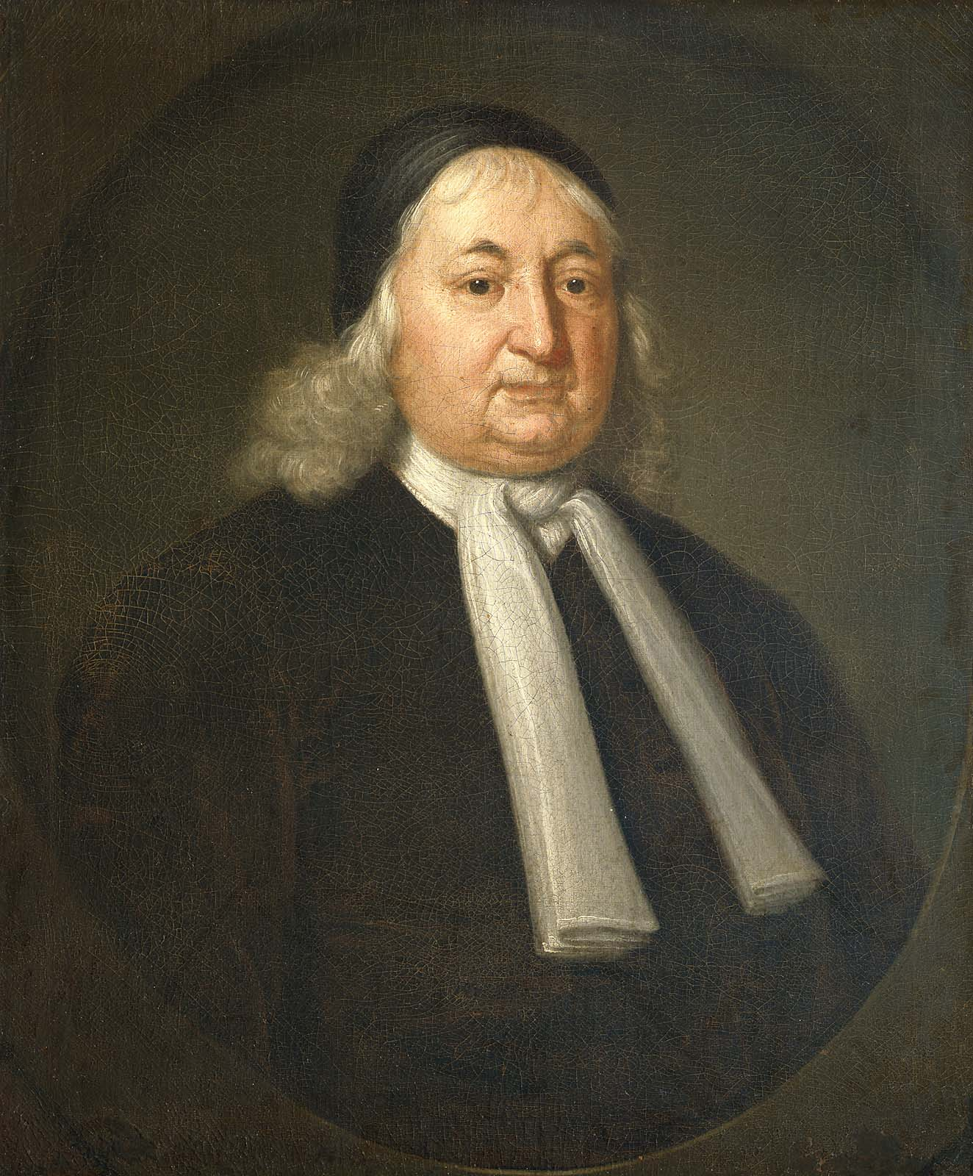
Judge Samuel Sewall
Sun, Jany. 15, 1716. An extraordinary cold storm of wind and snow. Bread was frozen at the Lord's Table
Notes:
The artist; to the Rev. Joseph Sewall, the sitter's son, 1730; to Samuel Sewall, 1769; to Judge Samuel Sewall, 1776; to the Rev. Samuel Sewall, Burlington, Mass., 1814; to Samuel Sewall, 1866; to Nellie L. Sewall Bennet; Benjamin Flayderman, Boston, 1943; with Vose Galleries, Boston, 1957; to MFA, 1958, gift of WIlliam L. Barnard by exchange and purchase. http://www.mfa.org/collections/object/judge-samuel-sewall-33612; https://archive.org/stream/samuelsewallworl98cham/samuelsewallworl98cham_djvu.txt

Slide 10
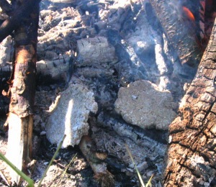
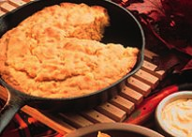
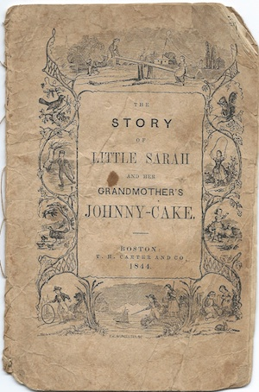
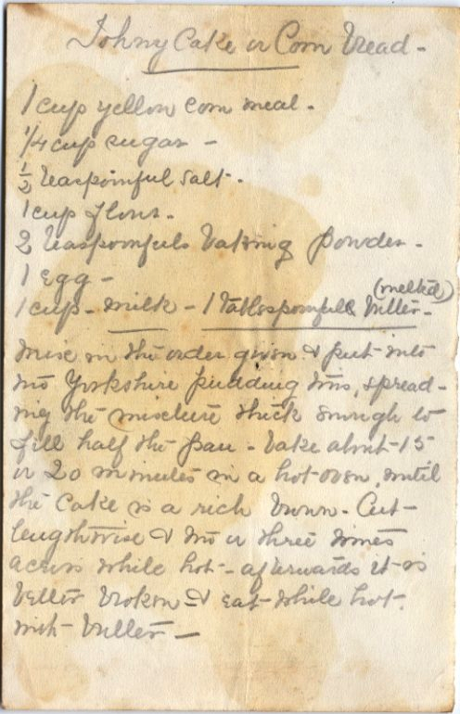
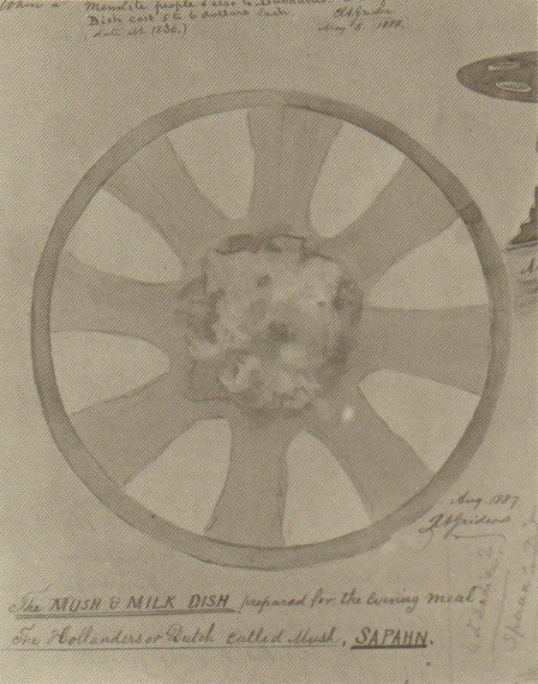
Notes:
Batter cakes, breads, and pancakes; Johnny Cake or Johny cake; “Mush and Milk Dish,”
Rufus Grider, 1888

