Slide 1
Best Practices and Relationship Building in Media Production
Chadwick Fellowship Project
Ed Wozniak
Senior Media Producer
Office of Distance Education

Slide 2

University of Wisconsin-Extension
&
Distance Teaching & Learning Conference
Madison, WI
August 2015

Slide 3




In August 2015, through the Chadwick Fellowship I received, I spent a week in Madison, WI with Patrick Wirth, the Director of Media Services at the University of Wisconsin-Extension School.
UW-Extension is the branch of the University of Wisconsin responsible for continuing education and online learning at all 26 campuses.
The weeklong “working sabbatical” in Madison had two purposes:
Spend time with Mr. Wirth at the offices of the Media Services Team of UW-Extension, learn about their processes and tools, and observe the overall workings of their large media team
Attend the UW Distance Teaching & Learning Conference in downtown Madison to expand my knowledge of online learning in general, as well as to connect with industry peers.

Slide 4
Media Services Team
While visiting with the Media Services Team at UW-Extension, I was given a complete orientation to their programs, their processes, and their tools. Some of main topics discussed in the orientation are as follows:
  The Media Team’s implementations of graphics, video, audio, motion graphics, and web design
  UW-Extension’s “E-Learning Suite”, a set of tools developed in-house to create media for online and digital learning
  UW’s course development process
  Media accessibility practices and guidelines
  The Media Services web page of faculty and staff resources

Slide 5
Distance Teaching & Learning Conference
While attending the Distance Teaching & Learning Conference, I had the change to meet and talk with industry peers, as well as attending several very instructive sessions, including:
  “Learning Ecosystems”
  “Design to Engage for Meaningful Online Active Learning"
  “The Next Generation of Learning”
  “Designing Mobile Learning"
  “Collaborative Planning for Effective Course Video Integration”

Slide 6
Takeaways From the Week in Madison
Between spending time with the UW-Extension Media Team and attending the Distance Teaching & Learning Conference, I came away with several key takeaways:
  Most of the UW Media Team’s solutions are developed in-house, which leads to greater flexibility in terms of how the project is developed. Because of this, there are generally about 8 hours worth of the working week devoted to research and development.
  The UW course development process begins well ahead of the start date for an online course. Media solutions are discussed right at the beginning of development.
  The Media Team’s projects are adherent to W3C/WCAG accessibility standards
  How the video platform Kaltura fits into their workflow
  The team’s focus on technology development grants
  Make an easily available list of media resources available to faculty as well as designers.

Slide 7
Strategies and Tools Implemented
Since my visit to Madison last August, I have been able to enact some of the ideas attained during that week into practice in the Media Department of the Office of Distance Education.
  We have created a complete tutorial website for media team staff, compiled media resources for designers, and have begun to completely overhaul the faculty resource area of our website.
  We have begun to incorporate motion graphics into effective instructional video segments.
  We have changed the workflow of video formats for ease of use and availability online, and have begun to transition to the Kaltura video platform.
  We have continued evaluation of our accessibility practices in regards to our media objects.
  We have already begun developing in-house solutions to media needs, including slideshows, interactive timelines, and data visualizations, none of which involved purchasing tools or investing in unproven platforms.

Slide 8
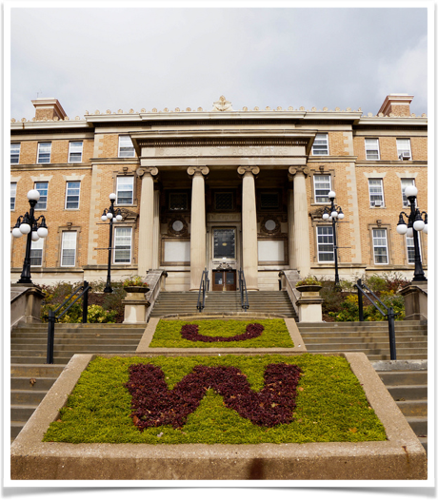
Summary
It was a great honor to receive a Chadwick Fellowship in 2015. From my experiences gained through it I have become more valuable as a media producer and as a manager in the media department of the Office of Distance Education.
I have also been affected personally by this, as my push to research and develop new technologies in the media department has led me to begin furthering studies into computer science.
My experience as a Chadwick Fellow has been invaluable to my growth as a media producer and lifelong learner.

