Slide 1

Developing a Digital Humanities Project in Gastronomy
Digital Humanities, also known as humanities computing, is a field of study, research, teaching, and invention concerned with the intersection of computing and the disciplines of the humanities.
It is methodological by nature and interdisciplinary in scope.
It involves investigation, analysis, synthesis and presentation of information in electronic form.
Project Goals:
  Digitize and preserve an archive of personal recipe collections
  Learn how digital humanities methods can be used to study the collection and demonstrate this to other students and scholars
The Chadwick Fellowship allowed me to attend the Digital Humanities 2013 Conference at the University of Nebraska in July, 2013. Some of the many presentations and workshops I attended included:
  Textual Analysis
  Crowd-sourcing
  Mapping and Visualization techniques
  Grant-writing for Digital Humanities projects and funding sources
  Gained familiarity with the wide range of projects where these methods are employed

Slide 2
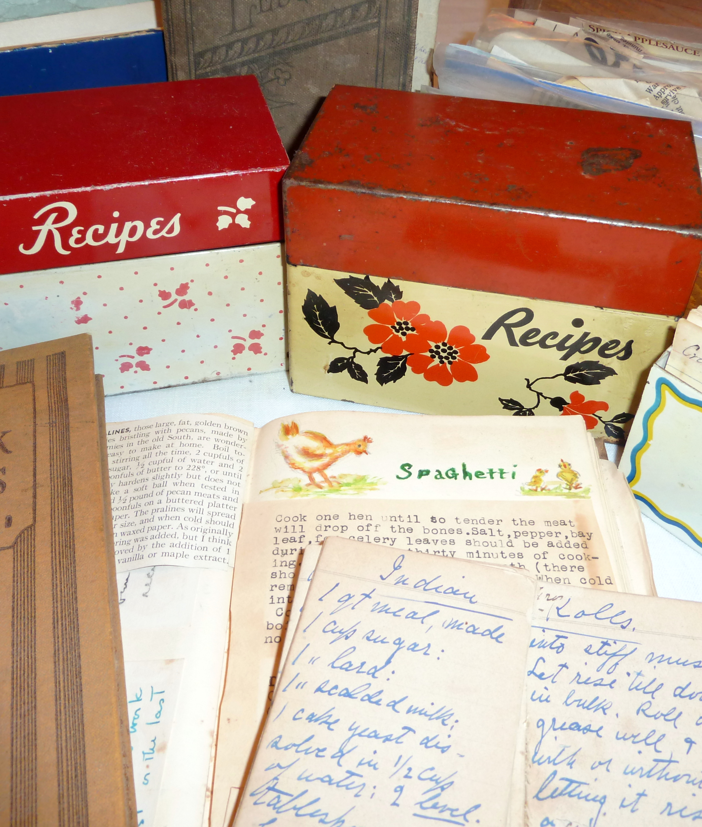
Personal Recipe Collections as Sources for Gastronomy Research: The case for a digitized archive
Valuable primary sources that documents “everyday cuisine”
Often are the sole surviving written record of a woman’s life - a personal archive
Unlike cookbooks, recipe boxes are rarely collected by libraries or archives.
While there are a number of easily accessed digital collections of cookbooks and restaurant menus, there is no comparable digital collection of personal recipe collections.
Compliments MET leadership in the field of Food Studies

Slide 3
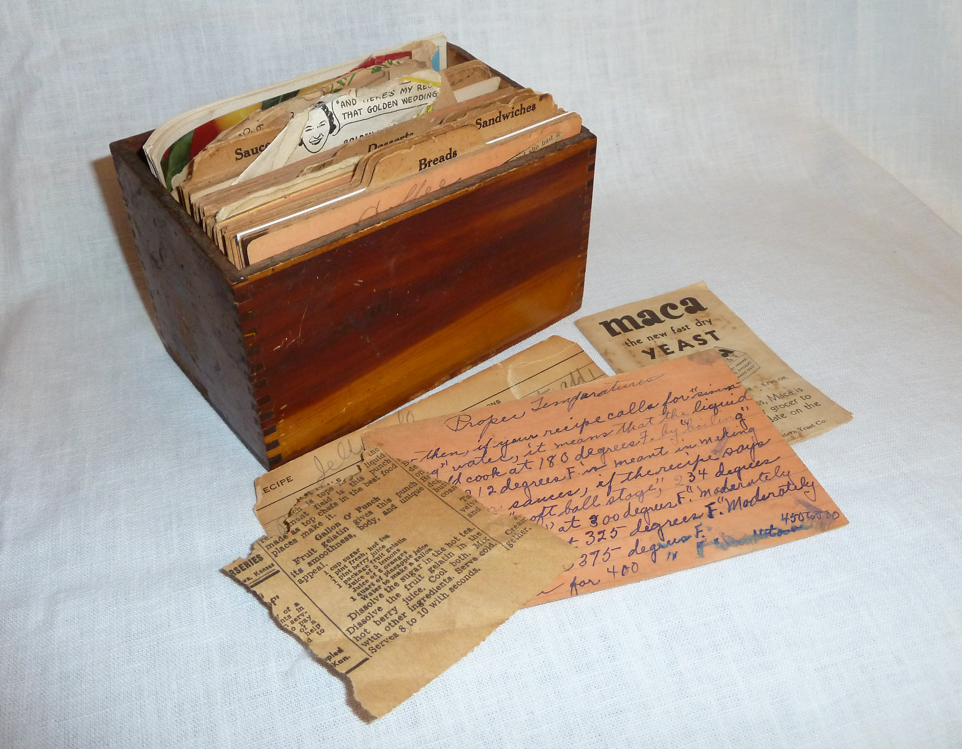

Project Outcomes
Access to the collection
Demonstrated use of the collection
29 Recipe boxes and scrapbooks digitized by Mugar Library
Collection freely available in the Institutional Repository, OpenBU
Students in MET Gastronomy course “Cookbooks and History” currently using this resource
View a Sample image
Sample project under development using Omeka digital exhibit software
Omeka allows for display of items; items classified using Dublin Core metadata terms
Recipes can be transcribed and are searchable for titles, ingredients, and methods

