Slide 1
Network Analysis of Social Group Dynamics
Madeline Grossfeld
Notes:
Want a better title, doesn’t describe the study well

Slide 2
Basics of Networks (Graphs)
Node (actor): each element in the dataset; a person
Edge (tie): a connection between two nodes; friendship
Degree: the number of edges connected to a single node
Attributes: relevant data about nodes besides the edges between them
  i.e. race, sex, age, etc.
Dyad: a pair of nodes
Triad: a triple of nodes
Notes:
Picture of network for reference

Slide 3
Application to Scientific Research:
Birds of a Feather, or Friend of a Friend?
Data
90,000 students from 1994-1995 in grades 7-12
Identify 5 best male and female friends from roster
  Most identified less than 10
Consider only reciprocated friendships
Questions
How do attributes affect friendships?
  Age, sex, race
What are some key patterns in social networks?

Slide 4
What influences friendship?
Sociality: how social a person is
  Ability to make friends
Selective Mixing: effects of sociodemographic attributes on friendship
  Assortative mixing: befriend others with similar attributes
  Disassortative mixing: ”opposites attract”
Triad closure: likelihood of two people being friends if they have a mutual friend
Notes:
Key point to talk about for selective mixing:
Process is selective mixing; outcome is mixing pattern
Similar for triad closure:
Process is triad closure; outcome is transitivity

Slide 5
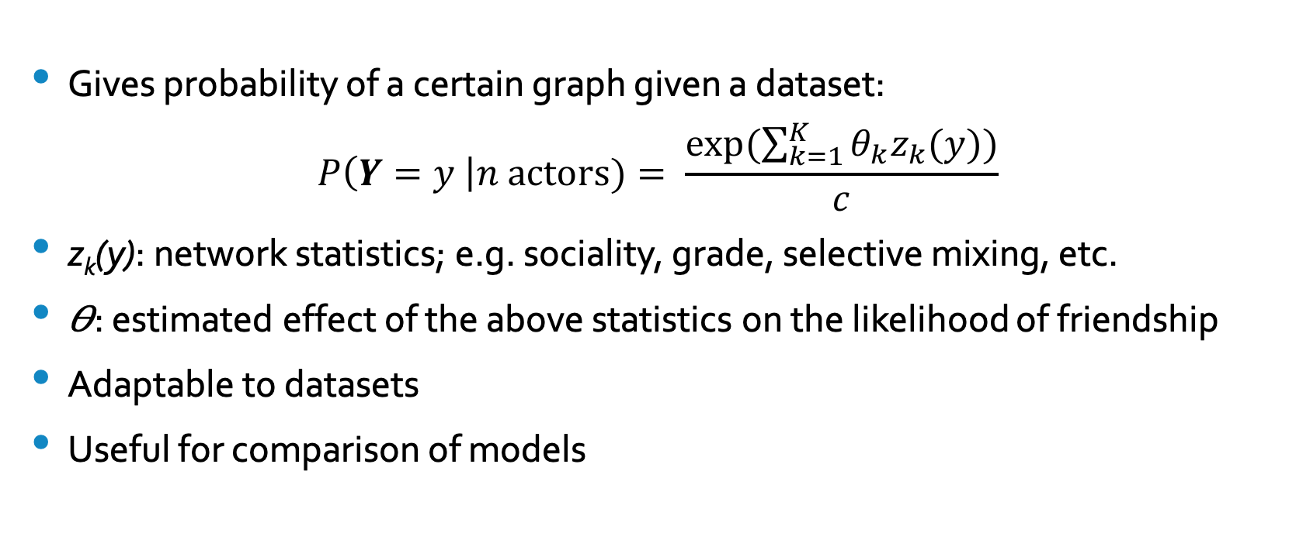
The Exponential Random Graph Model (ERGM)
Gives probability of a certain graph given a dataset:
$$P\left(Y=y \right|n actors)= \frac{exp⁡(\sum_{k=1}^{K}{θ_{k}z_{k}(y))}}{c}$$
z_{k}(y): network statistics; e.g. sociality, grade, selective mixing, etc.
𝛳: estimated effect of the above statistics on the likelihood of friendship
Adaptable to datasets
Useful for comparison of models

Slide 6
Concerns of the ERGM
Homogeneity assumption: the covariates’ effects are the same for all ties
Dyadic independence: assumes the probability of each tie does not depend on other ties only on attributes
Model degeneracy: model is unrepresentative of data
  Estimated statistics do not converge
  Statistics converge in an illogical way
Notes:
Homogeneity: each existence of a tie between two students with certain attributes is equally probable

Slide 7
Three Models Considered
Demographic Attribute Model
Attribute-based
Dyadic-Independent
Triad Closure Model
Homogeneous
Dyadic-Dependent
Full Model
Combines the two models
Estimates unique effects
Based on Selective Mixing
Based on Triad Closure
Selective Mixing and Triad Closure

Slide 8
Three Models Considered
Demographic Attribute Model
Attribute-based
Dyadic-Independent
Triad Closure Model
Homogeneous
Dyadic-Dependent
Full Model
Combines the two models
Estimates unique effects
Based on Selective Mixing
Based on Triad Closure
Selective Mixing and Triad Closure
Notes:
Insert circle

Slide 9
Findings of Analysis
Effects of grade and sex are homogeneous
  Assortative mixing and triad closure
Effects of race are not homogeneous:
  Hispanic: more assortative and triad closure mixing in homogeneous student populations
  White: more disassortative mixing and less triad closure when minority
  Black: more assortative mixing and triad closure when minority
  Asian: assortative mixing and triad closure in all cases

Slide 10
Possible Continued Studies
Students with no reciprocated friendships
  Currently underestimate number with unreciprocated friendships
Social distance of larger schools
  These models did not predict less dense networks
Consideration of age in a more dynamic sense
  Currently just see if two students are in the same grade, not how far apart

Slide 11
References

Slide 12
Thank You!
Questions?

