Slide 1
How to Use Bitcoin to
Design Fair Protocols
Ranjit Kumaresan (MIT)
Joint work with Iddo Bentov (Technion), Tal Moran (IDC Herzliya)

Slide 2




Fair Exchange
[Rab81,BGMR85,ASW97,ASW98,BN00,….]
E.g., contract signing, digital media
Abort Attacks
Need to force exchange to happen simultaneously
Fair exchange is impossible
[Cle86,PG99,BN00]
Notes:
Instead of picking on the wimpy functions we go after the toughest functions on the block.

Slide 3


Secure Computation [Yao86,GMW87]
x
y
f (x,y)
f (x,y)
Most general problem in cryptography
  Fair exchange is a special case
Fair 2-party secure computation is impossible [Cle86]
Definition of secure computation as inherently unfair in the presence of dishonest majority [GMW87]
Notes:
This work motivated by secure computation
Not only asymp but also concrete… especially those which are composable with one another…
Work in this area also addresses implementation and systems issues

Slide 4

Workarounds
Penalty model [ASW00,MS01,CLM07,Lin08,KL10]
  Deviating party pays monetary penalty to honest party
Bad guys lose money if they deviate after learning output
Honest parties never lose money
“Secure computation with penalties”
Notes:
Instead of picking on the wimpy functions we go after the toughest functions on the block.

Slide 5

Bitcoin [Nak08]
Decentralized digital currency
(Relatively) widely adopted
Lots of recent research activity
“Securely” implements a bank
Simplified Model
Two-party transactions
  Conditional
Notes:
Instead of picking on the wimpy functions we go after the toughest functions on the block.

Slide 6



Claim-or-Refund Functionality
Implicit in [Max11,BBSU12,BB13]
F_{CR}
Accepts from “sender” S
  Deposit: coins(x)
  Time bound: τ
  Circuit: ϕ
Designated “receiver” R can claim this deposit
  Produce witness T that satisfies ϕ
  Within time τ
If claimed, then witness revealed to ALL parties
Else coins(x) returned to S
T
ϕ, τ
Efficient realization via Bitcoin
Bitcoin scripts & timelocks
Allows realization in & across different models
Notes:
Escrow like functionality

Slide 7

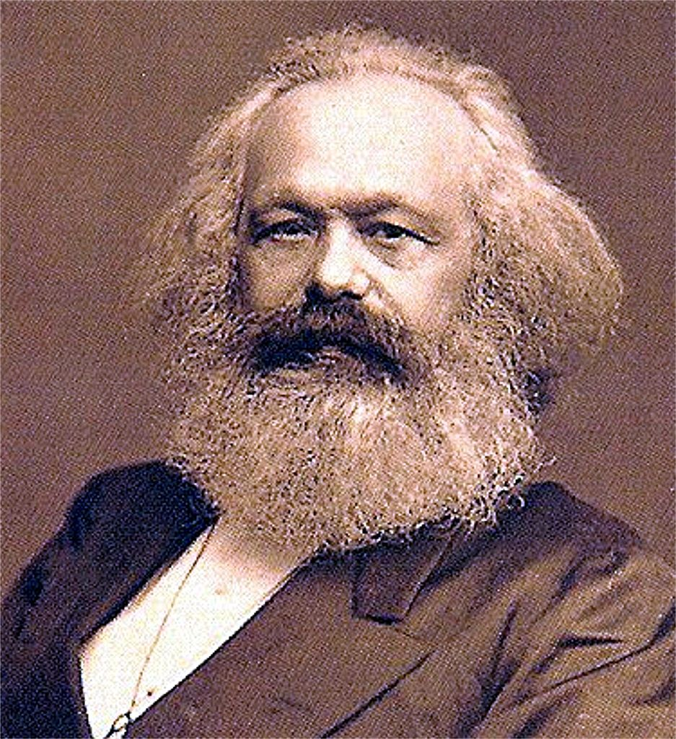
Conditional
transaction functionality
Unfair
ideal
HYBRID
IDEAL
Fair
ideal
≈
Notes:
Instead of picking on the wimpy functions we go after the toughest functions on the block.

Slide 8
Strategy
Reduce fair secure computation to
fair reconstruction
F_{f ’}
Hybrid model with functionality f ’
  Computes output of f, say z
  Secret share z into n additive shares sh₁,…,sh_{n}
  Computes commitments on shares
    c_{i} = com(sh_{i}; w_{i}) for every i
  Delivers output: ({c₁,…,c_{n}}, T_{i} = (sh_{i}, w_{i})) to party P_{i}
Notes:
Escrow like functionality

Slide 9
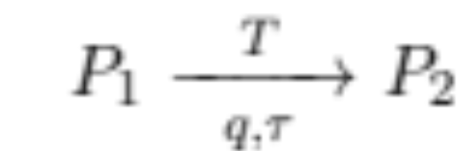
Fair Reconstruction
Secure computation with penalties
Honest parties never have to lose coins
If a party aborts after learning the output then every honest party is compensated
denotes
P₂ must reveal witness T = (sh,w) within time τ to claim coins(q) from P₁
“Abort” Attack
Adversary aborts without making its deposit but claims honest party’s deposit
Honest party loses money (although it learns output)
Malicious Coalitions
Coalition of corrupt parties learn honest party’s shares
Then adversary does not claim honest party’s claim-refund txn
Adversary learns output but honest party is not compensated
Notes:
Instead of picking on the wimpy functions we go after the toughest functions on the block.

Slide 10
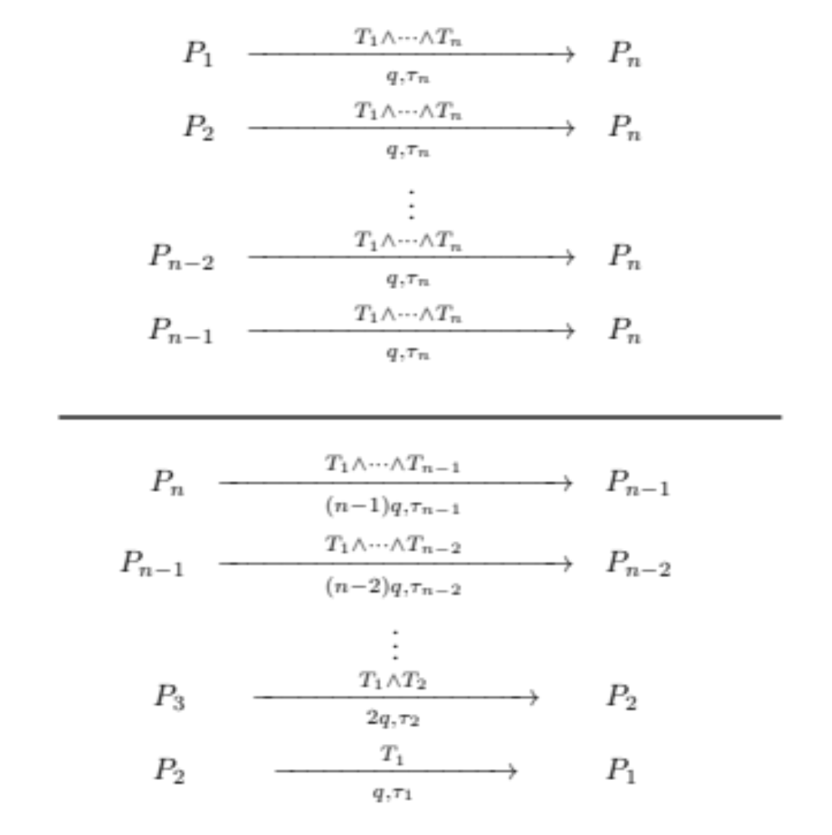
“Ladder” Protocol
Order of deposits/claims
Roof deposits made simultaneously
Ladder deposits made one after the other
Ladder claims in reverse
Roof claims at the end
Roof
High-level intuition
At the end of ladder claims, all parties except P_{n} have “evened out”
If P_{n} does not make roof claims then honest parties get coins(q) via roof refunds
Else P_{n} “evens out”
Ladder
Notes:
Instead of picking on the wimpy functions we go after the toughest functions on the block.

Slide 11
Related Work
Bitcoin lottery in the penalty model
  2-party lottery [Back-Bentov arXiv13]
  Multiparty lottery [ADMM, S&P’14]
Secure computation in the penalty model using Bitcoin
  2-party secure computation [ADMM, FC’14]
Somewhat ad-hoc construction/analysis
  Security not proven using the simulation paradigm
No multiparty secure computation in the penalty model
Constant round MPC [K-Bentov, CCS’14]
Fairness in stateful computations [K-Moran-Bentov, CCS’15]
Notes:
Instead of picking on the wimpy functions we go after the toughest functions on the block.

Slide 12
Summary
Penalty model for enforcing fairness
“Claim or refund” transactions in Bitcoin
Constructions in F_{CR} hybrid model for
  Secure computation with penalties
  More applications: E.g.: Verifiable computation, secure computation with restricted leakage [KB14]
THANK YOU!!!
Notes:
Instead of picking on the wimpy functions we go after the toughest functions on the block.

