Slide 1
Robots
By: Monét, Nitika, and Liz

Slide 2
What is a Robot??
A robot is a machine or a computer program which seems to have a life of its own.
A social robot is a robot that interacts and communicates with humans.

Slide 3
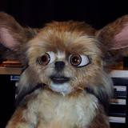
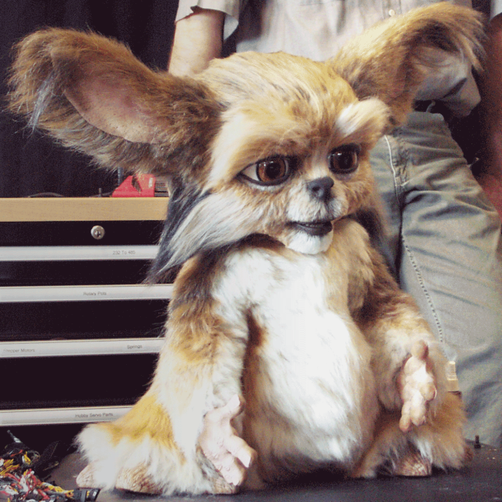
LEONARDO

Slide 4
Leonardo
The body of Leonardo was finished in 2002. It was created by the Personal Robots Group of MIT.
Leonardo was designed so he can learn from natural human interactions.
The main point to build this robot was to make a social robot.

Slide 5
Leo has a few different facial Expressions to show people the way he feels to enhance the interactions with humans. These are a couple of his many expressions.

Slide 6
A very important part of Leonardo is his communication with humans. When he is instructed to do a task he can perform it with a human partner. He is one of the most expressive robots today.

Slide 7
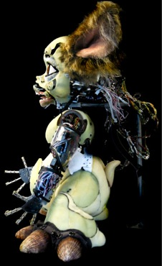
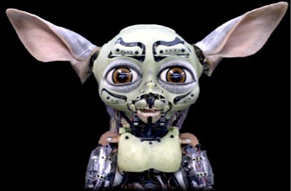
The characteristics of Leo are:
Brown fur
Big eyes he uses to memorize the faces of new people or things he interacts with.
Although Leo doesn’t walk he does make slight gestures.

Slide 8
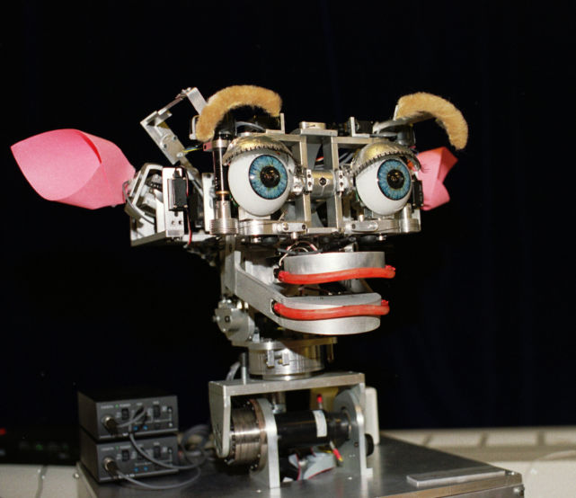
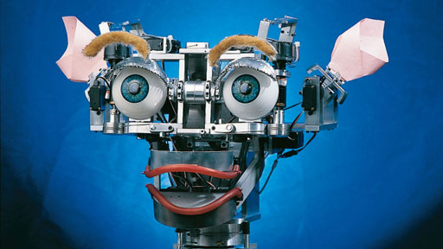
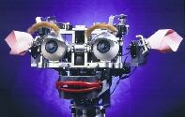
KISMET

Slide 9
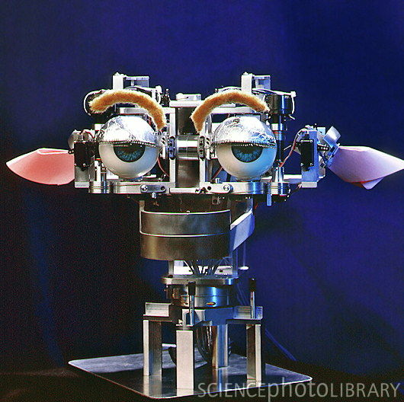
Kismet
Kismet is a robotic head that interacts with humans through facial expressions, head positions, and tone of voice.
Kismet’s features include:
Big blue eyes
Big lips
Ears
Eyebrows
The eyes are sensors that allow Kismet to take in information from its environment. Then, Kismet can communicate through emotions (such as happiness or disgust).

Slide 10
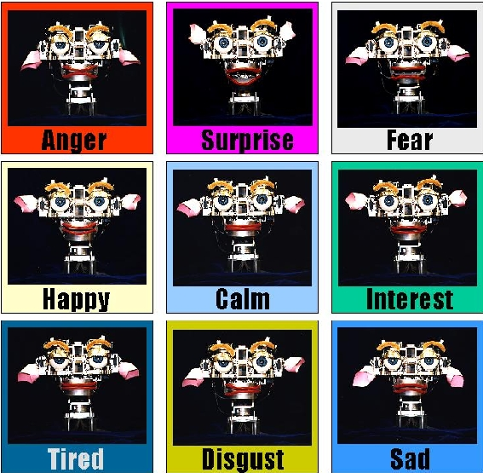
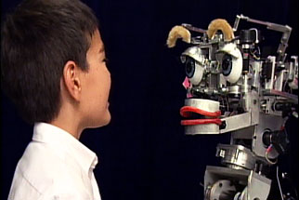
Communicating with Kismet
To talk to Kismet, you have to wear a microphone; Kismet also has microphones in his ears.
The microphones are used for recognizing your tone of voice.
Kismet’s features were made so that he could interact with humans naturally.
For example, if you are standing too close to him, it will back away.

Slide 11
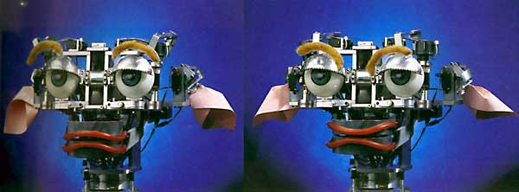
Making Kismet
Kismet was created to look as lifelike as possible. To do this, cartoon animators were asked to help.
He was also made to have a real presence.
This impacts many people on an emotional level.
Kismet learns by trial and error. At first, Kismet won’t be good at a task, but he will remember his mistakes and get better.

Slide 12
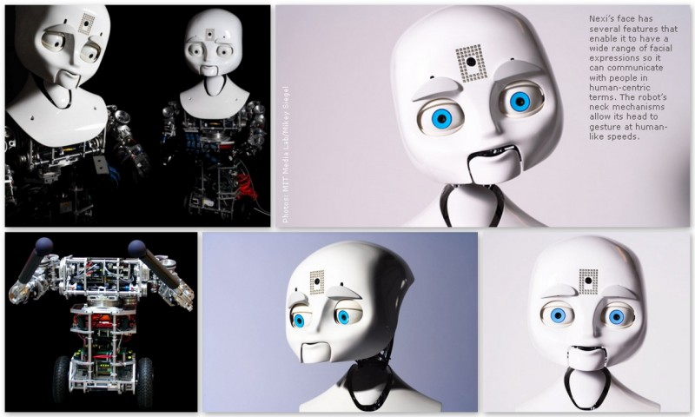
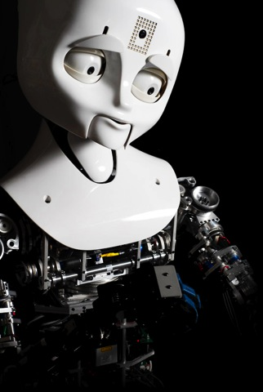
NEXI

Slide 13
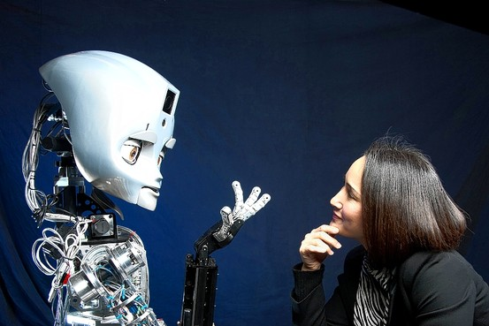
Nexi
A new experimental robot that can show facial expressions.
She is aimed to do a lot of tasks as a personal robot and human-robot teamwork.
She was created by the MIT Media Lab’s Personal Robots Group, a group leaded by Media Lab’s Cynthia Breazeal, who also created Kismet.

Slide 14
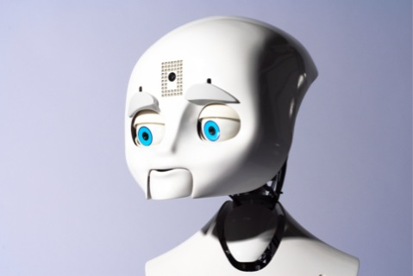
Nexi cont’d
The group was also collaborated with Prof. Rod Grupen from the University of Massachusetts-Amherst and two MIT robotic spin-off companies.
She is in a class of robots known as “MDS” abbreviated from Mobile/Dextrous/Social.

Slide 15
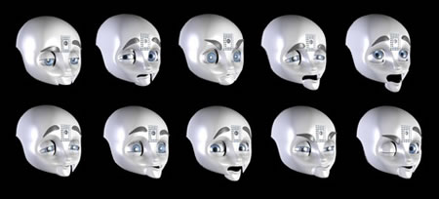
Nexi Anatomy
Unlike Kismet, Nexi has arms with detailed expressive abilities and also an upper body.
Her head can move at human-like speeds.
Examples of her facial expressions are gazing, eyebrows, and eyelids.
Her hands are used to handle objects, which are able to pick up a 10 pound object together.
Some of the possible facial expressions Nexi can show.

Slide 16
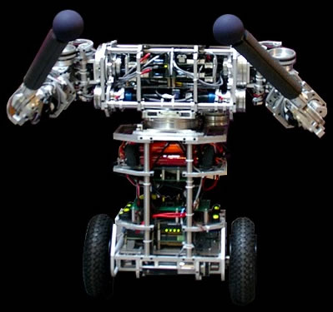
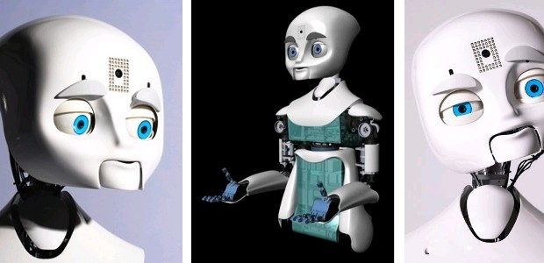
Nexi Anatomy cont’d
Her eyes (video cameras), ears (an arrangement of microphones), a 3-D infrared camera, and a laser rangefinder to support real-time tracking of objects, people, voices, and indoor navigation.
She currently uses a set of supportive wheels to operate as a stable platform during its early stage of development.

Slide 17
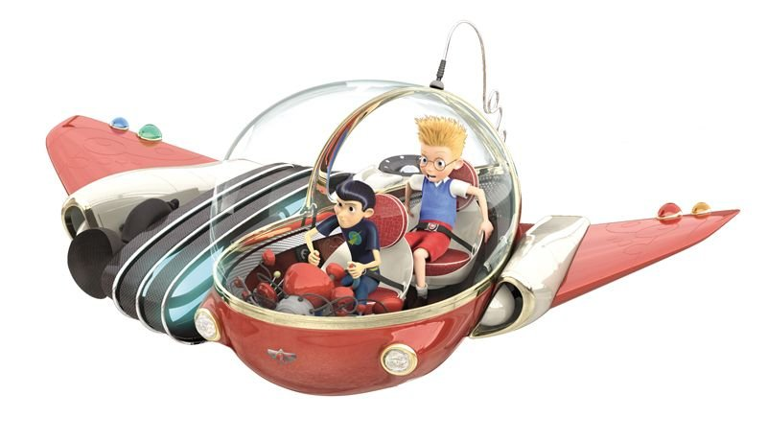
Robots of the Future
When we think of the Robots of the Future we picture:
Medical robots
In nursing homes and hospitals
Home caretakers for the sick
Household Robots
Cleaning robots
Babysitting
Construction Robots
Home/Buildings
Security Robots
Guarding important objects or people
Like the police
Robot Transportation
Robot cars and busses

Slide 18
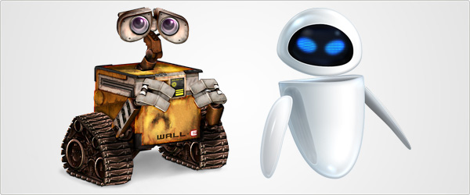
Outcome of Future Robots
Some people might have a negative output of the ideas of robots. They might think that Robots will eventually take over the world. And that Robots are due to the laziness of humans.
Also the prices of some robots might be very expensive at first but eventually as they become more popular the price will decrease.

Slide 19
Creation Of Lego Robots
Our robots were made out of Legos.
We attached:
Wheels
A light sensor
A motor
We programmed our robots using NQC.
We also had a tournament to present our robots. However, most malfunctioned.

Slide 20
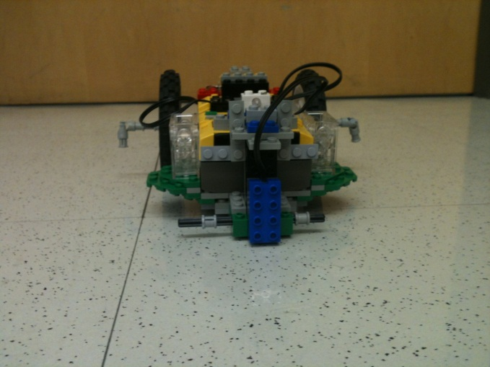
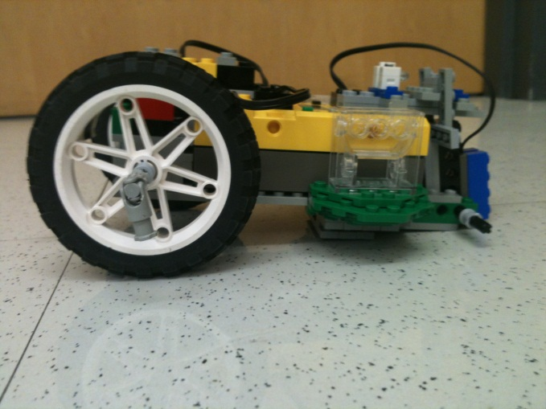
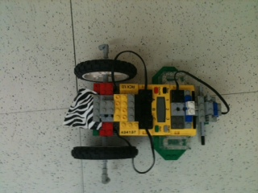
Our Lego Robot Pictures
Front View
Side View
Bird’s Eye View

Slide 21
ANY QUESTIONS?

Slide 22
THE END!!!!!!! Thanks for watching ☺ Copyright: Monét, Nitika, and Liz. If you try to steal our powerpoint, we will find you and destroy you.

