Slide 1
Hardware
Presentation by:
Serena, Ann & Nicole

Slide 2
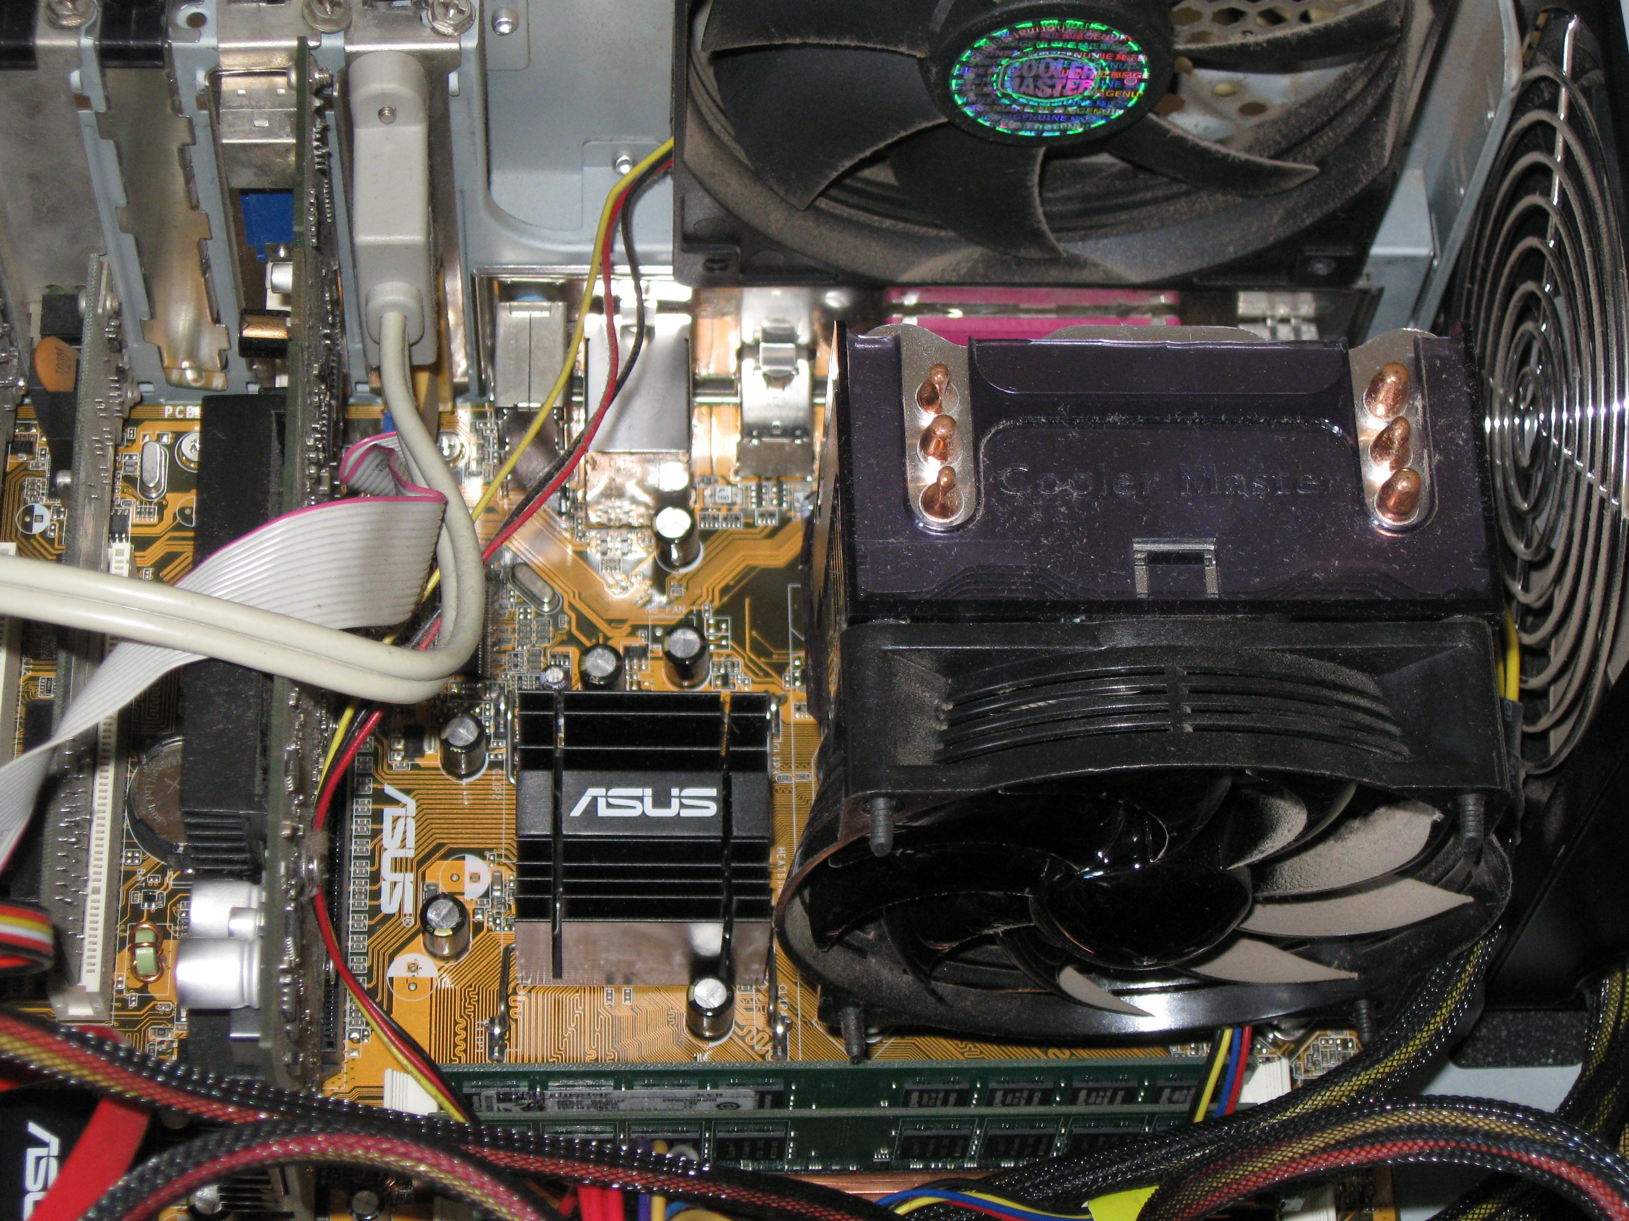
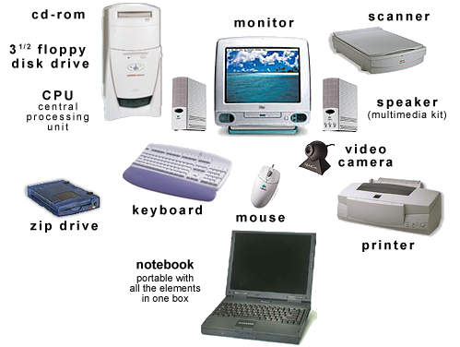
Hardware
Computer hardware refers to the physical parts that make up a computer.

Slide 3
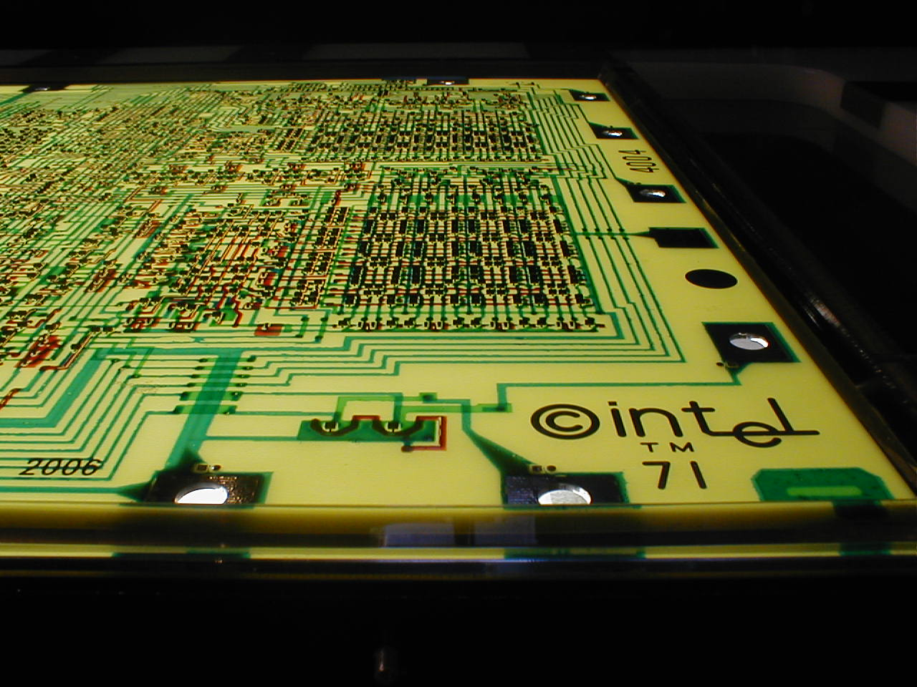
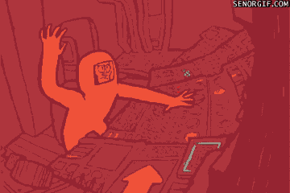
Input Devices
An input device is a piece of hardware that provides data to the computer to be interpreted.
Examples of input devices are the keyboard, mouse, webcam, and scanner.

Slide 4
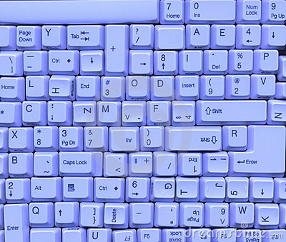
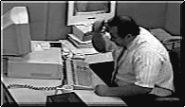
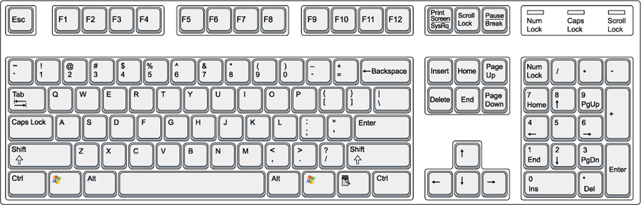
Keyboard
The keyboard is a device generally used to produce characters on the computer by pressing the labeled key. Pressing certain keys in combinations can give the computer commands as well.

Slide 5
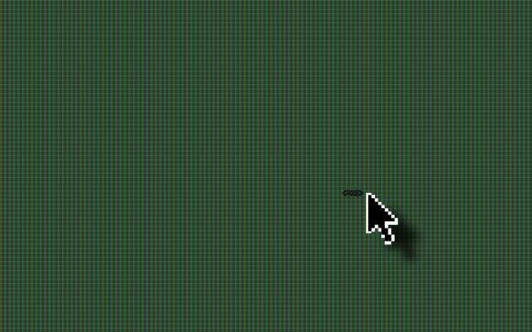
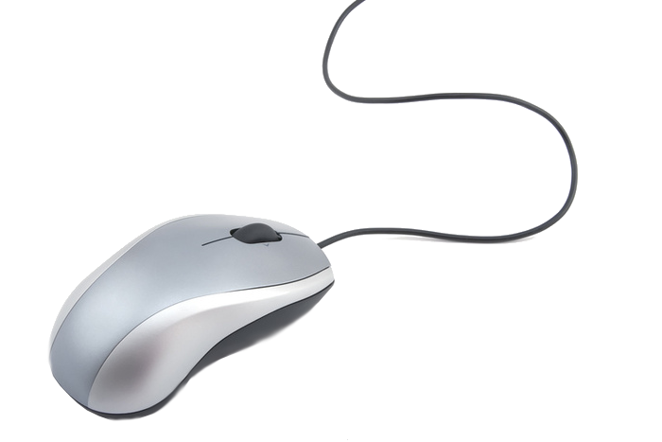
Mouse
A mouse is an input device that functions by detecting motion relative to the surface the mouse is on top of. Computer mice use
either a light sensor or a track ball to interpret movement.

Slide 6
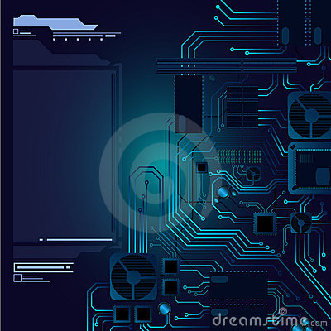
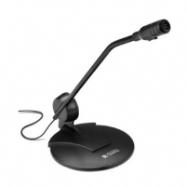
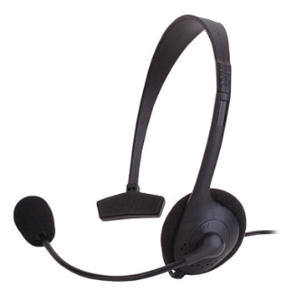
Microphone
A microphone is an input device that records sound and sends it to the computer in an electrical signal which the computer can understand and save as data. Computer microphones are usually hooked up to a headset.

Slide 7
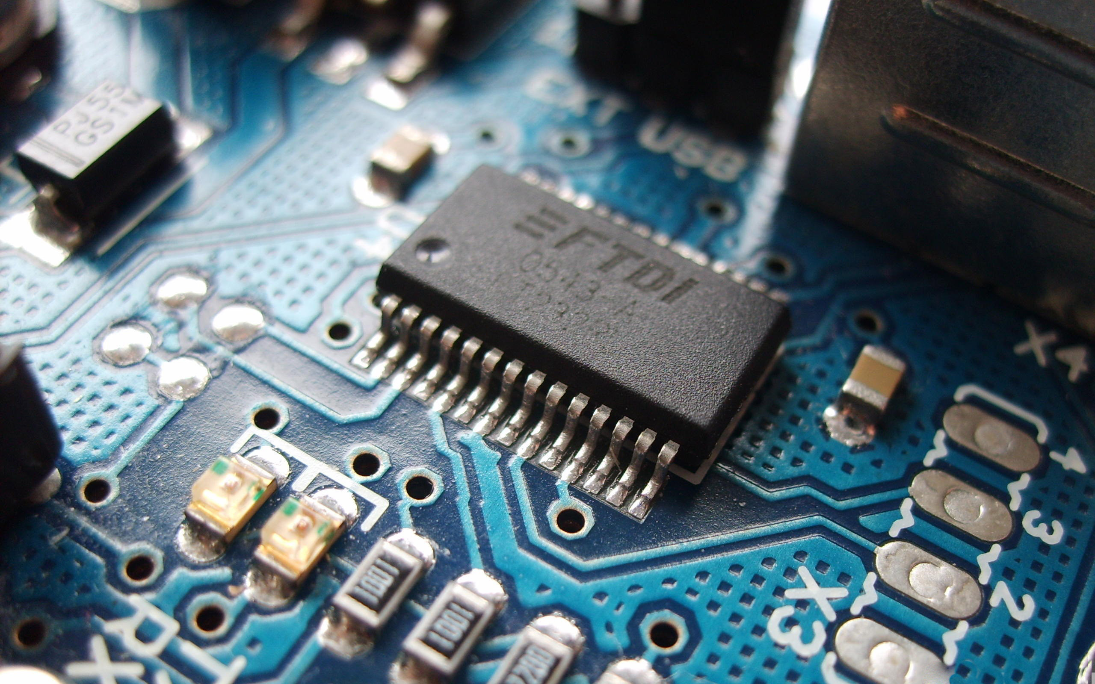
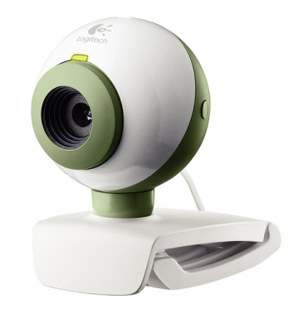
Webcam
A webcam is a video camera that feeds its images to a computer. Webcams are very fast and so they can be used to stream live or video chat. Webcams can also have microphones built-in to input sound as well.

Slide 8
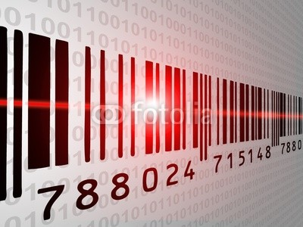
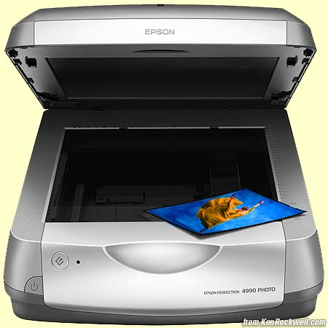
Scanner
Scanners optically convert images into digital images, they basically take a picture.

Slide 9
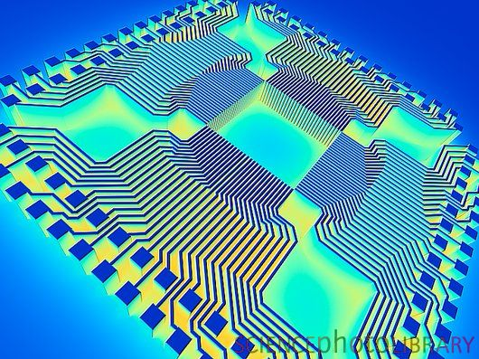
OUTPUT DEVICES
Output devices communicate computer data into a form humans can understand.

Slide 10
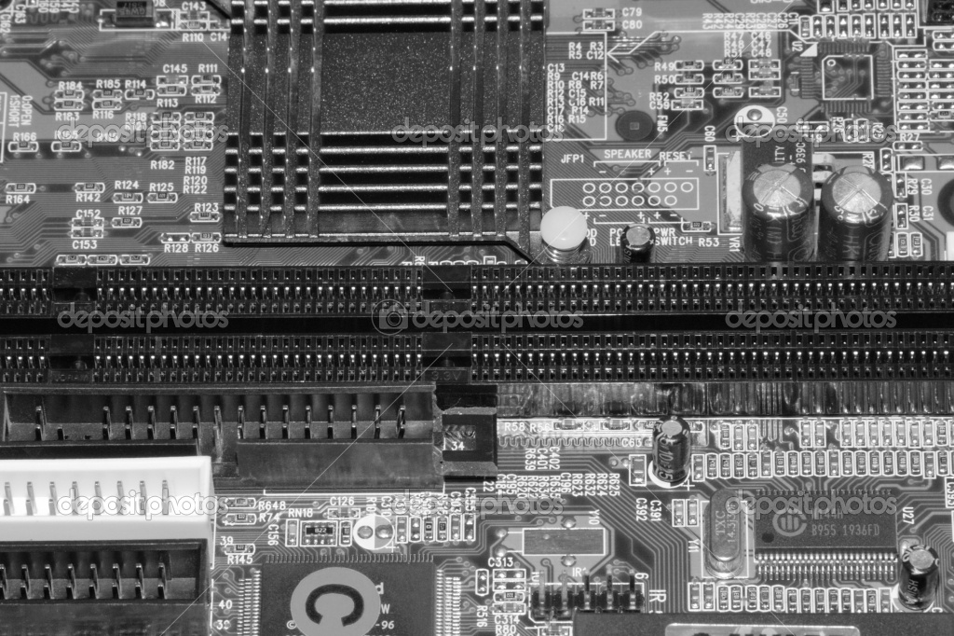
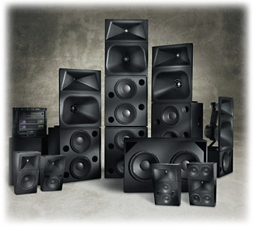
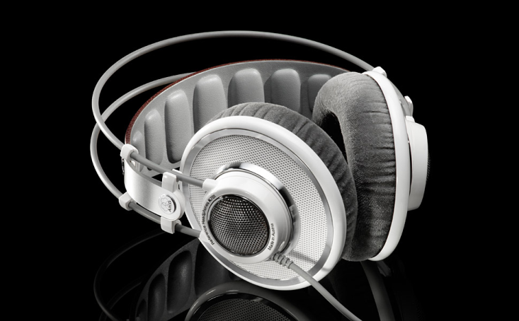
Speakers
Speakers and headphones output sound accordingly to electrical input. They are plugged into audio jacks or USB-ports.

Slide 11
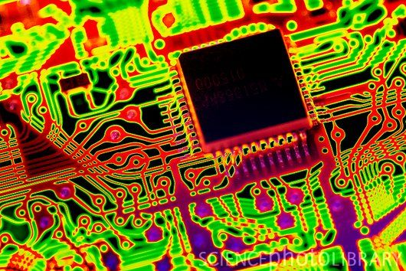
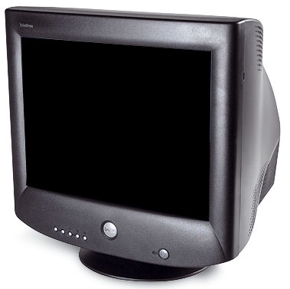
Monitor
Monitors are visual displays, much like TVs. They do not process information, they display it. The two main types of monitors are LCD and cathode ray tubes. Cathode ray
tubes take up much more
room and are becoming
increasingly outdated.

Slide 12
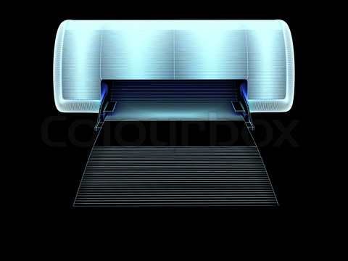
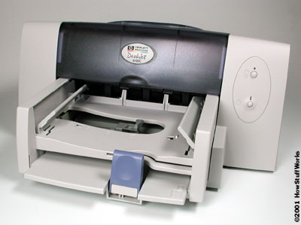
Printer
Printers physically write text or pictures onto paper using ink. They take pictures from the computer and write them onto paper in lines of color.

Slide 13
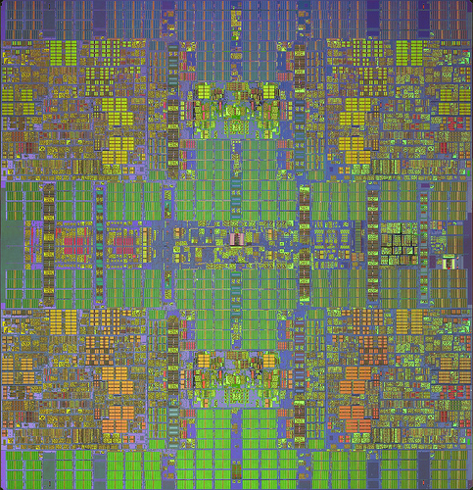
Removable Data Storage
Removable data storage is memory stored on hardware that can be put into and taken out of the computer and kept intact while outside of the computer.

Slide 14
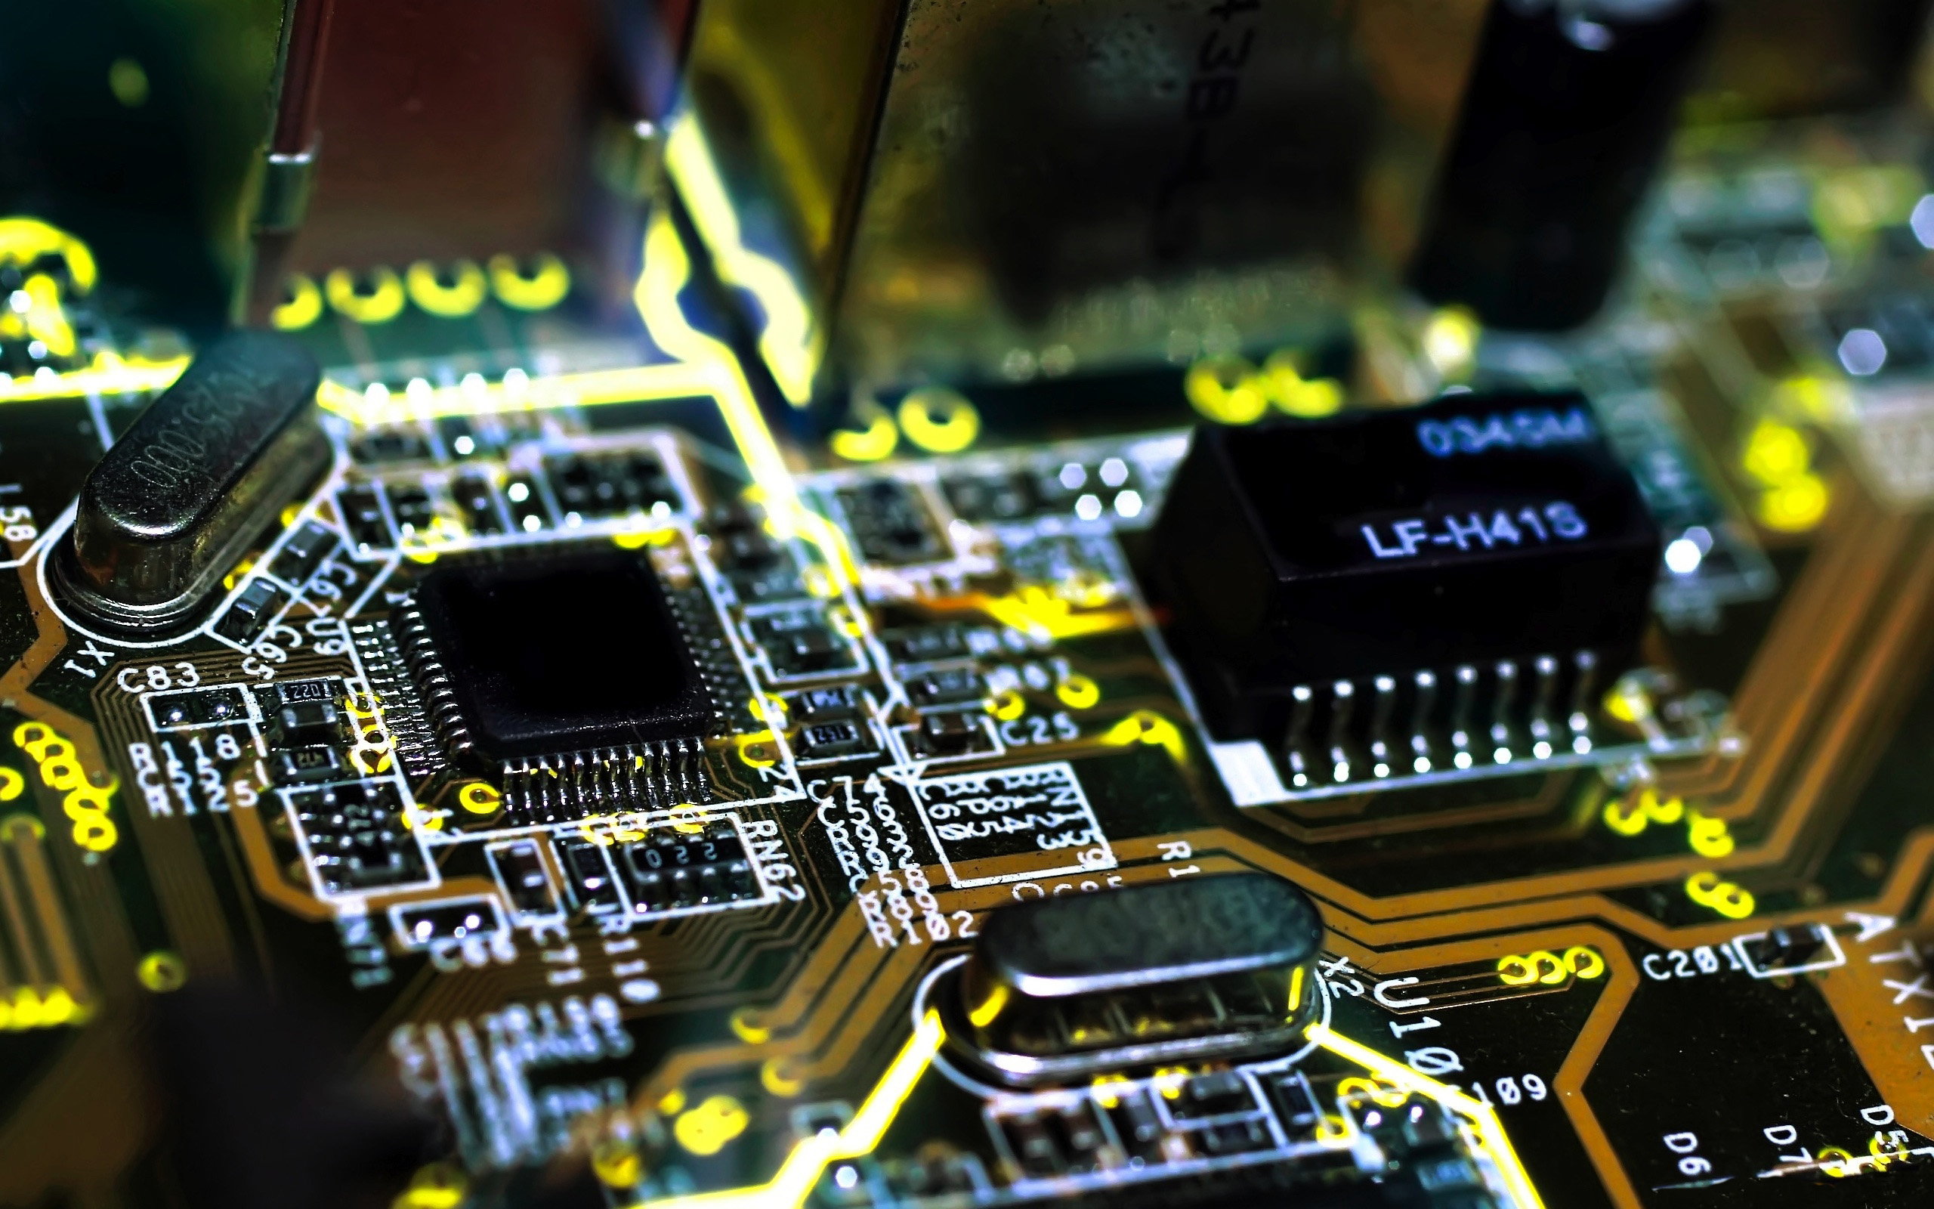
Memory Card
A memory or flash card is a form of removable data storage used for storing digital information. They are used in many electronic devices. They are small, re-writable, and able to retain data without power.

Slide 15
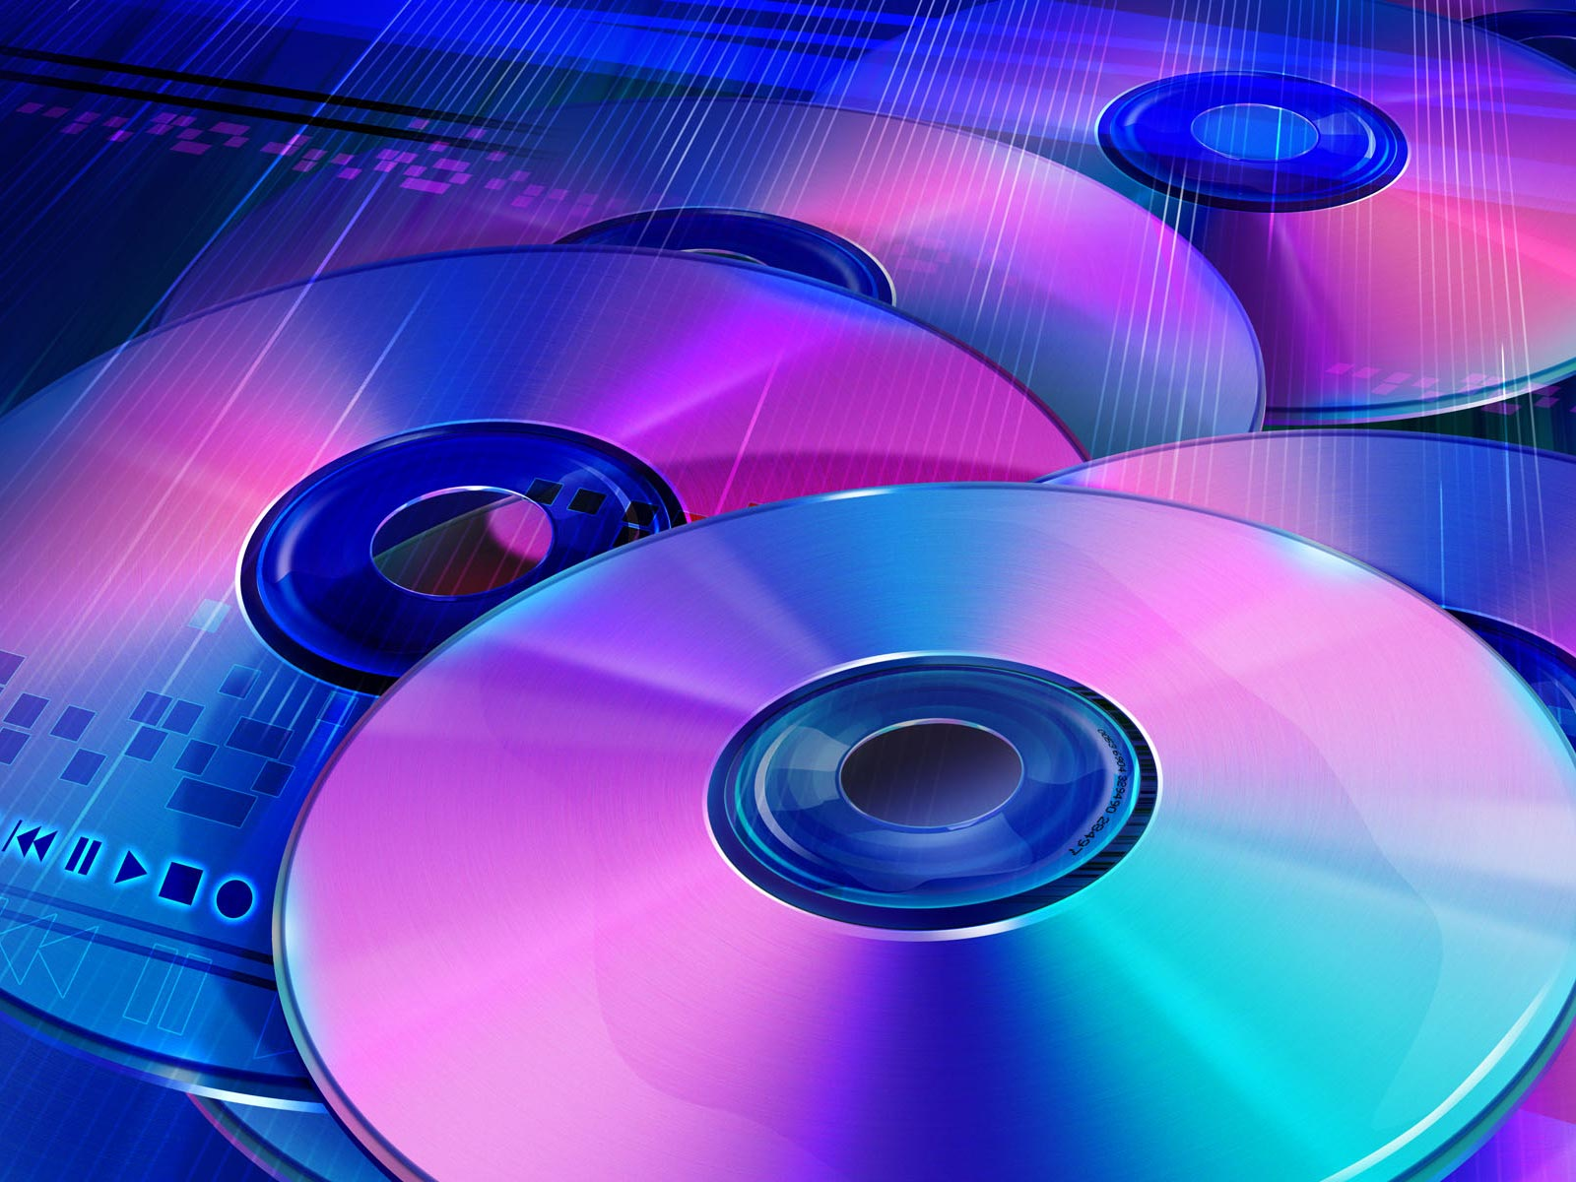
Optical Disks
Optical disks are forms of removable data storage that is written with a laser. They either reflect in an area or don’t to give the computer data of either a 0 or a 1. CDs and DVDs are examples of optical disks.

Slide 16
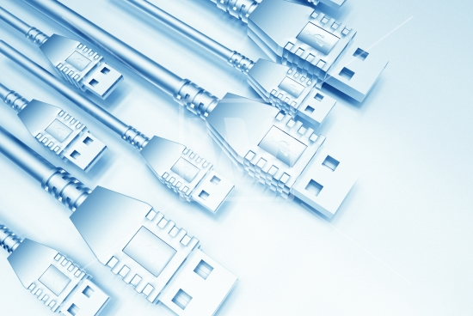
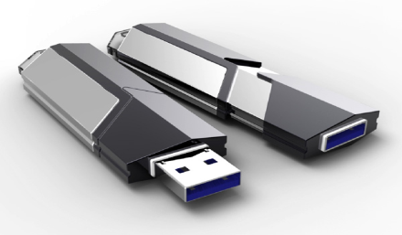
USB flash drive
Universal Serial Bus(USB) flash drives are another form of removable data storage. They are flash drives that store memory and go into USB ports and are generally writable. A USB port is a universal port designed so that keyboards, mice, headphones, speakers, etc. could all go into one slot.

Slide 17
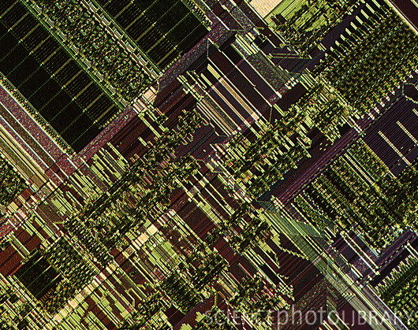
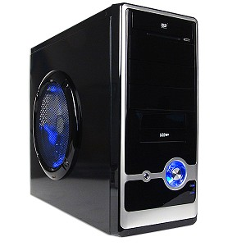
Computer Case
A computer has hardware inside of its case which each have a function to run the computer, the computer case is just the outside “shell” of the computer so that you can’t damage the inside. It’s
what makes the computer
have it’s shape and look.

Slide 18
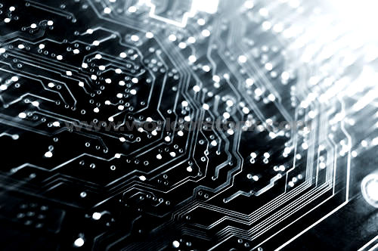
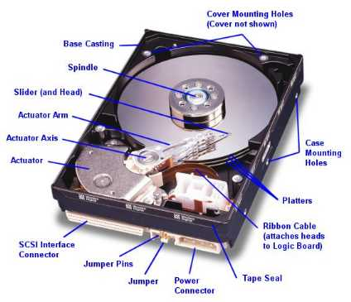
Hard Disk
A hard disk is a device for storing and retrieving digital information. The data is mechanically read and written to and from the disk by magnetic heads.

Slide 19
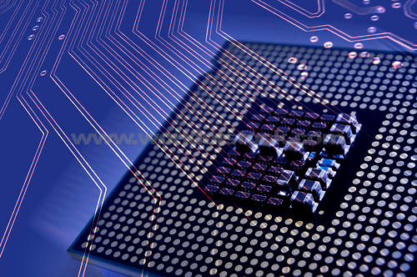
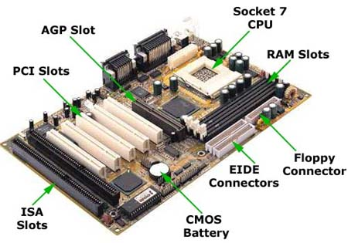
Motherboard
Everything in the
computer connects to
the motherboard. It
consists of sockets for
microprocessors, slots to install main memory, chip set, memory chips, clock generator, expansion cards, and connectors.

Slide 20
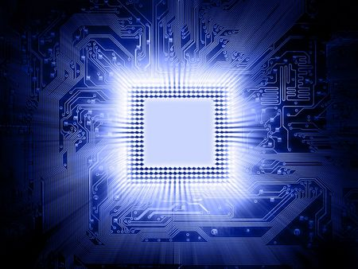
Microprocessor
A microprocessor is a programmable chip that uses digital data as input. It then processes the digital data according to instructions stored in its memory, and runs the commands as output. CPUs are all microprocessors but not all microprocessors are CPUs.

Slide 21
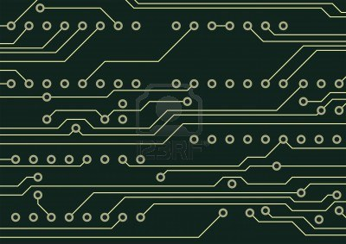
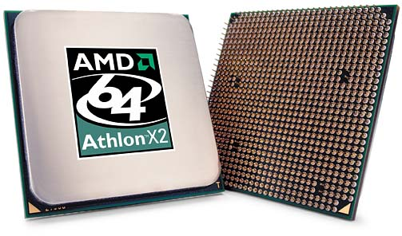
CPU
Central Processing Unit (CPU)
is the hardware which runs the
instructions of a computer
program. It performs the basic logic,
arithmetical and input/output operations.
The CPU is often thought of as the “brain”
of the computer.

Slide 22
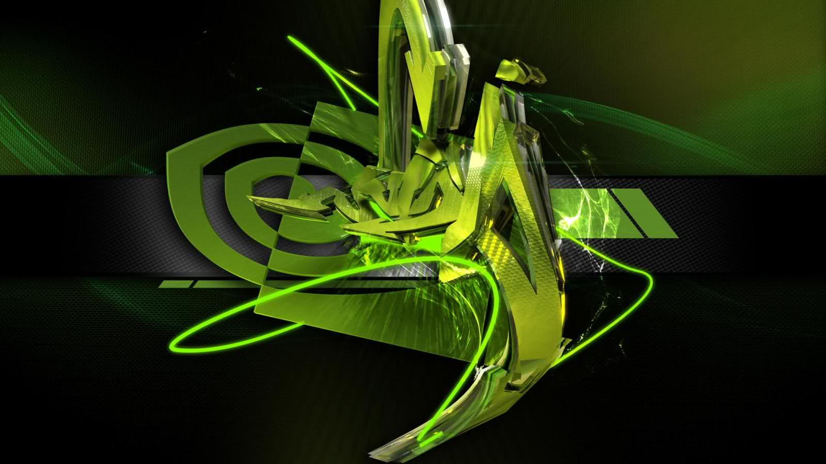
Graphics Card
The graphics, or video card of a computer is hardware component which outputs images to a monitor. Most video cards render 3D scenes, 2D graphics and format things such as text. They usually have their own fan, ram and processors.

Slide 23
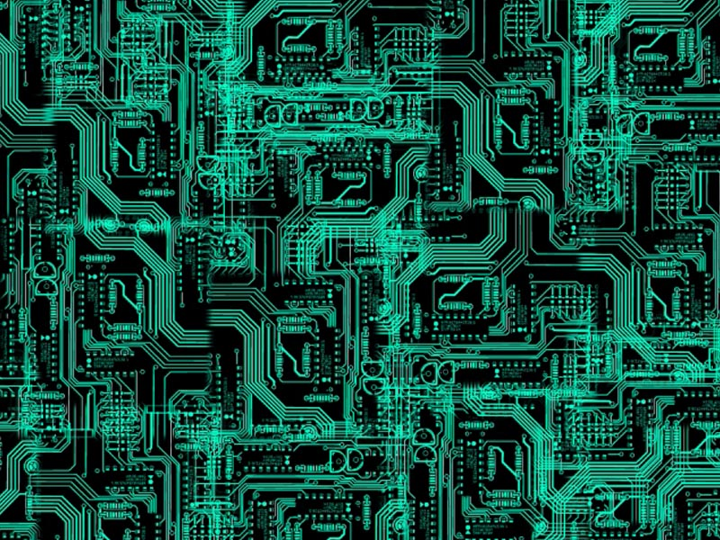
Sound Card
The sound, or audio card is a piece of hardware that controls input/output audio.
Most use a digital-to-analog converter to turn digital data into an electrical signal (analog) which is then converted to sound.

Slide 24
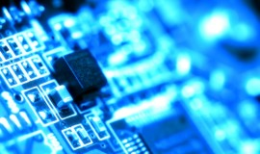
RAM/ROM
Random Access Memory (RAM) is a form of data storage on a computer It can be accessed in any order RAM can be added in physical cards, just like additional hard disks can be installed for extra memory An average computer has 4 slots for additional RAM cards to be added. Adding RAM is the most basic way to speed up your computer | Read-Only Memory (ROM) is a form of data storage on a computer It can only be accessed in the given order and can not be altered without taking large measures of effort. Is often used in distributing firmware CD-ROMs are read-only so they can’t be modified easily

Slide 25
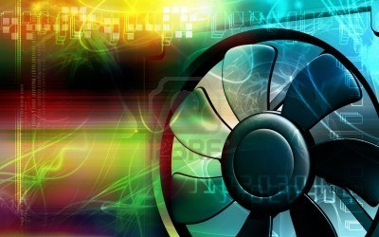
Fan
Computer fans are designed to cool off the inside components of a computer so that they don’t fry up. It draws cooler air from outside and expels hotter air or transfers air to a heatsink. Heatsinks dispells heat into the air.

Slide 26
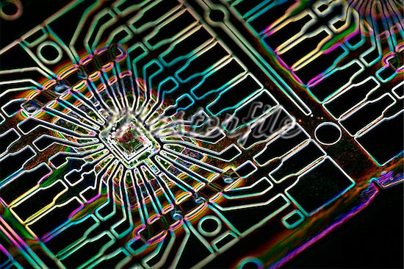
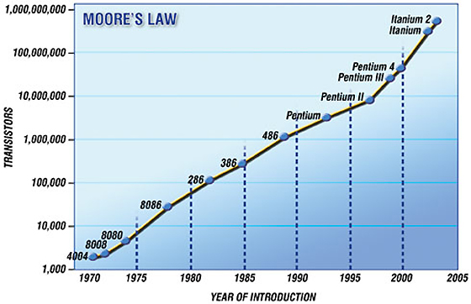
Moore’s Law
Moore’s Law is a prediction that the number of transistors on computer chips, or integrated circuits, will double approximately every two years. It has been extremely accurate so far but is expected to slow down.

Slide 27
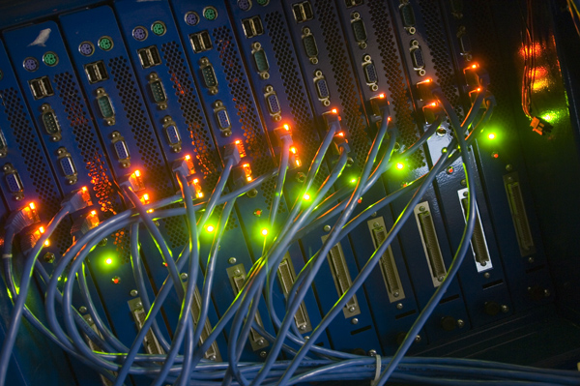
Thanks for watching
our presentation!
-Nicole Morales, Serena Do, Ann Le

