Slide 1
Humanitarian Work
and Global Health
Asha Ibrahim, Naomi Slavin, Aliyah Jackson, and Alicia Walker

Slide 2
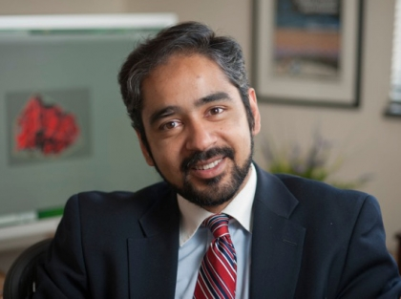
Our Inspiration
Professor Muhammad Zaman was a guest speaker
LEED (Lab for Engineering Education & Development)
His presentation was about advances in technology to help decrease the number of preventable deaths in third world countries.

Slide 3
Statistics
In parts of Africa, 20% of babies born will die within the first 72 hours of life.
Why?
-No/limited electricity
-Refrigeration for vaccines
-Safe and clean drinking water
-No hospitals and trained medical faculty
-Pneumonia is often undetectable without technology

Slide 4
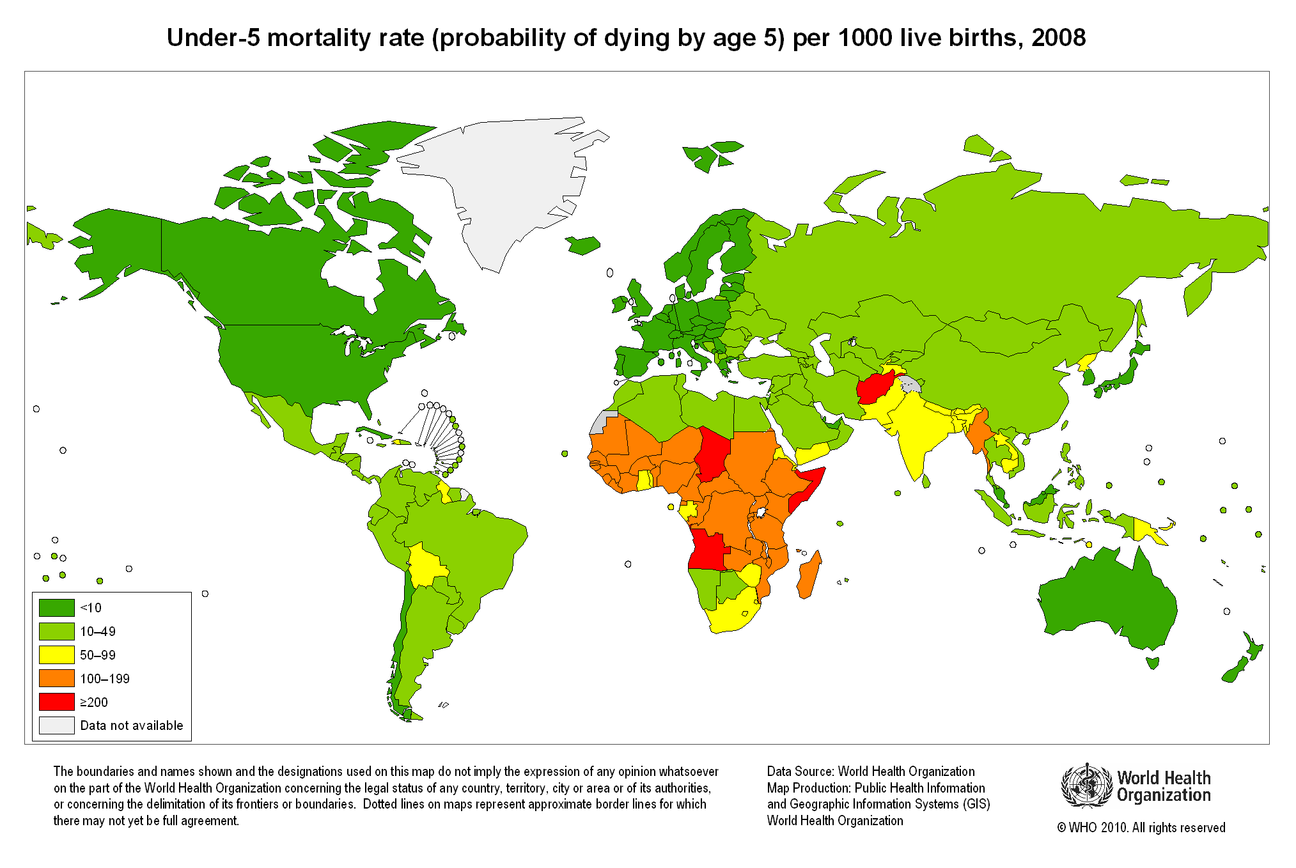

Slide 5
Statistics Continued
People at risk of malaria
Malaria casualties in 2010
Tuberculosis in 2008
About 80% of reported TB cases occurred in 22 countries in 2010
HIV/AIDS around the world
34 million people live with HIV/AIDS worldwide

Slide 6
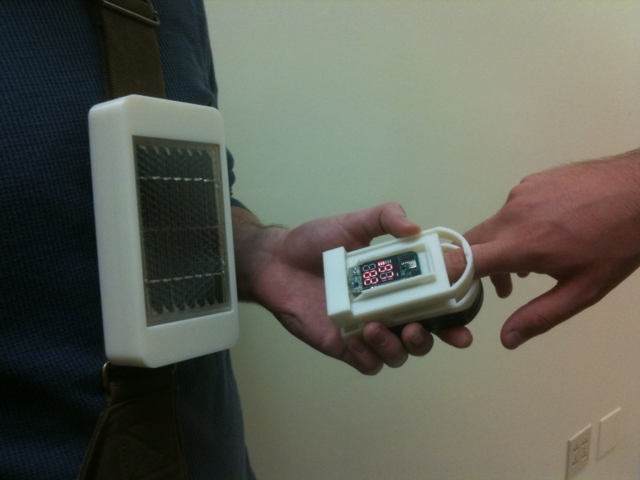
Connection to Engineering:
Pneumonia
Old cell phone batteries to a mobile pulse-oximeter.
This device allows medical professionals to easily test and give access to medication

Slide 7
http://www.youtube.com/watch?v=mBXfhE69N1E&feature=player_detailpage

Slide 8
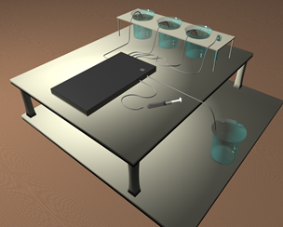
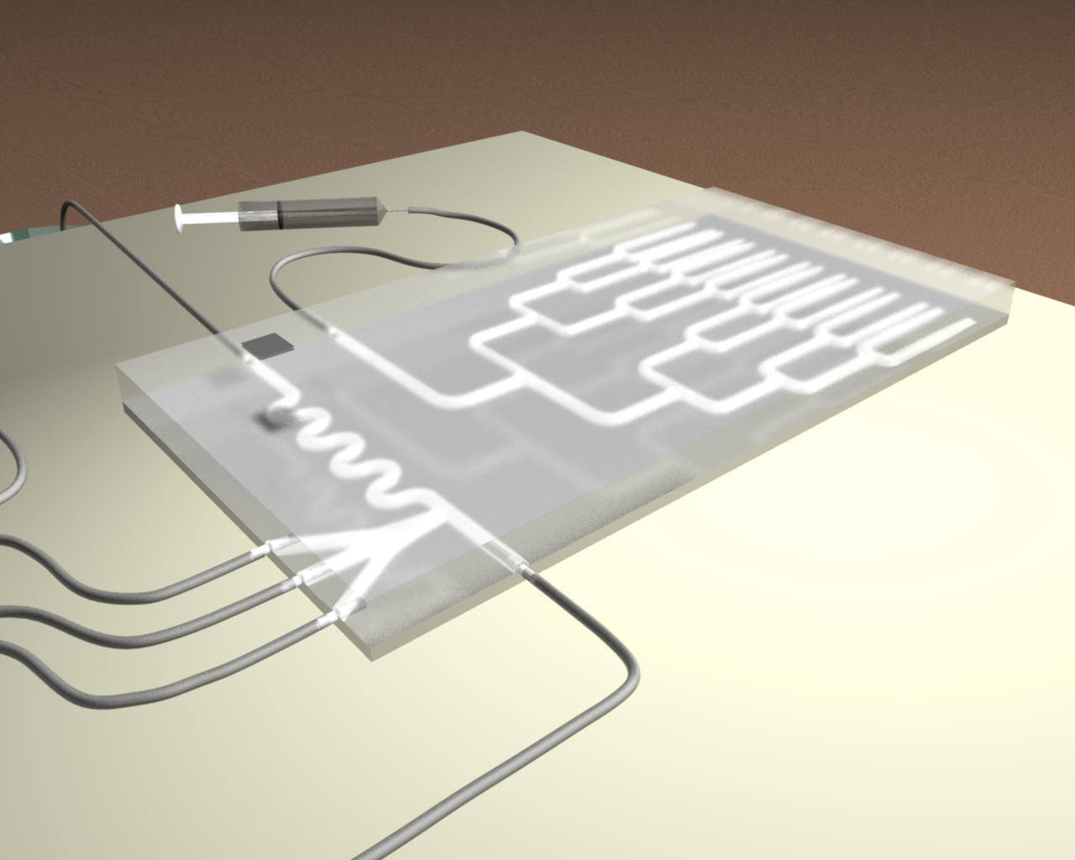
Connection to Engineering:
Malaria
What does it do?
Helps prevent counterfeit drug problems and resistance due to inauthentic drugs

Slide 9
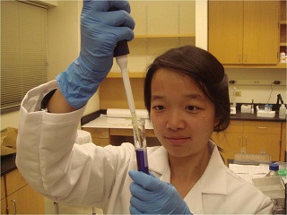
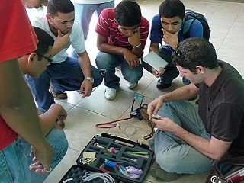
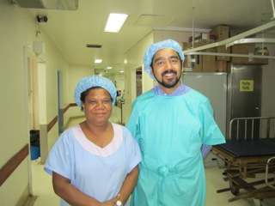
Pictures:
Professor Zaman in his lab

Slide 10
Getting Involved:
On the Web
If you want to help, here is one of many websites where you can give simple ideas to make a big difference.
www.bu.edu/leed/contribute

Slide 11
Getting Involved:
Closer to Home
Volunteer!
-at soup kitchens, shelters, and anywhere else to help less fortunate
Donate!
-food, clothes, old phones, and books
Educate!
-yourself and others about the status of global health

Slide 12
Sources
http://www.who.int/mediacentre/factsheets/fs094/en/
http://www.who.int/features/factfiles/tb_facts/en/index5.html
http://www.who.int/features/factfiles/tuberculosis/en/index.html
http://www.who.int/features/factfiles/hiv/facts/en/index2.html

