Slide 1
Cryptography
A Presentation by:
~Ksenia Potapov
~Amariah Condon
~Janette Fong
~Janice Lau

Slide 2
Definition – JANETTe
Cryptography is the study of techniques for secure communication in the presence of third parties.
Applications of cryptography include ATM cards, computer passwords, etc.
Used to protect email messages, credit cards, etc.

Slide 3
Important Terms/Steps – Amariah and Janice
Authentication – Process of proving one’s identity.
Privacy/Confidentiality – Ensuring that no one can read the message except the intended person.
Integrity – Assuring the intended receiver that the original message has not been altered in any way.
Non-Repudiation – Mechanism to prove that sender really sent the message.

Slide 4
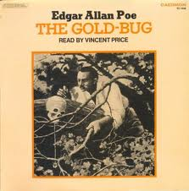
History – Amariah
Cryptography has been around for hundreds of years.
Was only used in governments until the creation of DES, a standard for data encryption, and public-key cryptography.
Babington Plot: 1586 plot to assassinate Queen Elizabeth and put Mary, Queen of Scots on the throne in her place. Ultimately led to Mary’s execution.
Edgar Allen Poe used cryptanalysis, which is code-breaking, as a subject for The Gold-Bug.
WWII: mechanical and electromechanical ciphers were used.

Slide 5
Types of ciphers – Ksenia & Janette

Slide 6
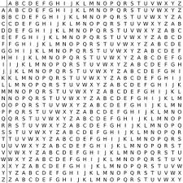
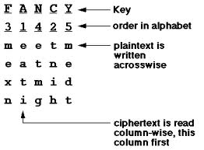
Classical – Amariah
There are two types of classical ciphers: substitution and transposition
Substitution examples:
Caesar cipher
cipherstuvwxyzabdfgjklmnoq
Vigenère Square
Transposition examples:
write every word backwards
Columnar cipher R R G T
Chinese cipher A A O H
F N D E

Slide 7
Rotor Machines – Janice
In cryptography, it is an electro-mechanical stream cipher device for encrypting or decrypting secret messages.
Composed of:
Primary component: a set of rotors, which are rotating disks with an array of electrical contacts on either side.
Wiring between contacts implements a fixed substitution of letters, replacing them in complex fashion.
After encrypting each letter, rotors advance positions, changing substitution.
It produces a complex polyalphabetic substitution cipher that changes with every keypress.
Mechanization
Rotor machines change the wiring with each key stroke.
Wiring is placed inside a rotor and rotated with a gear every time a letter is pressed.
Every letter press on the keyboard spins the rotor and gets a new substitution, implementing a polyalphabetic substitution cipher.

Slide 8
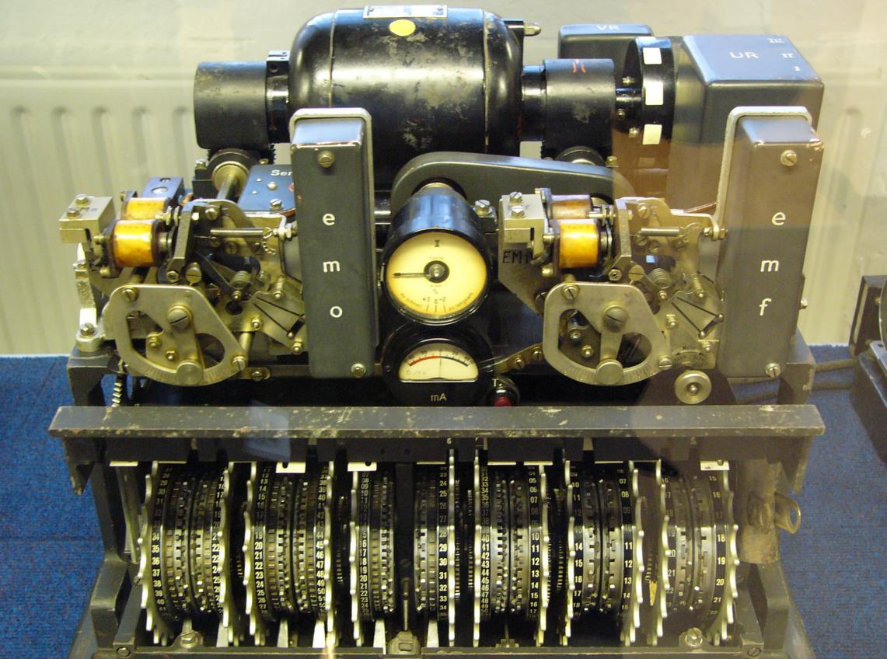
The Lorenz cipher used during WWII by the Germans

Slide 9
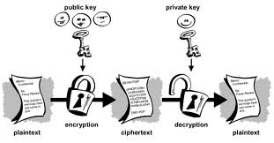
Public key – Amariah
Type of encryption that uses two keys, a public key that everyone knows and a private key, to encrypt a message.
Both keys are related in a special way so only the public key can be used to encrypt messages and only the correct private key can be used to decrypt the message.
It is impossible to guess what the private key is even if you know the public key.

Slide 10
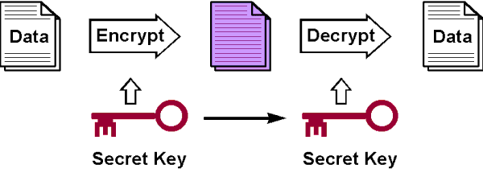
Symmetry/Secret key – Janette
Symmetry key is an encryption system in which the sender and the receiver of the message share one key that is used to encrypt and decrypt the message.
Symmetry key is a more simpler and faster way to communicate than public keys, but the only problem you would have to consider would be that you would have to get the key to the receiver of the message in a separately secure way.
Symmetry key may be called ‘secret key cryptography’.

Slide 11
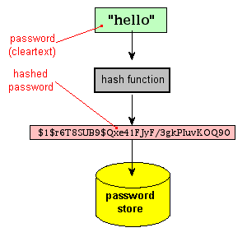
Hash functions – Ksenia
One-way cryptography
Have no key since the plaintext is not recoverable from the cipher text.
Applications: Facebook, twitter, tumblr, and any other application requiring a password.
Notes:
Hash Functions – one way encryption → in some sense uses no key
- uses fixed length hash value computed based upon the plaintext
- makes it impossible for either content or length of plaintext to be recovered
- typically used to provide digital fingerprint of a file’s content
- commonly employed to encrypt passwords
- provide measure of integrity of file

Slide 12
Different Ciphers – Ksenia
ATBASH
a simple substitution cipher originally made for the Hebrew alphabet. It consists in substituting the first letter for the last, the second for the one before last, and so on, reversing the alphabet.
An Atbash cipher for the Latin alphabet would be as follows:
Plain: abcdefghijklmnopqrstuvwxyz Cipher: ZYXWVUTSRQPONMLKJIHGFEDCBA
Example:
Message: “IT IS GOING TO RAIN THIS AFTERNOON” Cipher: Rg rh tlrmt gl izrm gsrh zugvimllm

Slide 13
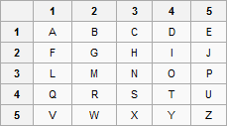
Tap Code
encodes messages, letter by letter, in a very simple way and transmits it using a series of tap sounds.
Note: Example:
Message: “IT IS TIME” Cipher: (2,4)(4,4)(2,4)(4,3)(4,4)(2,4)(3,2)(1,5)
Notes:
It was used to encode messages, letter by letter, in a very simple way and transmit it using a series of tap sounds.
It has been commonly used by prisoners to communicate with each other.

Slide 14
Breaking Ciphers – Janice
Cryptographic attacks: designed to subvert security of cryptographic algorithms, used to attempt to decrypt data without access to a key.
Attack Methods
There are six related cryptographic attack methods: three plaintext-based, and three ciphertext-based.

Slide 15
Known Plaintext and Ciphertext-Only Attacks
Known plaintext attacks: a cryptanalyst has access to a plaintext and corresponding ciphertext, seeks to discover a correlation between the two
Ciphertext-only attacks: where a cryptanalyst has access to a ciphertext, but no access to corresponding plaintext
With simple ciphers, frequency analysis can be used to break the cipher.
Chosen Plaintext and Chosen Ciphertext Attacks
Chosen plaintext attacks: a cryptanalyst can encrypt a plaintext of choice and study resulting ciphertext
Chosen ciphertext attacks: a cryptanalyst chooses a ciphertext and tries to find a matching plaintext
Can be done with a decryption oracle (a machine that decrypts without exposing the key)

Slide 16
Adaptive Chosen Plaintext and Adaptive Chosen Ciphertext Attacks
In both, a cryptanalyst chooses further plaintexts or ciphertexts (which adapts the attack) based on prior results.
Side Channel Attacks
These attacks leverage additional information based on physical implementation of a cryptographic algorithm, including hardware used to encrypt or decrypt data.
Brute Force Attacks
These attacks systematically attempt every possible key.
Example on a 4-bit key

Slide 17
Demonstration
Notes:
Here is a little demostration

Slide 18
Thank you!

