Slide 1
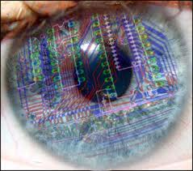
What’s our decision? Computer Vision!!! O.o
By: Honney Thomas, Faria Kader & Sarah Tran

Slide 2
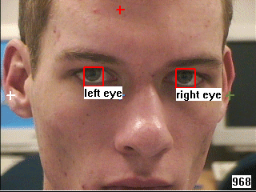
What is Computer Vision?
Computer Vision “is a discipline that studies how to reconstruct, interpret and understand a 3D scene from it’s 2D images in terms of the properties of the structures present in the scene”.
-Robert Fisher, Ken Dawson-Howe, Andrew Fitzgibbon, Craig Robertson, Emanuele Trucco, Wiley, 2005.
Computer vision systems analyze images and video automatically and determine what the computer "sees" or "recognizes.” -Margrit Betke

Slide 3
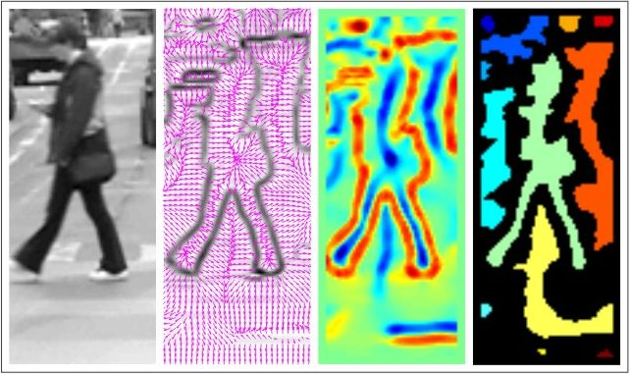
Using Computer Vision: Facial Expression
Detecting faces allows the devices to identify the presence of faces apart from the task of recognizing them.
In this video Masha, a college student, is experimenting on how the computer judges our face and tells our mood by the color of the dragon on the screen.
http://www.youtube.com/watch?v=7tD1KlTkunM&feature=player_embedded

Slide 4
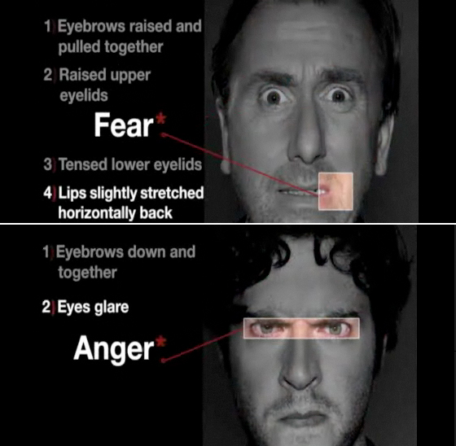
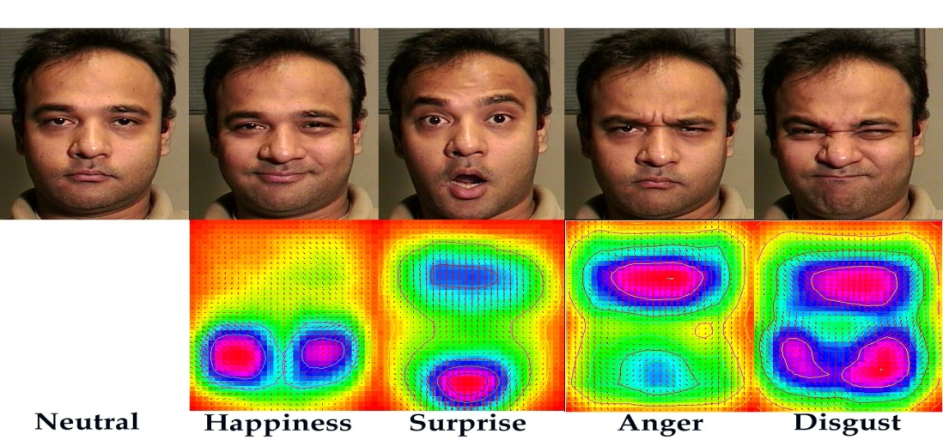
Using Computer Vision: Facial Expressions
Here are pictures of people and their expressions. As you can see, below the faces, the camera can sense where the main features change in the face.

Slide 5
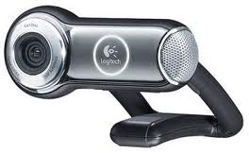
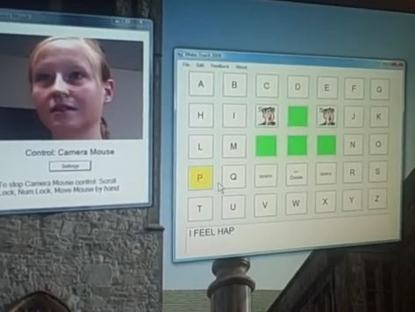
Camera Mouse
The Camera Mouse can detect your head’s motions and move along on the computer screen.
“Instead of using a mouse, a webcam or built-in camera looks at you and tracks a spot on your face. If you move your head to the left, the mouse moves to the left. If you hold the pointer over the spot, a click is issued. Anything you can do with a mouse, you can do with Camera Mouse.” – Professor Gips
June 2007, Camera Mouse was made available free of charge through Internet download.
According to Gips, 100,000 copies were downloaded in the first 31 months; in the year following that, another 100,000. More recently is that100,000 were downloaded in just one month

Slide 6
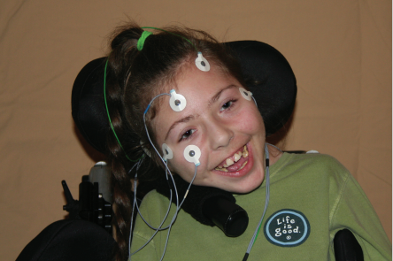
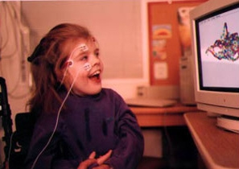
Eagle Eyes
Eagle Eyes allows people who can only move their eyes to use the computer by having five electrodes attached to their head in spots that can see head and eye movement.
“Eagle Eyes and Camera Mouse do more than provide the disabled a means to access and use the computer; they now have a means of communicating and connecting that their body has denied from them for years.”

Slide 7
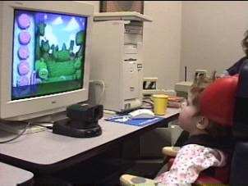
Computer Vision to the rescue !!
Computer Vision can also be used to help people in need
Such as those who can’t use certain body parts to communicate.
Jordan, the girl above, can’t communicate using her hands to move the mouse on a computer. But with the Camera Mouse that recognizes where she wants to click on she can move the mouse where she wants using her head.

Slide 8
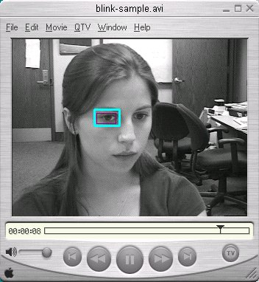
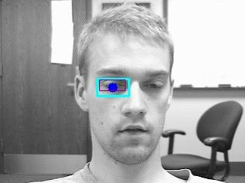
Computer Vision : Speaking with Eyes
The computer senses your eyes and notices the eye movements. When someone blinks the computer would click something.
Looking into the side, or raising eyebrows are some ways to communicate with your eyes in the computer.
There’s also the eye gaze detection that detects where you are trying to move to.

Slide 9
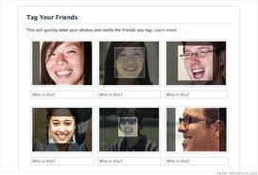
Facebook tagging ! \(^_^\)
Facebook also has face recognition.
It scans you and your friends' photos for recognizable faces and suggests nametags for the faces by matching them with their profile photos and other tagged photos.

Slide 10
Professor Betke
Lastly, we want to say thank you to Mrs. Betke for providing us with so much information about computer vision.
She was the one that motivated us to do this presentation.
Her presentation was really interesting and we learned so much from her. We also thank her for providing us with quotes and helping us with our slides too.

Slide 11
Thanks For Listening/Watching ! :D

