Slide 1
Circuits & Logic Gates
By:
Hanan, Nakilah, and Amani

Slide 2
The four main parts of a circuit
Switch
Energy source
Load
Wires
The current flows from a power-source to a “load” then the load converts the electric energy into another type of energy current.

Slide 3
How a circuit works
A circuit is a pathway of wires that electrons can go through. The electrons move from the voltage that the battery or the power source gives off. When the electrons reach the light bulb or the switch it gives it the power to make it work.

Slide 4
The wires have to go from the power source to the device and back again in almost a circle in order for it to work. This allows the electrons to go in and out of the circuit.

Slide 5
When you see a circuit it will almost always have an “on” “off” switch. When the switch is off it makes a gap and the electrons cant move through. When it is turned on the electrons can move though since the gap is closed.

Slide 6
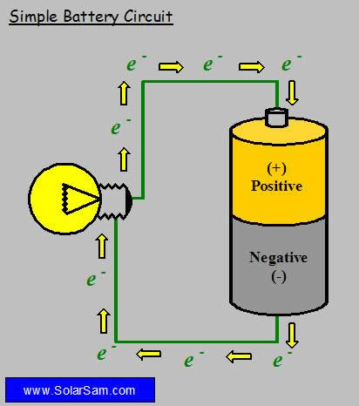
How an electrical circuit works!

Slide 7
Types of Circuits
There are two main types of circuits:
Series Circuits
Parallel Circuits

Slide 8
Series Circuits
The series circuit only have one path, but all the loads are connected side by side on one path. There must not be a break in that path or the circuit will not work at all.
The resistance increases when each load is added.
The voltage will stay the same.
The current stays the same in all the parts but it decreases as the loads are added.

Slide 9
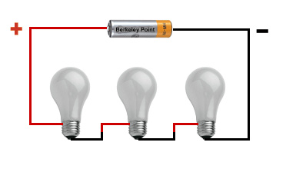
A series Circuit!

Slide 10
Parallel Circuits
Electricity Can flow through many paths making branches, but each load usually has its own branch. A break in one branch will not cause for the other branches to not work.
The resistance decreases as the loads increases.
The voltage stays the same.
The more paths that the circuits have the more energy is demamded to have to make it work.

Slide 11
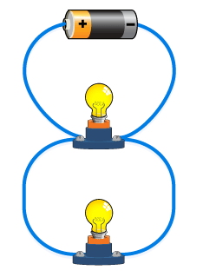
A Parallel Circuit!

Slide 12
Dance Pad Circuit!!

Slide 13
Logic Gates
A logic gate is a type of circuit that controls the flow of electricity that the Boolean logic computers use to make decisions.

Slide 14
The Boolean Logic is a form of algebra where all values are transferred into either “TRUE” or “FALSE”.

Slide 15
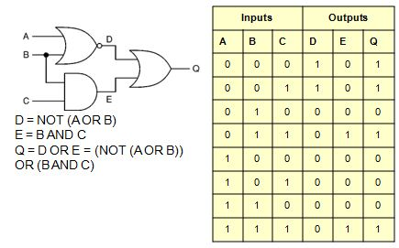
Example of a Logic Gate

Slide 16
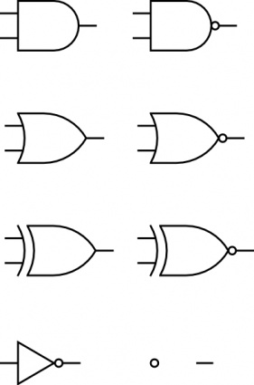
The different types of Logic Gates
And
Or
Xor
Nor
Not
Nand

Slide 17
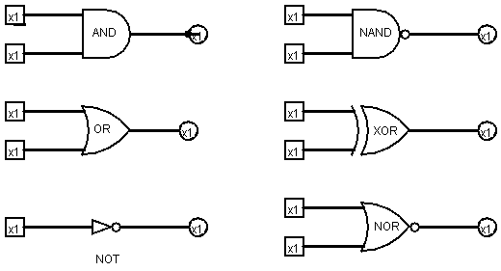
Examples:

Slide 18
THE END!!!

